Slide 1

CSA0508 – Database Management System
Software Components of DBMS
Guided by:
Presented by:
Dr. Ayyappan
Hemalakshmi H (192571049)

Slide 2
Introduction
A Database Management System (DBMS) is built from several coordinated software modules.
The three core internal components are:
Query Processor
Storage Manager
Transaction Manager
These work together to ensure efficient data retrieval, safe storage, and reliable multi-user access.

Slide 3
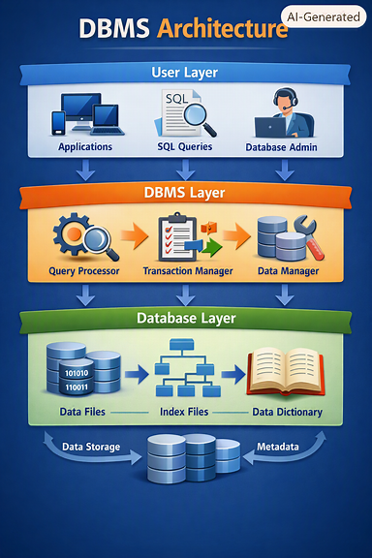

Slide 4
Query Processor
Role
The query processor interprets user queries (mostly SQL) and converts them into low-level instructions that the DBMS can execute.
Key Functions
Parsing - Checks SQL syntax and builds a parse tree.
Query Optimization - Chooses the most efficient way to execute the query using cost-based algorithms.
Query Execution Engine - Executes the optimized query plan using relational operators (selection, join, projection).

Slide 5
Query Processor
Why It Matters
Reduces query execution time
Ensures efficient use of indexes and joins
Converts high-level SQL into machine-level operations

Slide 6
Query Processor: Parsing & Validation
Key Points:
SQL query is checked for syntax errors
DBMS builds a parse tree
Validates table names, column names, data types
Ensures the query follows relational rules
Outcome:
A structured representation of the query ready for optimization

Slide 7
Query Processor: Query Optimization
Key Points:
Chooses the best execution plan
Uses cost-based optimization (I/O cost, CPU cost, index usage)
Reorders operations (e.g., push down selections)
Selects best join method: nested-loop, hash join, sort-merge
Outcome:
Fastest possible plan for executing the query

Slide 8
Query Processor: Execution Engine
Key Points:
Uses relational operators:
Selection
Projection
Join
Sorting
Interacts with storage manager to fetch data
Outcome:
Produces the final result set for the user

Slide 9
Storage Manager
Role:
The storage manager handles how data is physically stored, organized, and retrieved on disk.
Key Functions:
File Manager Manages files, pages, and blocks on disk.
Buffer Manager Moves data between disk and main memory; reduces disk I/O.
Index Manager Maintains structures like B+ trees and hash indexes for fast access.
Record Manager Handles record formats, layouts, and access methods.

Slide 10
Storage Manager
Why It Matters
Ensures efficient data storage
Minimizes disk access time
Supports indexing and data organization
Provides data structures for fast retrieval

Slide 11
Storage Manager: File & Page Management
Key Points:
Organizes data into files, pages, blocks
Handles page allocation, deallocation
Manages physical placement of data on disk
Outcome:
Efficient disk usage and structured data storage

Slide 12
Storage Manager: Buffer Manager
Key Points:
Maintains a buffer pool in main memory
Reduces disk I/O by caching frequently accessed pages
Uses replacement policies: LRU, MRU, Clock
Outcome:
Faster query execution due to fewer disk reads

Slide 13
Storage Manager: Index Manager
Key Points:
Creates and maintains indexes
Common index types:
B+ Tree
Hash Index
Speeds up search, join, and sorting operations
Outcome:
Quick access to specific records

Slide 14
Transaction Manager
Role:
The transaction manager ensures that multiple users can access the database safely without corrupting data.
Key Functions:
Concurrency Control Uses locking, timestamp ordering, or MVCC to prevent conflicts.
Recovery Manager Uses logs and checkpoints to restore the database after crashes.

Slide 15
Transaction Manager
Transaction Scheduling Ensures ACID properties:
Atomicity – all or nothing
Consistency – valid state transitions
Isolation – no interference
Durability – permanent results

Slide 16
Transaction Manager: Concurrency Control
Key Points:
Prevents conflicts when multiple users access data
Techniques:
Locking (2PL)
Timestamp Ordering
MVCC (Multi-Version Concurrency Control)
Outcome:
Ensures isolation and consistency

Slide 17
Transaction Manager: Recovery System
Key Points:
Maintains logs of all operations
Uses checkpoints to reduce recovery time
After crash:
Undo incomplete transactions
Redo committed transactions
Outcome:
Database returns to a consistent state

Slide 18
ACID Properties
Atomicity - All steps of a transaction happen completely or not at all
Consistency - Database moves from one valid state to another
Isolation - Transactions do not interfere with each other
Durability - Committed results survive crashes
Outcome - Reliable and predictable transaction behavior

Slide 19
How These Components Work Together
The Query Processor decides what to do.
The Storage Manager decides where and how to do it.
The Transaction Manager ensures it is done safely and reliably.
Together, they form the backbone of any DBMS.

Slide 20
Conclusion
A DBMS is not just a data storage tool — it is a complex software system. The Query Processor, Storage Manager, and Transaction Manager work in coordination to provide:
Fast query execution
Efficient data storage
Reliable multi-user access
Crash recovery and consistency
This architecture makes modern databases robust, scalable, and dependable.

Slide 21


