Slide 1
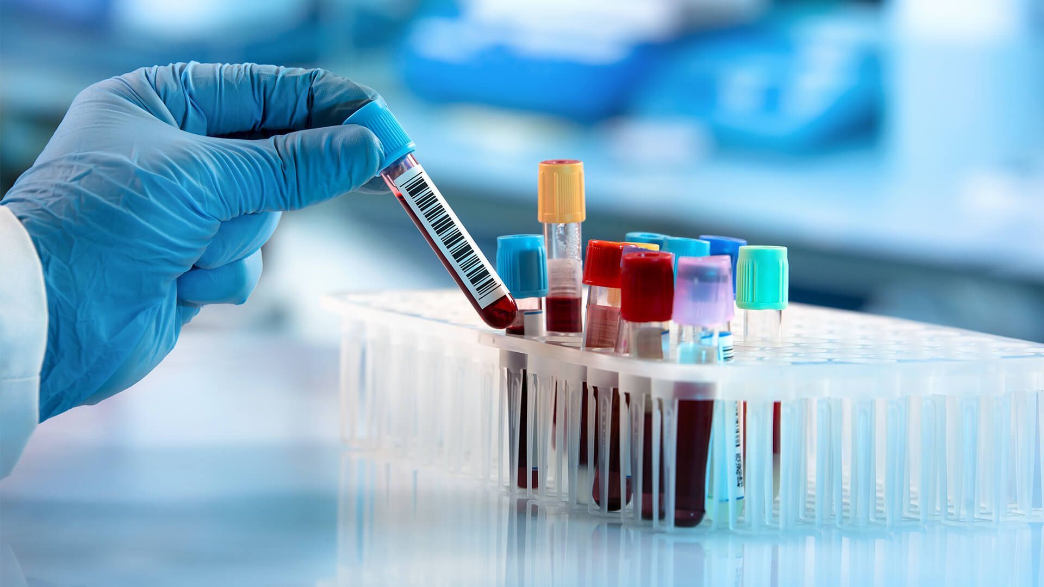
Blood Cancer Detection Using Microscopic Images
Team:
B.Harish(17VV1A0507)
M.Hemalata(17VV1A0526)
P.Pranaya Durga(17VV1A0534)
B.Rhema Sravya(17VV1A0508)
GUIDE : Dr. P. Aruna Kumari

Slide 2
CONTENTS
Motivation
Abstract
Introduction
Problem Statement
System Architecture
CNN Model
Result Analysis
Outputs
Conclusion

Slide 3
Motivation
The main motto of this work is to detect the Leukaemia at earlier stage with the help of Image Processing techniques.
Leukaemia means blood cancer which is featured by uncontrolled and abnormal production of white blood cells(leukocytes) by the bone marrow in the blood.
Acute Lymphoblastic Leukaemia(ALL) is a type of Leukaemia which is more common in children due to its non specific nature of the symptoms and signs of ALL leads wrong diagnosis.
Even haematologist finds it difficult to classify the Leukaemia cells, there manual classification of blood cells is not only time consuming but also inaccurate therefore early identification of Leukaemia yields in providing the appropriate treatment to the patient.
Detection through the images is fast and cheap method.

Slide 4
Abstract
Identification of Blood disorders is practiced by visualization of blood samples through a microscope by the naked eye of a human. In this work, a computerised technique has been developed to help the doctor in identifying different types of Luekemia. Initially, the RGB image is converted to segmented image by using Region Based Segmentation. To this segmented image the features are extracted and are classified into different types of luekemia. The required code is developed using Google Colab. A graphical user interface will be developed for a better understanding of procedure. This technique is used to identify the diseases and diagnose them at an early stage. Images are used as inputs, as they are cheap and do not need any kind of expensive testing nor lab equipment. This work will be using the features in the microscopic images and examine any kind of changes on color, texture, geometry and statistical analysis of the images. The changes that are found in this features will be used as our classifier input.

Slide 5
Introduction
Blood Cancer, also known as hematologic cancer, typically starts in the bone marrow and then begins to affect blood cells but it can take on a variety of forms.
Types of blood cancer include leukemia, non-Hodgkin lymphoma, Hodgkin lymphoma, and multiple myeloma.
Leukemia is cancer of blood cells in which number of white blood cells increases numerously and those are immature cells that interfere with other blood cells, usually red blood cells and platelets and it originates in bone marrow.
The components of blood are Red Blood Cells(erythrocytes),White Blood Cells(leucocytes) and platelets.
Leukemia is detected only by analyzing the white blood cells. So our study is focused only on white blood cells(WBCs).

Slide 6
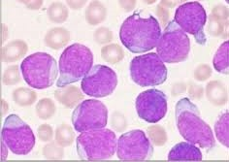
Introduction (cont.)
Leukemia is grouped in two ways according to how fast the cells are growing : acute or chronic.
As in acute leukemia, if the treatment is not done in a precise time, the person will die within a few months.
And it is very necessary to detect cancer in the early stages to treat this type of cancer or any type of cancer.
It takes more time and effort to do the detection process by technicians manually and it costs more with the help of the instrument.
There are four major forms of leukaemia. They are:
Acute lymphoblastic leukaemia (ALL)
Acute myelogenous leukaemia (AML)
Chronic lymphocytic leukaemia (CLL)
Chronic myelogenous leukaemia (CML)
Acute

Slide 7
Problem Statement
Blood cell segmentation and identification is a vital in the study of blood as a health indicator. A complete blood count is used to determine the state of a person’s health based on the contents of the blood in particular the white blood cells and the red blood cells. The main problem arises when massive amounts of blood samples are required to be processed by the hematologist or Medical Laboratory Technicians.
Leukemia is a term used for diseases in which abnormal cells divide without control and are able to invade other tissues. Leukemic cells can spread to other parts of the body through the blood and lymph systems.

Slide 8
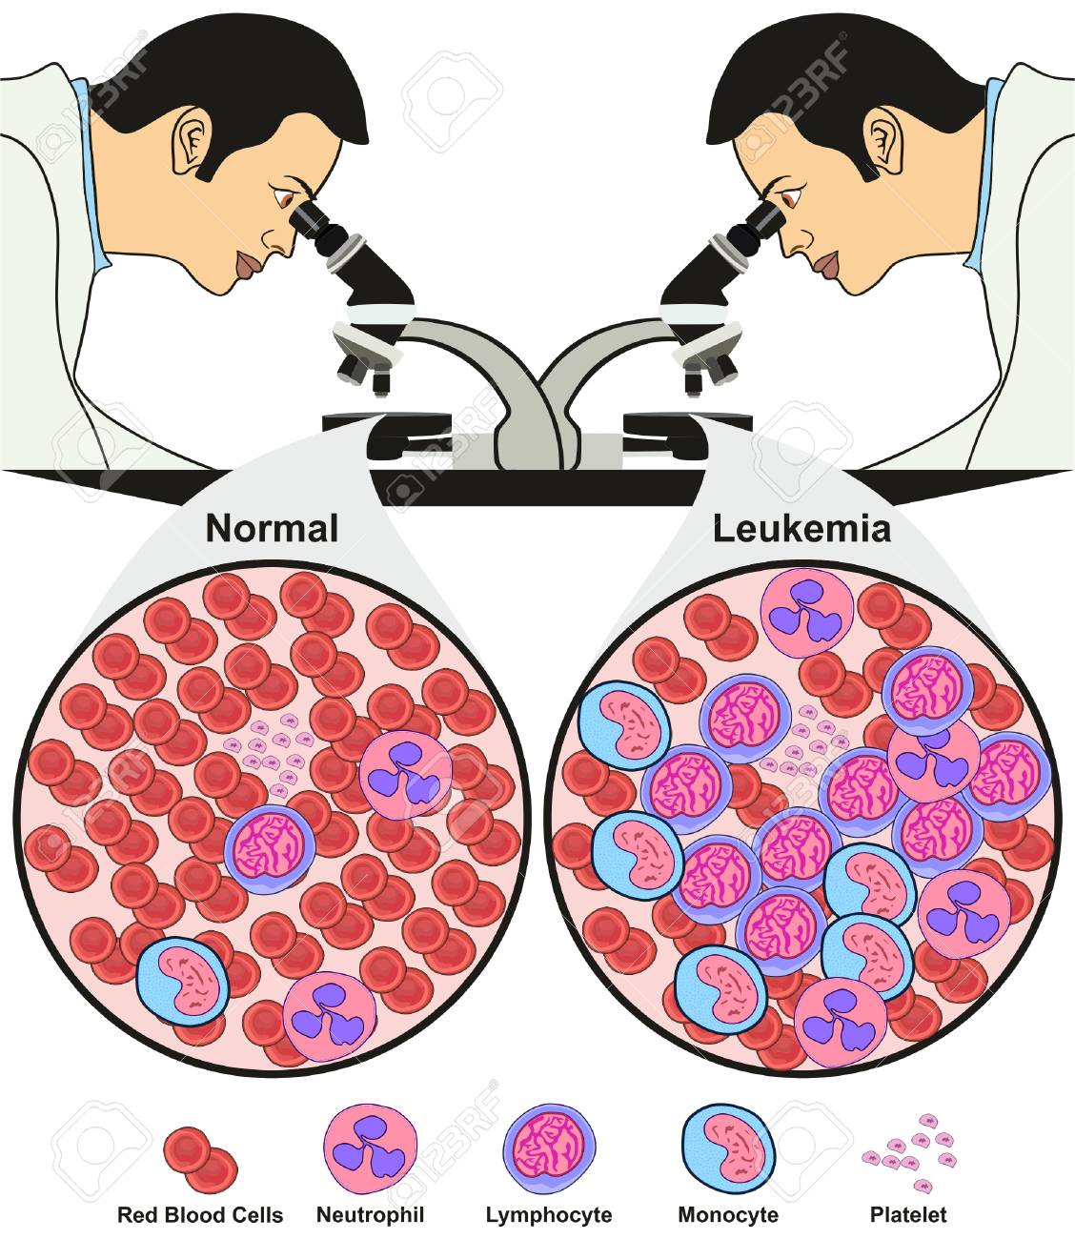
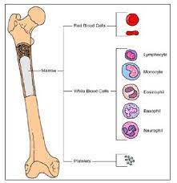
Bone Marrow

Slide 9
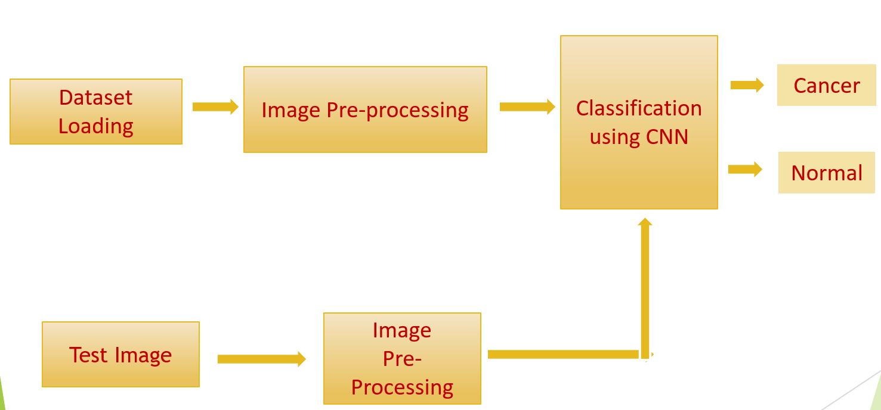
System Architecture

Slide 10
Dataset
Images used in this project were obtained from Kaggle dataset which is a public dataset available online. (Leukemia Classification)
This dataset was divided into 2 classes.
In total there are 15,135 images from 118 patients with two labelled classes:
1. Normal cell
2 .Leukemia blast.
The task of identifying immature leukemic blasts from normal cells under the microscope is challenging due to morphological similarity.

Slide 11
Image Pre-processing
Image pre-processing has to apply some operations to images, like enhance an image, extract useful information and analyze it and make decisions.
The aim of pre-processing is to improve the quality of the image so that we can analyze it in a better way.
By preprocessing we can suppress undesired distortions and enhance some features which are necessary for the particular application we are working for.
Those features might vary for different applications.
In this work Noise Removal and segmentation was implemented.

Slide 12


Noise Removal-Bilateral Filter
Algorithm:
Step 1: The bilateral filter starts with linear Gaussian smoothing.
Step 2: The weight for f(y)f(y) equals Gs(x-y) and is only dependent on the spatial distance ||x-y||.
Step 3: The bilateral filter adds a weighting term that depends on the tonal distance f(y)−f(x)f(y)−f(x). This results in:
Step 4: Observe that because the weights explicitly depend on the image values, we need an explicit normalization such that ‘sum’ of all weights equals one.

Slide 13
Segmentation
Image segmentation is the process of partitioning an image into multiple segments.
Segmentation is used to locate objects and boundaries in images.
There are different methods for segmentation like Region Based Segmentation, Clustering methods, Compression based methods, Watershed transformation, Edge detection.
Region-based segmentation is a technique for determining the region directly. Region growing is a simple region-based image segmentation method. It is also classified as a pixel-based image segmentation method since it involves the selection of initial seed points.

Slide 14
Algorithm
The Algorithm for the Region Based Segmentation is :
Completeness-The segmentation must be complete i.e, 𝑖=1 𝑛 𝑅𝑖 = 𝑅 Every pixel must be in a region
Connectedness- The points of a region must be connected in some sense
Disjoint ness - Regions must be disjoint: 𝑅𝑖 𝑅𝑗 =∅ ∀𝑖 = 1,2, … 𝑛
Satisfiability- Pixels of a region must satisfy one common P(Ri) = TRUE,∀𝑖 property P at least , i.e. any region must satisfy a homogeneity predicate P
Segment ability - Different regions satisfy different P(𝑅𝑖 ∪ 𝑅𝑗) = FALSE properties i.e any two adjacent regions cannot be merged into a single region.

Slide 15
Classification
Neural networks are used in the automatic detection of cancer in blood samples.
Neural network is chosen as a classification tool due to its well-known technique as a successful classifier for many real applications.
The training and validation processes are among the important steps in developing an accurate process model using CNNs.
In the training part, connection weights were always updated until they reached the defined iteration Number or suitable error.
Neural network is chosen as a classification tool due to its well-known technique as a successful classifier for many real applications. The training and validation processes are among the important steps in developing an accurate process model using CNNs.

Slide 16
CNN Model
A CNN is a multilayered neural network with a special architecture to detect complex features in data.
CNNs have been used in image recognition, powering vision in robots, text in images and for self-driving vehicles.
The CNN consist layer of neurons and it is optimized for two-dimensional pattern recognition.
CNN has three types of layer namely convolutional layer, pooling layer and fully connected layer.
Our network consists of 11 layers excluding the input layer. The input layer takes in a RGB color image where each color channel is processed separately.

Slide 17
Layers in CNN
The first 3 layers of convolution network are convolution layer.
First convolution layer applies 32 of 3*3 filters to an image in the layer. The other two layer applies 64 of 3*3 and 128 and 3*3 filters respectively to an image.
The nonlinear transformation sublayer employs the ReLU activation function.
The max pooling sublayer applies a 2*2 filter to the image which results in reducing the image size to its half.
At this point, convolution network extracts 128 features, each represented by a 32*32 array for each color channel.

Slide 18
The eighth layer is the flatten layer. The flatten layer transforms a multidimensional array into one-dimensional array by simply concatenating the entries of the multidimensional array together.
The output of this flatten layer is a one-dimensional array of size 7800. The ninth layer is the fully connected ANN with the ReLU activation function that maps 7800 input values to the 128 output values.
The tenth layer is the dropout layer. 30% of the input values coming to the layer are dropped to zero to reduce the problem of overfitting.
The eleventh and the final layer is a fully connected ANN with the sigmoid activation function that maps 64 input values to 2 class labels.

Slide 19
Parameters in CNN
Parameter | Description | Used values
Optimizer | Algorithm to minimize a loss function and build parametrized models based on data | Adam
Loss function | Algorithm that measures error of the model | Binary-cross entropy
Stride | The step taken by a filter when convolves around input | 1
Padding | Number of additional pixels of zero that help to preserve the original size | Valid (no padding)
Dropout rate | Fraction of the input units that is dropped | 0.3
Batch size | Number images trained per step | 128

Slide 20
Training
First, we train convolution network using the data in training set to find appropriated filters weights in the three convolutional sublayers and the weights that yield minimum error in the two fully connected layers.
Next, we evaluate convolution network using the data in the validation set to obtain validation error and cross-entropy loss.
We repeat the training of convolution network in this same procedure until we complete 50 epochs.
Last, we evaluate the performance of convolution network using data in the test set.

Slide 21
Result Analysis
There are many optimizers available out of which four optimizers are considered and compared as follows:
From the table, optimizer Adam has the best accuracy when compared to other optimizers. Based on this, an additional epochs are considered and after executing that, it has observed an accuracy of 92.03 at 50th epoch. So, the model with optimizer Adam, is considered as the Optimized Model.
S.No | Optimizer | Epochs | Accuray
1 | Adadelta | 10 | 62.34
2 | Adadelta | 20 | 68.83
3 | Adamax | 10 | 70.41
4 | Adamax | 20 | 79.13
5 | Nadam | 10 | 82.14
6 | Nadam | 20 | 87.37
7 | Adam | 10 | 88.90
8 | Adam | 20 | 90.09

Slide 22
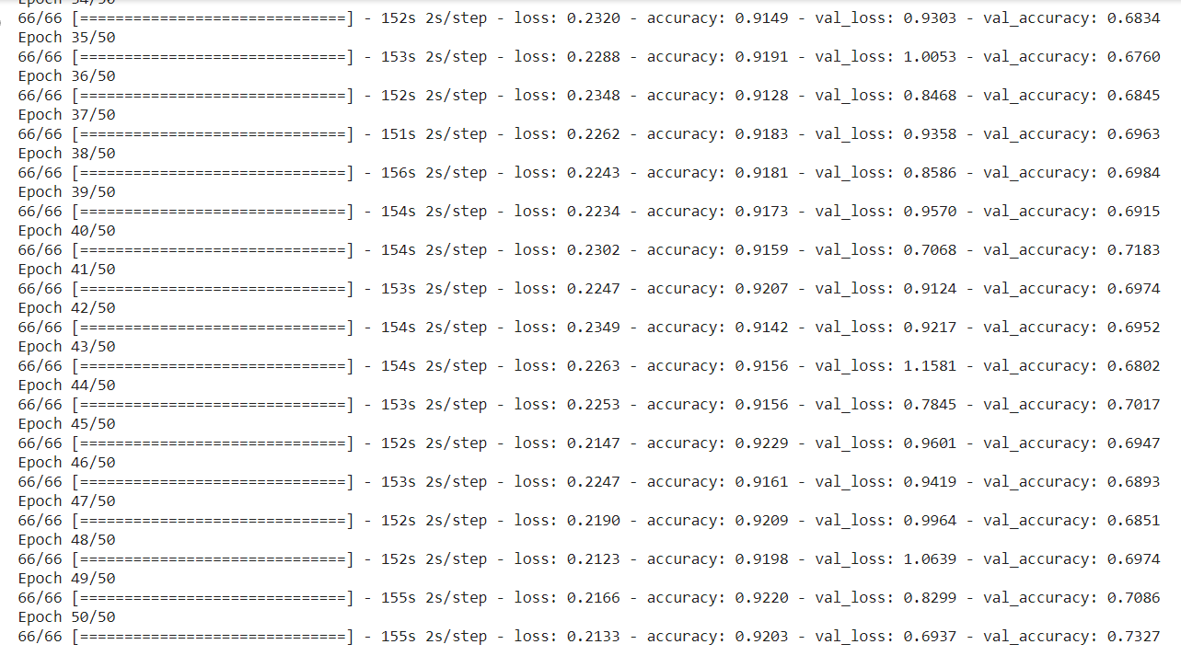
Results
We have performed fifty series of iteration from which we can clearly observe that the loss is decreasing with each iteration.
Loss is about how much right the model is. So we wanted to minimize the loss function and as a result our model has perfectly declined the loss value straight from starting point and at every iteration we get closer to minimum.

Slide 23
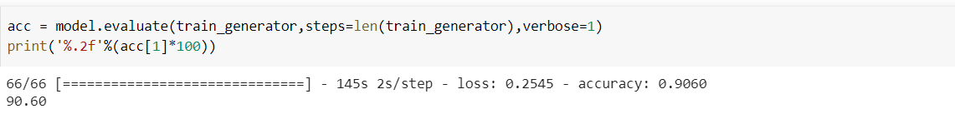
We have loss curve which is decreasing with each iteration which shows that loss is minimizing giving the best result.
On the other hand, we have performed accuracy curve which is increasing with each iteration that means our model is getting better and better at learning.
Testing Accuracy

Slide 24
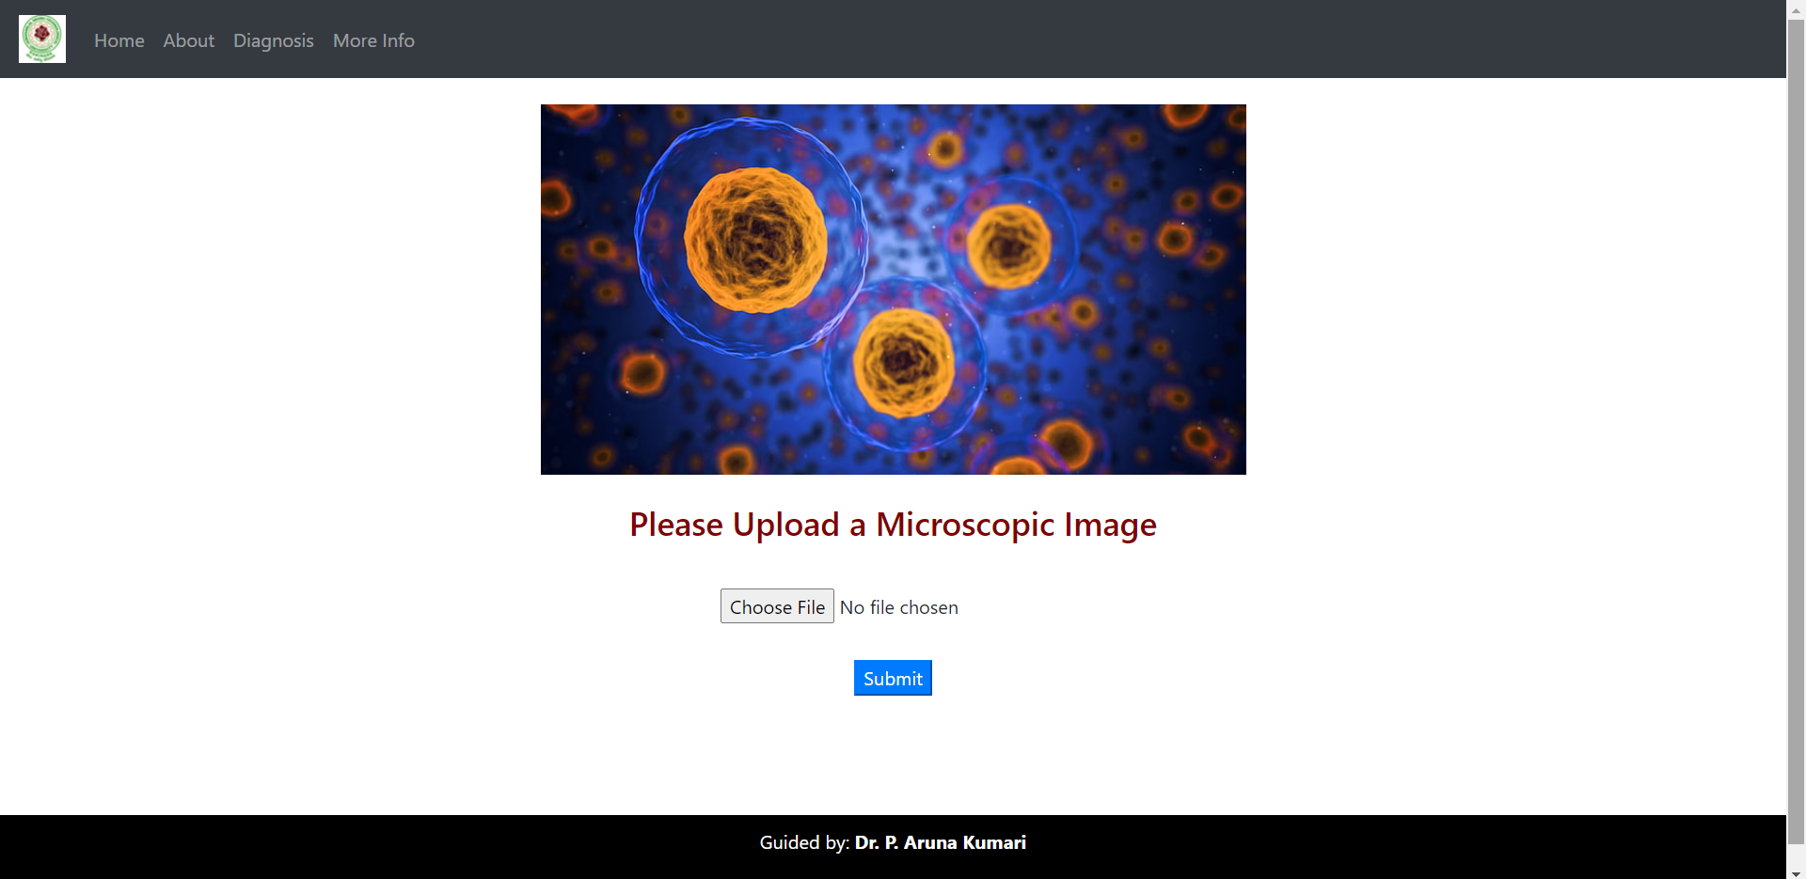
UI design
a) User Interface for Diagnosis of cancer is:

Slide 25
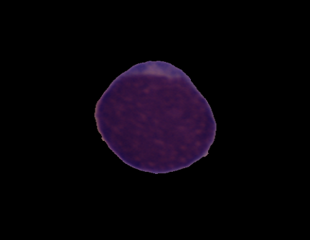

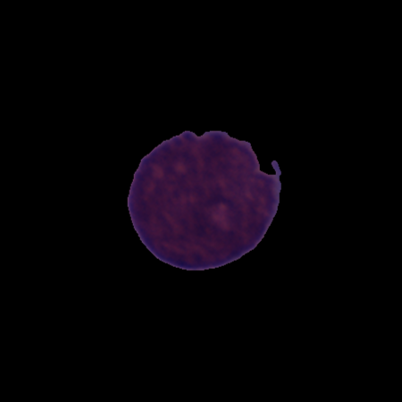
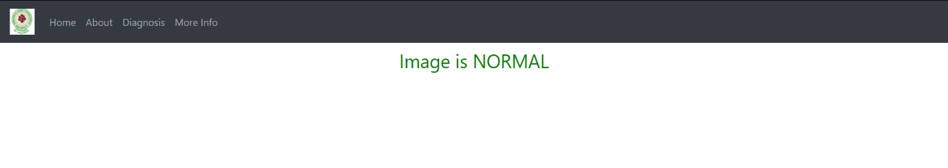
b) Input Image
Output
Input Image

Slide 26
Conclusion
The final model comprised of 3 CRP stacks, flatten layer and 2 dense layers and was trained during 50 epochs on batch size = 128 with Adam as an optimizer. It shows loss and accuracy curves for training and validation sets. The final model scored on average 0.92 in precision and in recall, which means that the final model classifies correctly 92 out of random 100 images correctly, and 92 images out of 100 images of one class. The final model’s architecture seems working well on this data set. It trained relatively fast, and quickly achieved accuracy of 92.03%.

Slide 27

THANK YOU
B.Harish
M.Hemalata
P.Pranaya Durga
B.Rhema Sravya
Guided by : Dr. P. Aruna Kumari

