Slide 1
SENTIMENT ANALYSIS
CAPSTONE PROJECT
Presented By:
1. Hemalatha Doddi - Vignan’s Nirula Institute of Technology and Sciences for Women – CSE[AI&ML]

Slide 2
OUTLINE
Problem Statement
Proposed System/Solution
System Development Approach [Technology Used]
Algorithm & Deployment
Result
Conclusion
Future Scope
References

Slide 3
Problem Statement
The dataset of this sentiment analysis project is customer reviews of a restaurant. The goal of this machine learning model is to develop a system that can accurately predict the sentiment [positive or negative] of a new review. This model should be able to take in a new review, process it, and provide a sentiment score with a high level of accuracy.

Slide 4
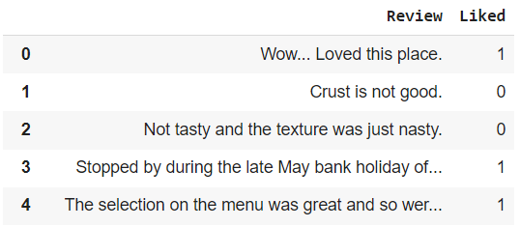
Proposed Solution
The proposed system aims to predict the sentiment[positive or negative] of a particular restaurant based on their customer reviews. To know the quality and taste of a food based on the customer reviews we use the machine learning techniques for accurate results. The solution will consist of the following components:
Data Collection:
Gather historical data based on customer reviews of a restaurant, including preferences of a customer, likes, taste , and quality.
Gathering both positive and negative reviews in equal number for better results.
Utilize real-time data sources such as customer preferences to enhance prediction accuracy.

Slide 5
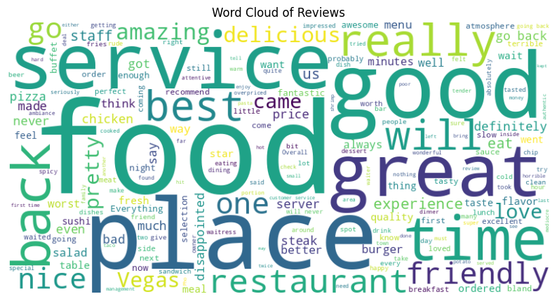
Proposed Solution
Data Preprocessing:
The collected data needs to be cleaned, processed and prepared for input to the model.
This includes removing stop words, stemming the words, and converting the text data into numerical form.
Clean and preprocess the collected data to handle missing values, outliers, and inconsistencies.
Feature engineering to extract relevant features from the data that might impact the accuracy.

Slide 6

Proposed Solution
Machine Learning Algorithm:
Implement a machine learning algorithm, such as a classification algorithm [Example: Naive Bayes Algorithm], to predict sentiment[positive or negative] based on historical patterns.
Considering other factors like customer preferences, taste, and quality of food to improve prediction accuracy.
Naive Bayes algorithm is trained on the dataset, with the sentiment labels and reviews.
Deployment:
Develop a user-friendly interface or application that provides real-time predictions of a customer sentiment of a food in restaurant.
Deploy the solution on a scalable and reliable platform, considering factors like server infrastructure, response time, and user accessibility.
The final step involves deploying the trained model for predicting sentiment analysis on new restaurant review.
Enter a review
The review is predicted positive
I love chicken fry biriyani

Slide 7
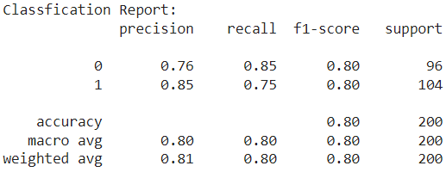
Proposed Solution
Evaluation:
Evaluating the accuracy of the model on the testing data. We compare the predicted class labels with the true class labels of the testing dataset to calculate the accuracy of the classifier.
Assess the model's performance using appropriate metrics such as Accuracy, Precision, Recall, F1 Score and other relevant metrics.
Accuracy:
Accuracy is a good metric to assess the overall correctness of the model.
Precision:
This metric measures how many of the predicted positives are actually positive.
Recall:
This metric measures how many of the actual positives were identified as positive.
F1 Score:
This is a harmonic mean of precision and recall.
Fine-tune the model based on feedback and continuous monitoring of prediction accuracy.

Slide 8
System Approach
The "System Approach" section outlines the overall strategy and methodology for developing and implementing the rental bike prediction system. Here's a suggested structure for this section:
System requirements:
Hardware Requirements: Specify the minimum hardware specifications needed to run the system effectively, such as CPU, RAM and storage requirements.
Software Requirements: Detail the required software components, including operating systems and any specific dependencies.
Library required to build the model:
Programming Language: Specify the programming language used (e.g., Python) and rationale for choosing it.
Key Libraries:
Natural Language Processing (NLP): List NLP libraries used for text preprocessing and analysis (e.g., NLTK, SpaCy).
Machine Learning: Identify ML libraries utilized for building and training models (e.g., scikit-learn, TensorFlow, PyTorch).
Data Handling: Mention libraries used for data manipulation and handling (e.g., pandas, NumPy).
Visualization: Note any libraries employed for data visualization (e.g., matplotlib, seaborn).
External APIs: If applicable, mention any external APIs integrated into the system for additional data or functionality.

Slide 9
Algorithm & Deployment
In this Algorithm section we are describing the machine learning algorithm chosen for predicting sentiment[positive or negative] of a customer review. Here's an example structure for this section:
Algorithm Selection:
Naive Bayes algorithm is commonly used in text classification, including sentiment analysis, because it is simple, efficient, and performs well given the right circumstances. So we include the naive bayes algorithm in the restaurant reviews dataset.
Naive Bayes algorithm assumes that the probability of each word or phrase in a dataset is independent of other words or phrases, hence the name "naive".
In restaurant reviews dataset, most of the words or phrases used are independent of each other, which makes Naive Bayes a good choice.
Data Input:
In the context of restaurant reviews, the features used in the Naive Bayes algorithm would typically be the individual words or phrases that appear in the text data. These could include:
For example, some input features might include:
Words that describe the taste of the food [E.g. delicious, salty, spicy].
Words that describe the atmosphere of the restaurant [E.g. noisy, loud, peaceful].
Words that describe the service provided [E.g. friendly, slow, attentive].
Words that describe the price/value of the restaurant [E.g. expensive, cheap, affordable]
Words that describe specific dishes on the menu [E.g. biriyani, noodles, fried rice].
The Naive Bayes algorithm assumes that these features are independent of each other, which reduces the complexity of the model and makes it computationally efficient.
Each word or phrase is a feature, and the frequency of each feature in a given review is used to determine the probability that the review is positive or negative.
Each of these features could be assigned a probability, based on their frequency in positive and negative reviews, which would be used to predict the sentiment of future reviews.
The specific input features used by the algorithm will depend on the data being analyzed and the domain-specific knowledge of the person designing the algorithm.

Slide 10
Algorithm & Deployment
Training Process:
First a dataset of historical data is collected.
This dataset should include both positive and negative examples of the target variable.
The dataset is then pre-processed to prepare it for modeling.
This involves cleaning the data, removing any unnecessary information, and converting the data into a format that can be fed into the model.
The Naive Bayes algorithm is then trained on the pre-processed dataset.
Usually we split the data into training and testing sets, with approximately 70% of the data used for training and 30% for testing.
Some specific considerations or techniques employed while training the Naive Bayes algorithm include:
Cross-Validation:
Cross-validation is a technique used to determine the accuracy of a model.
It involves dividing the dataset into k-folds, with k representing the number of folds, and training the model on k-1 folds while testing it on the remaining fold.
This process is repeated k times, with each fold used as a testing set once.
This technique helps to prevent overfitting and provides a more accurate estimate of the model's performance.
Hyperparameter tuning:
Hyperparameters are parameters that are set manually before the learning process begins, such as smoothing parameters or priors as well as for model training.
In the case of the Naive Bayes algorithm, the hyperparameters that can be tuned include smoothing and word weights. Tuning these hyperparameters can improve the performance of the Naive Bayes algorithm.
Smoothing helps to prevent zero probabilities by adding a small value to all probabilities, while word weights adjust the importance of each word in the bag of words representation.
Hyperparameter tuning is done by trying different values of the hyperparameters and choosing the combination that provides the highest accuracy.

Slide 11
Algorithm & Deployment
Prediction Process:
After the Naive Bayes algorithm has been trained on the historical customer reviews data, it can be used to make predictions on new, previously unseen customer reviews of the restaurant.
The process of making predictions in real-time typically involves the following steps:
Data Pre-processing:
The restaurant review data is pre-processed in the same way as the historical data.
This involves cleaning the data and converting it into a suitable format that can be used by the Naive Bayes algorithm.
Featurization:
The pre-processed data is then fed into the Naive Bayes algorithm, which uses the probability calculations derived from the training process to classify each review.
The algorithm evaluates the probability of each word in the review text given the target variable’s class, and combines these probabilities to get the final probability of belonging to a particular class.
Prediction:
Once the probabilities have been computed, the Naive Bayes algorithm uses a decision rule to assign a final class label to the review. The decision rule is usually based on assigning the review to the class with the highest probability.
Usually predictions are done on the testing dataset when the model is previously trained with training dataset.
After making predictions on the testing dataset , then the model compare the predicted sentiment[positive or negative] with trained sentiment[positive or negative].
If the predicted sentiment[positive or negative] is same as trained sentiment[positive or negative] then the model having the high accuracy when it is done for all the cases.
If the predicted sentiment[positive or negative] is not same as trained sentiment[positive or negative] then the model having low accuracy then the model having high error rate if it is done in most of the cases.
Enter a review
The review is predicted positive
The noodles are fantastic

Slide 12
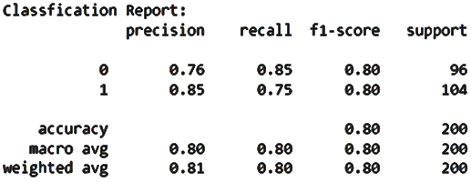
Result
For every machine learning model the performance can be represented in the form of accuracy.
Classification Report:
A classification report is typically generated using test data [data not seen by the model during training] to evaluate its generalization ability.
It is typically used to evaluate the predictive power of a machine learning model.
A classification report is a summary of the performance of a machine learning model for classification tasks.
It provides key metrics such as precision, recall, F1-score, and support for each class in the classification problem.
These metrics help to evaluate how well the model predicts each class and provide insights into its strengths and weaknesses.
The report is generated using test data and is useful for understanding the model's overall performance and making informed decisions about its deployment or improvement.

Slide 13
Conclusion
I had trained a Naive Bayes classifier on a dataset consisting of restaurant reviews to predict sentiment (positive or negative) associated with each review. Here are the key findings and conclusions from our model:
Model Performance: The Naive Bayes classifier demonstrated strong performance in predicting sentiment from restaurant reviews. It achieved an overall accuracy of approximately 80%, indicating that the model correctly classified 80% of the reviews.
Precision and Recall: The precision and recall scores for both positive and negative sentiments were balanced, with precision around 0.80 and recall also around 0.80 for both classes. This suggests that the model is equally adept at identifying both positive and negative sentiments.
F1-score: The F1-score, which combines precision and recall into a single metric, was around 0.80 for both classes. This indicates a robust balance between precision and recall, suitable for applications where both types of errors (false positives and false negatives) are important to consider.
Strengths: The Naive Bayes algorithm's strength lies in its simplicity and efficiency, making it suitable for large datasets with high-dimensional features like text data (words in reviews). It assumes independence between features, which despite being a simplifying assumption often performs well in practice for text classification tasks.
Challenges: While Naive Bayes algorithm performs well overall, it may struggle with context-dependent sentiments and reviews containing mixed sentiments. Additionally, it assumes that all features (words) are independent, which may not hold true in all cases, potentially leading to suboptimal performance in complex sentiment analysis tasks.
Recommendations for Improvement: To further enhance model performance, future improvements could focus on:
Feature Engineering: Exploring more sophisticated text representations (like word embeddings or TF-IDF) to capture semantic meaning and context.
Model Selection: Evaluating other algorithms (such as SVMs or deep learning models like LSTM) that can capture more complex relationships in text data.
Ensemble Methods: Combining predictions from multiple models to improve robustness and generalization.
In conclusion, the Naive Bayes model trained on restaurant reviews showed promising results in sentiment analysis, achieving 80% accuracy and balanced performance across positive and negative sentiments. Understanding its strengths and limitations is crucial for leveraging its potential in real-world applications.

Slide 14
Future scope
Enhancing and expanding a restaurant review sentiment analysis system involves several avenues for improvement and growth. Here are some potential enhancements and expansions to consider:
1. Incorporating Additional Data Sources
Social Media Integration: Extend the system to analyze sentiment from social media platforms (e.g., Twitter, Instagram) where users discuss restaurants. This could provide real-time feedback and a broader spectrum of opinions.
User Review Platforms: Integrate with platforms like Yelp, TripAdvisor, or OpenTable to gather more comprehensive reviews and ratings. This would increase the diversity and volume of data available for analysis.
2. Algorithm Optimization:
Advanced Text Processing: Implement advanced text preprocessing techniques such as lemmatization, named entity recognition (NER), or sentiment-specific lexicons to improve the accuracy of sentiment analysis.
Model Tuning: Explore hyperparameter optimization techniques to fine-tune the Naive Bayes or other algorithms used for sentiment analysis. Consider using more sophisticated models like Support Vector Machines (SVMs), ensemble methods (e.g., Random Forests), or deep learning architectures (e.g., LSTM networks) for better performance..
3. Integration of Emerging Technologies
Edge Computing: Implement edge computing solutions to perform sentiment analysis directly on IoT devices or at the network edge. This could reduce latency and bandwidth usage, ideal for applications in smart cities or remote areas.
Natural Language Processing (NLP) Advancements: Incorporate state-of-the-art NLP techniques such as transformer models (e.g., BERT, GPT) for more advanced sentiment analysis, capturing complex language structures and sentiments.
AI-driven Customer Interaction: Develop AI-driven chatbots or virtual assistants that can engage with users, provide restaurant recommendations based on sentiment analysis, and handle customer queries in real-time.
4. User Experience Enhancements
Sentiment Timeline Analysis: Provide historical sentiment analysis trends over time to identify seasonal patterns, trends, or changes in customer preferences.
Feedback Loop Integration: Implement mechanisms for continuous feedback from users and restaurants to improve the accuracy and relevance of sentiment analysis results.
By integrating these enhancements and expansions, the restaurant review sentiment analysis system can evolve into a more sophisticated and effective tool for both users seeking recommendations and restaurants aiming to improve customer satisfaction and operational efficiency.
Each enhancement should be carefully evaluated based on its potential impact, feasibility, and alignment with business objectives before implementation.

Slide 15
References
Here's a list of relevant sources, research papers, and articles that can be instrumental in developing a solution for analyzing restaurant reviews using machine learning algorithms:
Academic Papers and Research Articles:
Sentiment Analysis in Restaurant Reviews:
B. (2012). Sentiment analysis and opinion mining. Synthesis Lectures on Human Language Technologies, 5(1), 1-167.
This book provides a comprehensive overview of sentiment analysis techniques, including approaches specific to restaurant reviews.
Machine Learning Algorithms in Sentiment Analysis:
Pang, B., & Lee, L. (2008). Opinion mining and sentiment analysis. Foundations and Trends in Information Retrieval, 2(1-2), 1-135.
A foundational paper discussing various machine learning approaches for sentiment analysis, which can be adapted for restaurant reviews.
Advanced Techniques in Sentiment Analysis:
Vaswani, A., et al. (2017). Attention is all you need. Advances in Neural Information Processing Systems (NeurIPS), 30.
Introduces the transformer architecture, which has revolutionized natural language processing tasks, including sentiment analysis, and can be adapted for restaurant revie.
Sentiment Analysis in Consumer Reviews:
Pang, B., & Lee, L. (2008). Opinion mining and sentiment analysis. Foundations and Trends® in Information Retrieval, 2(1-2), 1-135.
Provides a comprehensive overview of opinion mining and sentiment analysis techniques, applicable to consumer reviews including restaurant feedback.
Research Paper on Sentiment Analysis of Restaurant Reviews in Social Media using Naïve Bayes Url:
https://www.researchgate.net/publication/354990885_Sentiment_Analysis_of_Restaurant_Reviews_in_Social_Media_using_Naive_Bayes
Article on Sentiment Analysis of Restaurant Reviews Url:
https://www.geeksforgeeks.org/sentiment-analysis-of-restaurant-reviews

Slide 16


