Slide 1

BLOOD ASSIST
(Website)
Presented By:
Hemalatha Muthu (1994784)
Abhishek Jannu (1995116)
Vignesh Eetaram (1994939)
.

Slide 2
Introduction:
This project is basically a management and information system which provides the information about donors and receivers for blood to the users. The main features of this project includes information of donors and receivers for users from anywhere in the form of obtaining statistical information about users who are registered.

Slide 3
Purpose:
The purpose of this application is to provide the details of the donors and receivers to user easily.
Scope:
Primarily the scope pertains to the registration of the user in the web application and find or add the details. This details will be recorded and available for the users in need. This system will focus to provide easy finding of blood.

Slide 4
General Description:
This application enables users to find blood in emergency situations and also users can add his details as donor for any needful. In this application users can easily find the details of donors and receivers through their web based platform. Users need to register with the application to view all the information which is available on the application. The user can search the details and find the details of the blood donors based on their blood group, area, place, etc... .Users can find details about the donor’s including their location.

Slide 5
Product Functions:
User has to register to the application.
User is having different tasks to select.
Donor, Receiver, Requests and Search are the tasks in user page.
Donor and Receiver has to add their details.
Requests will record the generated requests
Search is used to search the required entity.
User Characteristics:
User must be of age 18+ for registering to this application.

Slide 6
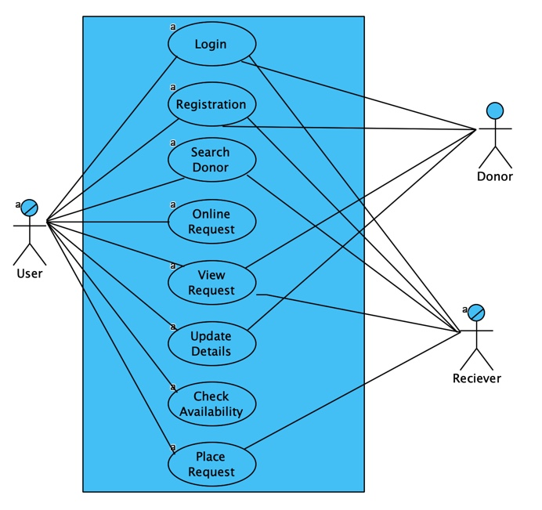
Analysis Model:
Use Case Diagram:

Slide 7
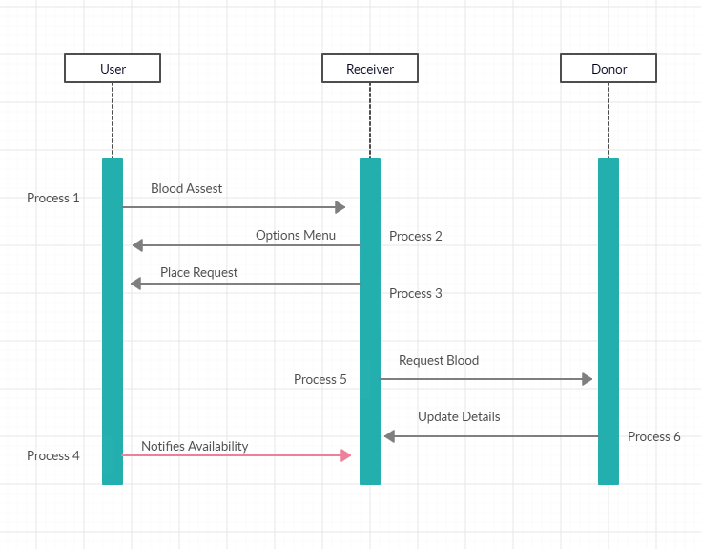
Analysis Model:
Sequence Diagram:

Slide 8
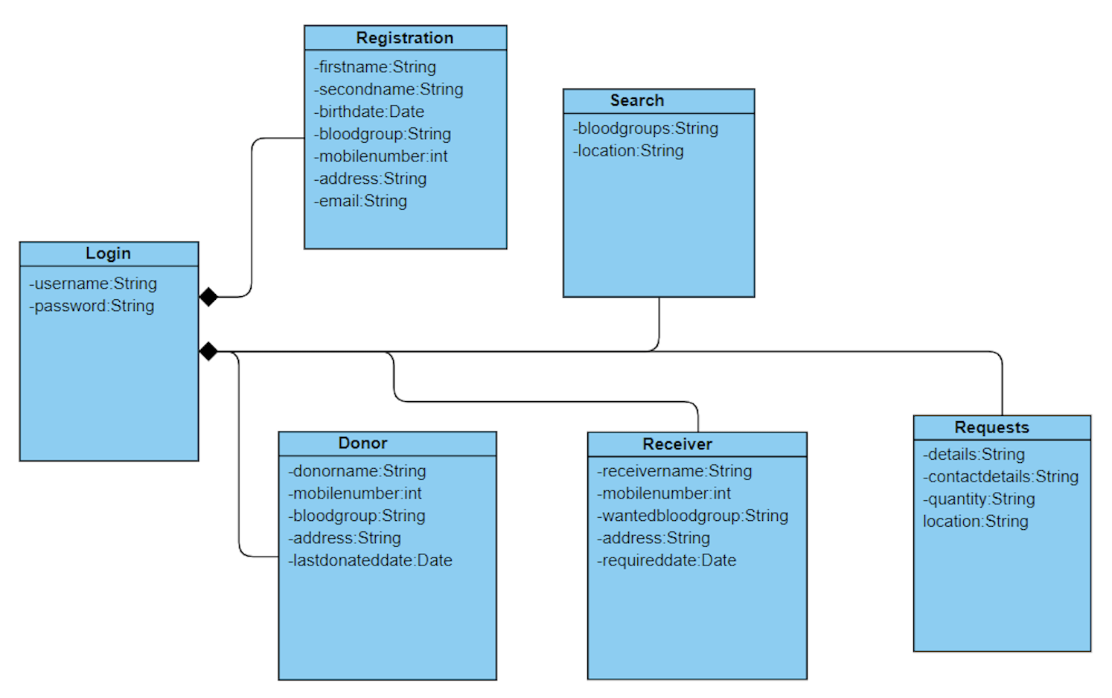
Analysis Model:
Class Diagram:

Slide 9
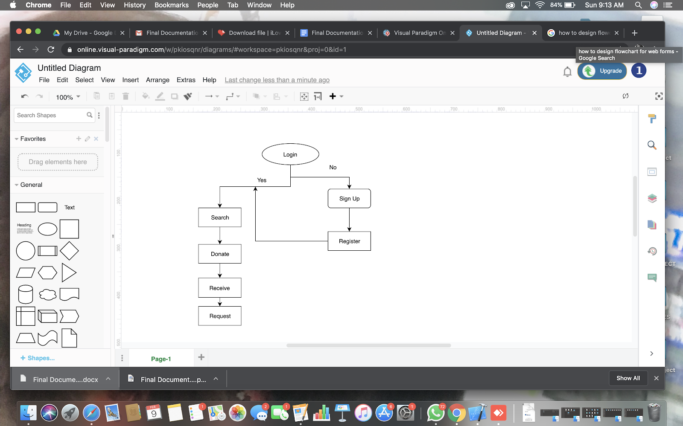
Flow Chart

Slide 10
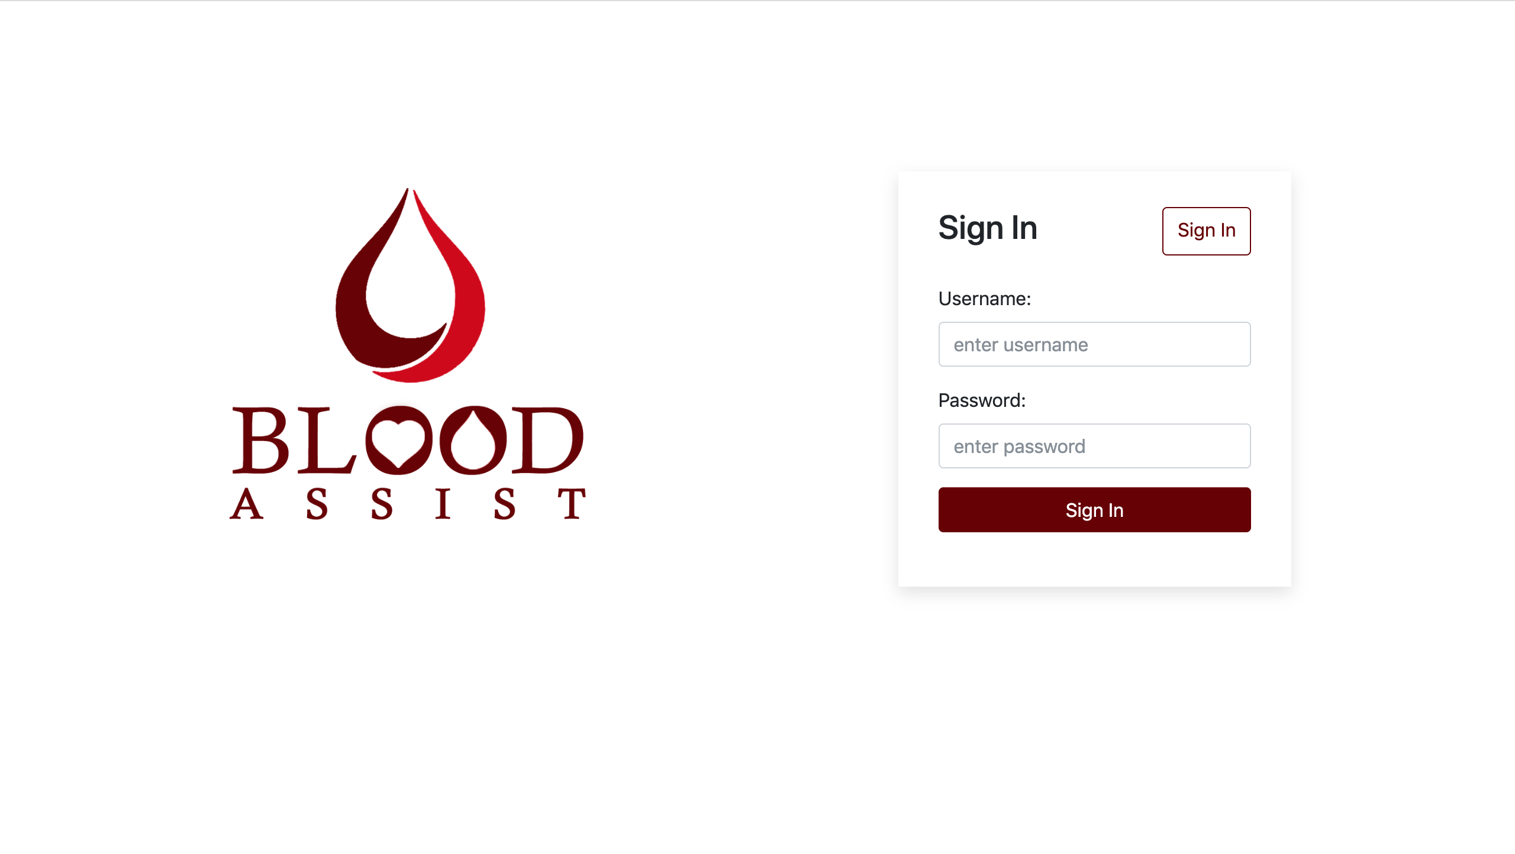
Screen Flow Design:

Slide 11
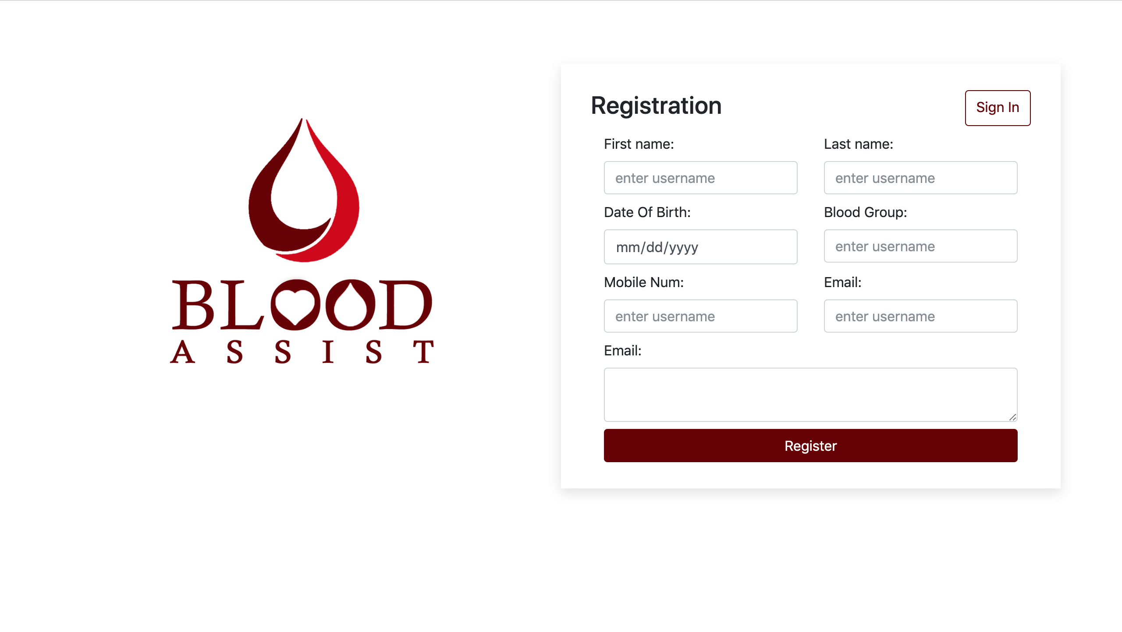

Slide 12
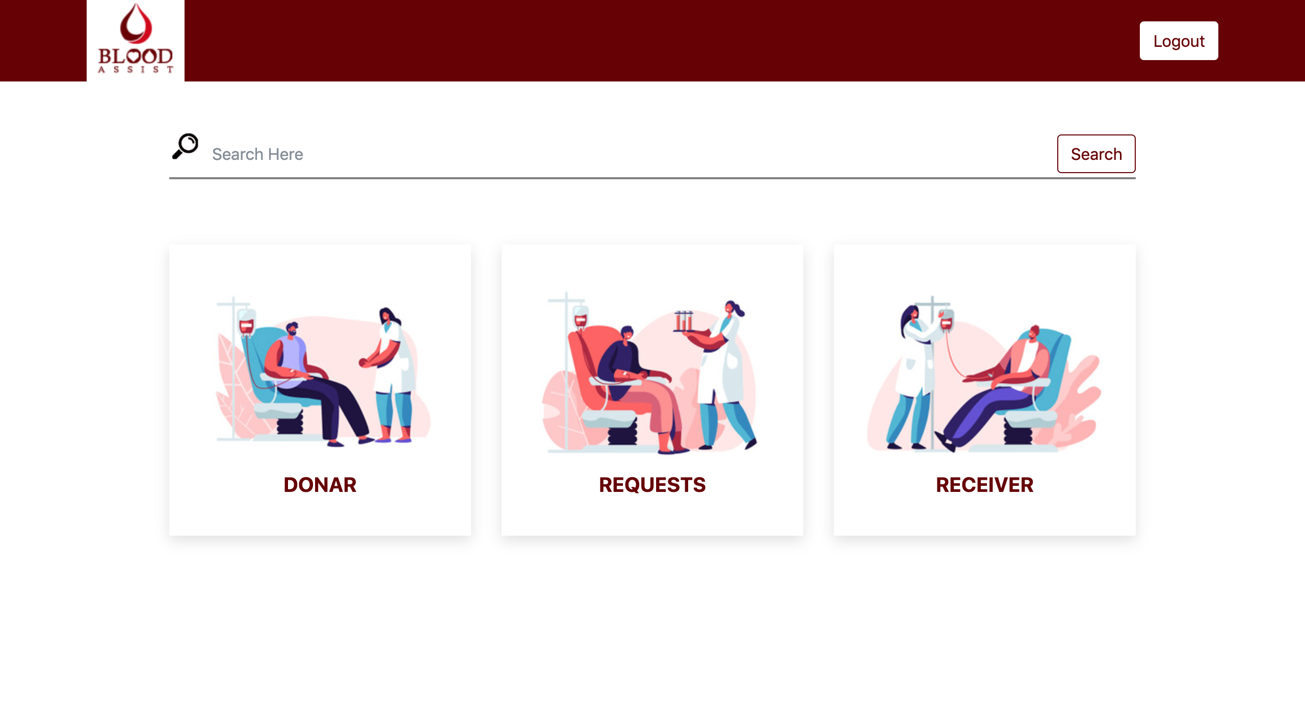

Slide 13
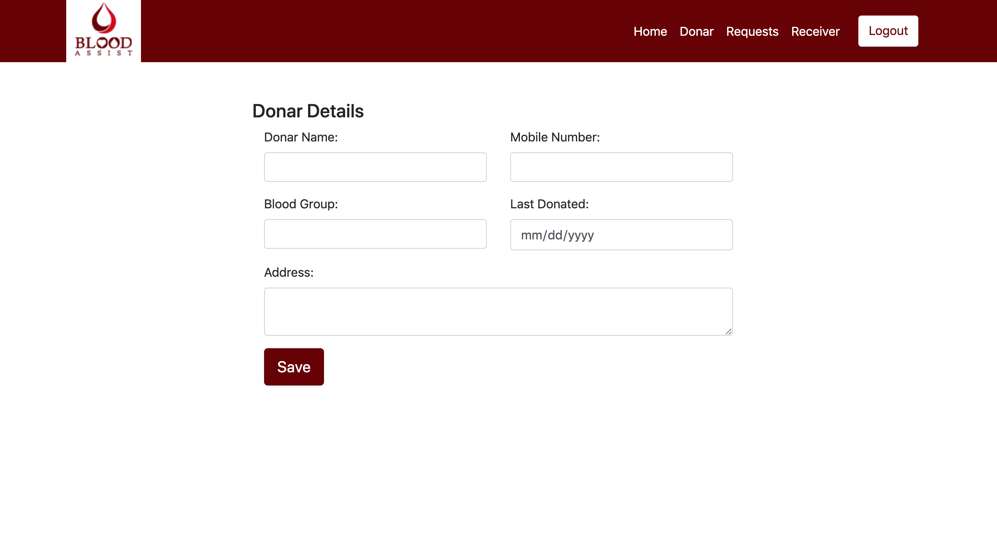

Slide 14
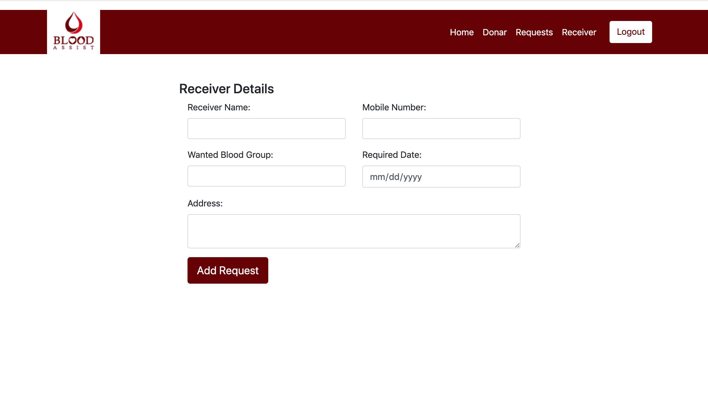

Slide 15
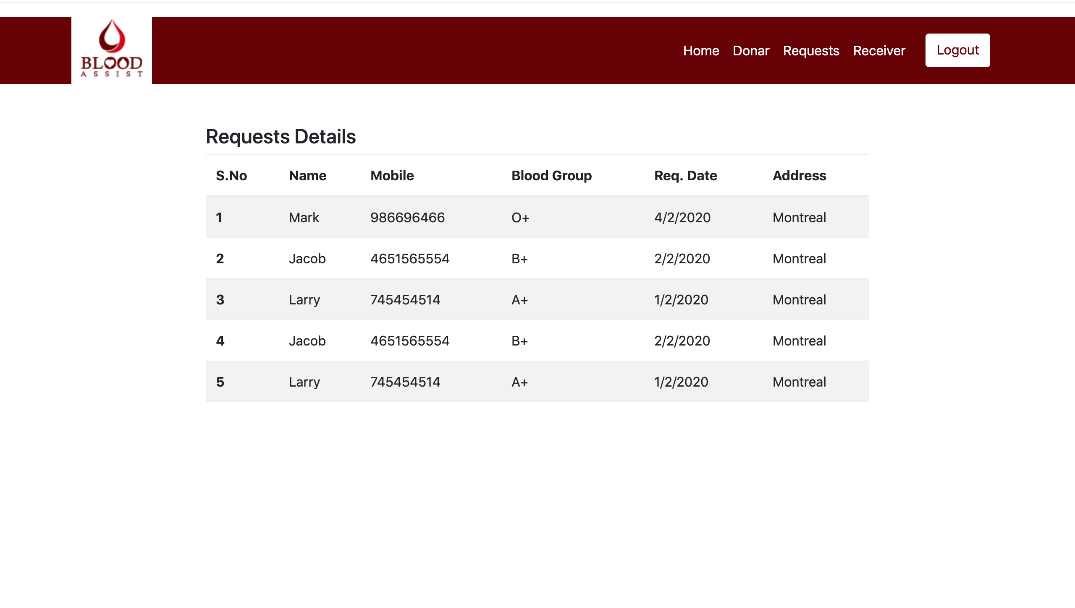

Slide 16
Software requirements:
Operating System : Microsoft Windows 7/8/10 (32- or 64-bit).
Web Technologies : DreamWeaver
Web Server : -
Database : -
Software :-

Slide 17
Requirements
Hardware requirements:
Hardware : Intel Core
RAM : 4 GB RAM minimum, 8 GB RAM recommended
Disk Space : 2 GB of available disk space minimum, 4 GB Recommended (500 MB for IDE + 1.5 GB for
Android SDK and emulator system image)
Resolution : 1280 x 800 minimum screen resolution

Slide 18
Thankyou ☺

