Slide 1
Employee Data Analysis using Excel
STUDENT NAME: G.Hemalatha
REGISTER NO: 312204235
DEPARTMENT: B.com Accounting and finance
COLLEGE. Annai violet arts and science college

Slide 2
PROJECT TITLE
Salary and compensation analysis

Slide 3


AGENDA
Problem Statement
Project Overview
End Users
Our Solution and Proposition
Dataset Description
Modelling Approach
Results and Discussion
Conclusion
3/21/2024 Annual Review

Slide 4

PROBLEM STATEMENT
Excel can be used to perform salary and compensation analysis by gathering and organizing data, calculating averages, and comparing compensation:

Slide 5

PROJECT OVERVIEW
.
A salary analysis report is a tool that helps companies understand and evaluate their pay structure, and make adjustments to ensure fair and competitive pay. It can help businesses attract and retain top talent, and create an equitable environment for their employees.

Slide 6

WHO ARE THE END USERS?
The end users of salary and compensation analysis through Excel data modeling are HR professionals, who use the data to make informed decisions about compensation management:

Slide 7

OUR SOLUTION AND ITS VALUE PROPOSITION
External competitivenes
Internal equity
Region
Level

Slide 8

THE "WOW" IN OUR SOLUTION
data model in Excel is a helpful feature that lets users incorporate data from several tables as long as the tables have one column in common. A data model allows users to forgo the VLOOKUP() function, making the data organization process much simpler. It also reduces other reporting complexities, like PivotTable object
3/21/2024 Annual Review
8

Slide 9
MODELLING
A salary and compensation analysis is a process that examines a company's pay structure and practices to ensure that they are fair and competitive. This analysis helps companies attract and retain top talent, and maintain a positive work environment.
9

Slide 10
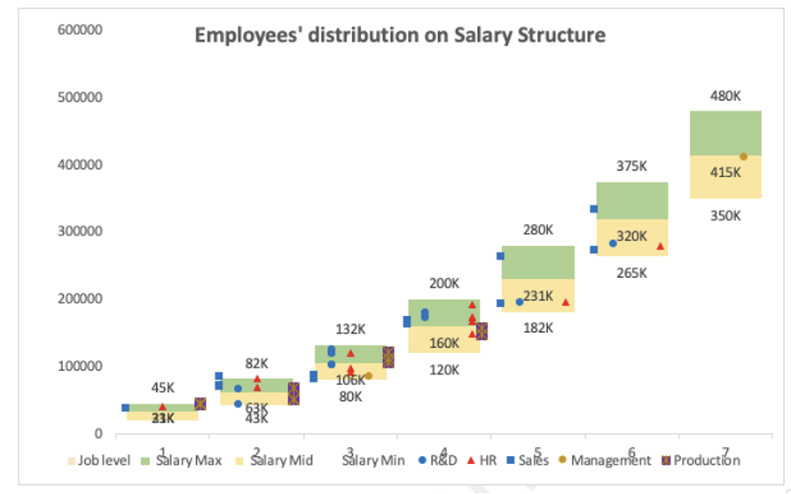
RESULTS
10

Slide 11
conclusion
A compensation analysis is the process businesses use to understand how to pay their employees. A compensation analysis is a tool that helps companies attract new employees and retain current ones through fair salaries. Because job market trends shift regularly, businesses can benefits.

