Slide 1
Employee Data Analysis using Excel
PRESENTED BY: HEMALATHA C
REGISTER NO: 312209564
NM ID: A101CECB24050B2976E48B1D378B1492
DEPARTMENT: B COM GEN
COLLEGE: ANNA ADARSH COLLEGE FOR WOMEN

Slide 2
PROJECT TITLE
Employee Performance Analysis using Excel

Slide 3


AGENDA
Problem Statement
Project Overview
End Users
Our Solution and Proposition
Dataset Description
Modelling Approach
Results and Discussion
Conclusion
3/21/2024 Annual Review

Slide 4

PROBLEM STATEMENT
Performance analysis is the practice of evaluating the quality of employee performance to determine whether they are meeting the company expectations.
It is used either to achieve a performance improvement or to ensure that the performance of an employee remains at an acceptable level.

Slide 5

PROJECT OVERVIEW
Employee Performance Analysis is an approach of evaluating the performance of employees on their job duties.
This helps both organizational success and individual employee development.
This involves assessing various aspects of an employee’s work, including their productivity, quality of work, adherence to company policies, and overall contribution to the organization’s goals.

Slide 6

WHO ARE THE END USERS?
Managers and Supervisors
Human Resources (HR) Professionals
Employees
Executives and Senior Leadership
Performance Improvement Teams

Slide 7

OUR SOLUTION AND ITS VALUE PROPOSITION
THE SOLUTION USED IN THE EMPLOYEE PERFORMANCE ANALYSIS ARE:
FILTERING- BY USING THE FILTERING OPTION THE MISING DATA ARE FOUND AND FILTERED OUT.
CONDITIONAL FORMATING- THIS HELPS IN HIGH LIGHTING PERFORMANCE METRICS, TRACKING ATTEDANCE,COMPARING EMPLOYEE RANKINGS, ETC…
PIVOT TABLE AND CHARTS- THIS HELPS IN SUMMARISING THE DATA, COMPARING DATA, FILTERING AND SLICING,CALCULATING PERCENTAGE AND REPORTS AND CUSTOMISING THE REPORTS ETC.. THE CHARTS GIVES A GRAPHICAL REPRESENTATION THAT COMBINES TEXT, SYMBOLS, AND/OR GRAPHICS TO SHOW RELATIONSHIPS BETWEEN MULTIPLE DATA SETS.

Slide 8
DATASET DESCRIPTION
THE SOURCE OF EMPLOYEE DATA SET WAS TAKENFROM KAGGLE WHERE, THE DATA SET HAS 26 FEATURES FROM THAT I TAKE 10 FEATURES TO ANALYSE EMPLOYEE PERFORMANCE.THE 10 FEATURES ARE AS FOLLOWS:
Employee ID: Unique identifier for each employee in the organization.
First Name: The first name of the employee.
Last Name: The last name of the employee.
Business Unit: The specific business unit or department to which the employee belongs.
Employee Status: The current employment status of the employee.
Employee Type: The type of employment the employee has.
Employee Classification Type: The classification type of the employee.
Gender: A code representing the gender of the employee.
Performance Score: A score indicating the employee's performance level.
Current Employee Rating: The current rating or evaluation of the employee's overall performance.

Slide 9

THE "WOW" IN OUR SOLUTION
A slicer is an interactive object in Excel that allows you to filter your data visually. Here’s how it works:
Data Filtering: Imagine you have a table or a PivotTable with lots of data. Slicers give you a snazzy way to filter that data. They display all the unique values from a selected column, and each value appears as an individual button within the slicer.
Easy Interaction: When you click a slicer button, it toggles the active filtering of your data. It’s like having a dashboard control panel right there in your spreadsheet.
Always Visible: Slicers float above your grid (like little data superheroes) and remain visible all the time. No more hunting for filter options buried in menus!
3/21/2024 Annual Review
9

Slide 10
MODELLING
EMPLOYEE PERFORMANCE ANALYSIS IS DONE FROM THE DATASET COLLECTED FROM KAGGLE.
THE EMPLOYEE DATA SET WAS FILTERED BY ADDING SOME FILL COLOUR TO THE FEATURE NEEDED FOR THE ANALYSIS.
TO REMOVE BLANK SPACES , I APPLIED CONDITIONAL FORMATTING AND FILTERED BY CLICKING ON TO THE FILTER BY COLOUR.
TO KNOW THE PERFORMANCE LEVEL, JUST APPLIED A FORMULA IN A COLUMN.
THE FORMULA=IFS(Z2>=5,”VERY HIGH”,Z2>=4,”HIGH”,Z2>=3,”MEDIUM”,TRUE ,”LOW”)
TO SUMMARIZE THE DATA, USING PIVOT TABLE LOCATE THE NECESSARY DATA IN THE GIVEN ROWS, COLUMN, FILTER, VALUES ETC…
AFTER THAT I ADD A SLICER TO THAT TO ADD SOME FILTER TO THE EMPLOYEE’S TYPE.
THEN I GAVE A DATA VISUALISATION, SO I ADD CHART TO GIVE A CLEAR VISUAL OF THE GIVEN DATA.
10

Slide 11
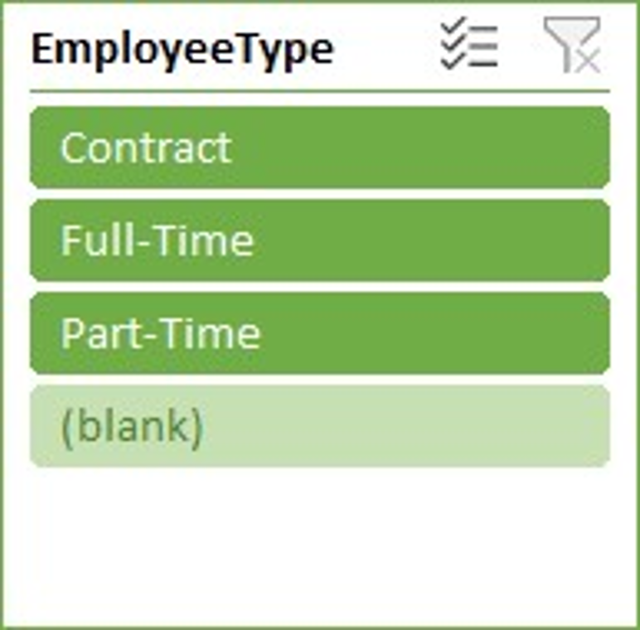
RESULTS
GenderCode | (All)
Count of FirstName | Column Labels
Row Labels | HIGH | LOW | MED | VERY HIGH | Grand Total
BPC | 16 | 34 | 85 | 15 | 150
CCDR | 18 | 47 | 65 | 15 | 145
EW | 21 | 41 | 78 | 14 | 154
MSC | 17 | 39 | 92 | 9 | 157
NEL | 21 | 41 | 77 | 15 | 154
PL | 29 | 33 | 69 | 12 | 143
PYZ | 26 | 41 | 75 | 15 | 157
SVG | 26 | 43 | 82 | 16 | 167
TNS | 21 | 45 | 71 | 13 | 150
WBL | 25 | 34 | 84 | 13 | 156
Grand Total | 220 | 398 | 778 | 137 | 1533
11

Slide 12
CONCLUSION
Employee performance analysis is a formal process where managers and stakeholders evaluate an employee’s work performance.
Its purpose is to identify strengths, weaknesses, offer constructive feedback, and assist with goal setting.
By assessing metrics of the employee’s performance the analysis is made.
Employee performance analysis isn’t a one-time event. It’s an ongoing process.
Continuously review data, adjust strategies, and celebrate successes.
So as explained from the above process, I done the employee performance analysis.

