Slide 1

Student Performance Data Analysis
NAME:K.HEMALATHA
AF ID:AF0366906
GUIDE NAME:MANALI PATIL

Slide 2
ABSTRACT
The dataset comprises student demographic information, including gender and ethnic group, alongside educational background details such as parental education and lunch type. It also includes variables related to academic preparation, family dynamics like parental marital status and number of siblings, and transportation status. Finally, the dataset provides student performance metrics in math, reading, and writing scores.

Slide 3
Software Requirements:
Python Jupiter Notebook: A Jupyter Notebook is an open-source web application that allows you to create and share documents containing live code, equations, visualizations.
Vrsion: 7.1.2
MySQL Workbench:MySQL Workbench is a unified visual tool for database architects, developers.
version:8.0.36.0
Pandas:Pandas is a Python library for data manipulation and analysis.
version: 2.2.1
Matplotlib: Matplotlib is a comprehensive library for creating static, animated, and interactive visualizations in Python.
version: 3.8.3

Slide 4
Advantages of the Project:
Insight into Student Performance: The dataset provides scores in math, reading, and writing, which can be used to analyze student performance and identify trends or patterns.
Demographic Information: Information such as gender, ethnic group, parental education level, and parental marital status offers insights into the demographic composition of the student population.
Influence of Factors on Academic Performance: By analyzing relationships between various factors (e.g., parental education, lunch type, test preparation) and student scores, one can assess the influence of these factors on academic performance.
Test Preparation Analysis: The dataset includes information about test preparation, allowing analysis of how students who completed test preparation courses perform compared to those who did not.

Slide 5
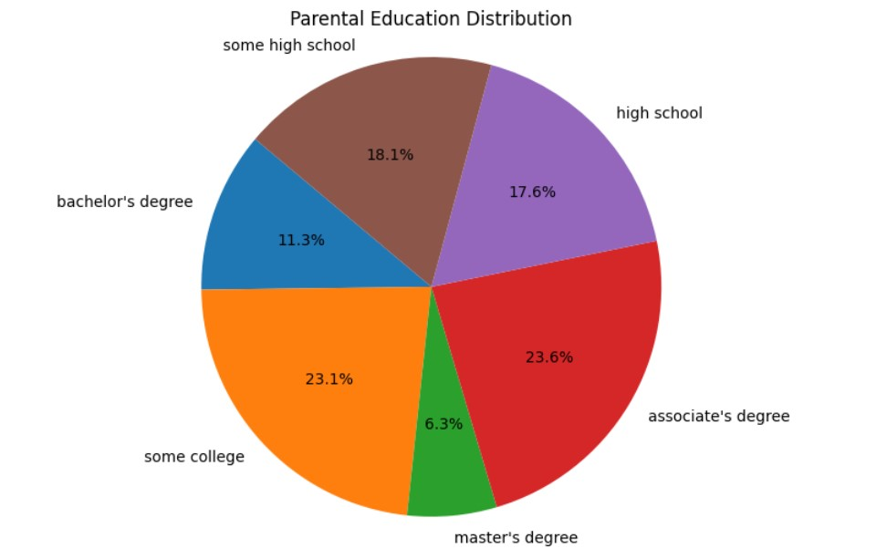
Parental Education Distribution

Slide 6
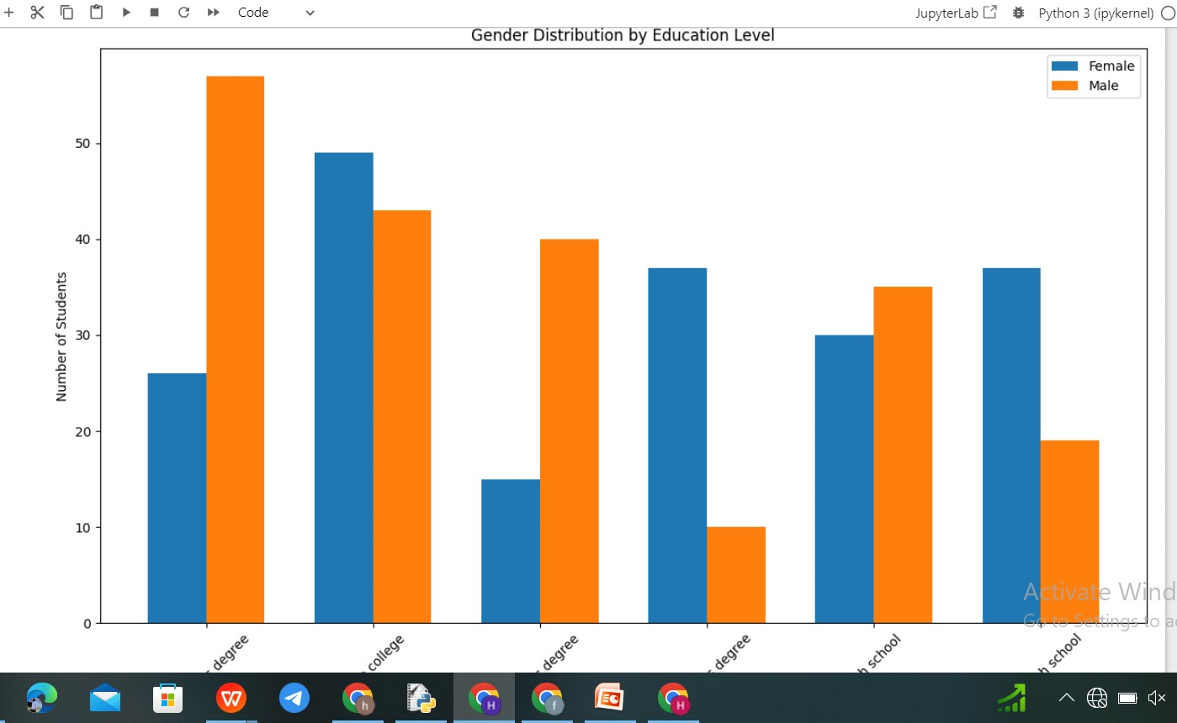
Gender Distribution by Education Level:

Slide 7
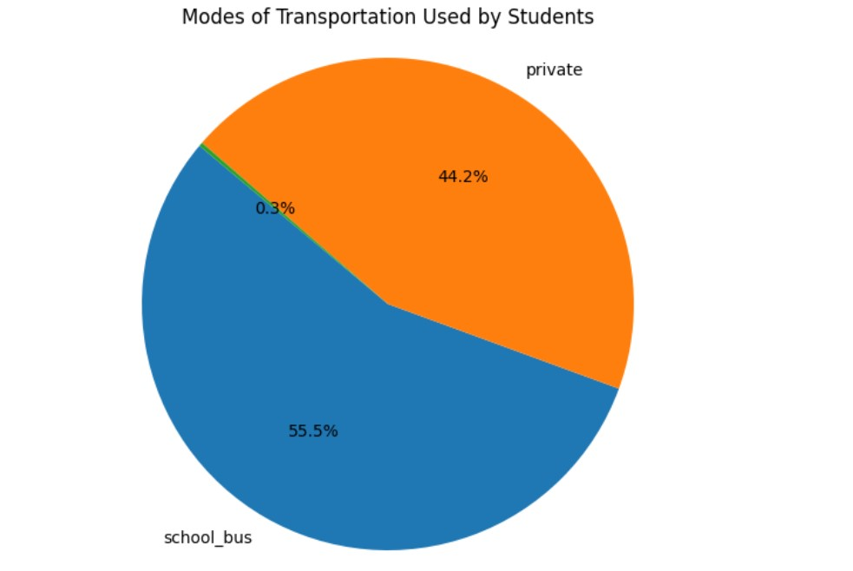
Mode of Transportation Used by Students:

Slide 8
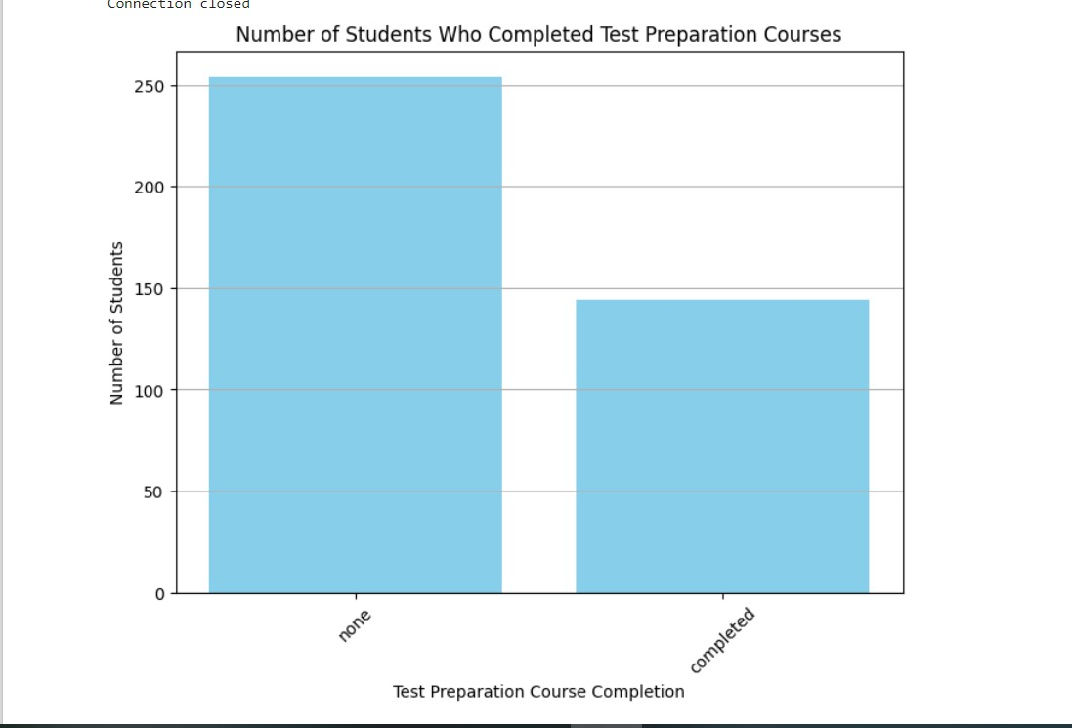
Number of Students who completed Test Preparation Courses:

Slide 9
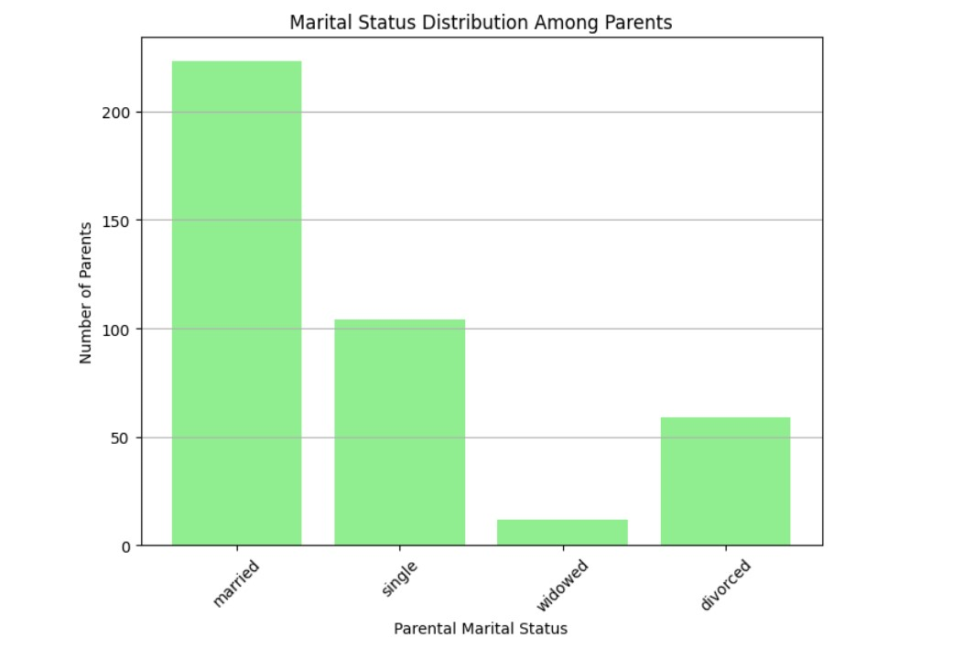
Marital status Distribution Among Parents:

Slide 10
Future Enhancements
Additional Features: Incorporate additional features such as socio-economic status, parental involvement in education, extracurricular activities participation, access to resources like computers or tutors, etc. These features can provide a more comprehensive understanding of factors influencing student academic performance.
Longitudinal Data: Collect data over multiple time points to analyze student academic progress and identify trends over time. Longitudinal data can provide insights into the effectiveness of interventions or programs aimed at improving student outcomes.
External Data Integration: Integrate external datasets, such as census data or educational policy data, to enrich the analysis and provide context for understanding student performance within broader socio-economic and policy frameworks.

Slide 11
Conclusion:
In conclusion, the dataset provides valuable insights into student demographics, family
background, and academic performance. Analyzing this data can help identify patterns
and factors that influence student achievement, which can be used to inform educational
policies and practices.

Slide 12

Thank You

