Slide 1
ASSIGHNMENT
MODULE -1 (HTML)

Slide 2
1. Are the HTML tags and elements the same thing?
HTML Tags: Tags are the starting and ending parts of an HTML element. They begin with < symbol and end with > symbol. Whatever written inside < and > are called tags.
Example: <P> </P>
HTML elements: Elements enclose the contents in between the tags. They consist of some kind of structure or expression. It generally consists of a start tag, content and an end tag.
Example: <P> this is the contents </P>

Slide 3
2. What are tags and attributes in HTML?
=>Tags are used to mark up the start of an HTML element and they are usually enclosed in angle brackets.
An example of a tag is: <h1>. Most tags must be opened <h1> and closed </h1> in order to function.
=>Attributes contain additional pieces of information. Attributes take the form of an opening tag and additional info is placed inside.
An example of an attribute is: <img src="myhome.jpg" alt="A photo of my home">
3. What are void elements in HTML?
=> HTML elements are surrounded by start and end tags to specify the starting and end of the element.
=> Void elements doesn’t have ending tags and can only have attributes but do not contain any kind of content. These elements can have backslash before ending of start tag but that is completely optional. Example of such elements are <br>, <hr>, <img>, <input>, <link>, <base>, <meta>, <param>, <area>, <embed>, <col>, <track>, <source> etc.

Slide 4
4. What are HTML Entities?
An HTML entity is a piece of text ("string") that begins with an ampersand (&) and ends with a semicolon (;). Entities are frequently used to display reserved characters (which would otherwise be interpreted as HTML code), and invisible characters (like non-breaking spaces). You can also use them in place of other characters that are difficult to type with a standard keyboard.
For example, the entity for the copyright symbol (©) is &copy;. For less memorable characters, such as &#8212; or &#x2014;, you can use a reference chart or decoder tool.
5. What are different types of lists in HTML?
There are three types of lists in HTML:
1.Unordered list -Bulleted items 3. Definiton list -a list of items, with a description of each item.
2. Ordered list -Numbered items
3. Definiton list -a list of items, with a description of each item.

Slide 5
6. What is the ‘class’ attribute in HTML?
The class is an attribute which specifies one or more class names for an HTML element.
The class attribute can be used on any HTML element.
The class name can be used by CSS and JavaScript to perform certain tasks for elements with the specified class name.
The class attribute is part of the Global Attributes, and can be used on any HTML element.
6. What is the difference between the ‘id’ attribute and the ‘class’ attribute of HTML elements?
The only difference between them is that “id” is unique in a page and can only apply to at most one element, while “class” selector can apply to multiple elements.
HTML id Attribute: The id attribute is a unique identifier which is used to specify the document. It is used by CSS and JavaScript to perform a certain task for a unique element. In CSS, the id attribute is written using # symbol followed by id.
HTML class Attribute: The class attribute is used to specify one or more class names for an HTML element. The class attribute can be used on any HTML element. The class name can be used by CSS and JavaScript to perform certain tasks for elements with the specified class name. The class name in CSS stylesheet using “.” symbol.

Slide 6
7. What are the various formatting tags in HTML?
- Formatting elements were designed to display special types of text:
<b> | Bold text
<strong> | Important text
<i> | Italic text
<em> | Emphasize text
<mark> | Marked text
<small> | Smaller text
<dell> | Deleted text
<ins> | Inserted text
<sub> | Subscript text
<sup> | Superscript text

Slide 7
8. How is Cell Padding different from Cell Spacing?
Cellpadding:
Cellpadding specifies the space between the border of a table cell and its contents (i.e) it defines the whitespace between the cell edge and the content of the cell.
Cellspacing:
Cellspacing specifies the space between cells (i.e) it defines the whitespace between the edges of the adjacent cells.
9. How can we club two or more rows or columns into a single row or column in an HTML table?
To merge cells in HTML, use the colspan and rowspan attribute.
The rowspan attribute is for the number of rows a cell should span,
the colspan attribute is for a number of columns a cell should span.

Slide 8
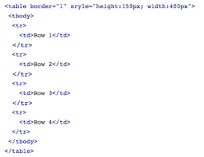

Slide 9
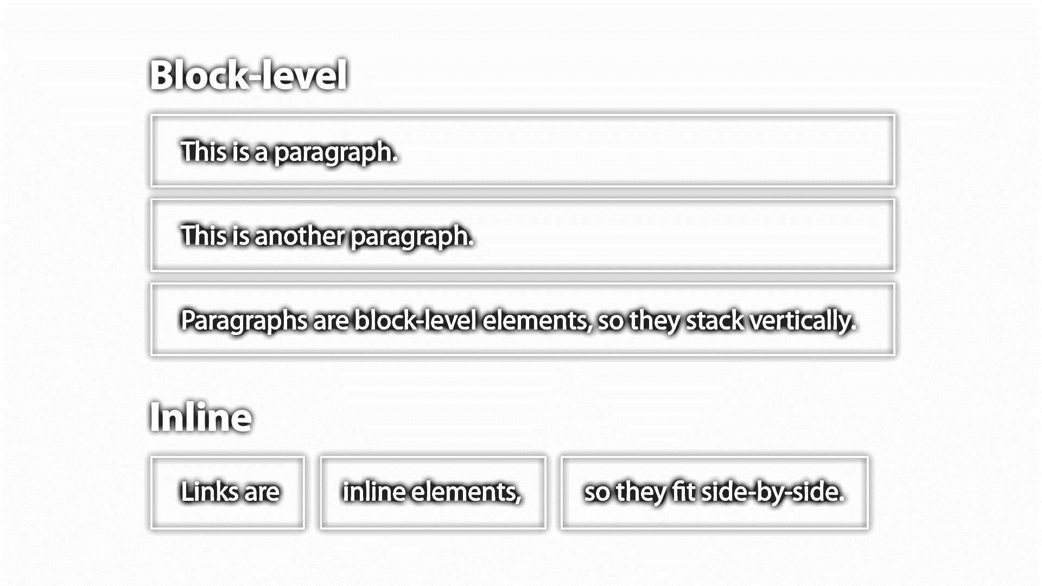
10.What is the difference between a block-level element and an inline element?
inline elements do not force a new line to begin in the document flow.
Block elements, on the other hand, typically cause a line break to occur (although, as usual, this can be changed using CSS).

Slide 10
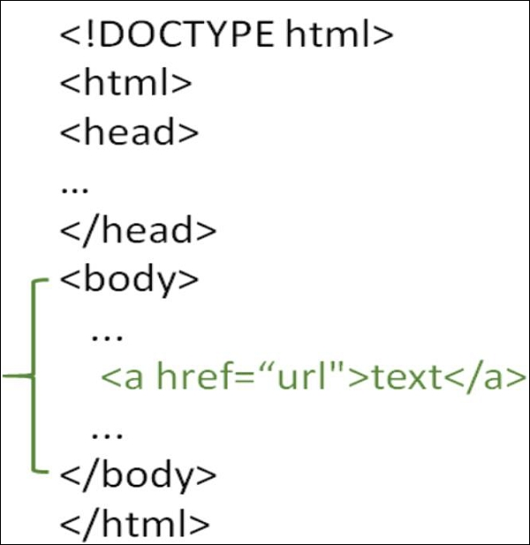
12.How to create a Hyperlink in HTML?
To make a hyperlink in an HTML page, use the <a> and </a> tags, which are the tags used to define the links. The <a> tag indicates where the hyperlink starts and the </a> tag indicates where it ends.

Slide 11
13 What is the use of an iframe tag?
The <iframe> tag specifies an inline frame. An inline frame is used to embed another document within the current HTML document.
<iframe src="https://www.google.com" title="Practicals"></iframe>
14 What is the use of a span tag? Explain with example?
The <span> tag is an inline container used to mark up a part of a text, or a part of a document
<p>Hello <span style="color:blue"> Good </span> morning.</p>

Slide 12
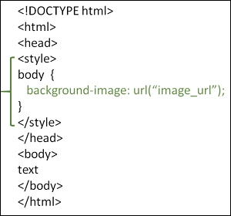
15 How to insert a picture into a background image of a web page?

Slide 13
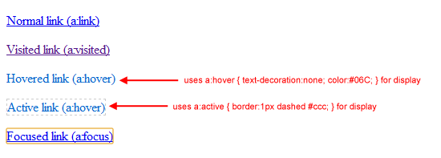
16. How are active links different from normal links?

Slide 14
17. What are the different tags to separate sections of text?
<br> tag – Usually <br> tag is used to separate the line of text.It breaks the current line and conveys the flow to the next line.<p> tag – This contains the text in the form of a new paragraph.
<blockquote> tag – It is used to define a large quoted section.
18. What is SVG?
SVG stands for Scalable Vector Graphics.
SVG defines vector-based graphics in XML format.

Slide 15
<html> <body> <h1>My first SVG</h1> <svg width="100" height="100"> <circle cx="50" cy="50" r="40" stroke="green" stroke-width="4" fill="yellow" /> </svg> </body> </html>

Slide 16
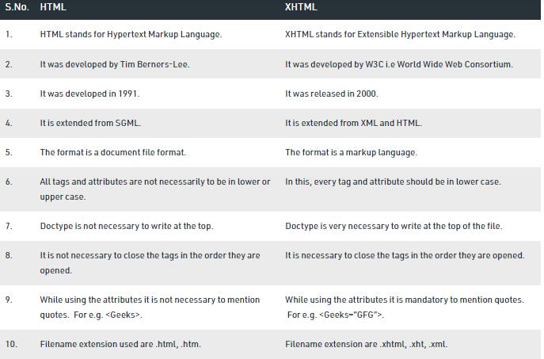
19. What is differene between HTML an d XHTML?

Slide 17
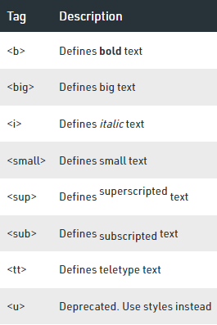
20. What are logical and physical tags in HTML?
Logical tags describe the behavior
Physical tags are used to decide the appearance of the text and do not provide any information about the text.
Physical Tags

Slide 18
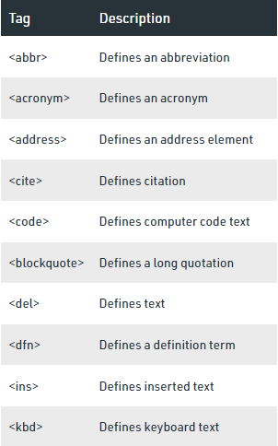
Logical Tags

Slide 19
THANK YOU!!!!!☺
THANK YOU!!!!!☺

