Slide 1
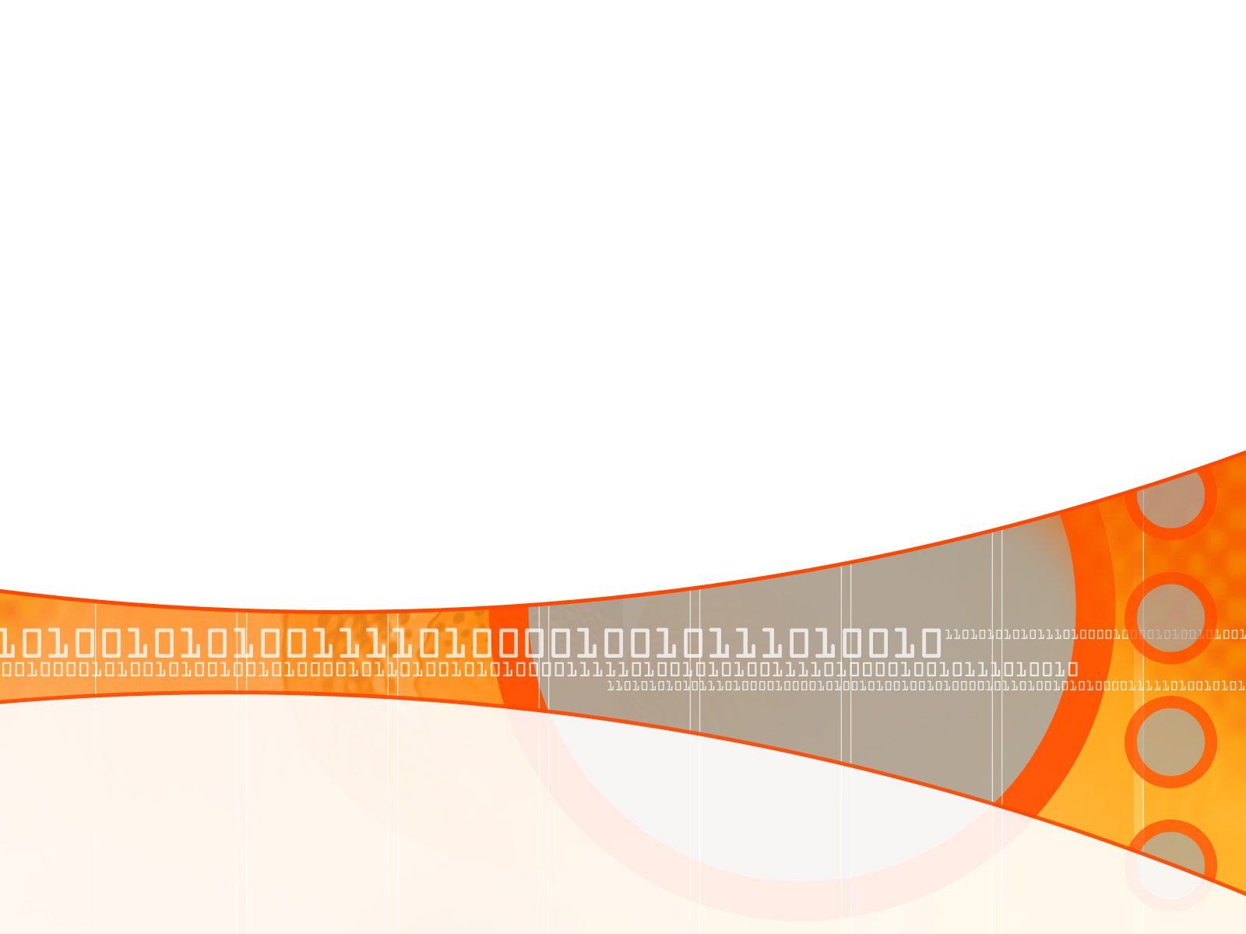



Driver’s Sleepiness Detection System
Introduction to Computational and Biological Vision
Fall 2007
Idit Gershoni

Slide 2
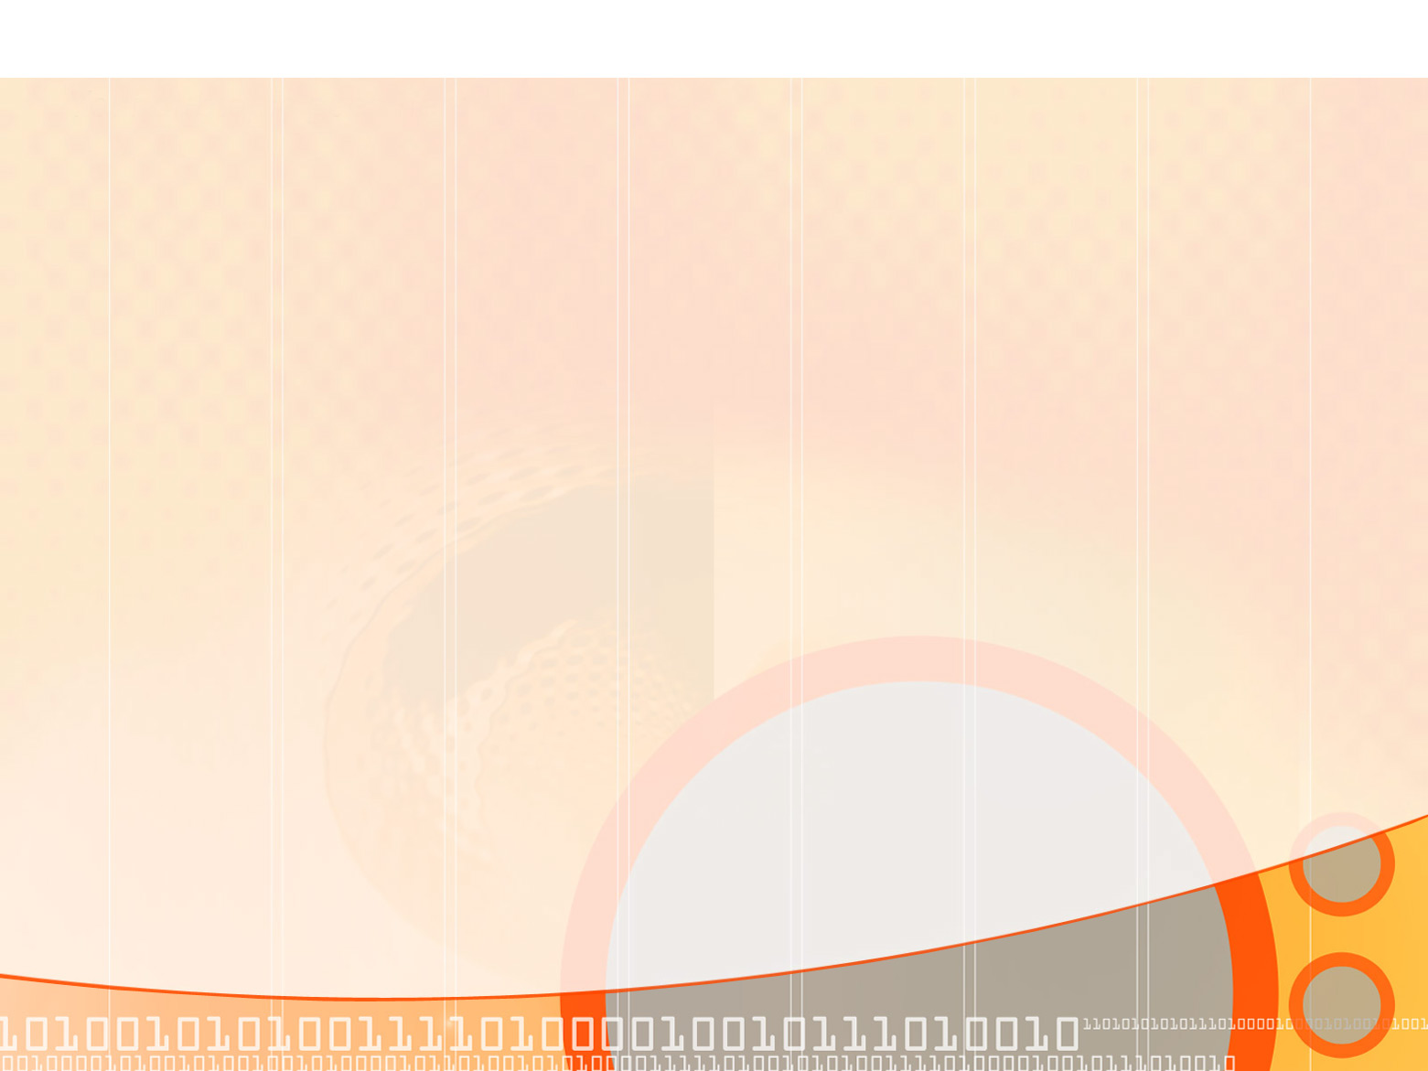
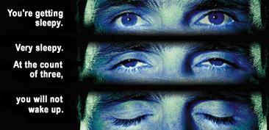
From Arizona Dept of Public Safety campaign:

Slide 3

Motivation (1)
A study (In the U.S) showed that 37% of drivers surveyed admitted to falling asleep at the wheel.
An estimated 1.35 million drivers have been involved in a drowsy driving related crash in the past five years.
Fall-asleep crashes are likely to be serious. The morbidity and mortality associated with drowsy-driving crashes are high, perhaps because of the higher speeds involved (Horne, Reyner, 1995b) combined with delayed reaction time.

Slide 4
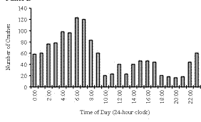
Motivation (2)
Accidents study in the U.S (1990-92):
Time of occurrence of crashes in drivers at ages 26 to 45 in which the crashes were attributed by the police to the driver being asleep (but in which alcohol was not judged to be involved).
The X axis is the time of day and the Y axis is the number of crashes.

Slide 5

Project Goal
Simulate sleepiness detection system using image processing methods.

Slide 6
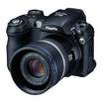
Tools
Fujifilm S5000 digital camera.
Matlab 7.2 (R2006a).
MJPEG Codec

Slide 7
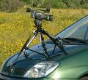
The (ideal) idea:
A video camera placed inside the car is continuously filming the driver’s face during the ride.
A detection system analyses the movie frame by frame and determines whether the driver’s eyes are open or shut.
If the eyes are shut for more than 1/4 a second (longer than a normal blink period) then the systems beeps to alert the driver.

Slide 8

In Practice
The system is only a simulation of such detection system, and doesn’t perform real-time detection & analysis.
However, it does work on a given video file with a given set of parameters.

Slide 9
Implementation - General
A Matlab program.
Input:
  A movie (avi file).
Output :
  Frames are displayed with a circle around the irises (if detected).
  A ‘beep’ sound is produced if eyes were detected as shut for too long (8 frames, 30 frames per sec => 0.25 second).

Slide 10
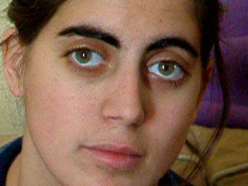
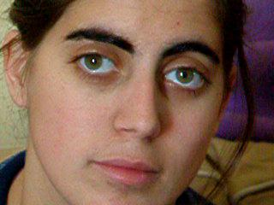
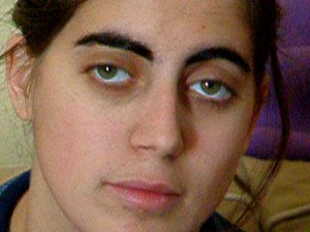
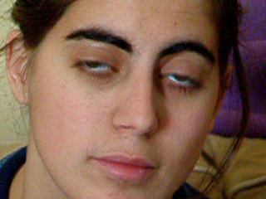
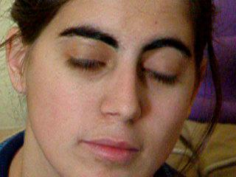
Implementation – Step by Step (1)
The movie is extracted to frames:
30 frames
per second

Slide 11
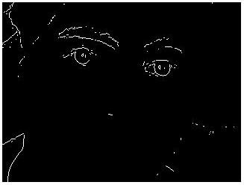
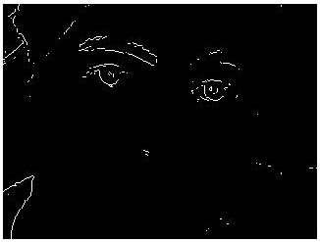
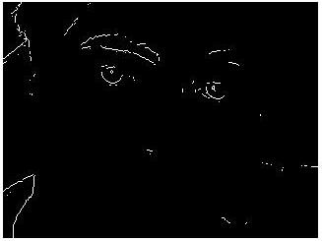
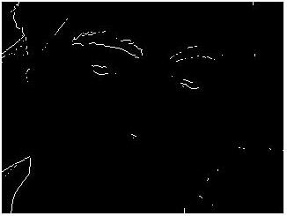
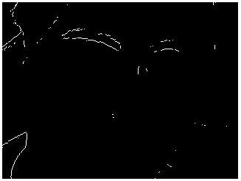
Implementation – Step by Step (2)
Apply edge detector on each frame:
The Sobel edge detector
did the work

Slide 12
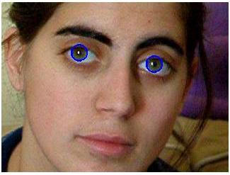
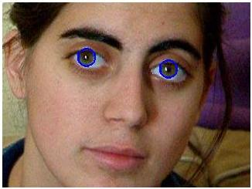
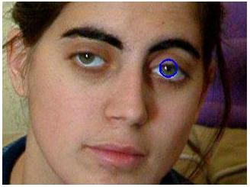
Implementation – Step by Step (3)
Perform Circular Hough transform on each frame in order to detect the irises:
Mark the circle detected
in blue circle

Slide 13
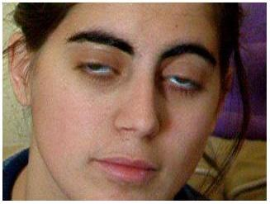
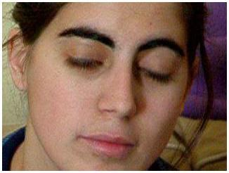
Implementation – Step by Step (4)
Perform Circular Hough transform on each frame in order to detect the irises:

Slide 14

Implementation – Step by Step (5)
If irises not found – make a ‘beep’ sound after not finding the irises in 8 consecutive frames.

Slide 15

Conclusions
In order for the system to detect sleepiness successfully, a set of parameters need to be given to the system manually, and might vary from movie to movie (threshold, radius).
Matlab works slow and uses a lot of virtual memory – might not be good enough for real-time solution.
Wearing glasses (of any kind) cause the system to fail.

Slide 16

Future Work
Improving the algorithm:
  Study the location of the eyes in the first image, and create a search area around the eyes for the following frames.
  Performing Hough transform with a range of possible radiuses.
Make the system work in real-time environment.

Slide 17


Questions?

Slide 18
References
DROWSY DRIVING AND AUTOMOBILE CRASHES:
http://www.nhtsa.dot.gov/people/injury/drowsy_driving1/drowsy.html
Federal Motor Carrier Safety Administration:
http://www.fmcsa.dot.gov/
BGU – Introduction to Computational and Biological Vision course:
http://www.cs.bgu.ac.il/~icbv071/LectureNotes/ICBV-Lecture-Notes-41- Perceptual-Organization-1-Edge-Aggregetion-Case-Study-1SPP.pdf
http://www.thesecrettosoundsleep.com/

