Slide 1
Telecom Data Analysis Report
Unveiling User Insights
Name: Hema. M
Date: 15-Jan-2024

Slide 2
AGENDA
Objective and Business Needs
Top Handsets used by Customers
Top Handsets Manufacturers
User Engagement Analysis
K-Mean Clustering for User Engagement
Experience Analysis
Less Engaged and Worst Experience Clusters
Satisfaction Analysis
Top Satisfied Customers
Model Building
Growth Opportunities and Enhancing User Experience

Slide 3
Objective and business need
Objective:
Conduct a comprehensive analysis of TellCo's telecommunication dataset to identify growth opportunities and provide strategic recommendations for the investor's decision-making process regarding acquisition or divestment.
Business Need:
The investor seeks to replicate past successes by leveraging data analysis to identify undervalued assets.
Previous successes have demonstrated the significant impact of data-driven decision-making on profitability.
TellCo's willingness to share financial information presents an opportunity to uncover potential areas for growth through data analysis.
The goal is to transform raw data into actionable insights, aiding the investor in making an informed decision regarding TellCo.

Slide 4
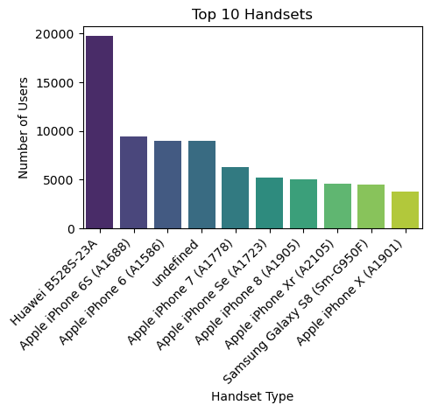
Top 10 handsets used by customers
The analysis reveals a variety of popular handset models among customers, comprising the top 10 preferences.
The Huawei B528S-23A emerges as the most widely used handset, with a substantial count of 19,752 occurrences.
Apple iPhone models, including the iPhone 6S, iPhone 6, iPhone 7, iPhone SE, iPhone 8, iPhone XR, and iPhone X, also feature prominently in customer device choices.
The presence of 'undefined' in the dataset suggests a category where handset types may not be explicitly identified, indicating potential areas for data refinement.
This analysis provides valuable insights into the popularity of specific handset models, enabling businesses to tailor services and optimize user experiences effectively.

Slide 5
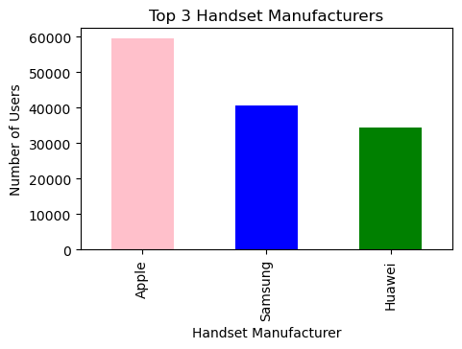
Top 3 handset manufacturers
Apple, Samsung, and Huawei emerge as the top three handset manufacturers in the dataset.
Apple exhibits the highest representation with 59,464 occurrences, followed by Samsung with 40,579 occurrences, and Huawei with 34,366 occurrences.
This data underscores the dominance of these manufacturers in the market, shaping consumer preferences and influencing industry trends.
Understanding the market share and presence of these key players is vital for strategic decision-making and market positioning within the telecommunications industry.

Slide 6
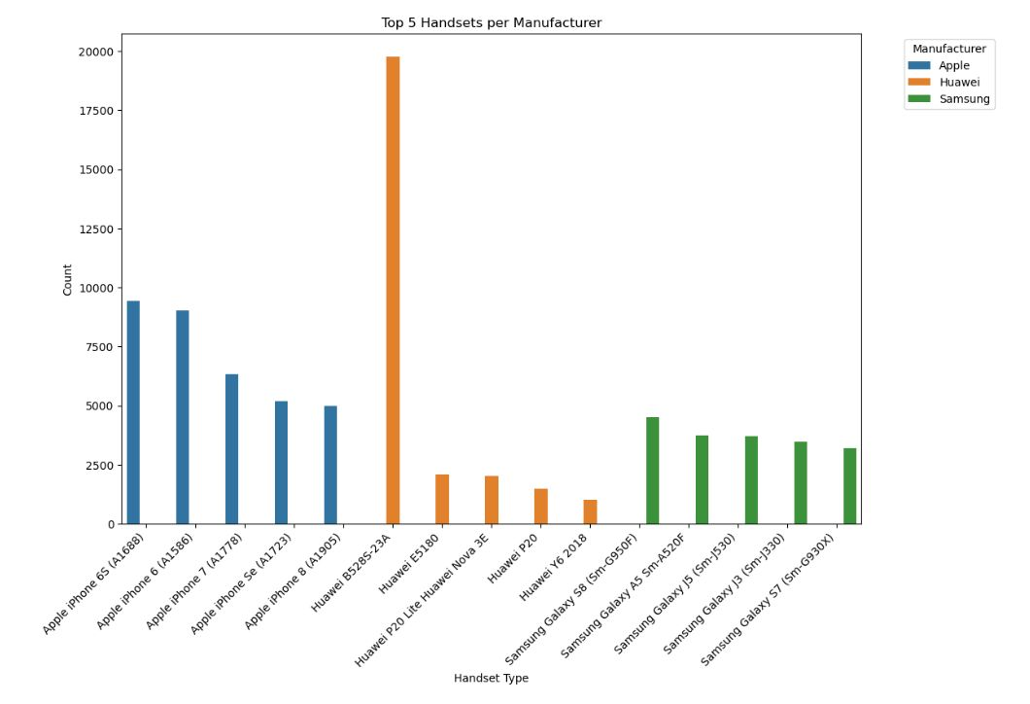
Top 5 handsets per top 3 manufacturers
Apple Handsets:
Most Popular: iPhone 6S
Followed by: iPhone 6, iPhone 7, iPhone SE, iPhone 8
Huawei Handsets:
Top Model: B528S-23A
Others Include: E5180, P20 Lite/Nova 3E, P20, Y6 2018
Samsung Handsets:
Leading Model: Galaxy S8
Other Popular Models: Galaxy A5, Galaxy J5, Galaxy J3, Galaxy S7

Slide 7
Recommendations for Marketing team
Promotion Strategy
Given the popularity of the Huawei B528S-23A, marketing teams should consider leveraging promotions or special offers to capitalize on its widespread usage and attract more customers
Apple Focus
With Apple exhibiting the highest representation among handset manufacturers, marketing efforts should prioritize highlighting the unique features and benefits of iPhone models to maintain and expand market share
Data Refinement
Competitive Analysis
User Experience Optimization
Invest in refining data collection processes to eliminate 'undefined' handset types and gain clearer insights into customer preferences. This will enable more targeted marketing strategies and better understanding of user behaviors
Continuously monitor the offerings and strategies of competitors, particularly Samsung and Huawei, to identify opportunities for differentiation and innovation.
Tailor services and user experiences to align with popular handset models, ensuring seamless compatibility and satisfaction for customers across different devices

Slide 8
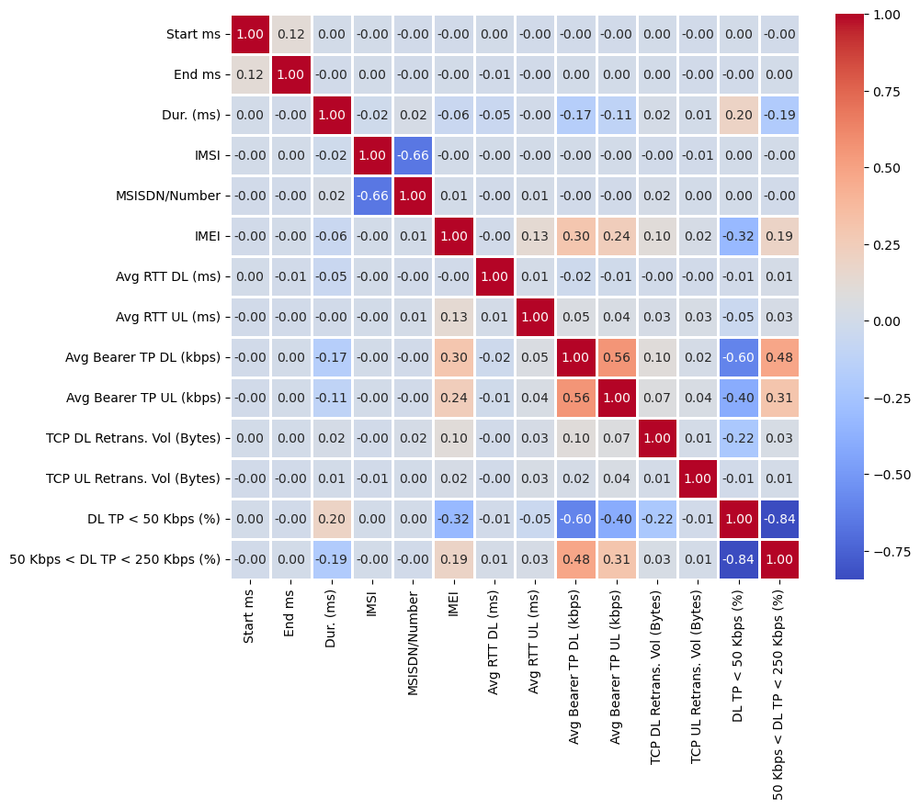
Correlation Analysis Insights
High Positive Correlation:
'Avg bearer tpt UL (kbps)' and 'Avg bearer tpt DL (kbps)' exhibit a strong positive correlation.
Indicates a significant relationship between uplink and downlink throughput.
Correlation with Throughput Range:
'50 Kbps < UL TP < 300 Kbps (%)' shows positive correlation with both 'Avg bearer tpt UL (kbps)' and 'Avg bearer tpt DL (kbps)'.
Implies variations in throughput within specified range align with changes in uplink and downlink throughputs.
Interpretation:
Correlation pattern highlights potential dependencies and interactions among performance metrics.
Emphasizes the importance of further exploration to understand underlying factors affecting network performance.

Slide 9
User Engagement Metrics and Their Importance
In the rapidly evolving telecommunication industry, user engagement plays a pivotal role in determining the success of a business. Telecom brands, as primary data providers for online activities, must not only focus on expanding their user base but also on creating a compelling user experience. While Quality of Service (QoS) improvements are beneficial, understanding and enhancing user engagement are crucial for sustained business success.
Session Frequency:
What it is: How often users connect.
Why it matters: Shows user habits, helps spot preferences, and can lead to revenue opportunities.
Session Duration:
What it is: How long users stay connected.
Why it matters: Reveals user interest, longer durations mean happier users, fostering loyalty.
Session Total Traffic :
What it is: The data used in a session.
Why it matters: Guides network optimization, ensuring resources match user demands.
Why User Engagement Matters:
Business Success: The ultimate success of a telecom business depends on the engagement and activity levels of its customers on various applications.
Resource Concentration: Efficiently utilizing network resources requires a profound understanding of user engagement patterns.
Strategic Decision-Making: Analysing user engagement helps in making informed decisions for service improvement and revenue growth.

Slide 10
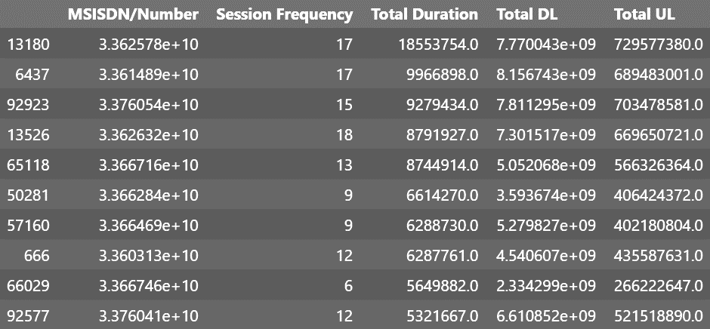
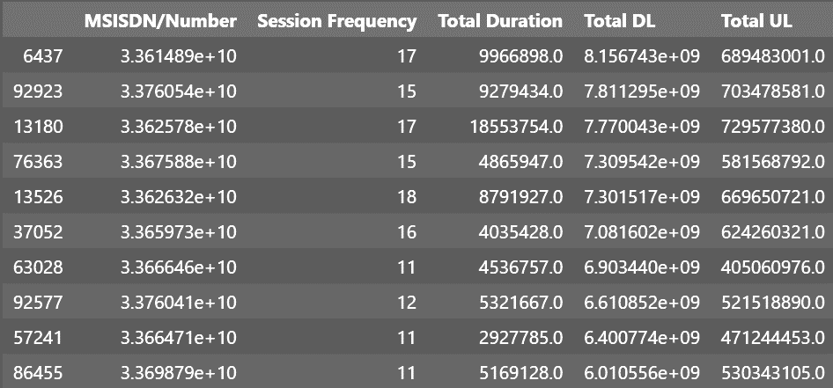
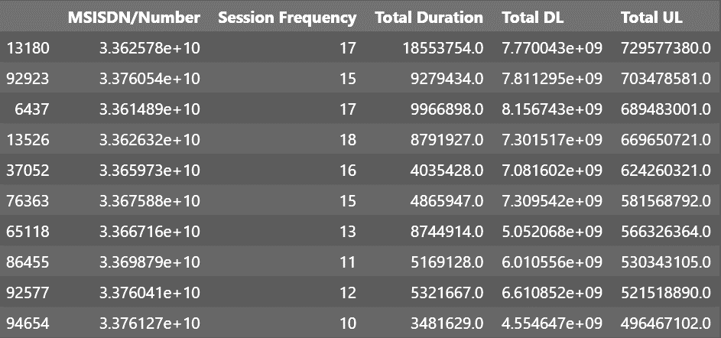
TOP 10 CUSTOMERS PER ENGAGEMENT METRICS
BASED ON TOTAL DURATION
BASED ON TOTAL DL
BASED ON TOTAL UL
Strategic Resource Allocation: Telecom providers should strategically allocate resources to accommodate users with longer durations, ensuring sustained user satisfaction.
Content Optimization: High total duration may indicate content consumption activities like streaming or extended online usage. Understanding these patterns can guide content optimization efforts.
Balancing Network Load: While high duration is positive, it's essential to balance network load. Attention should also be given to users with moderate durations to prevent network congestion.

Slide 11
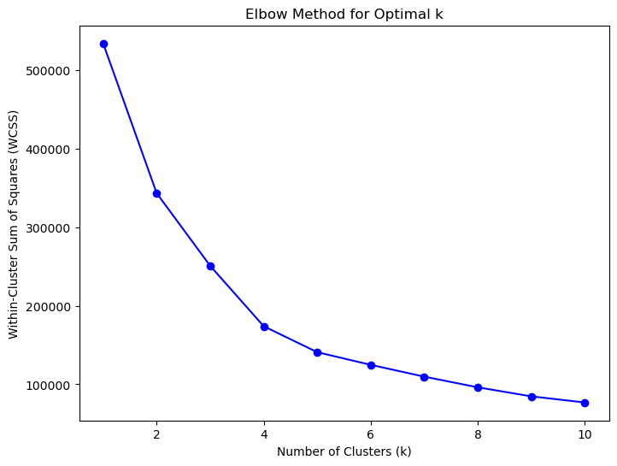
k-mean clustering for user engagement
Cluster Overview:
K-means clustering identifies four distinct user engagement clusters.
Cluster characteristics provide a nuanced view of user behavior, helping to personalize marketing strategies.
Key Insights:
The clustering provides a segmentation of users based on their engagement behavior.
This segmentation can guide targeted strategies for each user group.
Strategic Recommendation:
Marketing teams can target the top-engaged users identified in various categories for promotions and loyalty programs. Improving network resources for popular applications can enhance overall user satisfaction.
Optimal Value of K:
The optimal value of k (number of clusters) was determined as 4 based on the elbow method.
This analysis offers valuable insights into user engagement patterns, facilitating targeted strategies for enhancing user experiences and optimizing service offerings

Slide 12
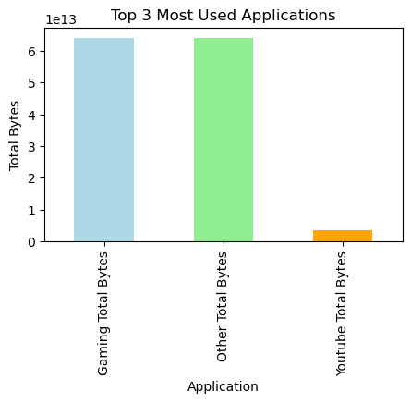
Top 3 most used applications
Gaming Application
The Gaming application has the highest total bytes, indicating that it is the most data-intensive app among the top three. Users are consuming a significant amount of data on gaming activities.
Other Application
The "Other" category ranks closely in terms of total bytes, suggesting a diverse set of applications within this group. Further analysis is needed to understand the specific apps contributing to this category.
YouTube Application
The YouTube application has a substantial but comparatively lower total bytes. While it may not be the most data-intensive, it remains a significant contributor to overall data usage.

Slide 13
Experience analytics –NAVIGATING USER EXPERIENCE
NETWORK
PARAMETERS
TCP Retransmission: This metric denotes the average number of times a Transmission Control Protocol (TCP) packet is retransmitted. A critical measure of data reliability, it directly impacts the seamless transmission of information across the network.
Round Trip Time (RTT): Reflecting the average time for a signal to travel from source to destination and back, RTT is a indicator of network responsiveness. Lower RTT values contribute to a more agile and user-friendly network
Throughput: At the heart of efficient data transfer lies throughput, indicating the average rate at which data is successfully transmitted. A key performance metric, throughput is instrumental in assessing the overall efficiency of data delivery.
In the dynamic landscape of the telecommunications industry, user experience stands as the linchpin for success. As mobile devices seamlessly integrate into the fabric of daily life, telecommunications providers must meticulously tailor their services to meet evolving consumer expectations. This imperative journey into the realm of user experience hinges on a profound understanding of two key elements: network parameters and device characteristics
DEVICE CHARACTERISTICS
Handset Type: The diversity of mobile devices in the market necessitates a keen examination of handset types. The characteristics and capabilities of each device profoundly influence the end-user experience. From basic functionality to advanced features, handset type plays a pivotal role in shaping the user interface and overall satisfaction.

Slide 14
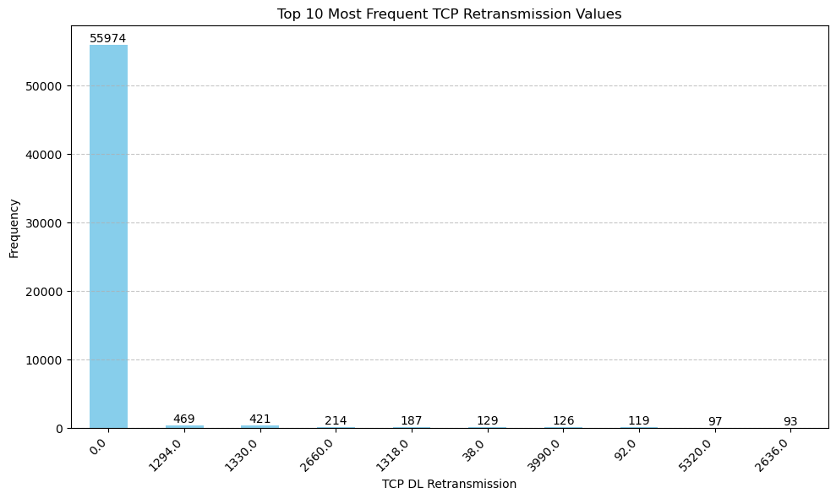
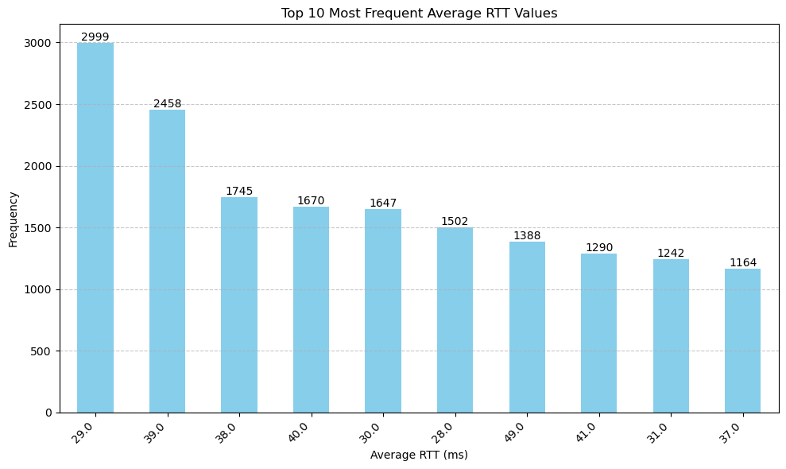
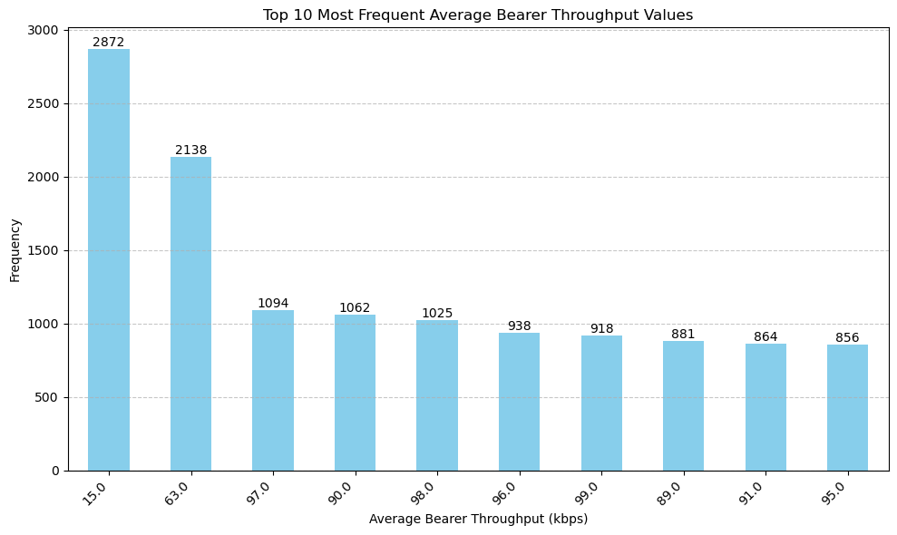
TOP 10 frequent tcp retransmission, rtt, bearer throughput.
TCP RETRANSMISSION
RTT
THROUGHPUT
Mostly Stable Transmission: The majority of TCP DL Retransmission values are at 0.0, indicating smooth data delivery.
Some Exceptions: While most values are low, occasional higher retransmissions suggest potential network issues.
Recommendation: Investigate further to resolve any underlying network problems for improved performance and user satisfaction
Common Latency: Most users experience RTT values around 29.0 milliseconds, followed by 39.0 milliseconds.
Consistent Experience: RTT values between 28.0 to 41.0 milliseconds are typical, indicating a stable latency experience.
Occasional Delays: Some instances, like 49.0 milliseconds, show slightly higher
Common Throughput Levels: Users commonly experience throughput levels around 15.0 and 63.0.
Consistent Experience: Throughput values between 15.0 to 99.0 are typical, indicating stable network performance.
Variability: Some fluctuations, like 89.0 and 91.0, suggest occasional changes in network speed.

Slide 15
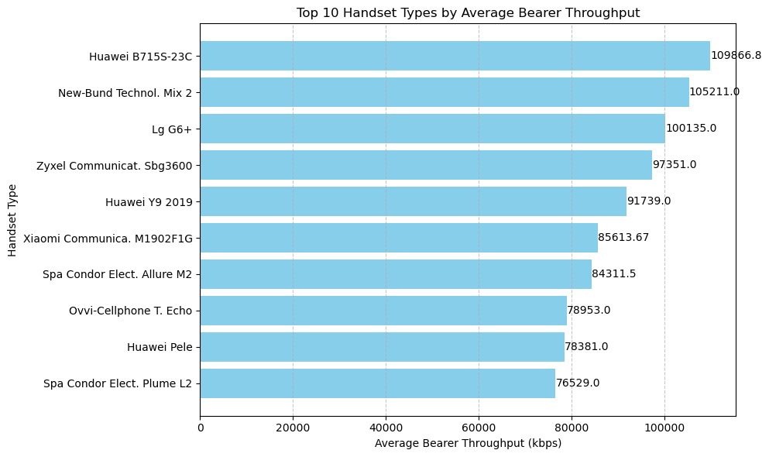
Distribution of average throughput per handset types
High Throughput Handsets: The top 10 handsets exhibit significant average bearer throughput, with values ranging from 76529.0 kbps to 109866.8 kbps.
Variety of Manufacturers: Handsets from various manufacturers, including Huawei, New-Bund Technol, LG, Zyxel Communicat, and Xiaomi, are among the top performers.
Performance Insights: Understanding the performance of these handsets can aid in network optimization and customer satisfaction initiatives.
Strategy: Develop targeted marketing campaigns or promotions highlighting the superior performance of these top-performing handsets. Collaborate with manufacturers to optimize network compatibility and performance for these devices, ensuring a seamless user experience. Additionally, prioritize the availability and promotion of these handsets to attract and retain customers seeking high-speed data connectivity.
Recommendation: Focus on identifying the specific features or technologies contributing to the high throughput of these devices. Leveraging this information can inform product development strategies and network enhancements to maintain or improve overall network performance

Slide 16
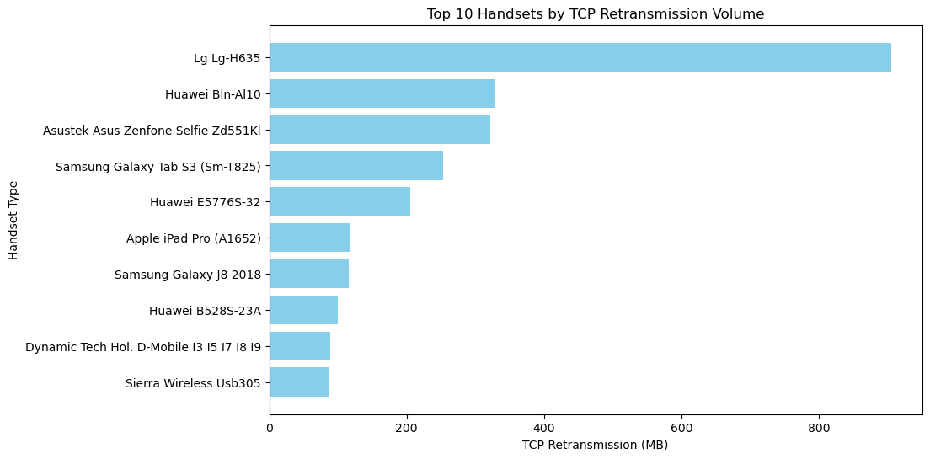
Average tcp retransmission view per handset type
Key Findings:
Strategy Development: Tailor campaigns to encourage users with high retransmission handsets to update devices or optimize network settings.
Collaboration Opportunities: Engage with manufacturers to release firmware updates addressing retransmission issues.
QoS Implementation: Implement Quality of Service measures to prioritize traffic for affected handsets, ensuring a smoother user experience.
Infrastructure Investment: Invest in network upgrades to meet increasing data demands and reduce retransmission rates across all handsets.
Recommendation:
Conduct further analysis to understand underlying causes of high TCP retransmission volumes for specific handsets.
Collaboration with handset manufacturers to address hardware-related issues contributing to high retransmission rates.
Continuous monitoring and optimization to enhance overall network efficiency.

Slide 17
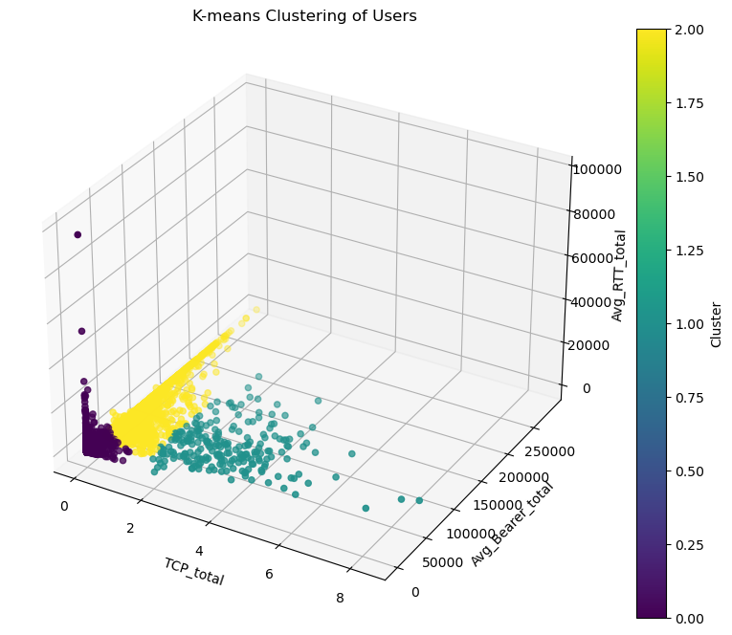
K-means clustering of users
Cluster 0 (Blue):
TCP_total: Moderate Avg_Bearer_total: Moderate Avg_RTT_total: Moderate
Characteristics:
Represents users with balanced and moderate values in TCP usage, average bearer throughput, and round-trip time. This group exhibits a standard level of engagement across all metrics.
Cluster 1(Orange):
TCP_total: High Avg_Bearer_total: High Avg_RTT_total: Low
Characteristics: Encompasses users with significantly high TCP usage and bearer throughput, accompanied by a low round-trip time. This cluster identifies highly active users who consume substantial data with efficient network responsiveness.
Cluster 2 (Green):
TCP_total: Variable
Avg_Bearer_total: Variable
Avg_RTT_total: Variable
Characteristics: Demonstrates variability in TCP usage, bearer throughput, and round-trip time. Users in this cluster exhibit diverse patterns, indicating a mix of engagement levels and network experiences.
Interpretation:
The clustering captures users with distinct network behaviors.
Cluster 0 represents a standard user group with balanced engagement.
Cluster 1 highlights high-engagement users with efficient network interactions.
Cluster 2 signifies a heterogeneous group with varying engagement patterns.
.

Slide 18
SATISFACTION ANALYSIS
Objective:
Uncover factors contributing to user contentment in the telecom sector.
Integrate insights from engagement and experience metrics to identify satisfaction influencers
Importance:
User satisfaction drives business success, influencing loyalty, recommendations, and brand perception.
Analyzing satisfaction provides actionable insights for service refinement, network optimization, and customer retention.
Evolving user expectations in the competitive telecom landscape highlight the importance of service quality and user experience.
User satisfaction is a strategic asset, shaping service customization and maintaining competitiveness.
Next Steps:
Guide through satisfaction analysis: score computation, top-performing user identification, regression modeling, clustering, and insight extraction.
Use insights to inform strategic decisions and enhance user satisfaction.
Additional Emphasis:
Focus on engagement (session frequency, duration, total traffic) and experience metrics (TCP retransmission, Round Trip Time, throughput) for comprehensive understanding.

Slide 19
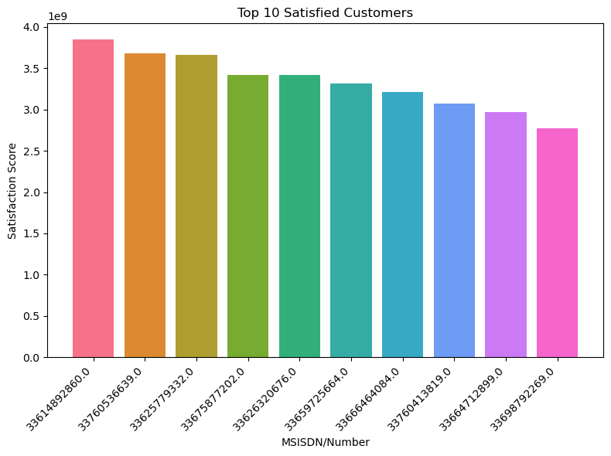
Top 10 satisfaction customers
The top 10 satisfied customers have been identified based on their high satisfaction scores.
Scores range from approximately 2.77 billion to 3.85 billion
Highly Satisfied: These customers are very happy with the telecom services they received.
Likely Loyal: They're likely to stick with the company and may recommend it to others.
Quality Service: The company seems to be delivering good service, meeting customer needs well.
Strengths Identification: Analyzing these customers can help find out what the company is doing right.
Benchmarking: They can be used as examples to improve satisfaction for other customers.

Slide 20
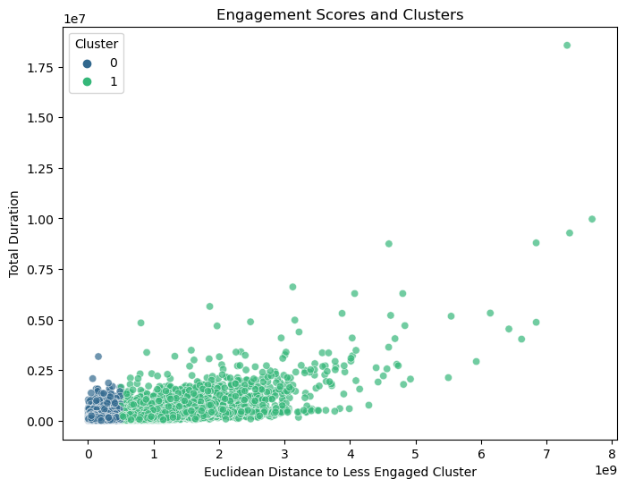
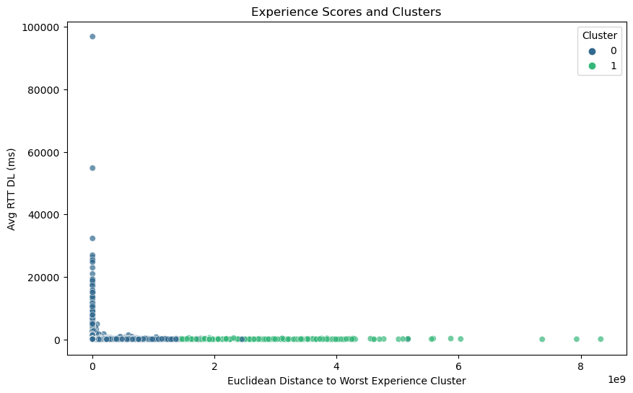
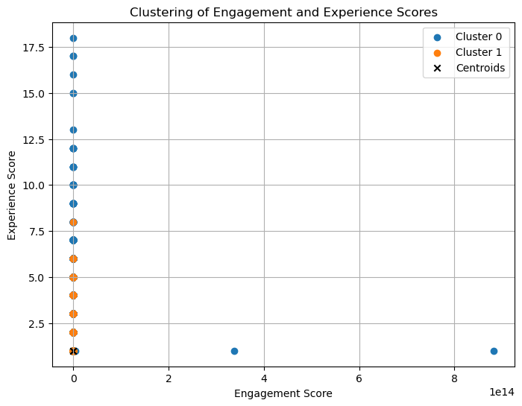
Engagement, experience score and clusters
Less Engaged Users
Worst experience users
K-mean clustering
Retransmission Volumes: Elevated TCP retransmission volumes may indicate potential data reliability issues for less engaged users, suggesting network congestion or packet loss.
Round-Trip Times: Higher round-trip times, both on downlink and uplink, suggest delays in data transmission, impacting network responsiveness for less engaged users.
These insights guide targeted improvements, addressing specific challenges and enhancing network performance for less engaged users.
Positional Significance: Points on the plot show how far users are from the worst experience cluster and their 'Avg RTT DL (ms)' value, giving a clear view of user experiences.
Cluster Identification: Colors denote assigned clusters, facilitating the identification of patterns. This aids in recognizing groups with similar 'Avg RTT DL (ms)' values and their corresponding distances to the worst experience cluster.
It guides strategic decisions to improve network performance and elevate user satisfaction
Clear Segmentation: K-Means clustering identified two distinct clusters in the combined 'Engagement Score' and 'Experience Score,' indicating straightforward segmentation.
Satisfaction Score Integration: Combining both scores results in a 'Satisfaction Score,' providing a comprehensive metric. This integrated approach simplifies insights and actions, allowing for immediate understanding and targeted strategies.
It offers a practical foundation for decision-making and interventions to enhance overall user satisfaction.

Slide 21
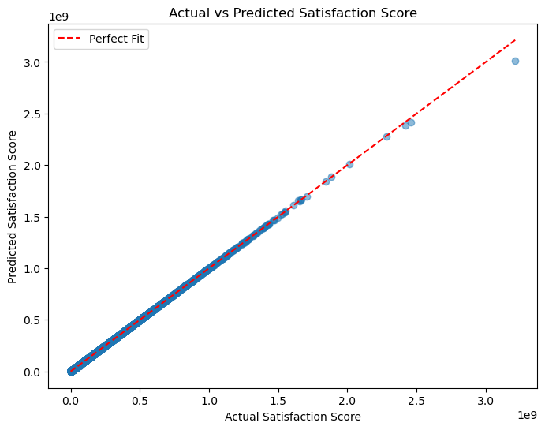
Model building for satisfaction score
The mean squared error (MSE) of approximately 2.21 trillion indicates a very low error between actual and predicted satisfaction scores.
The R2 score of approximately 0.9999 signifies that the model explains about 99.99% of the variance in the satisfaction scores, indicating an excellent fit.
The scatter plot illustrates a strong linear relationship between actual and predicted satisfaction scores, as most points lie close to the perfect fit line (y=x).
Overall, the model demonstrates high accuracy in predicting satisfaction scores, suggesting its effectiveness in this context

Slide 22
Growth opportunities and enhancing user experience from telco’s telecommunication
Market Dominance of Key Players: The data reveals the significant presence of industry giants like Apple, Samsung, and Huawei, indicating their dominance in shaping consumer preferences. This underscores the importance of aligning marketing strategies with these key players to leverage their market influence effectively
User Engagement Clusters: Through K-means clustering, four distinct user engagement clusters have been identified. This segmentation allows for targeted marketing strategies tailored to the specific behavior and preferences of each user group, thereby optimizing resource allocation and enhancing user experiences
Application Usage Insights: Analysis of the top three most used applications highlights the importance of catering to data-intensive activities such as gaming while also acknowledging the diverse set of applications within the "Other" category. Targeted promotions and network optimizations can be devised based on these usage patterns to maximize user satisfaction
In conclusion, the analysis indicates promising opportunities for growth and optimization within TellCo's telecom business. By leveraging the insights provided, the marketing team can make informed decisions regarding strategic investments, resource allocation, and customer-centric initiatives to drive profitability and competitive advantage in the telecommunications industry.
Network Performance and Device Characteristics: A deep dive into network parameters and device characteristics reveals crucial insights into user experience. Understanding factors like TCP retransmission, round-trip time, and throughput enables telecom providers to address network issues promptly and enhance overall service quality.
Satisfaction Analysis and Model Building: By integrating engagement and experience metrics, along with satisfaction scores, a comprehensive understanding of user satisfaction has been achieved. This allows for the identification of top-performing customers, as well as areas for improvement to elevate overall satisfaction levels.

Slide 23


