Slide 1
Core Java – Getting Started (Java-basic)
Fresher Learning Program
January, 2013

Slide 2
Objectives of Java-basic
Purpose:
Basic understanding of Java as a programming language and JVM
To understand benefit of Java
Product:
To be able to write a java program
Understand java source file, how to compile and run java program
Starting point of a java program
How to comment in Java
How to pass run time arguments
Process:
Theory Sessions followed by couple of assignments
A review at the end of the session and a Quiz.

Slide 3
Topics of Java-basic
Introduction of Java
Java Class
JVM
About the Java Program
Advantages
Recap

Slide 4
Introduction
Java is a simple and yet powerful object oriented programming language and it is in many respects similar to C++.
Java originated at Sun Microsystems, Inc. in 1991.
It was conceived by James Gosling at Sun Microsystems, Inc.
It was developed to provide a platform-independent programming language.

Slide 5
Java Class
/** The HelloWorldApp class implements an application that
* simply displays "Hello World!" to the standard output.
*/
class HelloWorldApp {
public static void main(String[] args) {
String hello = "Hello World!";
System.out.println( hello ); //Display the string.
}
}
(General discussion)
multi-line comment
class
method
reserved word
identifier
Single line comment

Slide 6
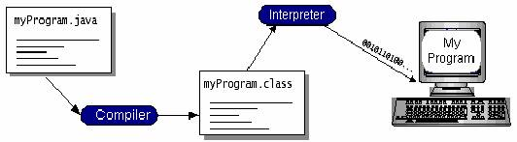
JVM Introduction
JVM
java
javac
Java Bytecode
Machine code

Slide 7
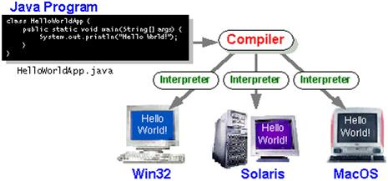
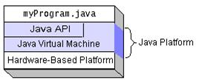
JVM Introduction….contn…

Slide 8
About the Java Program
public- main(..) is the first method called by java environment when a program is executed so it has to accessible from java environment. Hence the access specifier has to be public.
static: Java environment should be able to call this method without creating an instance of the class , so this method must be declared as static.
void: main does not return anything so the return type must be void
The argument String indicates the argument type which is given at the command line and arg is an array for string given during command line.

Slide 9
Setting up CLASSPATH
CLASSPATH environment variable can be used to specify the class search path.
Alternatively, the –classpath option (often abbreviated as to –cp) of the JDK tool commands can be used for the same purpose.
JDK tools first look in the directories where the java standard libraries are installed. If the class is not found there, the tool searches in the class path.
When no class path is defined, the default value of the class path is assumed to be current directory.

Slide 10
Java features
The following are some of them:-
Simple Reusable Portable (Platform Independent) Distributed Robust Secure High Performance

Slide 11
Recap (Keywords)
Starting point
Java class
RUN a java program
Platform independence
JVM
How to compile
Run time argument
Notes:
You may ask participants to explain these key words

Slide 12
Thank You For Your Time

