Slide 1
Seismic Hazard Assessment And Risk Management
Data Visualisation DAS 732 Assignment -3
By Team :- Deadline Missed
Tanish Pathania
Vasu Aggarwal
Hemang Seth

Slide 2
About Our Dataset
In April 2015, the 7.8 magnitude Gorkha earthquake struck near the Gorkha district of Gandaki Pradesh, Nepal.
The disaster resulted in the loss of nearly 9,000 lives and left millions of people homeless.
This Data visualisation will give us impact analysis, which districts were the most affected by the Earthquake, what were the damages caused and what were the aftermaths of this earthquake.
Based on this we would be submitting our analysis where we would be explaining all of these factors.

Slide 3
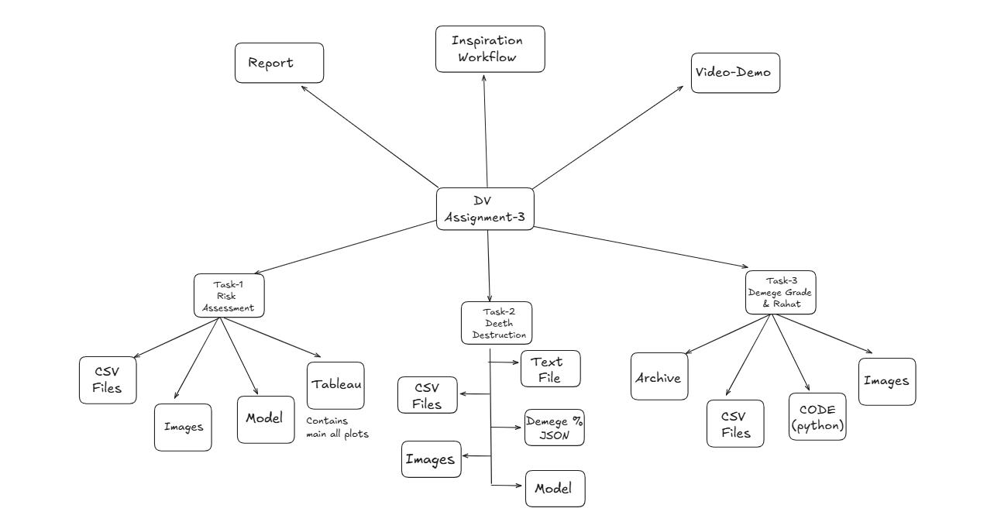
FILE STRUCTURE OF SUBMISSION

Slide 4
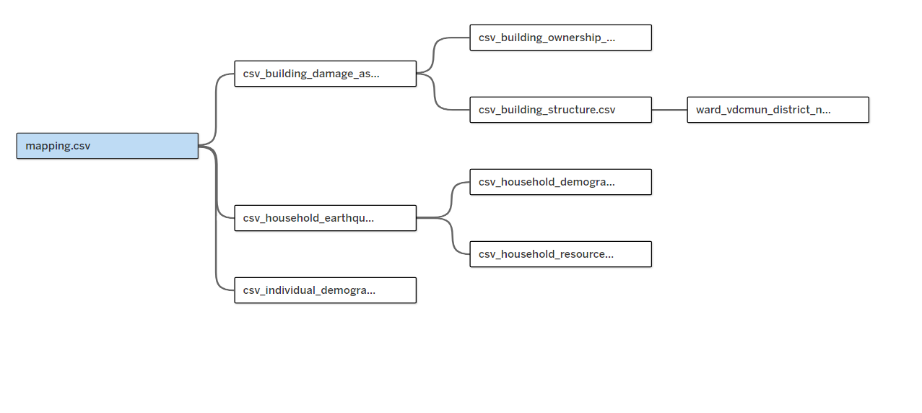
MAPPING OF OUR FILES (Tableau)

Slide 5
Task Allotment
TASK 1:- This involved the predicting of Risk Assessment and how the earthquake has left an impact in the Geo-Technical fault lines of Nepal so that the future earthquakes can be averted -> HEMANG SETH
TASK 2:- This involved the predicting of the Death and Destruction that the Earthquake has caused and how it has affected the population. Where will more damage happen in future-> TANISH PATHANIA
TASK 3:- This involved the predicting of the Damage Grades and Rahat Provided where the damage will be more if actions are not taken and how the poor have been affected by the earthquake as they haven’t received much of the Rahat yet. -> VASU AGGARWAL

Slide 6
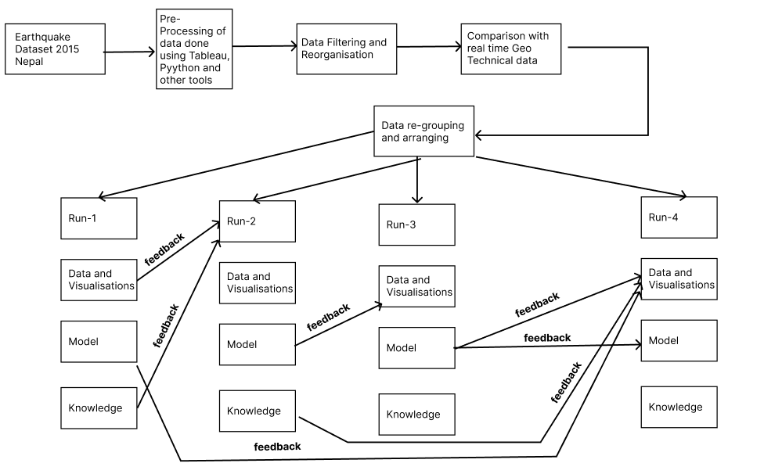
TASK -1- Visual Analytics Workflow

Slide 7
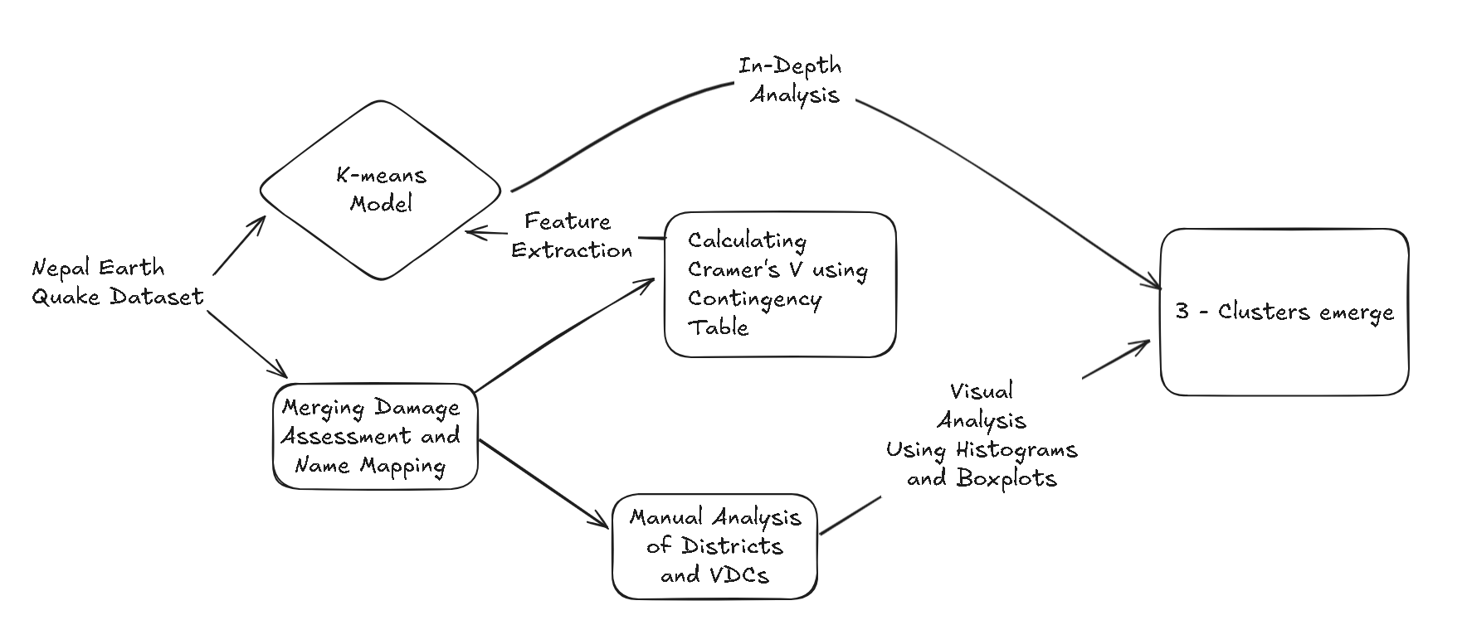
TASK -2- Visual Analytics Workflow

Slide 8
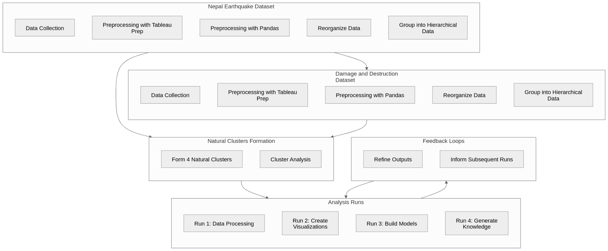
TASK -3- Visual Analytics Workflow

Slide 9
THANK YOU

