Slide 2
EROOR501
Devam Srivastava
Yash Trivedi
Hemangi Rudhankar
Aryan Saini

Slide 3
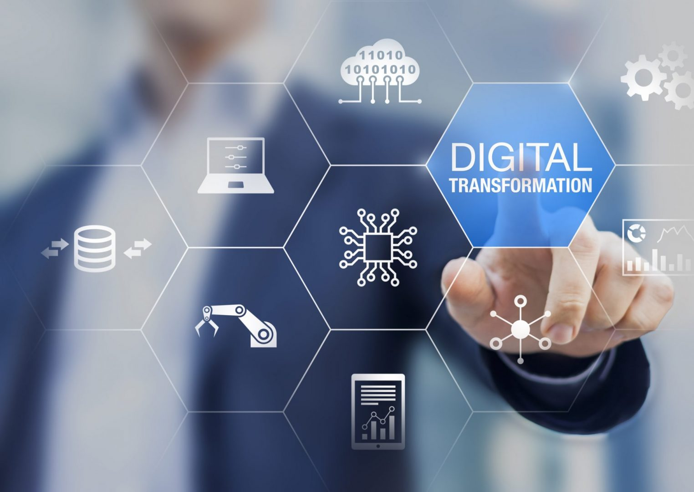
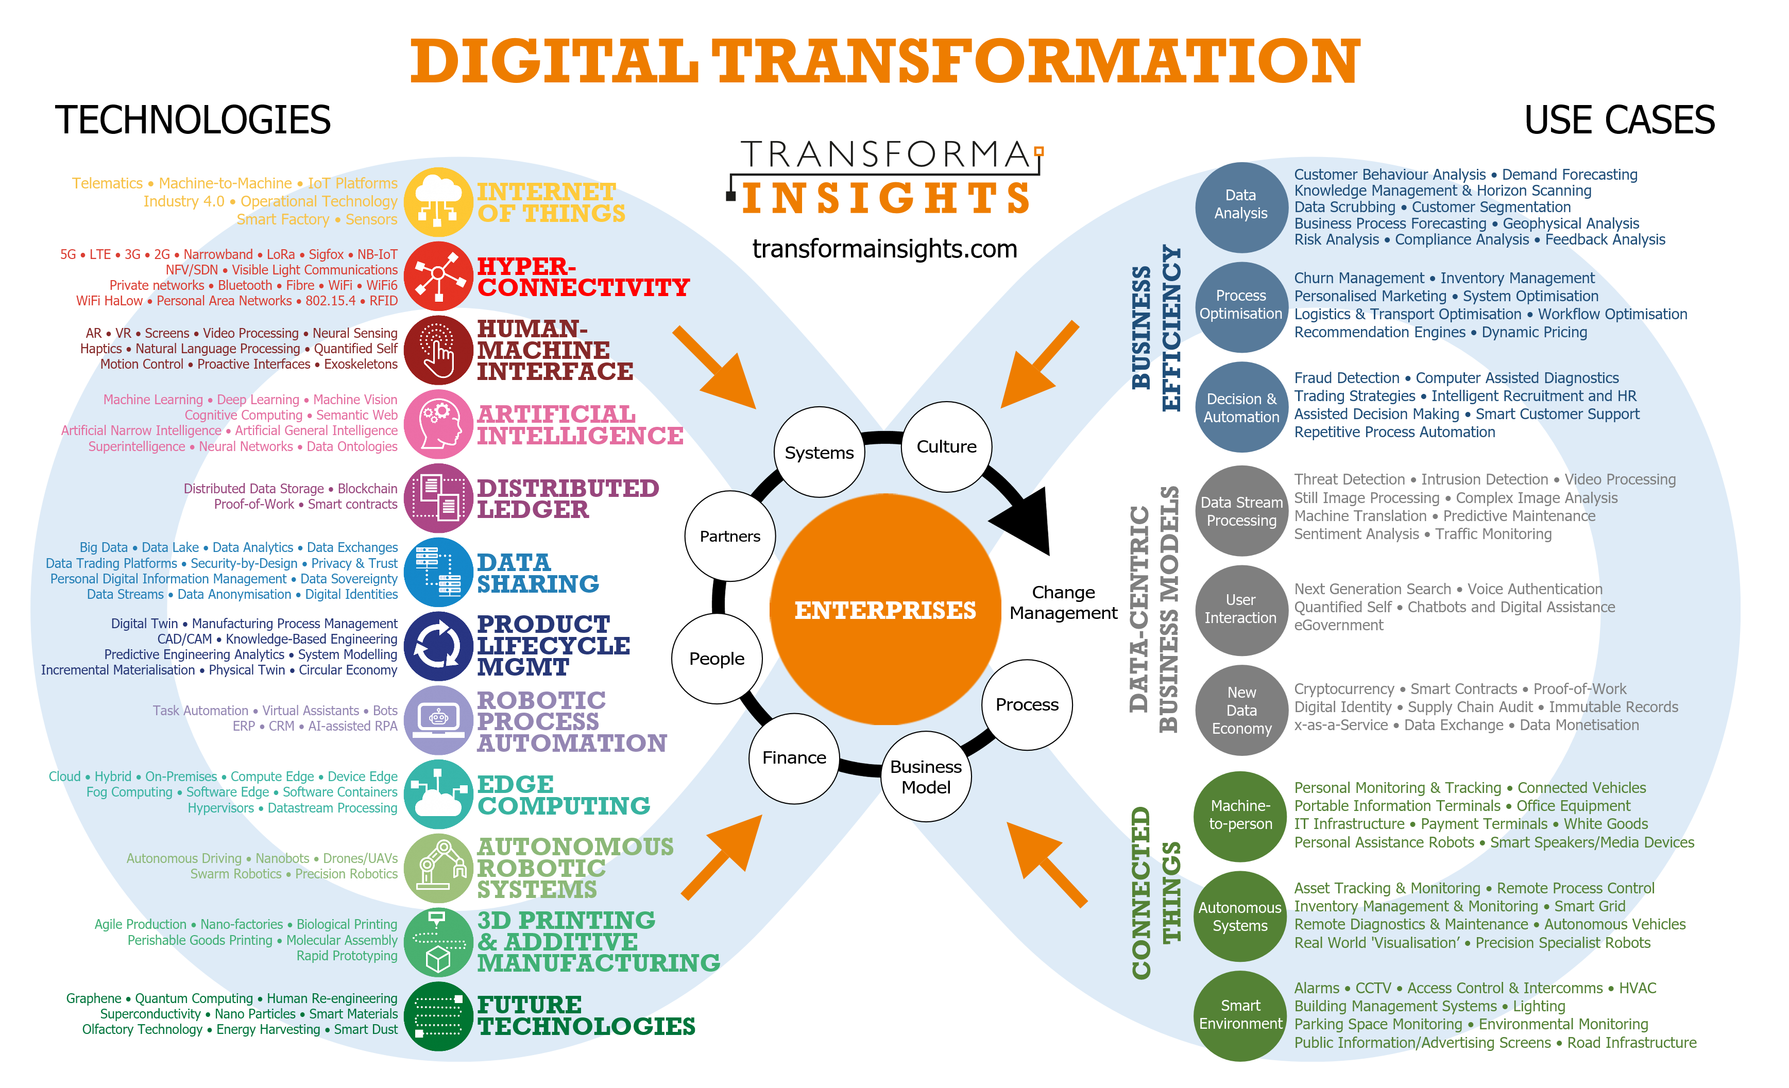
Problem Statement
DIGITALIZATION OF GOVERNMENT SECTOR IN THE FIELD OF ENVIRONMENT

Slide 4
Solution Statement
Our application helps Users get statistical info about the pollution rate, air quality, unemployment rate, etc. in the selected region where they want to establish their businesses or factories.
They also get some suggestions and precautions which can help their business to improve along with taking care of the environment.

Slide 5






Tech Stacks
HTML
CSS
Power BI
Java Script
Java
Python

Slide 6
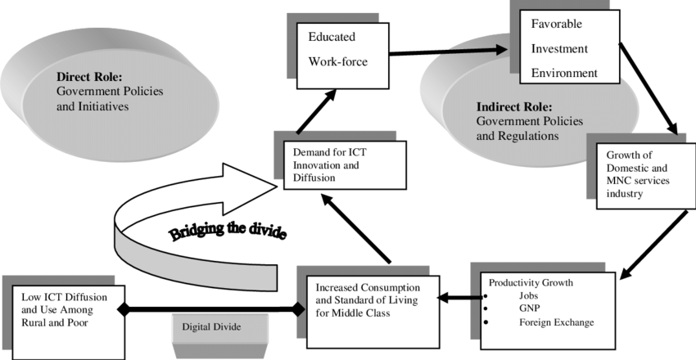

Slide 7

Future Scope of the Project
We are looking towards our project as a ‘GREEN INDIA PROJECT’, so we shall see ourselves as a ‘Pollution Free’ country in the future.

