Slide 1
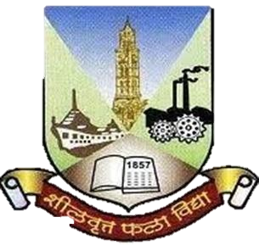
Presentation On
HR Attrition and Performance Dashboard Website
OF
BACHLOR OF SCIENCE(INFORMATION TECHNOLOGY)
BY
Mestry Hemangi Eknath
Seat no :- 1067057
Under the Guidance of
MR. Ninad Dani
Department of Information Technology
Vijayalakshmi Vishwanath Dalvie College Talere.

Slide 2
objective
The objective of this project is to perform an Exploratory Data Analysis (EDA) and Statistical Data Analysis on the HR Analytics Employee Attrition dataset using Python.
2. The goal is to gain insights into the factors influencing employee attrition and performance within the organization.
3. By examining various features and conducting statistical analysis, we aim to identify patterns, trends, and potential areas for improvement that can help the company better understand and manage employee attrition and performance.
4. Document the entire process, including data collection, analysis methodologies, findings, and conclusions. Prepare a comprehensive project report and presentation.

Slide 3
Purpose
The purpose of the "HR Attrition and Performance" project is to utilize data analytics methodologies to gain deeper insights into employee attrition and performance within organizations. The project aims to apply data-driven approaches to address the challenges of retaining talent and optimizing employee productivity by analyzing historical HR data and employing advanced analytics techniques.

Slide 4
Scope:- A Dashboard website for HR attrition and performance could be really helpful. It would give companies useful info about why employees leave and how well they're doing. This helps them keep their best workers and do better overall. HR teams would love it because it gives them quick, useful data and tips to make employees happier and the company more successful. Technologies:- Frontend And Backend:- Python Language( Streamlit Framework) Tools:- Visual Studio Code Microsoft Edge Star Uml For The Diagram

Slide 5
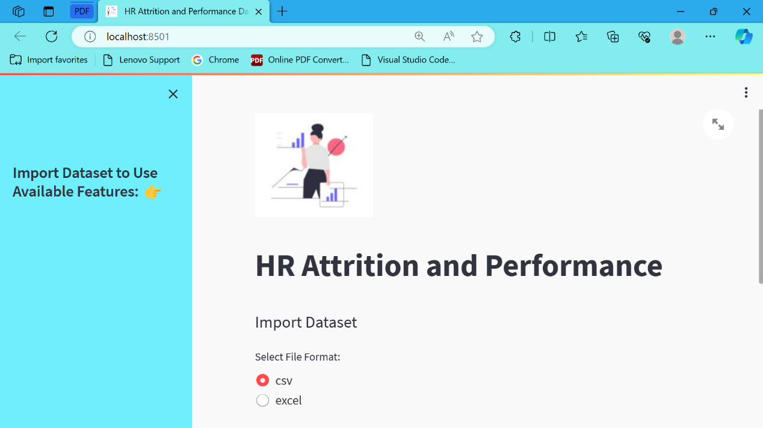
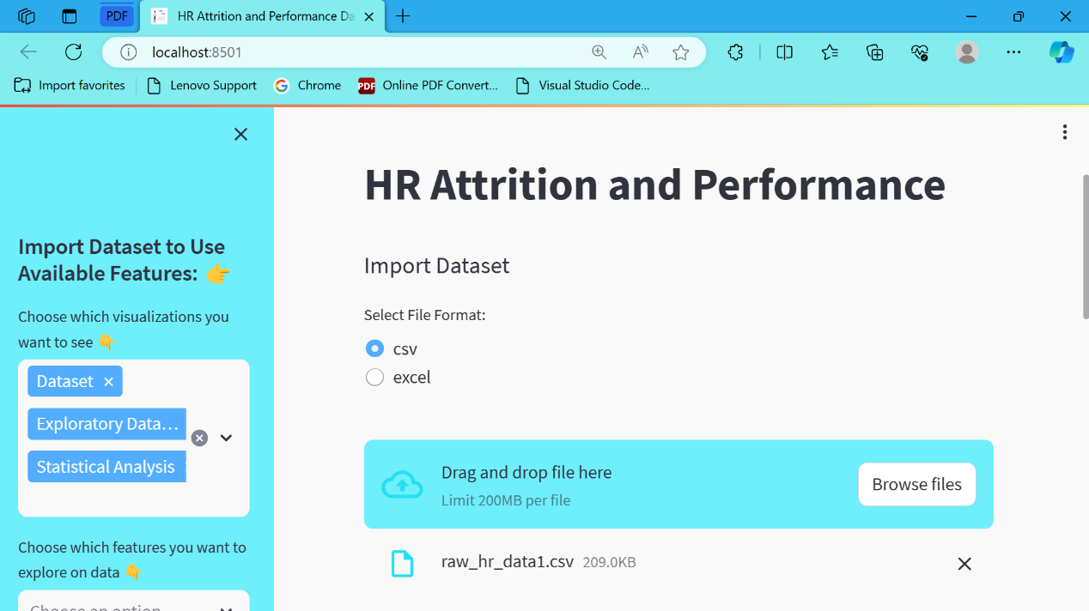
INTERFACE

Slide 6
Conclusions
In conclusion, the HR attrition and performance dashboard website provides a comprehensive solution for monitoring employee turnover and performance within an organization. By offering easily accessible data and insights, it empowers HR professionals and decision-makers to make informed choices to enhance employee retention and productivity. With user-friendly interfaces and intuitive features, this platform serves as a valuable tool in managing human resources effectively. Embracing this dashboard can lead to improved workforce management, better employee satisfaction, and ultimately, greater success for the organization as a whole.

