Slide 1
PROJECT PROCESS REPORT
“RECEIPT AND ENVOICE DEGITIZER”
TEAM A:
Ankit Sharma
Hemanjali Kodali
nirupama pardhu nakketla Sandana Aini Rethika S

Slide 2
PROJECT OVERVIEW
Backend system for Receipt & Invoice Digitizer
User Registration and Login
Password Hashing using bcrypt
JWT-based Authentication
SQLite Database Integration

Slide 3
Abstract
Invoice and Receipt Digitizer is Secure backend system for uploading and managing financial documents digitally.
Provides user authentication, a protected dashboard, and file storage.
Creates a foundation for future automation such as OCR-based data extraction.
Developed using FastAPI and React.
Follows a layered architecture separating APIs, business logic, and database operations.
User credentials are protected using password hashing.
Access to resources is secured through JWT-based authentication.
Designed for scalability, security, and modular expansion.
Ready to support advanced intelligent document processing in future phases.

Slide 4
Introduction
Manual handling of invoices and receipts is time-consuming and error-prone.
The system enables users to upload and manage documents digitally.
Provides secure access through authentication and a user dashboard.
Built using FastAPI with a scalable, modular design and Frontend using React.
Acts as the base for future OCR and intelligent automation.

Slide 5
Tech Stack
Frontend
React (version 18)
HTML, CSS
REST API integration
Dashboard UI for upload and management
Backend
FastAPI
JWT Authentication
Password Hashing
RESTful APIs

Slide 6
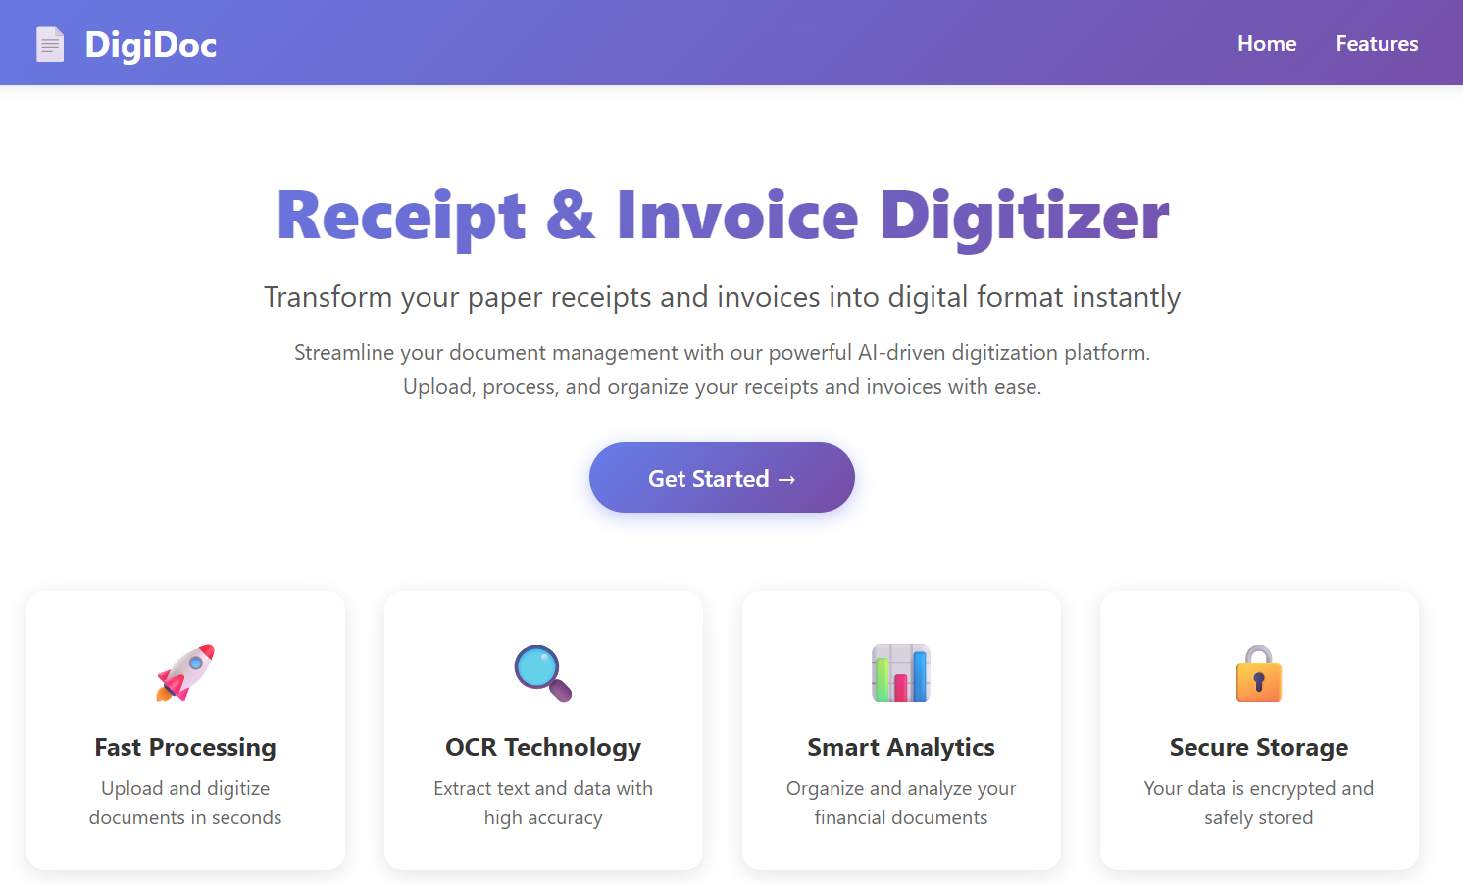
Frontend Architecture
Dashboard
Full-Stack Web Application (React + Node.js + Express)
Drag & Drop File Upload
OCR Simulation
File Management Dashboard
Export & Analytics

Slide 7
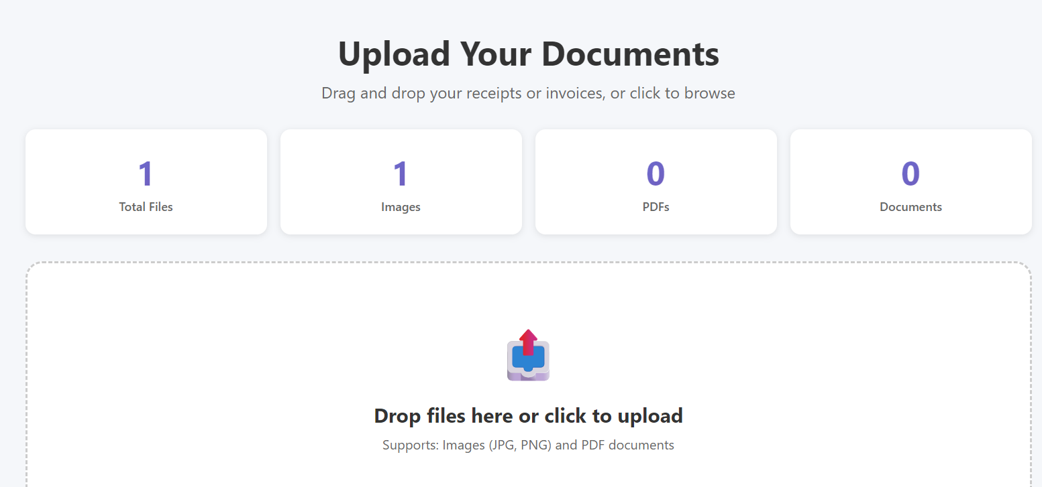
Frontend Architecture
Frontend Core Features
1. Drag & Drop Upload
HTML5 Drag & Drop API
React useState
2. File Preview
Image tag for images
iframe for PDFs
3. Search & Filter
Real-time filtering using JavaScript
Controlled input fields
4. Statistics Dashboard
Array filter & reduce methods

Slide 8
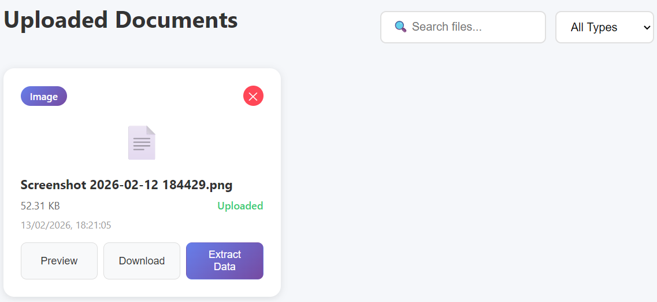
Frontend Architecture
Frontend State & API Communication
React Hooks Used
useState – Manage UI data
useEffect – Load data on mount
API Communication
Fetch API
GET, POST, DELETE requests
FormData for file upload
Blob API for export
Frontend updates UI automatically when state changes.

Slide 9
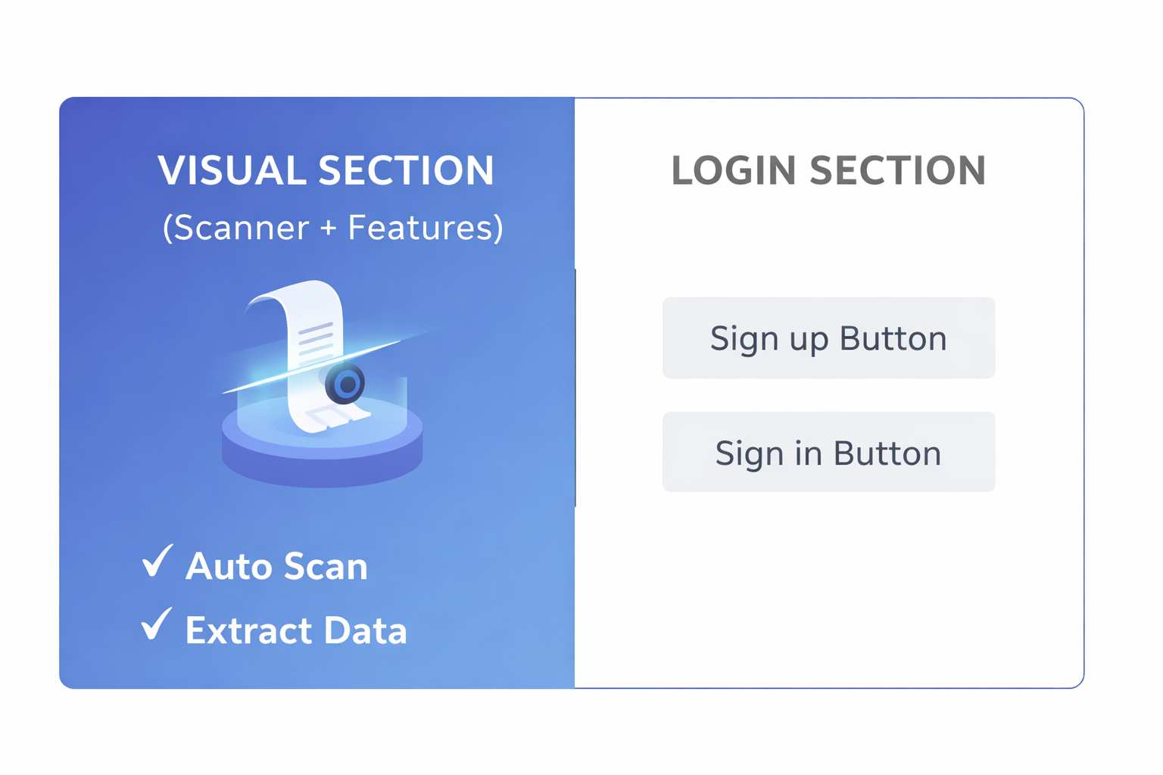
Frontend Architecture
User Login
Provides interface for users to sign in or register.
Accepts email and password as credentials.
Sends login request to backend APIs.
Stores received authentication token for session use.
Redirects authenticated users to the dashboard.
Figure shows the user Login Screen

Slide 10
Backend Architecture
Built using FastAPI with a modular, layered design.
APIs receive requests from the client and forward them to the service layer.
Service layer handles business logic such as authentication and file handling.
Repository layer manages communication with the database.
SQLite is used for storing users and document metadata.
JWT-based authentication protects routes and ensures secure access.
Clear separation of concerns improves scalability and maintainability.

Slide 11
Future Scope
Integrate OCR to automatically extract data from invoices and receipts.
Add analytics and expense insights through dashboards and reports.
Support multi-format and multi-language document processing.
Enable cloud storage and backup for scalability.
Provide search, filtering, and advanced document retrieval.

Slide 12
Thank You

