Slide 1
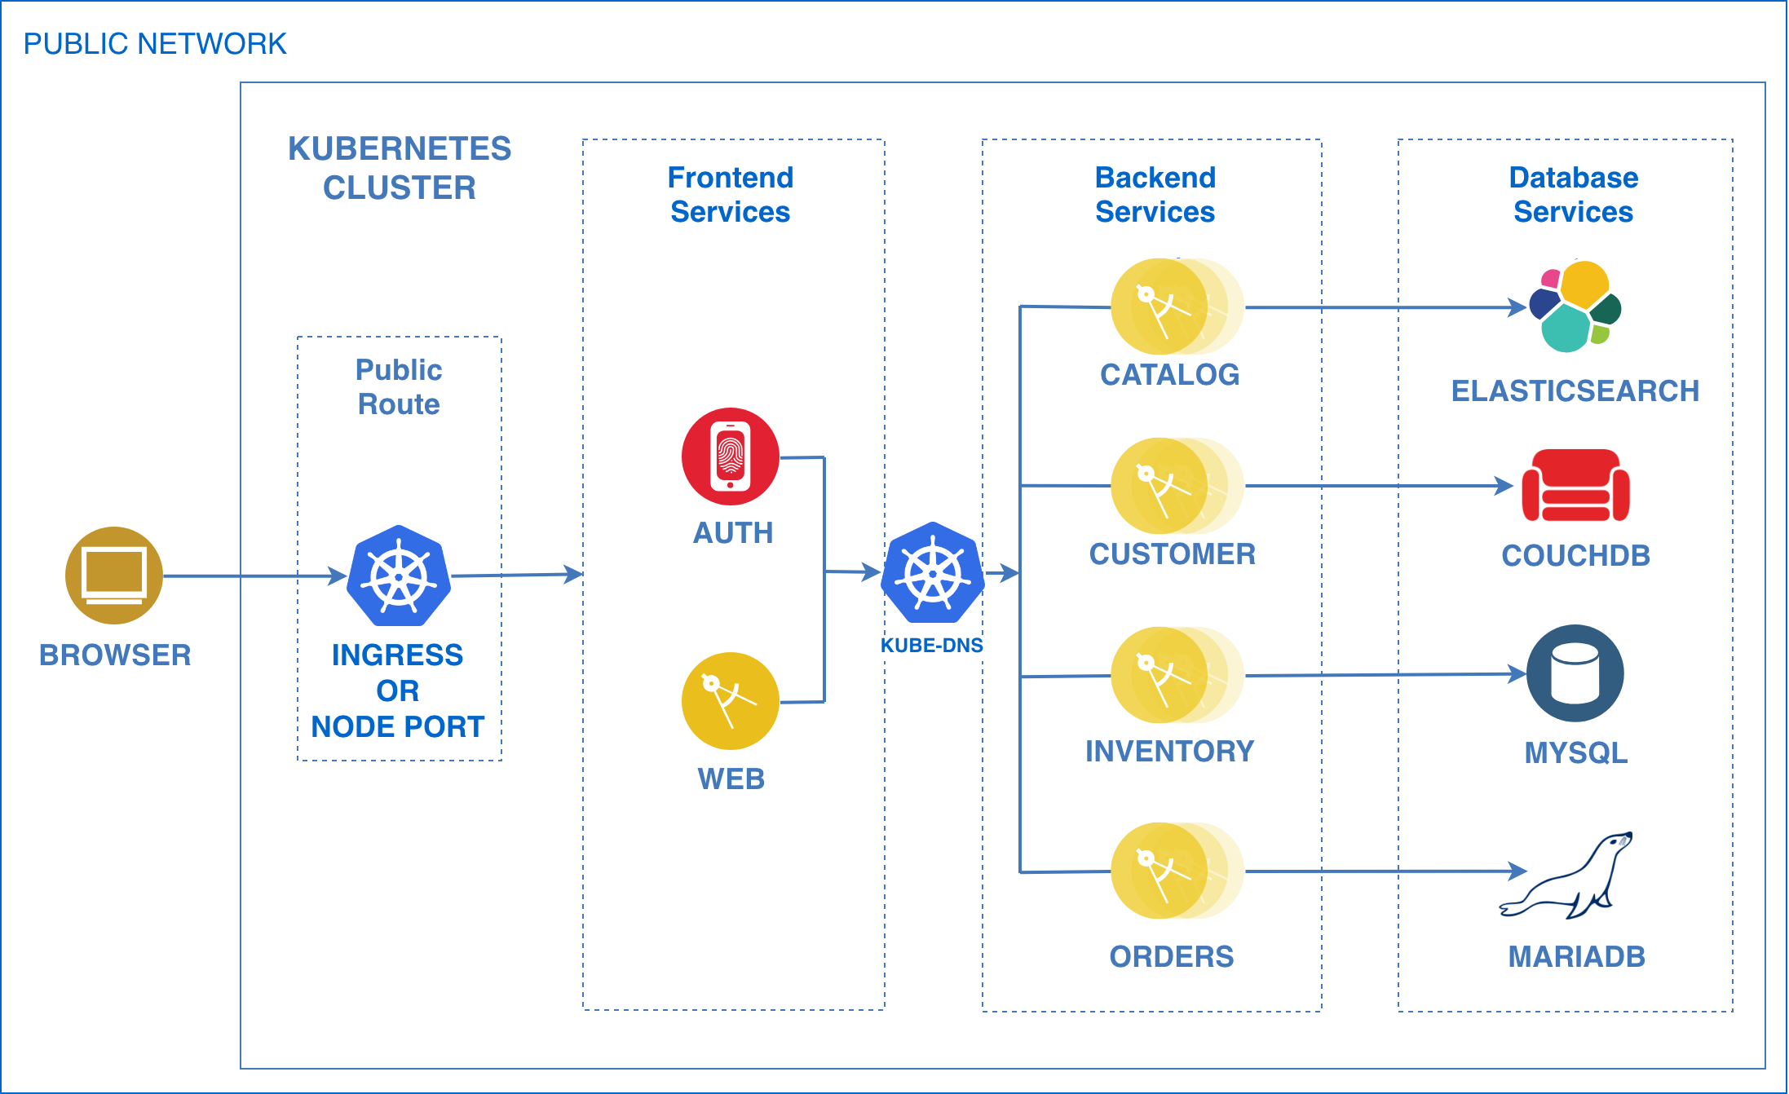
CLOUD REFERENCE ARCHITECTURES
Ask us about the Free Nougat!
CSMO
DevOps
ICP
Cognitive
MCM
Security
Infrastructure
Analytics
Come ask us about specific technology, practices, and tool choices to build and deploy apps on Cloud
Cloud Native Apps
Event Driven Architectures

