Slide 1
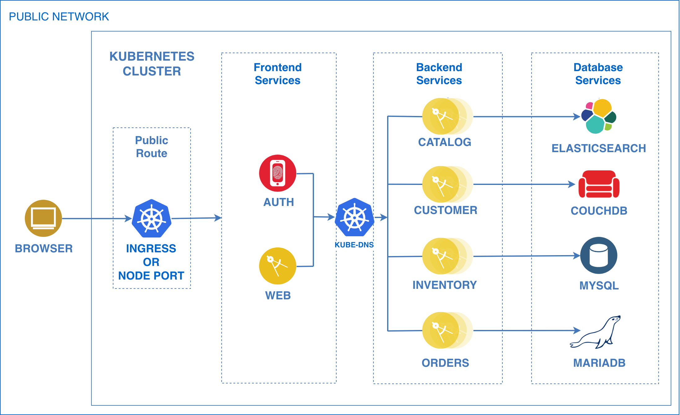
CLOUD REFERENCE ARCHITECTURES
MCM
CSMO
DevOps
ICP
Analytics
Cognitive
Security
Infrastructure
Come ask us about specific technology, practices, and tool choices to build and deploy apps on Cloud
Cloud Native Apps
Event Driven Architectures

