Slide 1
Basic Stopwatch
Made By Hemanshu Sonar
Intern @V2VEdTech LLP

Slide 2
1. IDEA / APPROACH DETAILS
The goal of the Professional Stopwatch App is to provide users with a sleek, professional tool for timing events with precision. The app should be user-friendly, aesthetically pleasing, and feature-rich, catering to both casual users and professionals who require accurate time tracking.

Slide 3
2. DESIGN
Professional and clean UI with a branded logo and background.
1st
Intuitive layout with easy access to Start, Stop, Lap, and Reset functions.
2nd
Display of current time and list of lap times.
3rd
A cohesive color palette to enhance user experience and visual appeal.
4th

Slide 4
3. FEATURES
Start/Stop Timer: Initiates and halts the stopwatch.
Lap Functionality: Records intermediate times.
Reset Button: Clears the timer and lap times.
Toast Notifications: Feedback for user actions.
Lap Times List: Displays all recorded lap times.

Slide 5
4. DEVELOPMENT PROCESS
Project Setup:
Create a new project in Android Studio.
Set up dependencies and configure project settings.
UI Design:
Design the layout using XML.
Implement styles and themes for a professional look.
Core Functionality:
Develop the timer logic using Handler and Runnable.
Implement button functionalities.
Testing and Debugging:
Test all functionalities.
Debug any issues and refine the app.

Slide 6
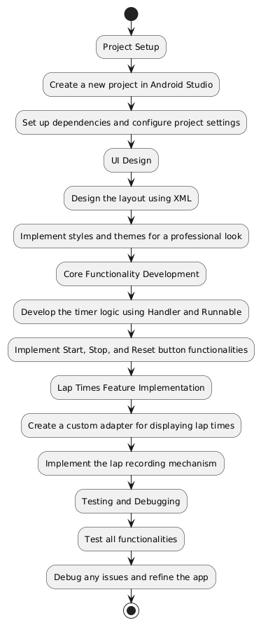

Slide 7
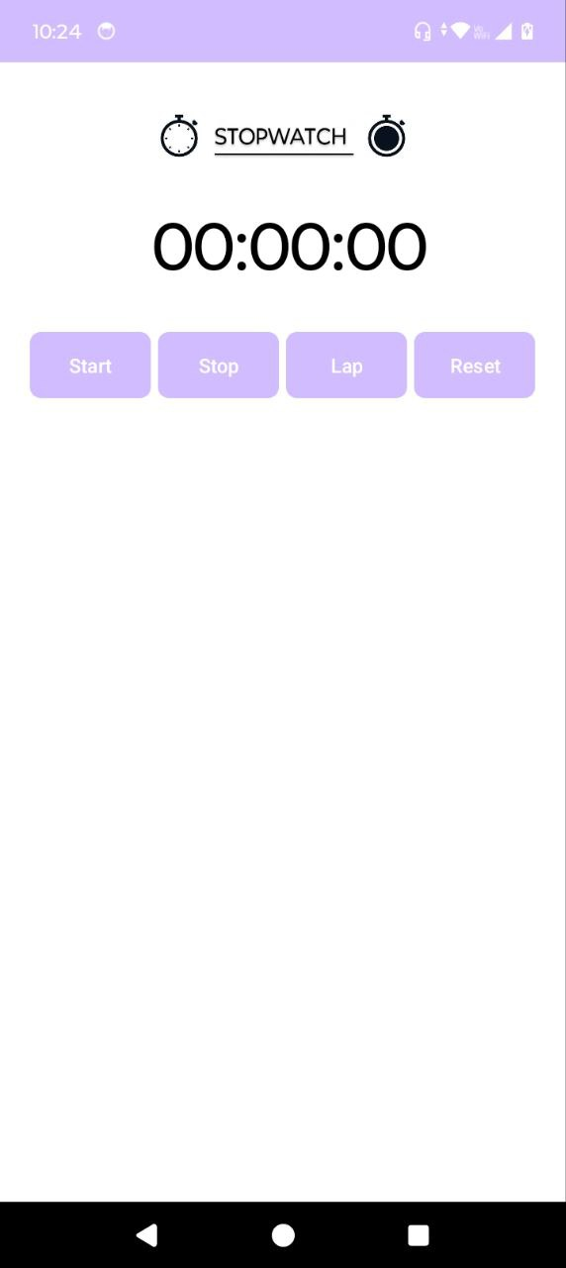
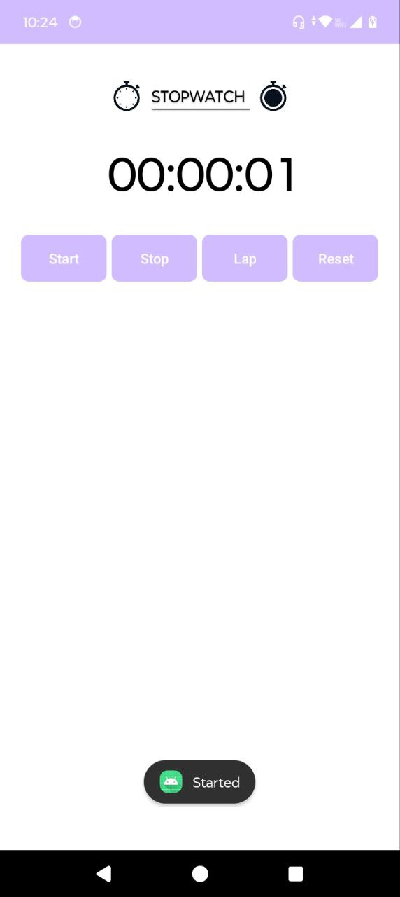
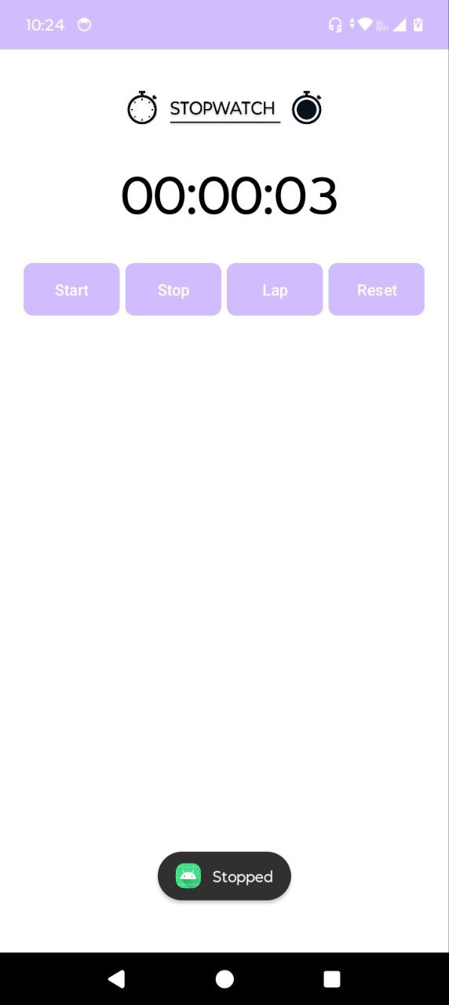
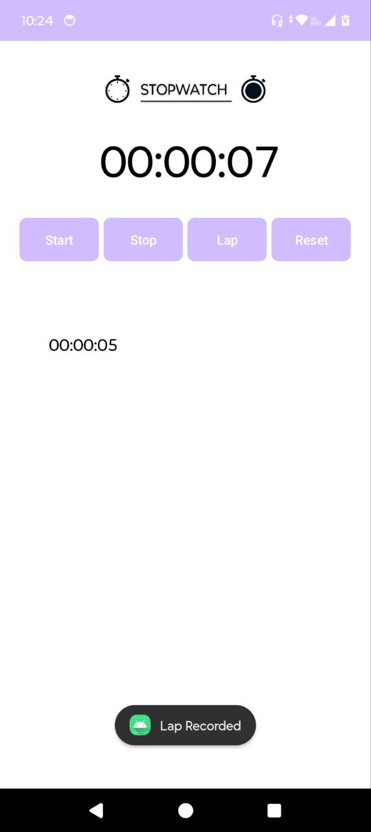
5. USER INTERFACE

Slide 8
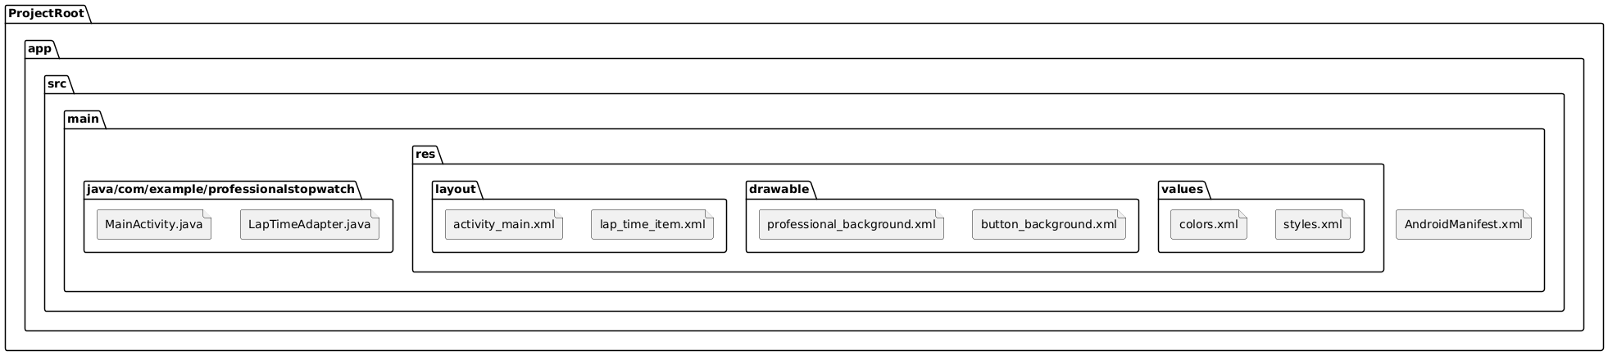
6. DIRECTORY STRUCTURE

Slide 9
7. MODULES REQUIRED
Core Timer Logic: Handles the start, stop, and reset functionalities.
Toast Notifications: Feedback for user actions.
Lap Time Recording: Custom adapter for displaying lap times.
UI Components: Layouts and styles for a professional interface.

Slide 10
8. REFERENCES
Android Developer Documentation: Official guidelines and examples.
Stack Overflow:
Community support for troubleshooting and best practices.
https://stackoverflow.com
Open Source Projects:
Inspiration and code snippets for implementing features.

Slide 11
9. FUTURE SCOPE
Export Lap Times: Allow users to export lap times as a CSV or text file.
Customizable Themes: Offer different colour schemes and themes.
Voice Commands: Integrate voice commands for hands-free control.
Advanced Analytics: Provide detailed analysis of lap times and performance.
A
B
D
C

Slide 12
10. Q&A

Slide 13
THANK YOU !

