Slide 1
Question
1. Match List-I with List-II.
Choose the correct answer from the options given below: [02 April, 2025 (Shift-II)]
List-I | List-II
A. Heat capacity of body | I. J kg⁻¹
B. Specific heat capacity of body | II. JK⁻¹
C. Latent heat | III. J kg⁻¹ K⁻¹
D. Thermal conductivity | IV. Jm⁻¹ K⁻¹s⁻¹
A
(A)-(III), (B)-(I), (C)-(II), (D)-(IV)
B
(A)-(IV), (B)-(III), (C)-(II), (D)-(I)
C
(A)-(III), (B)-(IV), (C)-(I), (D)-(II)
D
(A)-(II), (B)-(III), (C)-(I), (D)-(IV)

Slide 2
Question
2. Match List-I with List-II. [29 Jan, 2025 (Shift-II)]
Choose the correct answer from the options given below:
List-I | List-II
A. Magnetic induction | I. Ampere meter²
B. Magnetic intensity | II. Weber
C. Magnetic flux | III. Gauss
D. Magnetic moment | IV. Ampere meter
A
(A)-(III), (B)-(II), (C)-(I), (D)-(IV)
B
(A)-(I), (B)-(II), (C)-(III), (D)-(IV)
C
(A)-(III), (B)-(IV), (C)-(I), (D)-(II)
D
(A)-(III), (B)-(IV), (C)-(II), (D)-(I)

Slide 3
Question
3. Electric field in a certain region is given by $\vec{E} = \left( \frac{A}{x^{2}} \hat{i} + \frac{B}{y^{3}} \hat{j} \right)$. The SI unit of A and B are: [30 Jan, 2023 (Shift-I)]
A
$Nm^{3}C^{-1}; Nm^{2}C^{-1}$
B
$Nm^{2}C^{-1}; Nm^{3}C^{-1}$
C
$Nm^{3}C; Nm^{2}C$
D
$Nm^{2}C; Nm^{3}C$

Slide 4
Question
4. Match List-I with List-II. [27 Aug, 2021 (Shift-I)]
Choose the correct answer from the options given below:
List-I | List-II
A. R_H (Rydberg constant) | I. kg m⁻¹ s⁻¹
B. h(Planck's constant) | II. kg m² s⁻¹
C. $μ_{B}$ (Magnetic field energy density) | III. m⁻¹
D. $η$(coefficient of viscosity) | IV. kg m⁻¹ s⁻²
A
A-II, B-III, C-IV, D-I
B
A-III, B-II, C-I, D-IV
C
A-III, B-II, C-IV, D-I
D
A-IV, B-II, C-I, D-III

Slide 5
Question
5. If E and H represents the intensity of electric field and magnetising field respectively, then the unit of E/H will be: [27 Aug, 2021 (Shift-I)]
A
Joule
B
Newton
C
Ohm
D
Mho

Slide 6
Question
6. The density of a material in SI units is 128 kg m⁻³. In certain units in which the unit of length is 25 cm and the unit of mass 50 g, the numerical value of density of the material is [10 Jan, 2019 (Shift-I)]
A
40
B
16
C
640
D
410

Slide 7
Question
7. The dimension of $\sqrt{\frac{μ_{0}}{ε_{0}}}$ is equal to that of: $(μ_{0} = Vacuum permeability and ε_{0} = Vacuum permittivity)$ [07 April, 2025 (Shift-II)]
A
Voltage
B
Capacitance
C
Inductance
D
Resistance

Slide 8
Question
8. Match List-I with List-II.
Choose the correct answer from the options given below: [07 April, 2025 (Shift-II)]
List-I | List-II
(A) Mass density | (I) $[ML^{2} T^{-3}]$
(B) Impulse | (II) $[MLT^{-1}]$
(C) Power | (III) $[ML^{2} T^{0}]$
(D) Moment of inertia | (IV) $[ML^{-3} T^{0}]$
A
(A)-(IV), (B)-(II), (C)-(III), (D)-(I)
B
(A)-(I), (B)-(III), (C)-(IV), (D)-(II)
C
(A)-(IV), (B)-(II), (C)-(I), (D)-(III)
D
(A)-(II), (B)-(III), (C)-(IV), (D)-(I)

Slide 9
Question
9. Match the LIST-I with LIST-II
Choose the correct answer from the options given below: [03 April, 2025 (Shift-I)]
LIST-I | LIST-II
A. Boltzmann constant | I. $ML^{2} T^{-1}$
B. Coefficient of viscosity | II. $MLT^{-3} K^{-1}$
C. Planck's constant | III. $ML^{2} T^{-2} K^{-1}$
D. Thermal conductivity | IV. $ML^{-1} T^{-1}$
A
A-III, B-IV, C-I, D-II
B
A-II, B-III, C-IV, D-I
C
A-III, B-II, C-I, D-IV
D
A-III, B-IV, C-II, D-I

Slide 10
Question
10. Given a charge q, current I and permeability of vacuum $μ_{0}$. Which of the following quantity has the dimension of momentum? [02 April, 2025 (Shift-I)]
A
$qI/μ_{0}$
B
$qμ_{0} I$
C
$q^{2}μ_{0} I$
D
$qμ_{0}/I$

Slide 11
Question
11. If $μ_{0}$ and $ε_{0}$ are the permeability and permittivity of free space, respectively, then the dimension of $\left( \frac{1}{μ_{0} ε_{0}} \right)$ is: [02 April, 2025 (Shift-I)]
A
$L/T^{2}$
B
$L^{2}/T^{2}$
C
$T^{2}/L$
D
$T^{2}/L^{2}$

Slide 12
Question
12. If B is magnetic field and $μ_{0}$ is permeability of free space, then the dimensions of $(B/μ_{0})$ is: [22 Jan, 2025 (Shift-I)]
A
$ML^{2}T^{-2}A^{-1}$
B
$MT^{-2}A^{-1}$
C
$LT^{-2}A^{-1}$
D
$L^{-1}A$

Slide 13
Question
13. Which one of the following is the correct dimensional formula for the capacitance in F? M, L, T and C stand for unit of mass, length, time and charge: [22 Jan, 2025 (Shift-I)]
A
$[F] = [C^{2}M^{-1} L^{-2} T^{2}]$
B
$[F] = [CM^{-1} L^{-2} T^{-2}]$
C
$[F] = [CM^{-1} L^{-2} T^{2}]$
D
$[F] = [C^{2}M^{-1} L^{2} T^{2}]$

Slide 14
Question
14. The position of a particle moving on x-axis is given by $x(t) = A \sin{} t + B {\cos{}}^{2} t + Ct + D$, where t is time. The dimension of $\frac{ABC}{D}$ is [23 Jan, 2025 (Shift-I)]
A
$L^{3}T^{-2}$
B
$L^{2}$
C
$L^{2}T^{-2}$
D
L

Slide 15
Question
15. Match List - I with List - II.
Choose the correct answer from the options given below: [23 Jan, 2025 (Shift-I)]
List - I | List - II
(A) Permeability of free space | (I) $[ML^{2} T^{-2}]$
(B) Magnetic field | (II) $[MT^{-2}A^{-1}]$
(C) Magnetic moment | (III) $[ML^{-2}A^{-2}]$
(D) Torsional constant | (IV) $[L^{2}A]$
A
(A)-(IV), (B)-(III), (C)-(I), (D)-(II)
B
(A)-(III), (B)-(II), (C)-(IV), (D)-(I)
C
(A)-(II), (B)-(I), (C)-(III), (D)-(IV)
D
(A)-(I), (B)-(IV), (C)-(II), (D)-(III)

Slide 16
Question
16. The energy E and momentum p of a moving body of mass m are related by some equation. Given that c represents the speed of light, identify the correct equation [24 Jan, 2025 (Shift-I)]
A
$E^{2} = pc^{2} + m^{2}c^{4}$
B
$E^{2} = pc^{2} + m^{2}c^{2}$
C
$E^{2} = p^{2}c^{2} + m^{2}c^{4}$
D
$E^{2} = p^{2}c^{2} + m^{2}c^{2}$

Slide 17
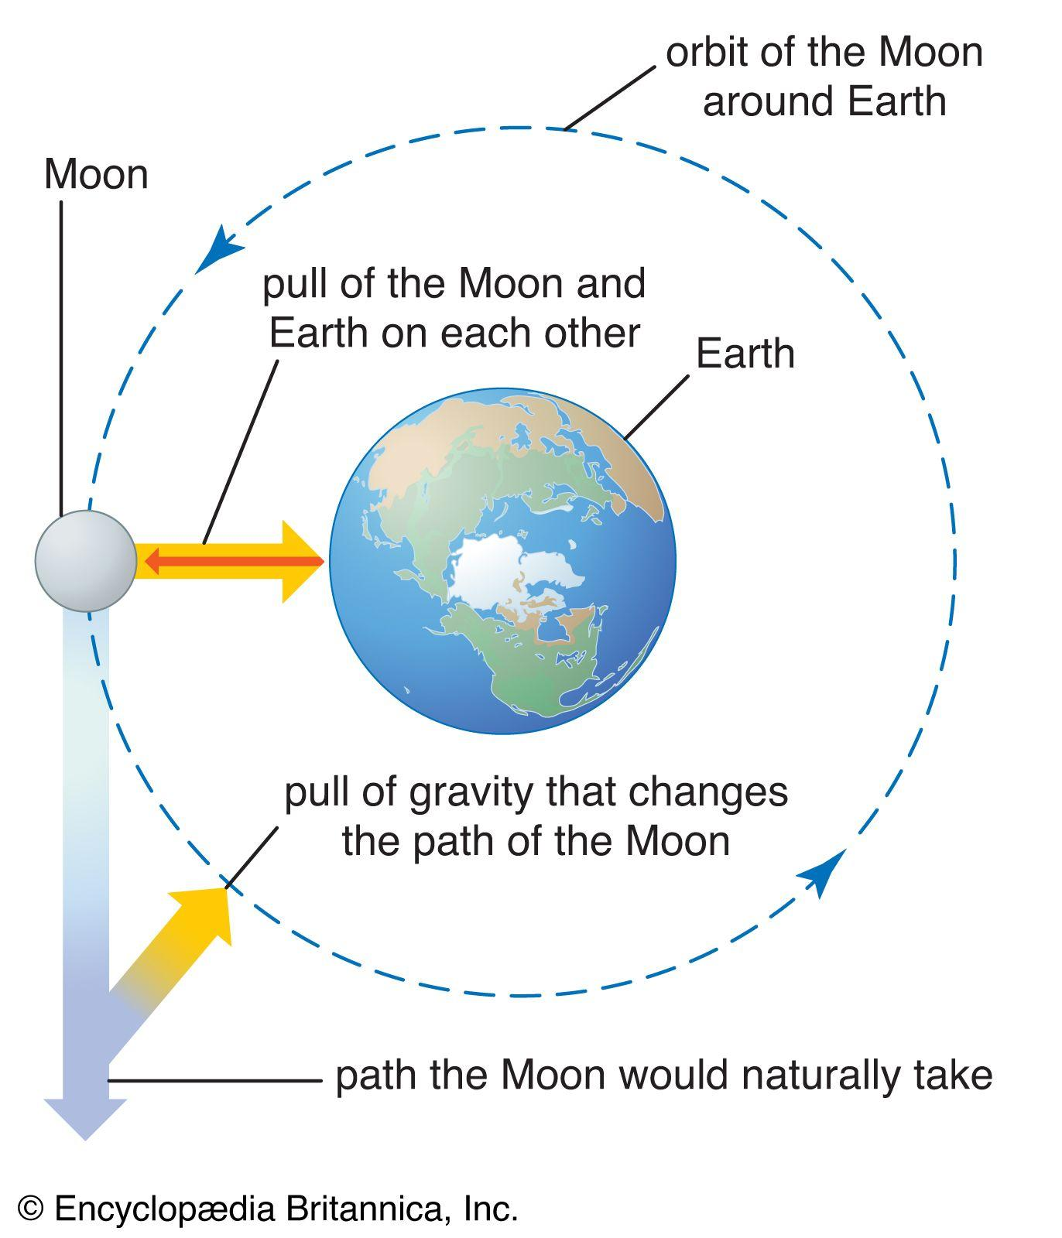
Question
17. In a measurement, it is asked to find modulus of elasticity per unit torque applied on the system. The measured quantity has dimension of $[M^{a} L^{b} T^{c}]$. If b = 3, the value of c is______. [28 Jan, 2025 (Shift-I)]

Slide 18
Question
18. Match List-I with List-II. [28 Jan, 2025 (Shift-I)]
Choose the correct answer from the options given below:
List-I | List-II
A. Angular Impulse | I. $[M^{0} L^{2} T^{-2}]$
B. Latent Heat | II. $[ML^{2} T^{-3}A^{-1}]$
C. Electrical resistivity | III. $[ML^{2} T^{-1}]$
D. Electromotive force | IV. $[ML^{3} T^{-3}A^{-2}]$
A
(A)-(III), (B)-(I), (C)-(II), (D)-(IV)
B
(A)-(II), (B)-(I), (C)-(IV), (D)-(III)
C
(A)-(III), (B)-(I), (C)-(IV), (D)-(II)
D
(A)-(I), (B)-(III), (C)-(IV), (D)-(II)

Slide 19
Question
19. The pair of physical quantities not having same dimensions is: [29 Jan, 2025 (Shift-I)]
A
Pressure and Young's modulus
B
Surface tension and impulse
C
Angular momentum and Planck's constant
D
Torque and energy

Slide 20
Question
20. The expression given below shows the variation of velocity ($υ$) with time (t), $υ = At^{2} + \frac{Bt}{C+t}$. The dimension of ABC is: [29 Jan, 2025 (Shift-I)]
A
$[M^{0}L^{2}T^{-2}]$
B
$[M^{0}L^{1}T^{-2}]$
C
$[M^{0}L^{2}T^{-3}]$
D
$[M^{0}L^{1}T^{-3}]$

Slide 21
Question
21. Match List-I with List-II. [29 Jan, 2025 (Shift-II)]
Choose the correct answer from the options given below:
List-I | List-II
A. Young's Modulus | I. M L⁻¹ T⁻¹
B. Torque | II. M L⁻¹ T⁻²
C. Coefficient of Viscosity | III. M⁻¹ L³ T⁻²
D. Gravitational Constant | IV. M L² T⁻²
A
(A)-(II), (B)-(IV), (C)-(I), (D)-(III)
B
(A)-(IV), (B)-(I), (C)-(IV), (D)-(III)
C
(A)-(IV), (B)-(II), (C)-(III), (D)-(I)
D
(A)-(I), (B)-(III), (C)-(II), (D)-(IV)

Slide 22
Question
22. The dimensional formula of latent heat is: [09 April, 2024 (Shift-I)]
A
$[M^{0}LT^{-2}]$
B
$[MLT^{-2}]$
C
$[M^{0}L^{2}T^{-2}]$
D
$[ML^{2}T^{-2}]$

Slide 23
Question
23. If $ε_{0}$ is the permittivity of free space and E is the electric field, then $ε_{0} E^{2}$ has the dimensions: [08 April, 2024 (Shift-II)]
A
$[M^{0} L^{-2} T A]$
B
$[ML^{-1}T^{-2}]$
C
$[M^{-1}L^{-3}T^{4}A^{2}]$
D
$[ML^{2}T^{-2}]$

Slide 24
Question
24. Given below are two statements:
Statement (I): Dimensions of specific heat is $[L^{2}T^{-2}K^{-1}]$
Statement (II): Dimensions of gas constant is $[ML^{2}T^{-1}K^{-1}]$ [06 April, 2024 (Shift-II)]
A
Statement (I) is incorrect but statement (II) is correct
B
Both statement (I) and statement (II) are incorrect
C
Statement (I) is correct but statement (II) is incorrect
D
Both statement (I) and statement (II) are correct

Slide 25
Question
25. Match List I with List II
Choose the correct answer from the options given below: [06 April, 2024 (Shift-II)]
List-I | List-II
A. Torque | I. $[M^{1}L^{1}T^{-2}A^{-2}]$
B. Magnetic field | II. $[L^{2}A^{1}]$
C. Magnetic moment | III. $[M^{1}T^{-2}A^{-1}]$
D. Permeability of free space | IV. $[M^{1}L^{2}T^{-2}]$
A
A-I, B-III, C-II, D-IV
B
A-IV, B-III, C-II, D-I
C
A-III, B-I, C-II, D-IV
D
A-IV, B-I, C-II, D-III

Slide 26
Question
26. What is the dimensional formula of $ab^{-1}$ in the equation $\left(P + \frac{a}{V^{2}}\right)(V-b) = RT$, where letters have their usual meaning. [05 April, 2024 (Shift-I)]
A
$[M^{0}L^{3}T^{-2}]$
B
$[ML^{2}T^{-2}]$
C
$[M^{-1}L^{5}T^{3}]$
D
$[M^{0}L^{3}T^{4}]$

Slide 27
Question
27. If G be the gravitational constant and u be the energy density then which of the following quantity have the dimension as that of $\sqrt{uG}$: [05 April, 2024 (Shift-I)]
A
Pressure gradient per unit mass
B
Force per unit mass
C
Gravitational potential
D
Energy per unit mass

Slide 28
Question
28. The dimensional formula of angular impulse is: [1 Feb, 2024 (Shift-I)]
A
$[ML^{-2}T^{-1}]$
B
$[ML^{2}T^{-2}]$
C
$[MLT^{-1}]$
D
$[ML^{2}T^{-1}]$

Slide 29
Question
29. Given below are two statements:
Statement-I: Planck's constant and angular momentum have same dimensions.
Statement-II: Linear momentum and moment of force have same dimensions.
In the light of the above statements, choose the correct answer from the options given below: [27 Jan, 2024 (Shift-I)]
A
Statement-I is true but Statement-II is false
B
Both Statement-I and Statement-II are false
C
Both Statement-I and Statement-II are true
D
Statement-I is false but Statement-II is true

Slide 30
Question
30. Match List-I with List-II. [30 Jan, 2024 (Shift-I)]
Choose the correct answer from the options given below:
List-I | List-II
A. Coefficient of viscosity | I. $[M L^{2}T^{-2}]$
B. Surface Tension | II. $[M L^{2}T^{-2}]$
C. Angular momentum | III. $[M L^{-1}T^{-1}]$
D. Rotational kinetic energy | IV. $[M L^{0}T^{-2}]$
A
A-II, B-I, C-IV, D-III
B
A-I, B-II, C-III, D-IV
C
A-III, B-IV, C-II, D-I
D
A-IV, B-III, C-II, D-I

Slide 31
Question
31. Match List-I with List-II.
Choose the correct answer from the options given below:
List-I | List-I
A. Young's Modulus (Y) | I. $[ML^{-1}T^{-1}]$
B. Coefficient of Viscosity ($η$) | II. $[ML^{2}T^{-1}]$
C. Planck's Constant (h) | III. $[ML^{-1}T^{-2}]$
D. Work Function ($φ$) | IV. $[ML^{2}T^{-2}]$
A
A-II, B-III, C-IV, D-I
B
A-III, B-I, C-II, D-IV
C
A-I, B-III, C-IV, D-II
D
A-I, B-II, C-III, D-IV

Slide 32
Question
32. Match List-I with List-II:
Choose the correct answer from the options given below: [25 Jan, 2023 (Shift-II)] [29 Jan, 2023 (Shift-I)]
List-I (Physical Quantity) | List-II (Dimensional Formula)
A. Pressure gradient | I. $[M^{0}L^{2}T^{-2}]$
B. Energy density | II. $[M^{0}L^{-1}T^{-2}]$
C. Electric Field | III. $[M^{1}L^{2}T^{-2}]$
D. Latent heat | IV. $[M^{0}L^{1}T^{-3}A^{-1}]$
A
A-III, B-II, C-I, D-IV
B
A-II, B-III, C-IV, D-I
C
A-III, B-II, C-IV, D-I
D
A-II, B-III, C-I, D-IV

Slide 33
Question
33. Match List - I with List - II
Choose the correct answer from the options given below: [25 Jan, 2023 (Shift-I)]
List - I | List - II
A. Surface tension | I. Kgm⁻¹s⁻¹
B. Pressure | II. Kgms⁻¹
C. Viscosity | III. Kgm⁻¹s⁻²
D. Impulse | IV. Kgs⁻²
A
A-(IV), B-(III), C-(II), D-(I)
B
A-(IV), B-(III), C-(I), D-(II)
C
A-(III), B-(IV), C-(I), D-(II)
D
A-(II), B-(I), C-(III), D-(IV)

Slide 34
Question
34. Match List-I with List-II
Choose the correct answer from the options given below: [12 April, 2023 (Shift-I)]
List-I | List-II
A. Spring constant | I. (T⁻¹)
B. Angular speed | II. (MT⁻²)
C. Angular momentum | III. (ML²)
D. Moment of Inertia | IV. (ML²T⁻¹)
A
A-II, B-I, C-IV, D-III
B
A-IV, B-I, C-III, D-II
C
A-II, B-III, C-I, D-IV
D
A-I, B-III, C-II, D-IV

Slide 35
Question
35. Match List-I with List-II.
Choose the correct answer from the options given below: [31 Jan, 2023 (Shift-II)]
List-I | List-II
A. Angular momentum | I. [ML² T⁻²]
B. Torque | II. [ML⁻² T⁻²]
C. Stress | III. [ML² T⁻¹]
D. Pressure gradient | IV. [ML⁻¹ T⁻²]
A
A-I, B-IV, C-III, D-II
B
A-III, B-I, C-IV, D-II
C
A-II, B-III, C-IV, D-I
D
A-IV, B-II, C-I, D-III

