Slide 1

Refractive Index
This constant in Snell's Law is denoted by the symbol μ (Read as *mew*).
It is known as the refractive index of the second medium with respect to the first medium.
It is given as
$μ = \frac{Speed of Light in first medium}{Speed of Light in second medium}$
For Example
If a ray of light travels from air to water, then the constant $μ = \frac{\sin{} i}{\sin{} r}$ is the refractive index of water with respect to air.
It is given as
Similarly, if a ray of light travels from air to glass, then
Note: The refractive index of air is 1. No medium can have refractive index less than 1.

Slide 2
Apparent Depth
When a vessel (like a glass, bucket, or swimming pool) is filled with a transparent liquid (like water), the bottom of the vessel appears to be raised when viewed from above.
This is due to refraction of light – rays coming from the bottom bend away from the normal as they pass from denser medium (liquid) to rarer medium (air).
So, the bottom does not look at its real depth, but at an apparent depth.

Slide 3
Real Depth and Apparent Depth
The relationship between Real Depth and Apparent Depth
$Apparent Depth = \frac{Real Depth}{μ}$
Where:
μ = refractive index of the liquid (w.r.t. air.)
Real depth = actual or true depth of the liquid.
Apparent depth = depth as seen from above.
Applications / Observations in Daily Life:
1. A swimming pool looks shallower than it really is.
2. A coin at the bottom of a glass of water appears raised.
3. Stick dipped in water appears bent at the surface

Slide 4
Question
The refractive index is the ratio of:
A
Speed of light in air to that in vacuum
B
Speed of light in denser medium to that in rarer medium
C
Speed of light in vacuum to that in the medium
D
None of these

Slide 5
Question
If the speed of light in glass is $2 × 10^{8}$ m/s and in air is $3 × 10^{8}$ m/s, the refractive index of glass w.r.t air is:
A
1.33
B
1.5
C
2
D
0.66

Slide 6
Question
If refractive index of diamond = 2.42, then the speed of light in diamond is approximately:
(Take speed of light in air = $3 × 10^{8}$ m/s)
A
$1.24 × 10^{8}$ m/s
B
$2.42 × 10^{8}$ m/s
C
$3.42 × 10^{8}$ m/s
D
$7.26 × 10^{8}$ m/s

Slide 7
Question
A vessel contains water of depth 20 cm. If refractive index of water = 1.33, the apparent depth will be:
A
26.6 cm
B
15 cm
C
13.3 cm
D
10 cm

Slide 8
Early Sunrise and Delayed Sunset
1. Before sunrise and after sunset, the upper layers of the atmosphere are warmer than the layers near the Earth's surface.
Hence, the air near the Earth's surface is denser than the air above.
2. When the Sun is just below the horizon, light from it passes through the Earth's atmosphere.
3. As the light travels from a rarer to a denser medium, it bends towards the normal at each refraction.
4. Due to the continuous bending of light rays at different successive layers, the Sun appears to be slightly higher in the sky than its actual position.
5. As a result:
In the morning, the Sun is seen a few minutes before it actually rises.
In the evening, the Sun is seen for 3–4 minutes even after it has actually set.
6. Therefore, the duration of the day appears longer by about 4 minutes.

Slide 9
Mirage in a Desert
1. Definition
In deserts, sometimes an inverted image of a tree is seen, which gives a false impression of water under the tree.
This phenomenon is called a mirage.
2. Cause of Mirage
It is caused due to refraction of light.
During daytime, the sand becomes very hot and heats the air just above it.
Thus, the air near the ground is hotter (rarer), while the air above is cooler (denser).
3. Layered Air Effect
The air forms layers with gradually increasing density as we move upward.
Lower layers: rarer (hot air).
Upper layers: denser (cool air).

Slide 10
Mirage in a Desert (Continued)
4. Path of Light
Light ray from the top of a tree travels from denser to rarer layers and bends away from the normal at each refraction.
The bending continues until the angle of refraction becomes 90° (light travels parallel to the ground).
Beyond this stage, the ray suffers total internal reflection instead of refraction.
5. Formation of Mirage
The reflected ray now travels upward, bending towards the normal while passing from rarer to denser layers.
When this ray reaches the observer's eye, it appears to come from the ground.
Thus, the observer sees an inverted image of the tree, giving the illusion of a pool of water.

Slide 11
Refraction of Light through a rectangular Glass Block/Slab
Phenomenon
A ray of light entering a rectangular glass slab undergoes two refractions – one on entering, one on leaving – and emerges parallel to its original direction but laterally displaced.
Steps of Refraction
The ray enters the glass from air → bends towards the normal (because glass is denser).
The ray travels straight inside the slab.
The ray emerges from glass to air → bends away from the normal.
The emergent ray is parallel to the incident ray but shifted sideways (lateral displacement).

Slide 12
Key Observations
Incident ray and emergent ray are parallel.
Lateral shift depends on thickness of slab and angle of incidence.
Key Line for Students
In a rectangular glass slab, the emergent ray is parallel but laterally displaced from the incident ray.

Slide 13
Question
The sun is seen about 2 minutes earlier at sunrise and about 2 minutes later at sunset due to:
A
Atmospheric scattering
B
Apparent shift of sun's position because of refraction
C
Rotation of Earth
D
Optical illusion only

Slide 14
Question
During sunrise and sunset, light from the sun bends:
A
Towards the normal
B
Away from the normal
C
Along the tangent
D
Not at all

Slide 15
Question
In a desert, air near the ground is:
A
Cooler and denser
B
Hotter and rarer
C
Hotter and denser
D
Same as upper air layers

Slide 16
Question
The inverted image of a tree in a mirage is seen because of:
A
Dispersion
B
Total Internal Reflection
C
Diffraction
D
Shadow formation

Slide 17
Question
When a ray of light passes through a rectangular glass slab, it:
A
Deviates from its path
B
Emerges parallel to the incident ray
C
Emerges perpendicular to the incident ray
D
Shows dispersion of colours

Slide 18
Question
In a glass slab, the angle of incidence is equal to the angle of:
A
Refraction
B
Emergence
C
Deviation
D
Reflection

Slide 19
Prism
A prism is a transparent medium bounded by five plane surfaces with a triangular cross section.
Two opposite surfaces of prism are identical and parallel triangles, while the other three surfaces are rectangular and inclined on each other

Slide 20
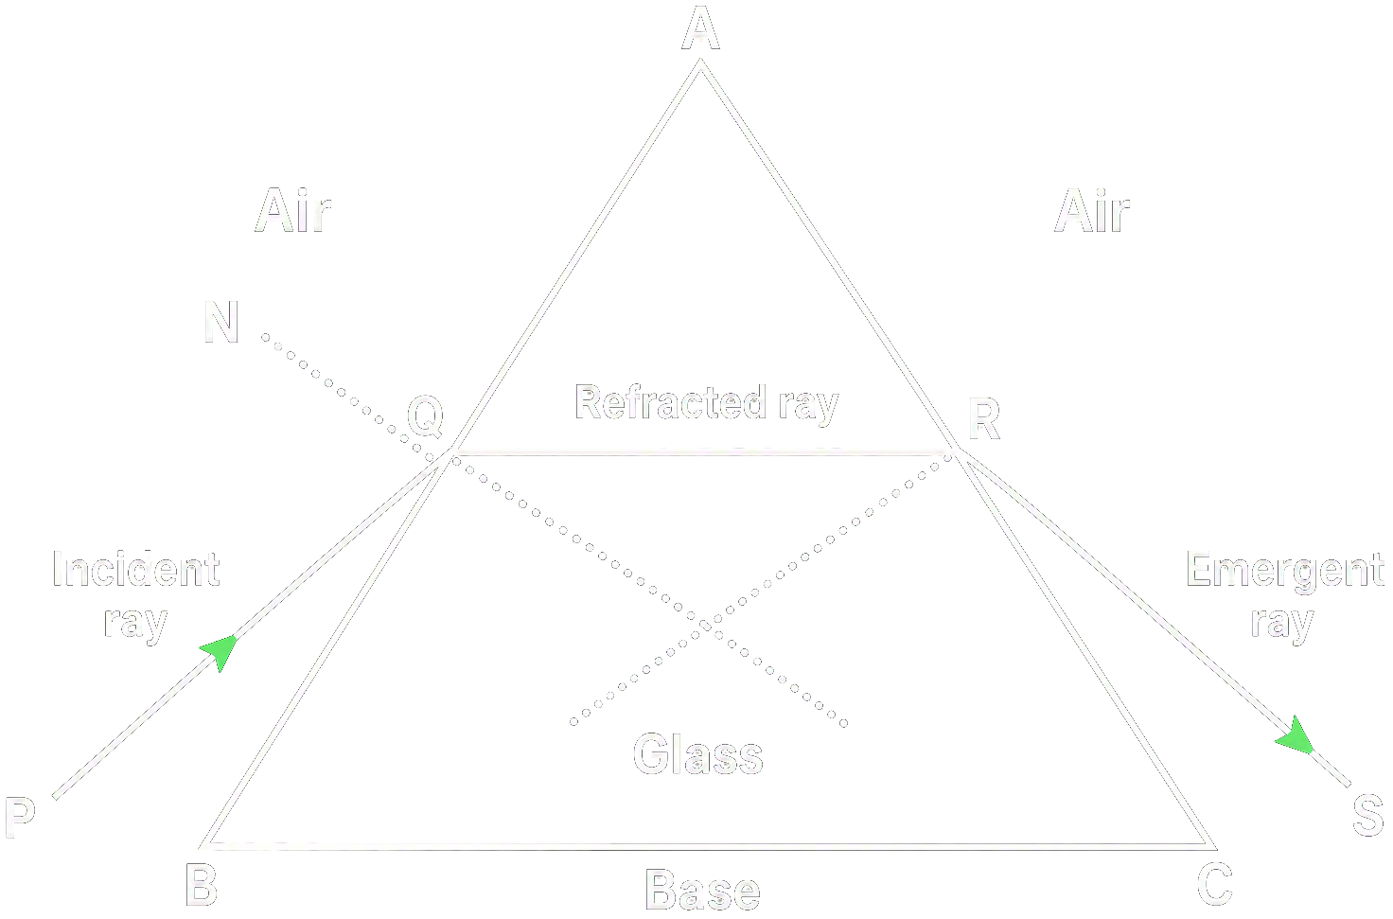
Refraction of light through a prism
1. Entry of Light into Prism
When a ray of light enters a glass prism from air, it bends towards the normal because glass is denser than air.
This is the first refraction.
2. Inside the Prism
The light travels inside the prism in a straight line.
3. Emergence of Light from Prism
When the ray comes out of the prism (from glass to air), it bends away from the normal, because air is rarer than glass.
This is the second refraction.

Slide 21
Refraction of light through a prism (Continued)
4. Deviation of Light
After both refractions, the emergent ray is in a different direction compared to the incident ray.
The angle between the incident ray and the emergent ray is called the Angle of Deviation (D).

Slide 22
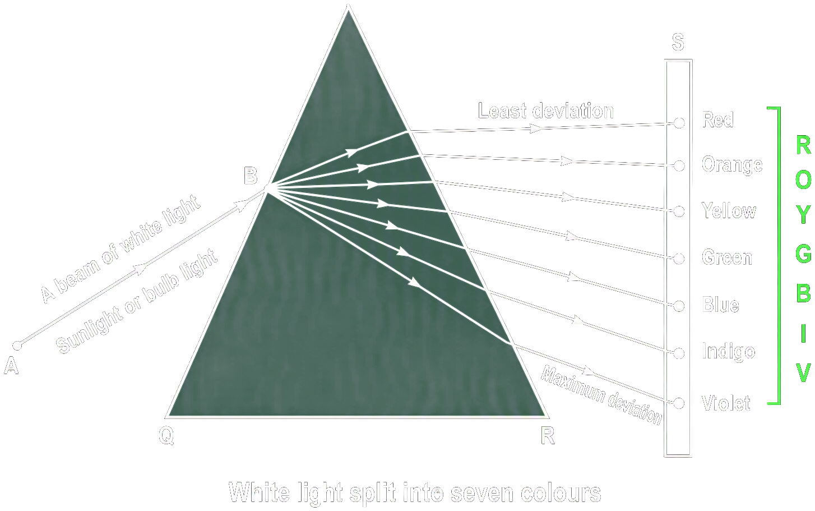
Dispersion of White Light
Newton's Experiment
White light from the sun was allowed to enter a dark room through a small aperture in a window.
A glass prism was placed in the path of this light.
The light coming out of the prism was received on a white screen.
2. Observation
A coloured patch like a rainbow appeared on the screen.
This coloured band was called the spectrum.
3. Order of Colours in Spectrum (VIBGYOR)

Slide 23
Dispersion of White Light (Continued)
4. Definition of Spectrum
Spectrum is the coloured band obtained on a screen when white light passes through a prism.
5. Conclusion by Newton
White light is a mixture of seven colours.
Prism does not produce colours; it only separates the colours already present in white light.
6. Dispersion of Light
The splitting of white light into its seven constituent colours on passing through a prism is called dispersion of light

Slide 24
Question
A prism is usually made of:
A
Wood
B
Glass or Plastic
C
Metal
D
Stone

Slide 25
Question
When a ray of light enters a prism from air, it bends: :
A
Away from the normal
B
Towards the normal
C
Does not bend
D
Parallel to the normal

Slide 26
Question
The angle between the incident ray and the emergent ray in a prism is called:
A
Angle of Prism
B
Angle of Reflection
C
Angle of Refraction
D
Angle of Deviation

Slide 27
Question
The splitting of white light into seven colours by a prism is called:
A
Dispersion of Light
B
Reflection of Light
C
Reflection of Light
D
Diffraction of Light

Slide 28
Question
The sequence of colours in the spectrum obtained from a prism is remembered by:
A
UV Rays
B
CMYK
C
RCB
D
VIBGYOR

