Slide 1


Mutations
Sudden inheritable change is mutation
OR
Sudden, discontinuous variations in genotype and phenotype of an organism.
Mutation term given by Hugo de Vries
Mutation causing agent- Mutagen

Slide 2
Types of Mutagen
Physical Mutagen
a) Ionizing radiations: X-rays, gamma rays etc.
b) Non-ionizing radiations: UV-rays
Chemical Mutagen
Mustard gas
$HNO_{2}$
Biological Mutagen
Bacteria
Virus

Slide 3
Types of Mutations
Genomatic Mutation
Change w.r.t. no. of chromosomes
Chromosomal aberration
Change w.r.t. chromosomal structure and gene structure
Gene Mutation
Change w.r.t. DNA (nucleotide)
Change in single nucleotide is point mutation

Slide 4
1. Genomatic Mutations
Aneuploidy / Heteroploidy | Euploidy
Change in 1–2 chromosomes (few); 2 types: 1. Hyperploidy: gain of chromosome 2. Hypoploidy: loss of chromosome | Change in set of chromosome — addition or deletion of complete set of chromosomes; 2 types: 1. Addition: Polyploidy 2. Deletion: Haploidy

Slide 5
Aneuploidy — Types
Hyperploidy
e.g. Trisomy at Ch-21 ↳ Down Syndrome
e.g. Trisomy in sex chromosome ↳ Klinefelter's syndrome
e.g. Trisomy at Ch = 18 ↳ Edward syndrome
Hypoploidy
e.g. Monosomy at X Chromosome ↳ Turner's Syndrome

Slide 6
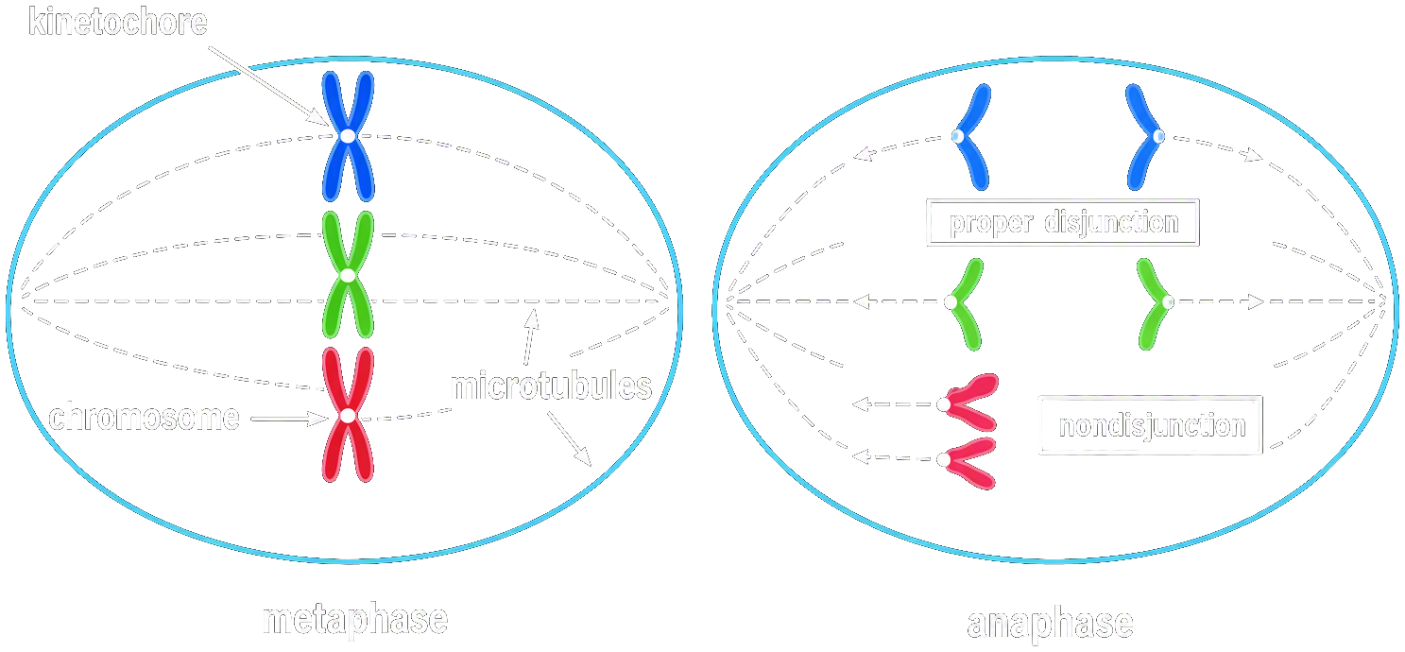
Reason of Aneuploidy
during cell division there is non-disjunction of chromosomes in anaphase

Slide 7
2. Chromosomal Aberrations
Change in structure of chromosome

Slide 8
3. Gene mutation
(a) Substitution: one nitrogenous base is replaced by other (point mutation)
Transition
Purine Replace Purine
Pyrimidine Replace Pyrimidine
Transversion e.g. SCA
Purine $⇌$ Pyrimidine
(b) Frame shift mutation: (will study in molecular basis of Inheritance)

Slide 9
Types of Human Genetic Disorders
Mendelian Disorders | Chromosomal Disorders
1. Determined by mutation is single gene | 1. Disorder created due to imbalance in number 2 rearrangement of chromosome
2. There is change in single gene, this disease is also k/a gene related human disorders | 2. Can't be studied through pedigree analysis
3. They are transmitted to offspring as Mendelian principles
4. Can be studied through pedigree analysis

Slide 10
Chromosomal Disorders
1. Down's Syndrome
2. Klinefelter's Syndrome
3. Turner's Syndrome

Slide 11
Down's Syndrome
Autosomal Aneuploidy disorder
Presence of an additional copy of chromosome number 21 (trisomy of 21)
Chromosome involved 21st (Autosome)
Sex affected – both males & females
Total chromosome number: 47
1st described by Langdon Down (1866)

Slide 12


Down's Syndrome
Features:
1. Short statured with small round head
2. Flat back of head
3. Broad flat face
4. Epicanthus (absent eye fold)
5. Partially open mouth
6. Furrowed Big & wrinkled tongue
7. Congenital heart disease
8. Palm broad with characteristic palm crease
9. Many 'loops' on finger tips
10. Physical, psychomotor & mental development retarded (I.Q very less)
11. Under-developed gonads and genitalia

Slide 13
Klinefelter's Syndrome
Sex-linked Aneuploidy disorder
Presence of an additional copy of X-chromosome (trisomy of X-chromosome)
Genetic complement - 44+XXY
Sex affected – Males
Total chromosome number: 47
Discovered by Klinefelter
Overall masculine development
Tall Stature Feminine characters develop (Breast develop - Gynecomastia) and other ♀ sec. sex characters.
Sterile

Slide 14
Turner's Syndrome
Sex-linked Aneuploidy disorder
Loss of one copy of X-chromosome (Monosomy of X-chromosome)
Short stature
Females are sterile
Ovaries & genitalia are rudimentary; No menstruation
Poor breast development & lack of other secondary sexual characters
Webbed neck

