Slide 1
Income-Expense Tracker
(Full-Stack Project during TalentServe Software Engineering Internship) June -July 2023
-An web application to help users track their income and expenses, categorize transactions and provide Financial insights and report.
Github Link

Slide 2








Technology Stack
Front-End | Back-End | Database

Slide 3
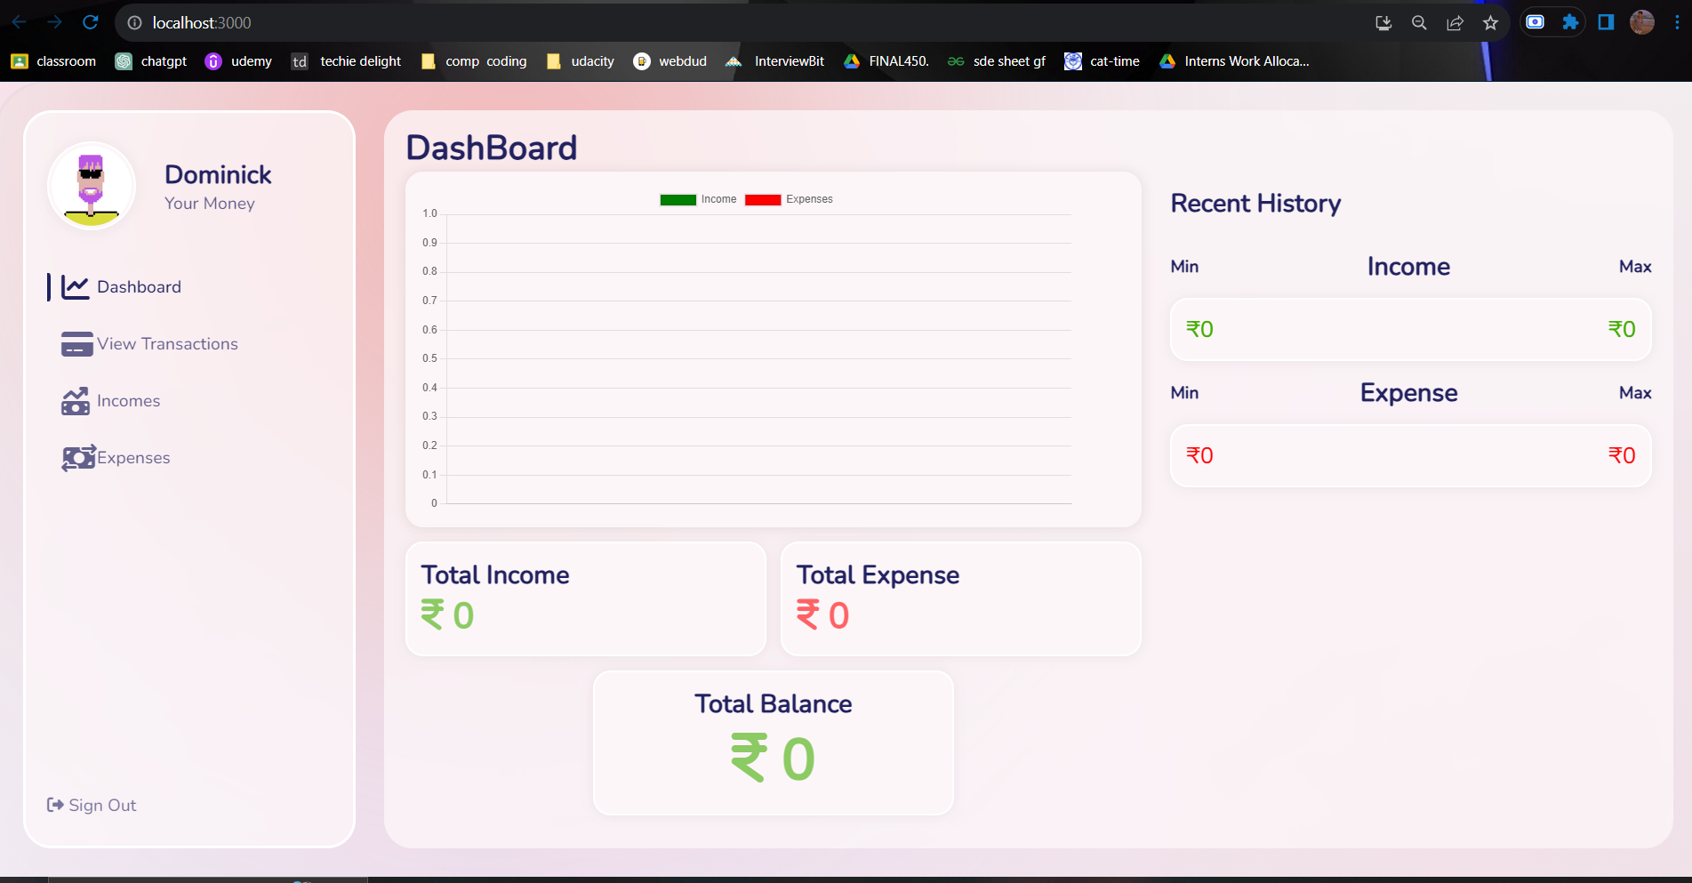
Home-Page
This is the Dashboard of our application where all the data will be displayed. Initially it is like this-

Slide 4
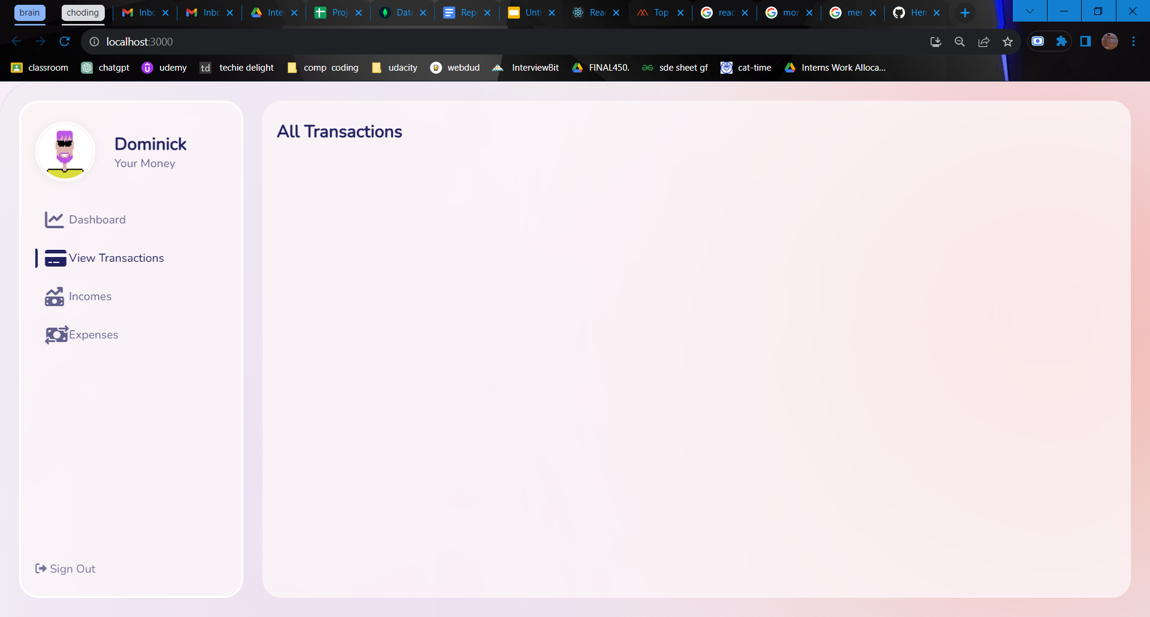
Transactions Page
This is the Transactions Page of our application where all the transactions will be displayed. Initially it is like this-

Slide 5
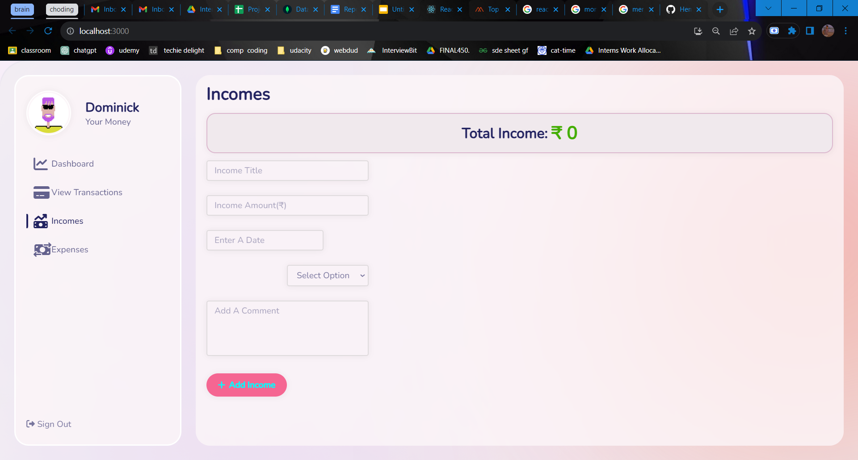
Incomes Page
This is the Incomes Page of our application where all the Income related work will be done. All the fields are required to be filled. Initially it is like this-

Slide 6
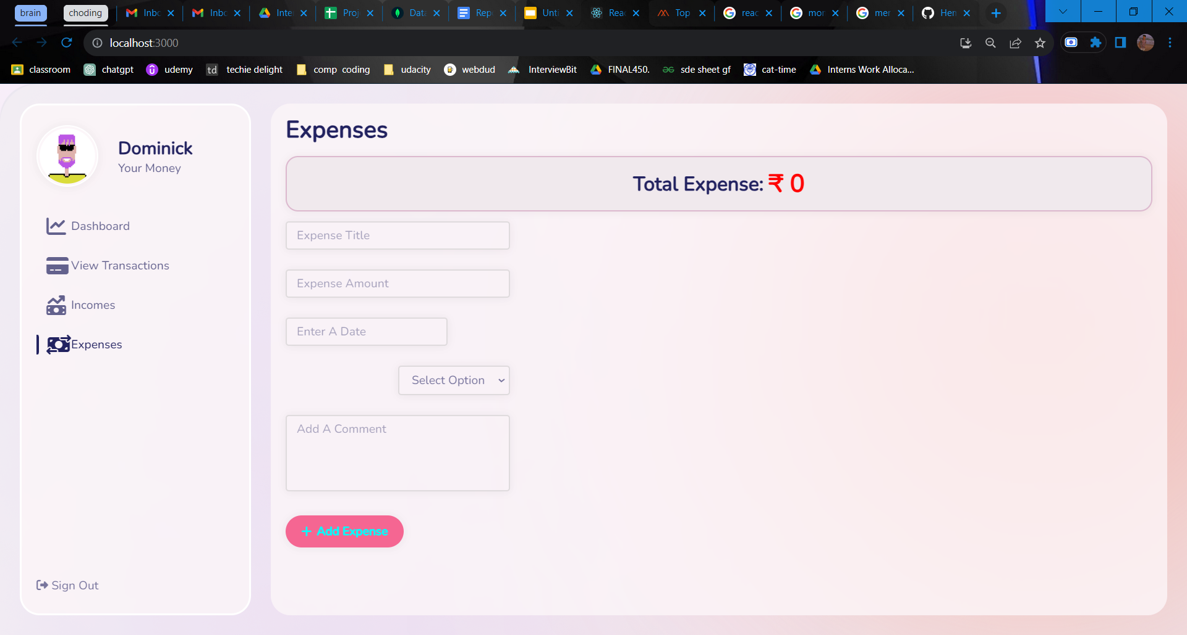
Expenses Page
This is the Expenses Page of our application where all the Expenses related work will be done. All the fields are required to be filled. Initially it is like this-

Slide 7
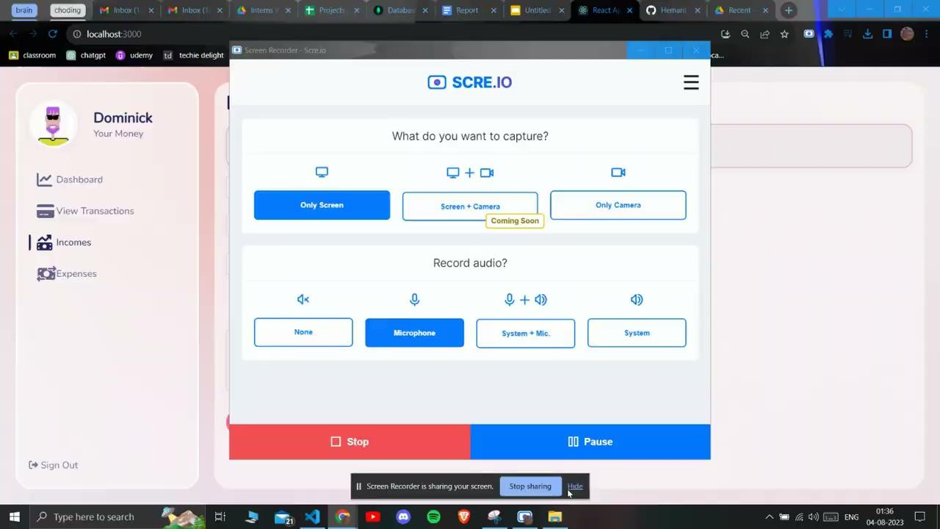
Adding and Deleting Income

Slide 8
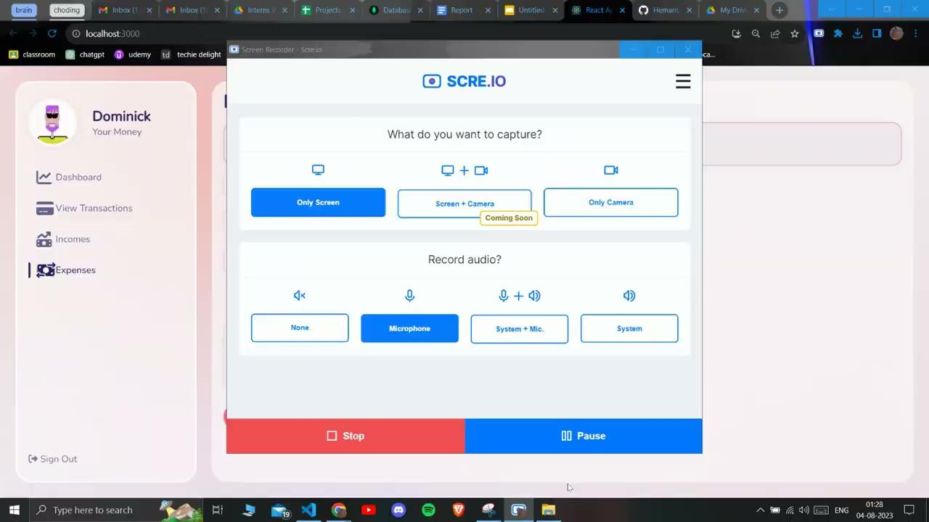
Adding and Deleting Expense

Slide 9
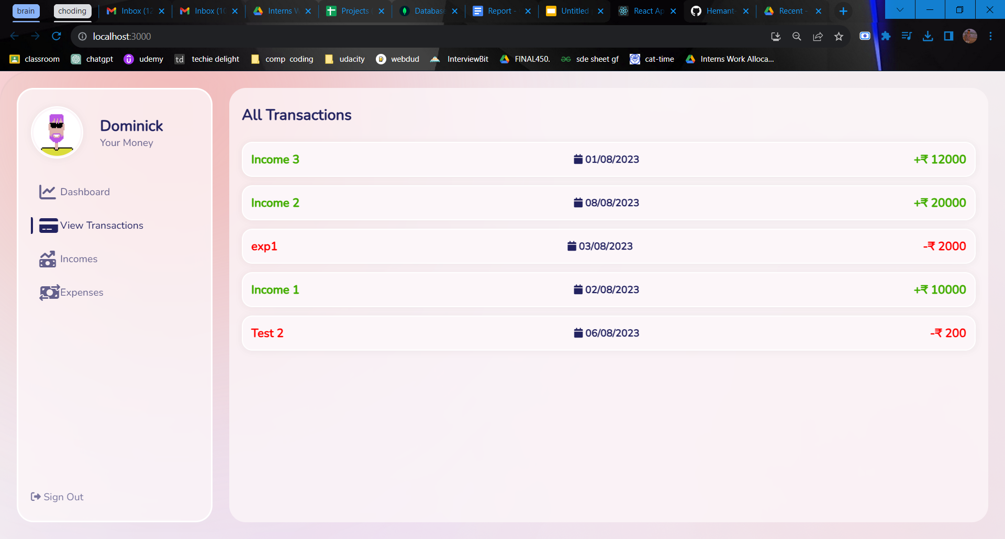
View all Transactions
You can see all your transactions in the order according to time you created them.

Slide 10

Dashboard Functioning

