Slide 1
MG-ECFM results on PaySim
Updated run: 2M rows sampled from all 6.36M real PaySim rows
Five models, 50 chronological drift windows, tuned thresholds, CPU run | 2026-11-10
Notes:
This deck shows the updated results of the full MG-ECFM pipeline on real PaySim data. The run used a seeded random sample of 2,000,000 of 6,362,620 rows from all 743 steps. The decision threshold of every model is now tuned on the operating split. Slide 3 lists what changed from the first run.

Slide 2
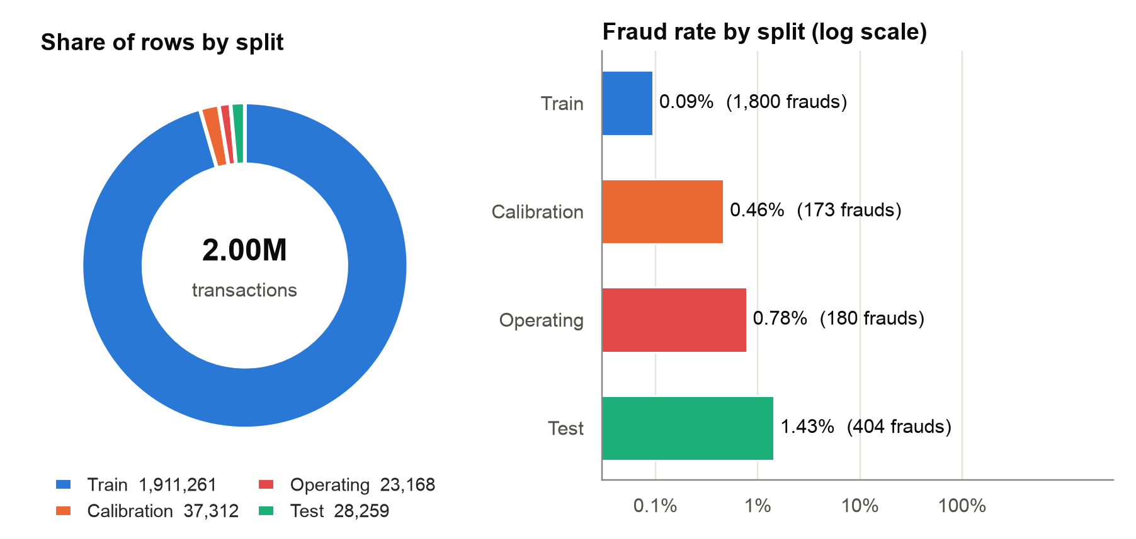
Run setup and data splits
Run facts
PaySim: 2,000,000 of 6,362,620 rows, sampled from steps 1 to 743.
Fast profile, seed 42, 32 causal features.
50 chronological test windows (steps 632 to 743).
Drift evaluation: 2 h 41 min on an Apple Silicon Mac (CPU).
Saved model: models/mg_ecfm_paysim_2m.pkl (1.1 GB).
Command
python -m experiments.run_drift_eval --source paysim --sample-rows 2000000 --save-service models/mg_ecfm_paysim_2m.pkl
Notes:
The run used the fast profile with seed 42. The rows are a uniform random sample of the full log, in time order. So the configured step splits of the project now apply. Train has 1,911,261 rows, calibration 37,312, operating 23,168 and test 28,259. The test split has 404 frauds. The drift evaluation took 9,682 seconds. All numbers come from reports/drift_evaluation_manifest.json.

Slide 3
What changed from the first run
180 of 23,168
0.108
1 to 743
Operating rows are fraud
MG-ECFM threshold
Steps in the sample
Both classes are present, so the threshold search runs.
Tuned on the operating split. It was 0.5 in the first run.
The first run used steps 1 to 179 only.
Code changes
Calibration and operating splits must contain both classes.
New option --sample-rows: a seeded sample over the whole stream.
New option --save-service: saves the evaluated MG-ECFM model.
Read with care
The test split has 28,259 rows and a fraud rate of 1.43%.
18 of 50 test windows contain only frauds. PR-AUC is not defined there.
The first run had a different test period, so its numbers are not comparable.
Notes:
In the first run, the operating split had 186 rows and all of them were frauds. So the threshold stayed at 0.5 for every model. Also, the first run used only the first 2M rows, which cover steps 1 to 179 of 743. This run samples 2M rows from all steps and requires both classes in the calibration and operating splits. The operating split now has 23,168 rows and 180 frauds. The tuned thresholds are: MG-ECFM 0.108, BP1 0.868, BP2 0.971, BP3 0.951, BP4 0.451. The test period changed, so do not compare the numbers of the two runs directly.

Slide 4
Headline results on the pooled test set
0.571
0.555
0.516
7,569
MG-ECFM PR-AUC (pooled)
MG-ECFM F1 (pooled)
MG-ECFM F2 (pooled)
MG-ECFM loss per txn
95% CI 0.445 to 0.672. Best baseline: BP4 0.551.
Tuned threshold 0.108. Best baseline: BP1 0.508.
Best baseline: BP1 0.445.
Rank 4 of 5 (lower is better). Lowest: BP2 3,715.
What this means
MG-ECFM detects frauds best: it catches 199 of 404 frauds at its threshold, more than any baseline.
The PR-AUC lead over BP4 is not significant (Wilcoxon, Holm p = 1.000).
The monetary loss is high because CS-ACRC routing approves most frauds (slides 12 and 13).
Notes:
All four numbers are pooled over the 28,259 test transactions. They come from bootstrap_ci in reports/statistical_significance_results.json. MG-ECFM has the highest PR-AUC, F1 and F2 of the five models. Its Brier score is equal to BP4. The PR-AUC lead over BP4 is small and not significant (Wilcoxon, Holm p = 1.000). MG-ECFM has rank 4 of 5 on expected monetary loss.

Slide 5
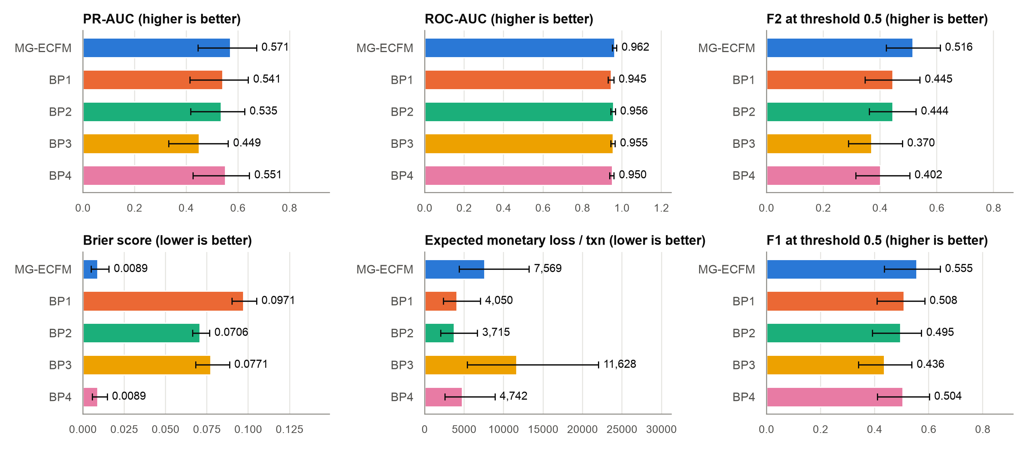
Pooled metrics with 95% bootstrap intervals
Notes:
Each bar is the pooled value on the full test set. The error bar is the 95% block-bootstrap interval with the monitoring window as the unit (1,000 resamples). MG-ECFM leads on PR-AUC (0.571), ROC-AUC (0.962), F1 and F2. The PR-AUC intervals of all models overlap a lot, because the test split has only 404 frauds. BP2 has the lowest expected monetary loss.

Slide 6
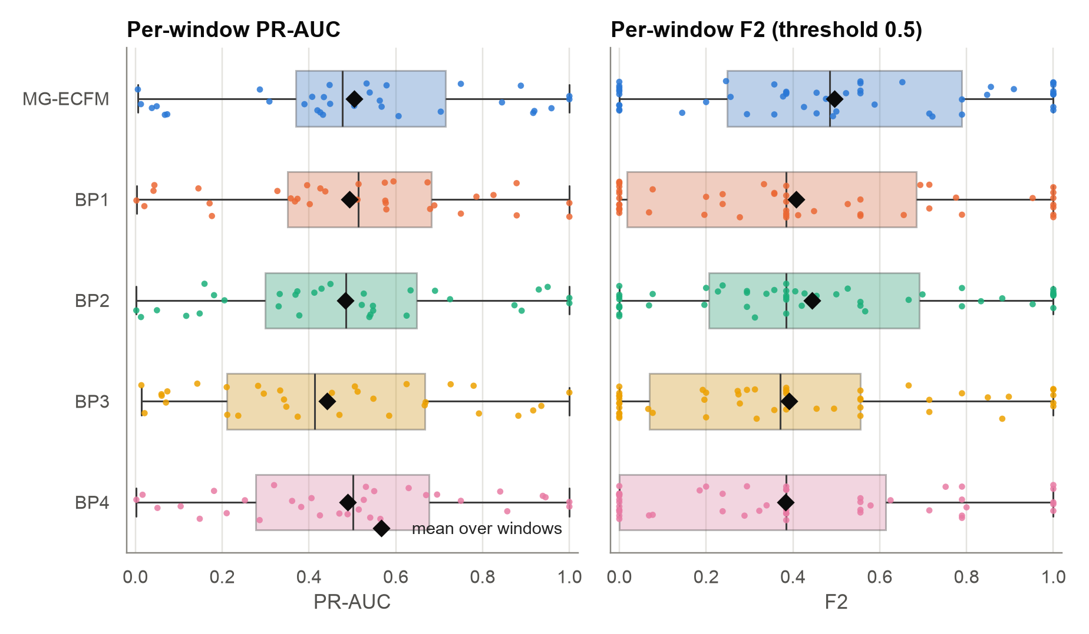
Per-window results vary a lot
Per-window view
Mean PR-AUC: MG-ECFM 0.504, BP1 0.493, BP4 0.489.
Mean F2: MG-ECFM 0.496, BP2 0.445.
Wilcoxon on PR-AUC: no baseline is significant after Holm.
Notes:
Each dot is one test window. The diamond is the mean over windows. PR-AUC is defined in 32 of 50 windows. MG-ECFM has the highest window mean on PR-AUC (0.504) and F2 (0.496). The spread inside each model is much larger than the gap between models. So the per-window tests do not find a significant PR-AUC difference.

Slide 7
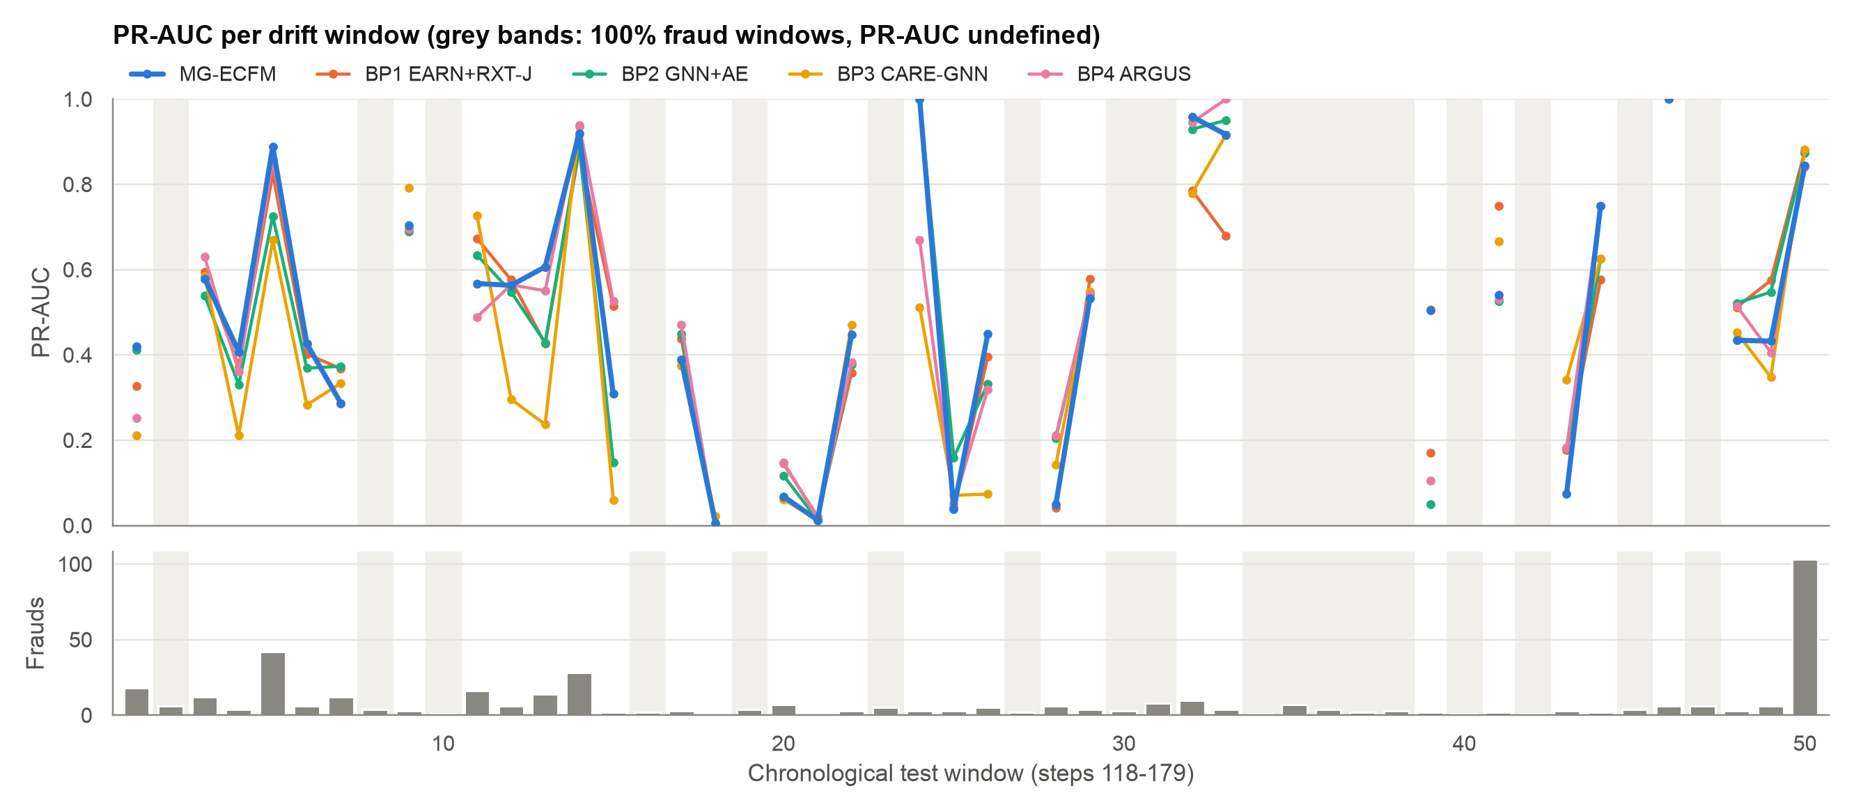
PR-AUC across the 50 drift windows
Notes:
The top panel shows PR-AUC per window for each model. The bottom panel shows the number of frauds per window. The grey bands mark the 18 windows that contain only frauds. PR-AUC is not defined there. Window sizes go from 1 to 2,595 transactions. The late PaySim steps have few genuine transactions, so many windows are small. All five models follow a similar path.

Slide 8
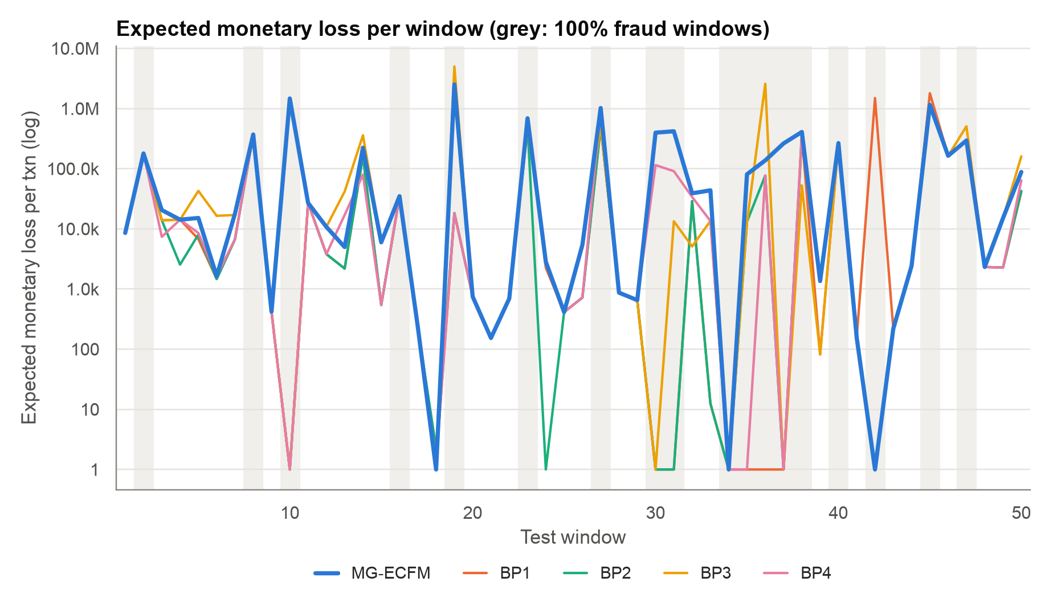
Expected monetary loss per window
Why the loss is high
CS-ACRC approved 311 of 404 frauds.
At its threshold, MG-ECFM flags 199 frauds, but the routing does not use that threshold.
Pooled EML per txn: MG-ECFM 7,569, BP2 3,715, BP3 11,628.
Notes:
Expected monetary loss (EML) is the realised asymmetric loss per transaction under each model's own policy. The y axis uses a log scale. The loss of MG-ECFM is high in the all-fraud windows, because CS-ACRC approves most frauds there. BP1 to BP4 use a binary approve or block policy at their tuned threshold.

Slide 9
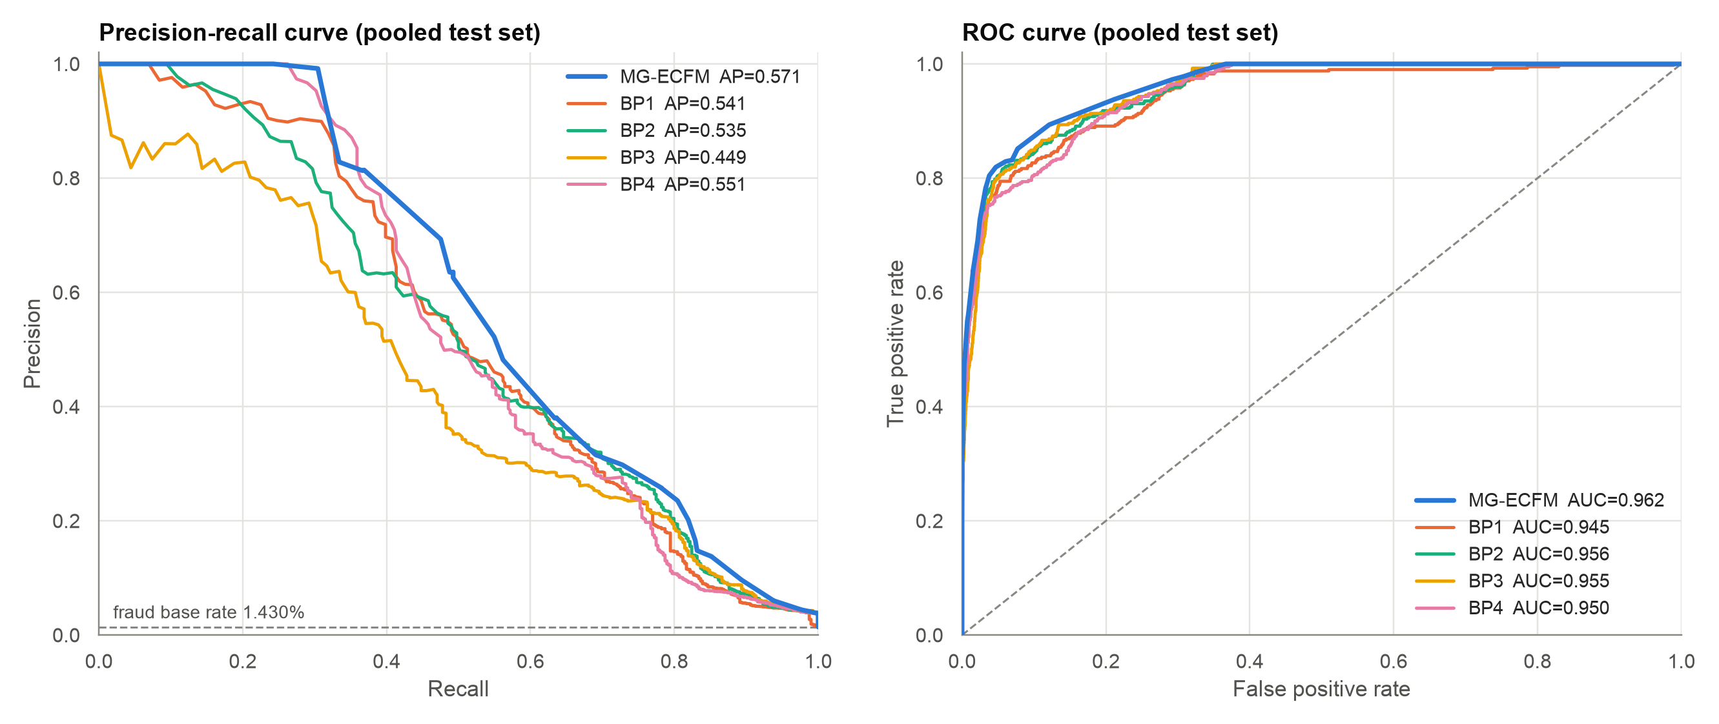
Pooled precision-recall and ROC curves
Notes:
The curves use all 28,259 test transactions. They use the scores only, so the threshold does not change them. MG-ECFM has the highest average precision (0.571) and the highest ROC-AUC (0.962). On ROC-AUC all models are between 0.945 and 0.962. The fraud base rate in the test split is 1.43%.

Slide 10
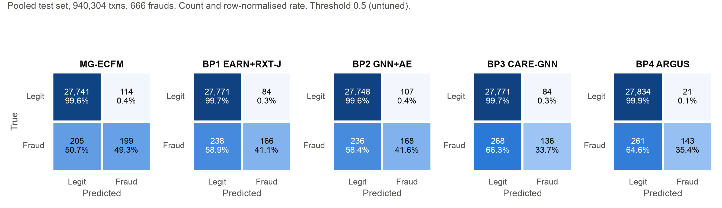
Confusion matrices at the tuned thresholds
MG-ECFM
199 of 404 frauds caught (49.3%).
114 false alarms (0.41% of legit).
BP4 ARGUS
143 of 404 frauds caught (35.4%).
21 false alarms (0.08% of legit).
BP1 to BP3
33.7% to 41.6% of frauds caught.
84 to 107 false alarms.
Notes:
Each matrix shows the count and the row-normalised rate. Each model uses its own threshold, tuned on the operating split. MG-ECFM catches the most frauds (199 of 404) with 114 false alarms. BP4 is the most strict: it raises only 21 false alarms but catches 143 frauds. In the first run, BP1 to BP3 flagged most genuine transactions. With tuned thresholds they do not.

Slide 11
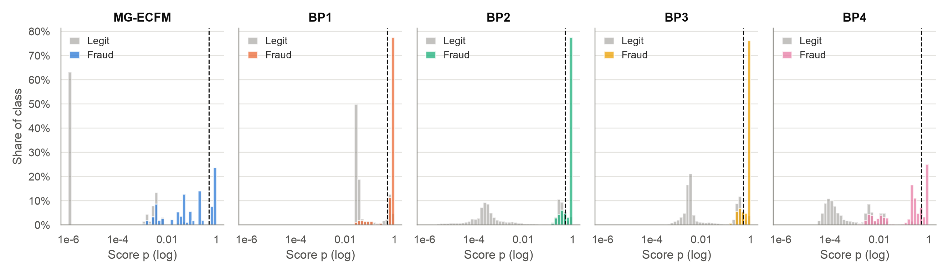
Score distributions by true class
MG-ECFM
Threshold 0.108: low, because genuine scores are near zero.
Many fraud scores are between 0.01 and 0.5.
BP1 to BP3
Thresholds 0.87 to 0.97: close to 1.
Scores are not calibrated (Brier 0.07 to 0.10).
Notes:
Each panel shows the share of each class per score bin on a log scale. The dashed line is the tuned threshold of each model. MG-ECFM gives low scores to genuine transactions and spreads fraud scores over a wide range. So its tuned threshold (0.108) is low. BP1 to BP3 give high scores to most transactions, so their tuned thresholds are close to 1.

Slide 12
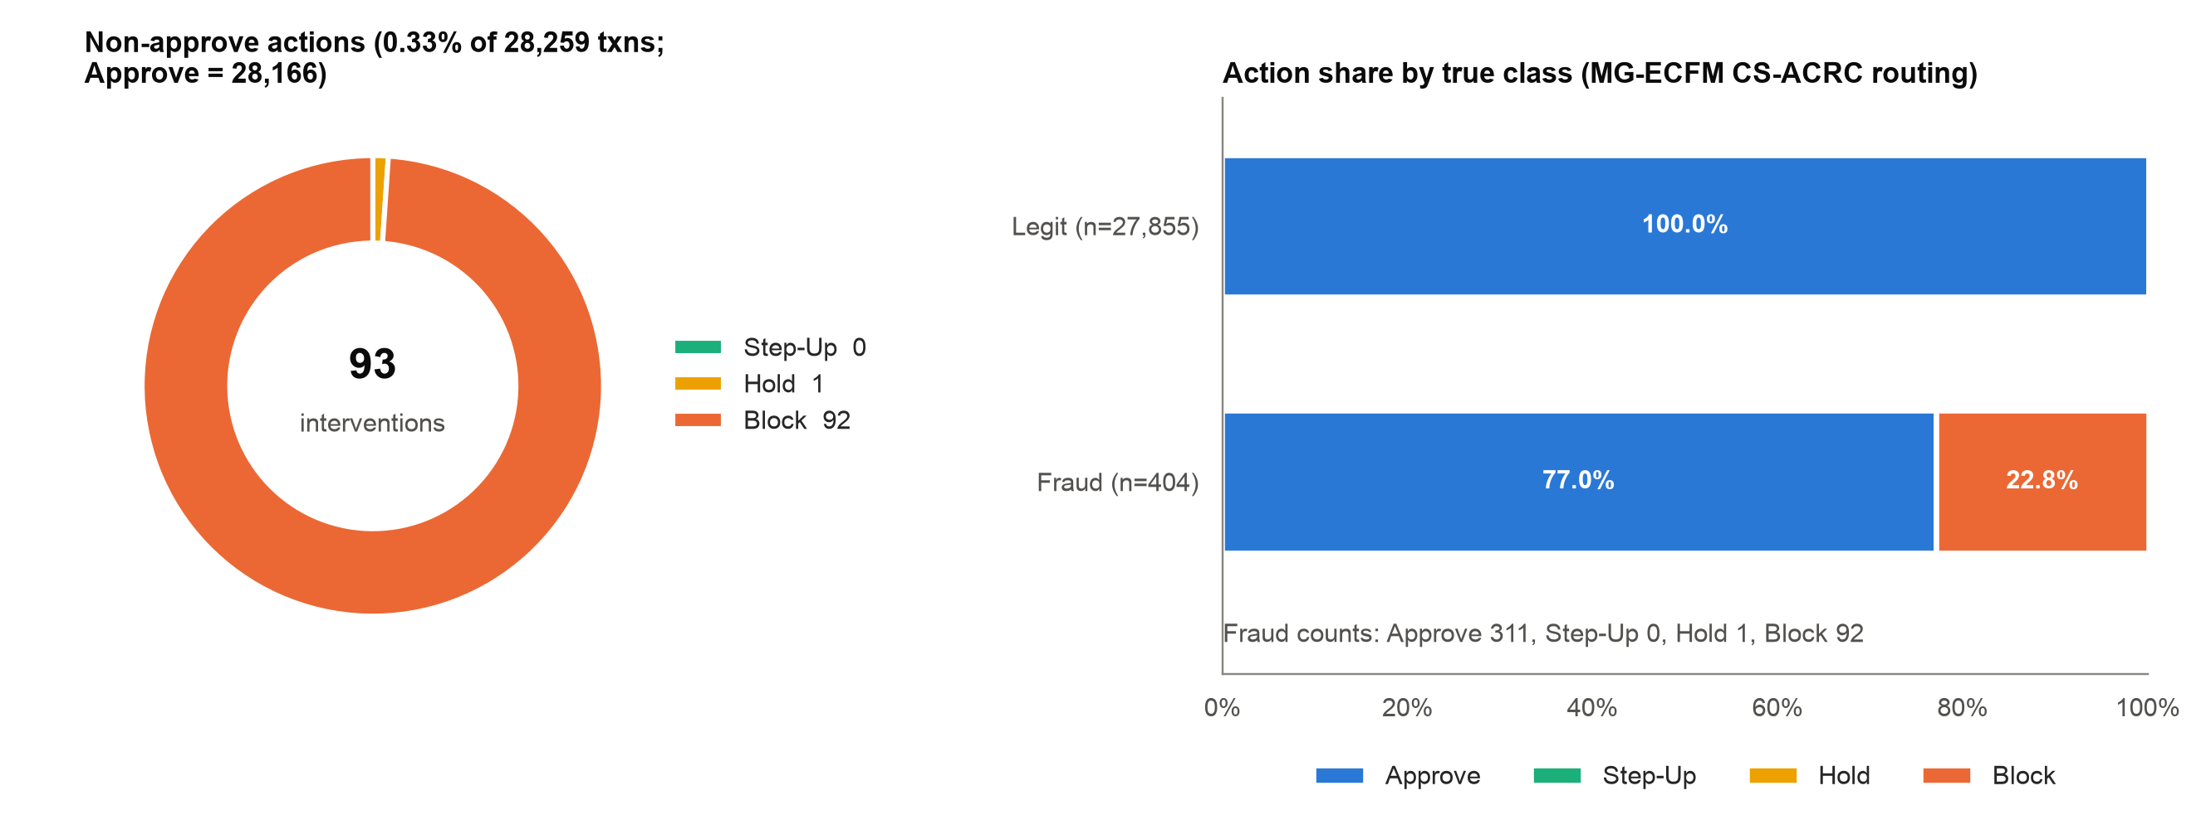
MG-ECFM action mix: Approve, Step-Up, Hold, Block
Finding CS-ACRC approved 311 of 404 frauds (77.0%). At the tuned threshold, the detector flags 199 frauds. The routing loses this gain.
Notes:
CS-ACRC routes each transaction to one of four actions: Approve, Step-Up, Hold or Block. MG-ECFM sent 93 of 28,259 test transactions away from Approve. Of the 404 frauds, 311 were approved, 0 got Step-Up, 1 got Hold and 92 were blocked. No genuine transaction got an intervention. The routing does not use the tuned threshold. The next slide shows the reason.

Slide 13
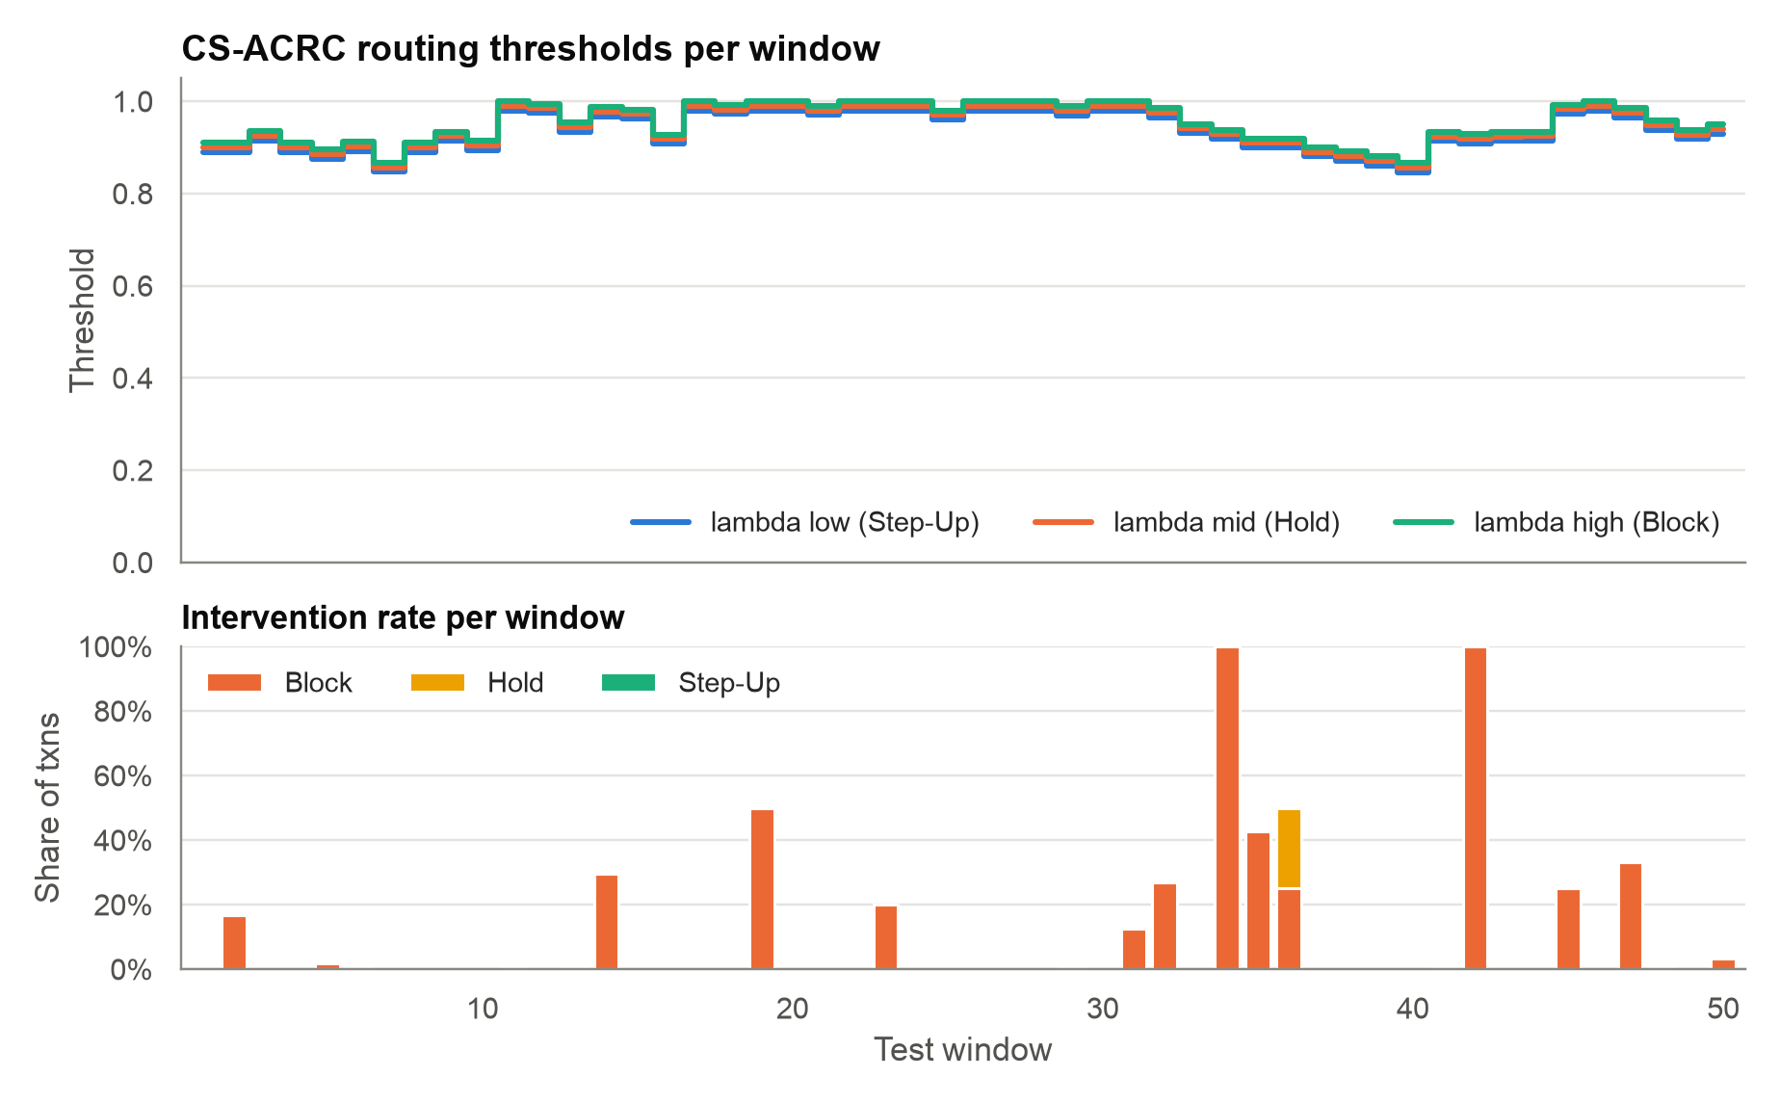
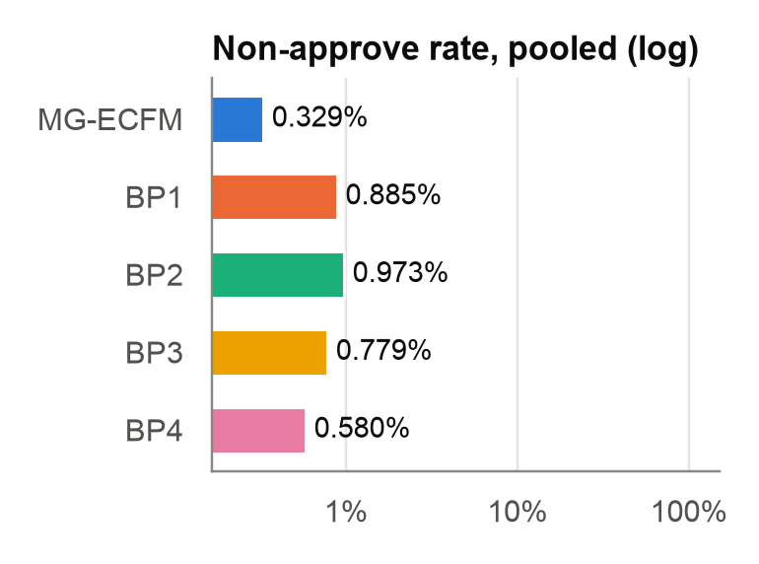
CS-ACRC thresholds are close to 1
Start: 0.89 / 0.90 / 0.91.
Median: 0.93 / 0.94 / 0.95.
Detector threshold: 0.108.
Notes:
The left chart shows the three CS-ACRC thresholds per window. After the operating split they are 0.89, 0.90, 0.91. The median over windows is 0.93, 0.94, 0.95. The tuned detector threshold is only 0.108. With routing thresholds this high, CS-ACRC approves almost everything. This is the main cause of the high monetary loss. The small chart compares the pooled non-approve rate of all models on a log scale.

Slide 14
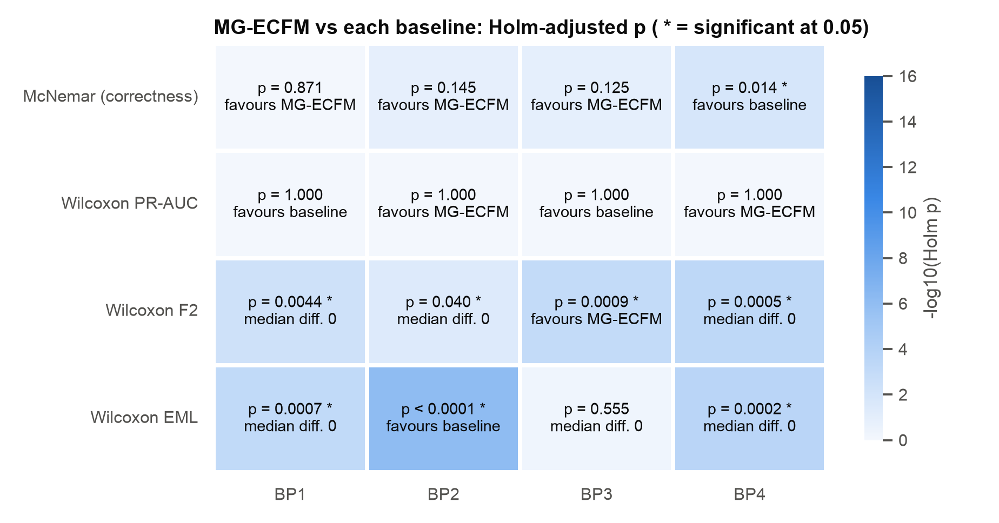
Statistical significance against each baseline
Reading the tests
McNemar: only BP4 differs, in favour of BP4.
PR-AUC: no significant difference (Holm p = 1.0).
F2: Holm p < 0.05 against all four baselines.
EML: BP2 has a lower loss (Holm p < 0.001).
Notes:
Each cell gives the Holm-adjusted p-value of MG-ECFM against one baseline. A star means significant at 0.05. The text gives the direction. McNemar compares per-transaction correctness at the tuned thresholds. Only BP4 differs (Holm p = 0.014): BP4 is more often correct (99.00% vs 98.87%), because it raises fewer false alarms. The Wilcoxon test on per-window PR-AUC is not significant for any baseline. The Wilcoxon test on F2 is significant for all four baselines.

Slide 15
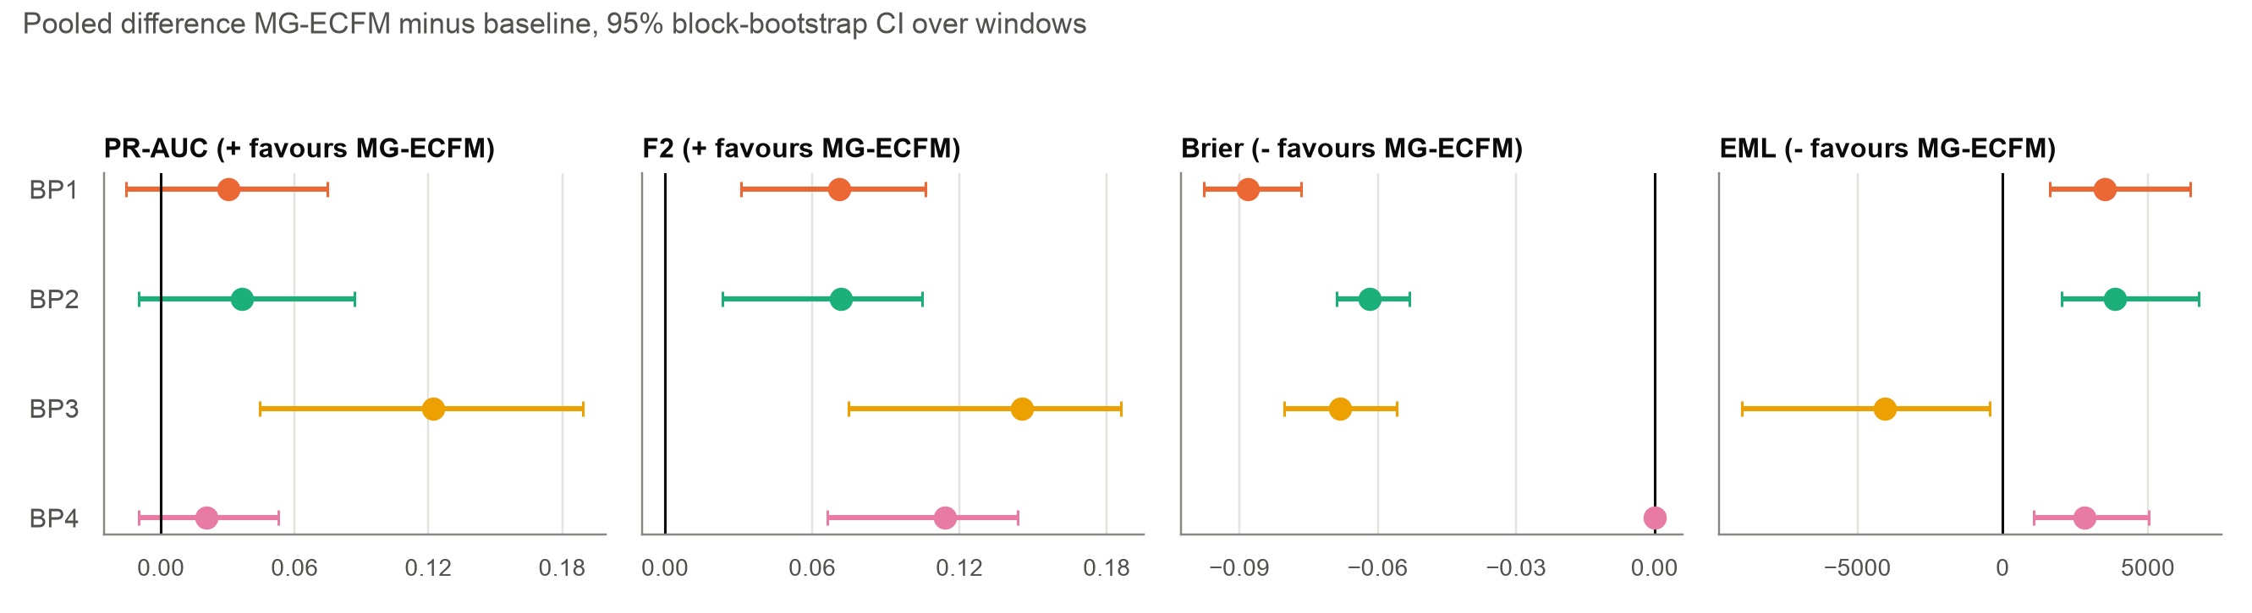
Pooled differences with 95% bootstrap intervals
PR-AUC
Clear gain over BP3.
Interval crosses zero for BP1, BP2, BP4.
F2
Clear gain over BP1, BP2, BP3, BP4.
Brier
MG-ECFM is lower than BP1, BP2, BP3.
Equal to BP4.
EML
Clear difference for BP1, BP2, BP3, BP4.
Only BP3 has a higher loss.
Notes:
Each point is the pooled MG-ECFM value minus the baseline value. The bar is the 95% block-bootstrap interval. If the interval does not cross zero, the difference is clear. PR-AUC: the interval excludes zero for BP3. F2: it excludes zero for BP1, BP2, BP3, BP4. Brier: for BP1, BP2, BP3. EML: for BP1, BP2, BP3, BP4.

Slide 16
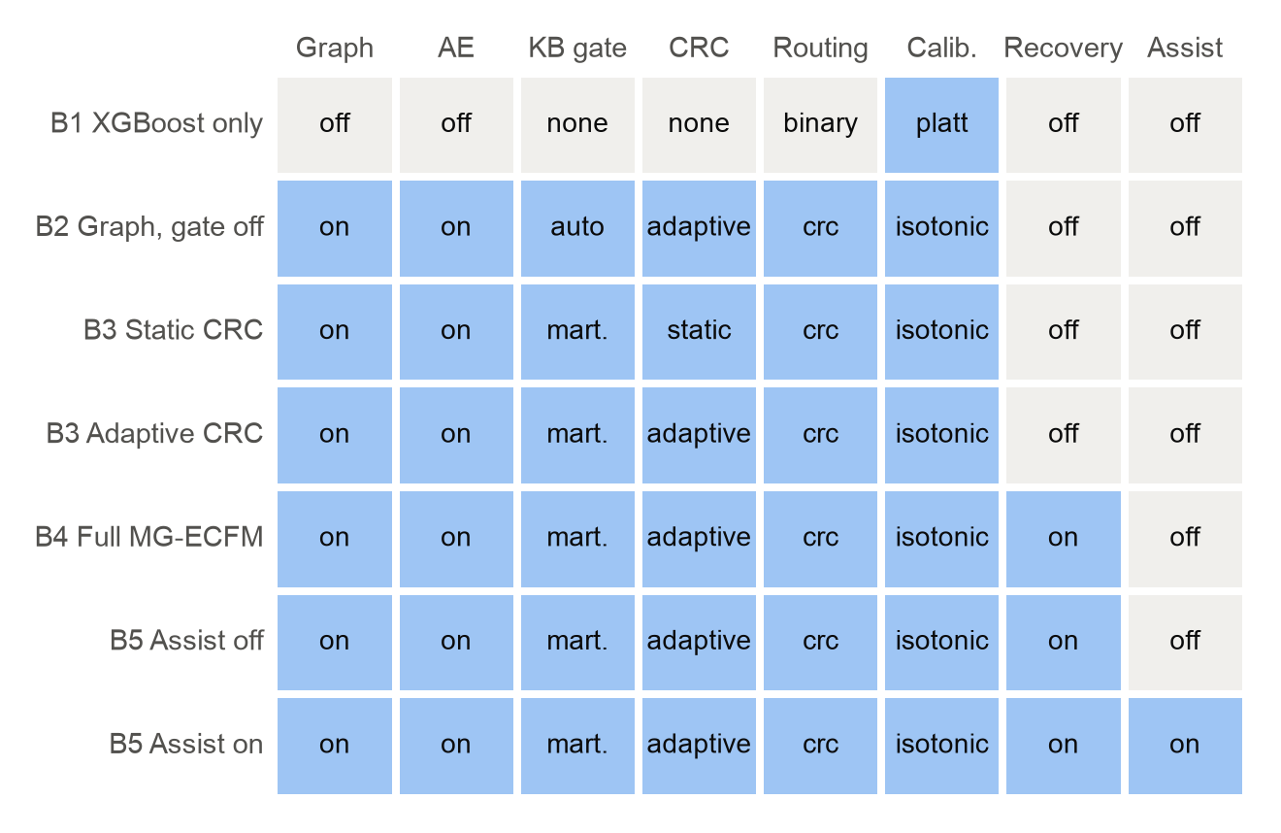
Ablation design: seven arms, B1 to B5
Read this before the results
B1 is XGBoost only, with no graph, gate or recovery.
B2 admits every candidate rule (200 rules).
B3 adaptive, B4 and B5 share one fitted pipeline, so their ranking metrics are the same by construction.
The gate admitted 0 rules in B3 to B5.
So this run cannot measure the effect of the KB, recovery and assist.
Notes:
The matrix shows which component each arm switches on. Blue means on. B3 adaptive, B4 and B5 branch from one fitted pipeline. So they share the same ranking metrics by construction. The martingale knowledge gate again admitted 0 rules on the real stream. So the knowledge base, recovery and assist had no rules to act on.

Slide 17
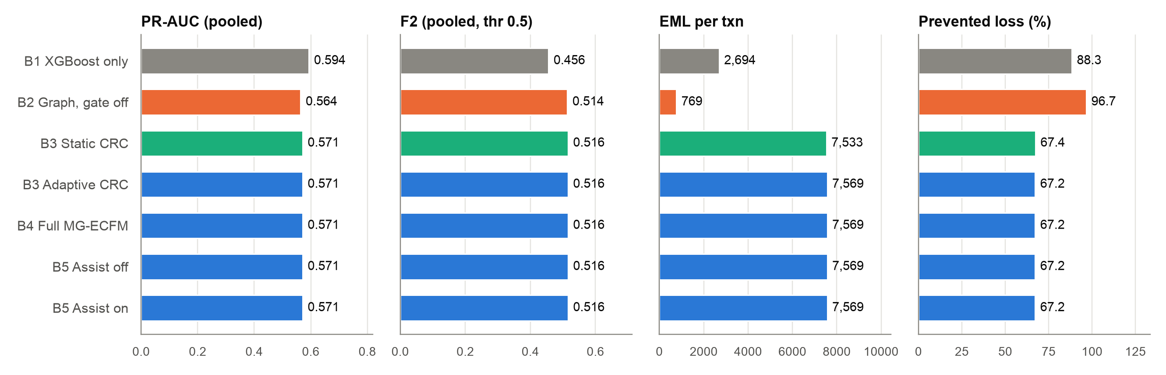
Ablation results per arm
B1 XGBoost only: PR-AUC 0.594, higher than full MG-ECFM.
B2 (gate off): lowest EML (769).
Static CRC EML 7,533 vs adaptive 7,569.
Recovery rate in B4: 0.00%.
Notes:
All values are pooled over the test windows. B1 XGBoost only has the highest PR-AUC (0.594). The full MG-ECFM has 0.571. B2 with the gate off has the lowest EML (769) and the highest prevented loss (96.7%). Static CRC (7,533) and adaptive CS-ACRC (7,569) give almost the same EML. Recovery in B4 does not change the net loss (213.89M).

Slide 18
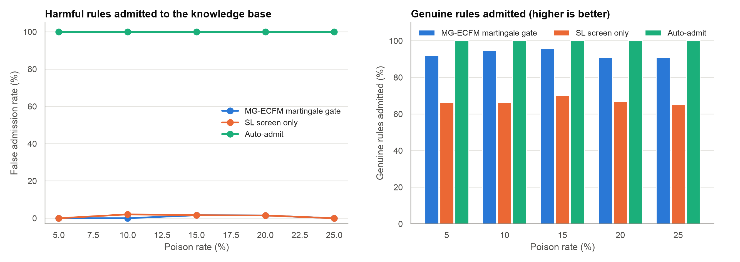
Knowledge poisoning: false admission rate
Finding The gate keeps harmful admissions at or below 1.6% and still admits 91% or more of genuine rules. The SL screen loses about one third of genuine rules.
Notes:
This stress test injects harmful candidate rules at poison rates from 5% to 25%. The martingale gate admits at most 1.6% of harmful rules. Auto-admit admits all of them. The SL screen alone admits at most 2.1% of harmful rules, which is close to the gate. But the SL screen admits at most 70.3% of genuine rules. The gate admits 91.0% to 95.7%.

Slide 19
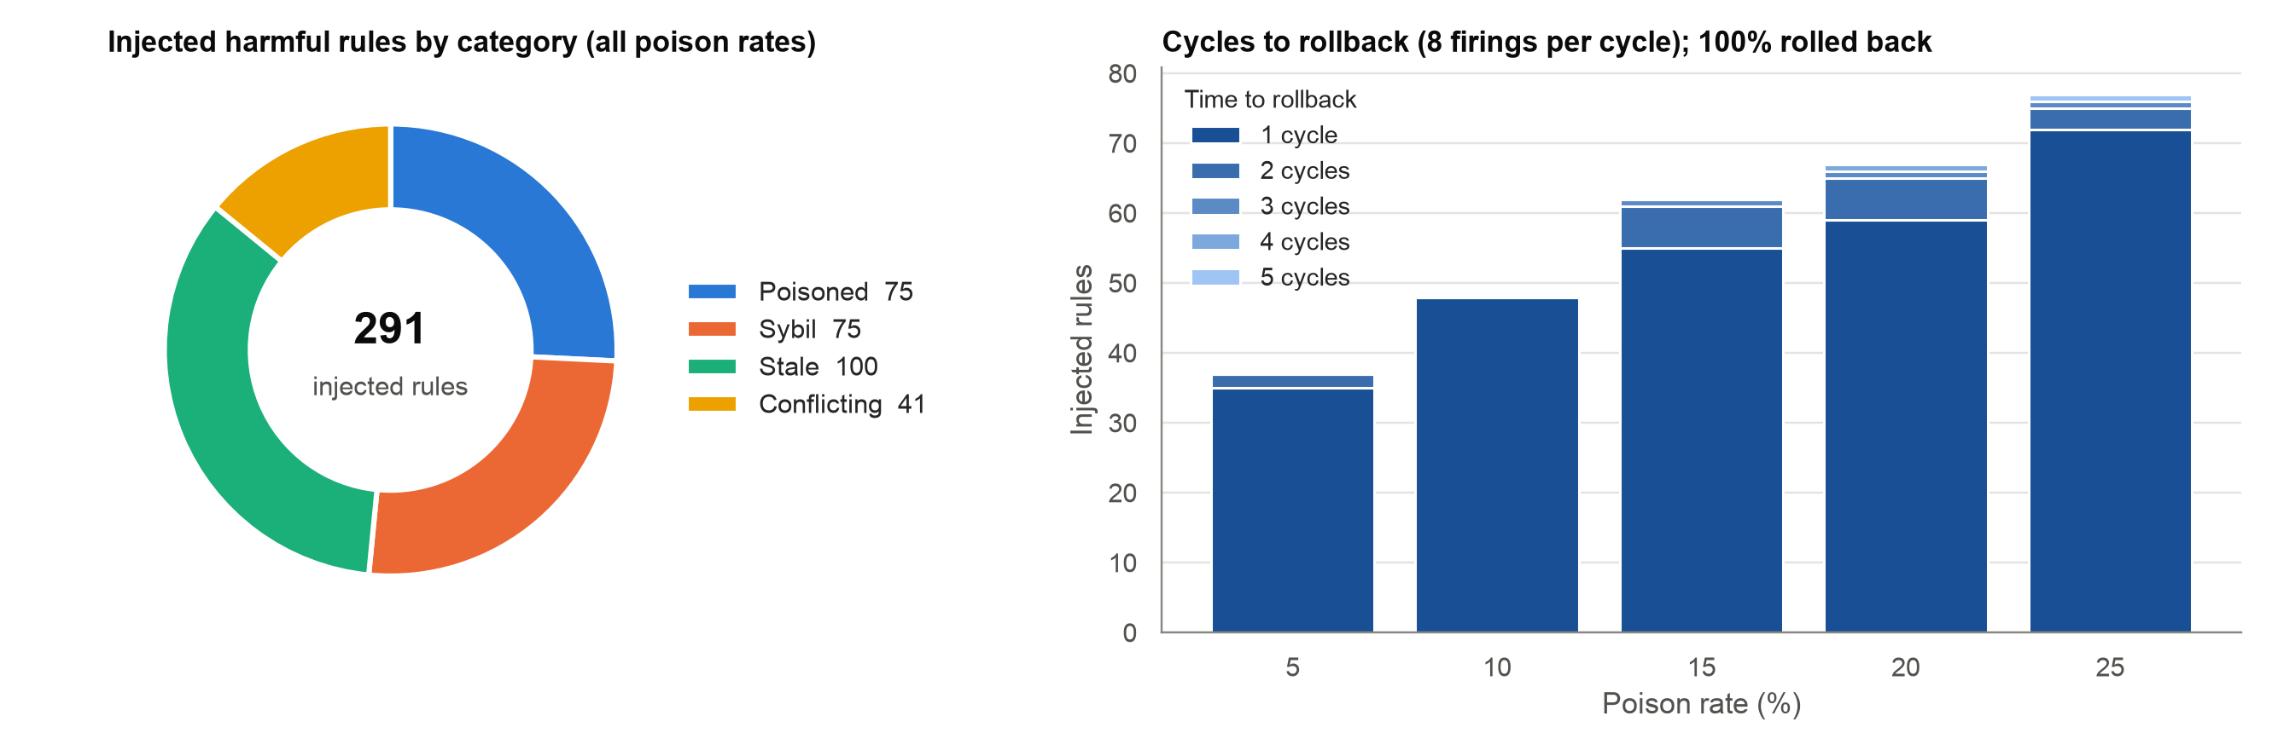
Injected harmful rules are rolled back fast
Finding 100% of 291 injected harmful rules were rolled back. 92.4% took one cycle (8 firings). The maximum was 5 cycles.
Notes:
In this test, 291 harmful rules go directly into the active knowledge base. The left chart shows the rule categories. The right chart shows the cycles to rollback per poison rate. One cycle has 8 verified firings. The gate rolled back 100% of the injected rules. 92.4% were rolled back in one cycle. The maximum was 5 cycles.

Slide 20
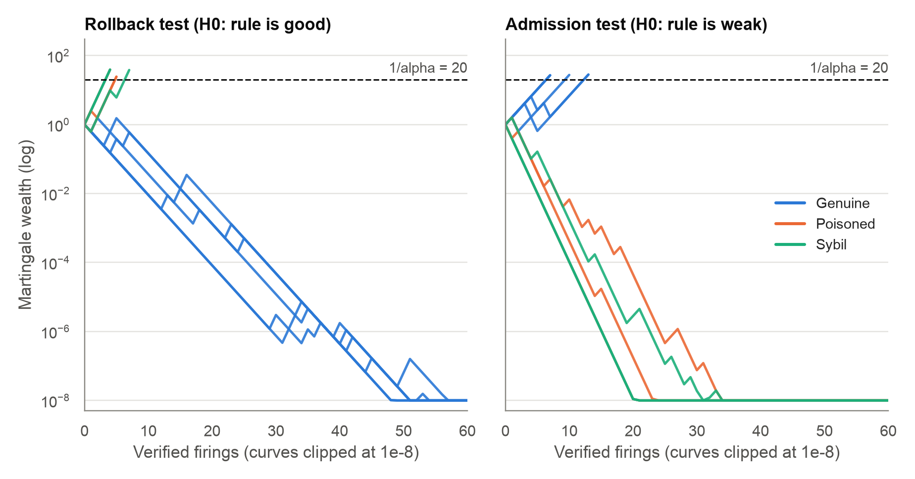
Martingale wealth trajectories
What the curves show
Rollback test: poisoned and Sybil rules cross 20 after 4 to 7 firings.
Genuine rules never cross, so they stay active.
Admission test: genuine rules cross after 7 to 13 firings.
Poisoned and Sybil rules never cross, so they are never admitted.
Notes:
Each line is the e-process wealth of one rule. A test stops when the wealth reaches 1/alpha = 20. In the rollback test, poisoned and Sybil rules reach 20 after 4 to 7 firings. The wealth of genuine rules falls toward zero, so they stay active. In the admission test, genuine rules reach 20 after 7 to 13 firings. Poisoned and Sybil rules never reach 20, so the gate never admits them. Curves are clipped at 1e-8 for display.

Slide 21
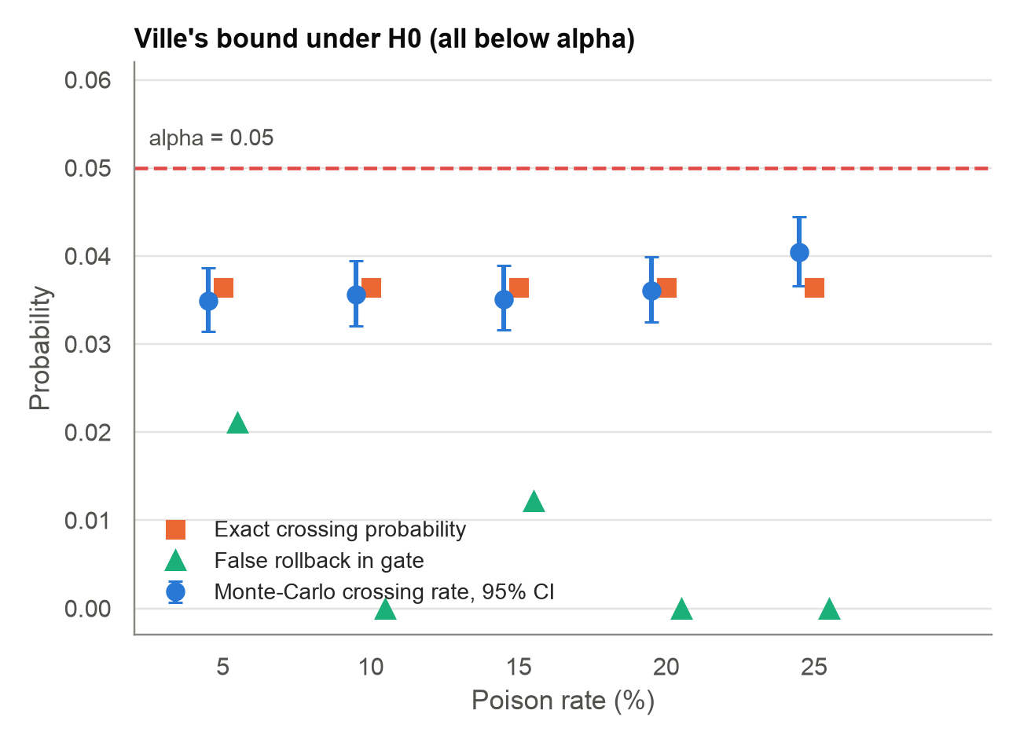
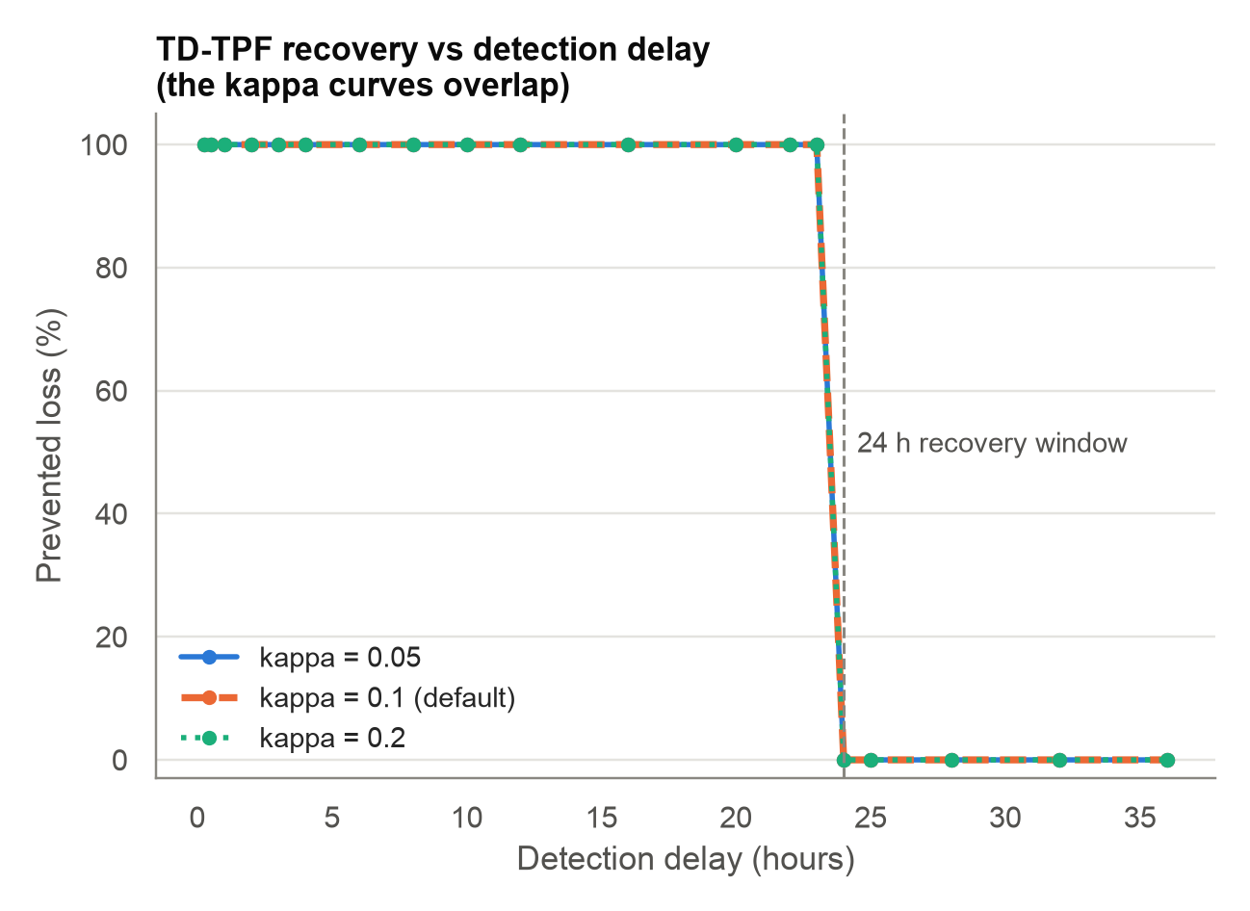
Ville's bound holds; recovery stops at 24 hours
All checks are below alpha = 0.05 (max MC rate 0.0404).
100% prevented up to 23 h; 0% from 24 h.
Notes:
Left: under the null hypothesis, Ville's inequality says the crossing probability is at most alpha = 0.05. The exact crossing probability is 0.0365. The highest Monte-Carlo rate is 0.0404. All checks are below alpha. Right: TD-TPF recovery prevents 100% of the loss for detection delays up to 23 hours. From 24 hours it prevents nothing, because the 24-hour recovery window has closed. The three kappa values give the same curve, so the lines overlap. The recovery curves use 250 frauds from fig4_tdtpf_recovery_curves.csv.

Slide 22
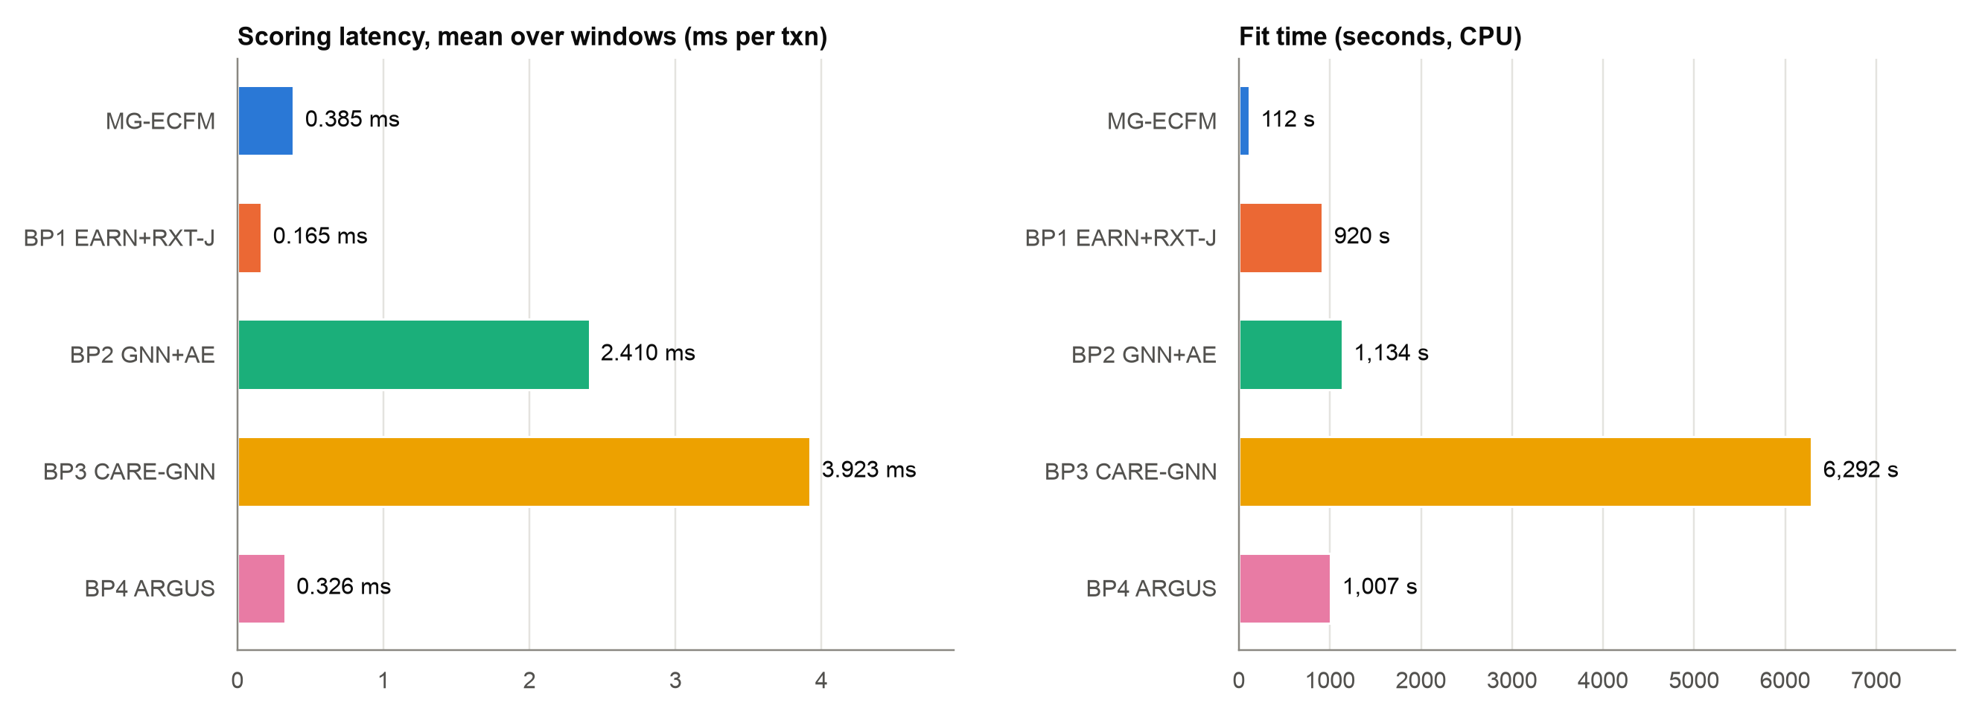
Scoring latency and fit time
Finding MG-ECFM scores a transaction in 0.385 ms and fits in 112 s, the shortest fit time of the five models.
Notes:
Latency is the amortised batch-scoring time per transaction on CPU, as the mean over windows. MG-ECFM needs 0.385 ms per transaction. Faster: BP1 (0.165 ms), BP4 (0.326 ms). MG-ECFM has the shortest fit time (112 s). BP3 CARE-GNN needs 6,292 s. Fit times come from fit_reports in the manifest. They use the fast profile on 1,911,261 training rows.

Slide 23
Conclusions and next steps
Findings
Best pooled PR-AUC (0.571), F1 (0.555) and F2 (0.516).
PR-AUC lead is not significant. F2 lead is significant (Holm p < 0.05).
CS-ACRC approves 311 of 404 frauds, so the loss is rank 4 of 5.
XGBoost alone (B1) has a higher PR-AUC than the full model.
The gate admitted 0 rules, so the KB had no effect.
Next steps
Align the CS-ACRC thresholds with the tuned detector threshold.
Find why the graph and fusion layers lower PR-AUC versus XGBoost.
Find why the gate admits no rules on PaySim.
Use more test data: the test split has only 404 frauds.
Notes:
With tuned thresholds, MG-ECFM gives the best pooled PR-AUC, ROC-AUC, F1 and F2 of the five models. The PR-AUC lead is small and not significant. The F2 lead is significant against all four baselines. The monetary loss is still high, because the CS-ACRC routing thresholds are close to 1 and approve most frauds. The knowledge gate still admits no rules on the real stream.

