Slide 1

Phase 1 Results: Single-Model Framework
Hallucination Mitigation
in Large Language
Models
Ms. Sakshi Sunil Chougule
M.Tech. Computer Science and Engineering
URN: 1025230001
Guided by
Dr. A. J. Shikalgar
Academic Year 2026–27
Ms. Sakshi Sunil Chougule
Hallucination Mitigation in LLMs
01

Slide 2
Contents
Presentation roadmap
Introduction, problem statement and literature review
Research gap, objectives and the Phase 1 plan
Phase 1 execution: implemented system and audit
Evaluation setup and Phase 1 results
Discussion, Phase 2 work plan and references
Ms. Sakshi Sunil Chougule
Hallucination Mitigation in LLMs
02

Slide 3
Introduction
Technical baseline
CONTEXT
LLMs can generate fluent responses that contain incorrect facts or inconsistent reasoning.
Factuality measures agreement with external knowledge.
Faithfulness measures agreement with the supplied context.
Knowledge-based errors need evidence verification; logic-based errors need structured reasoning checks.
The proposed framework combines internal uncertainty screening with targeted verification.
Ms. Sakshi Sunil Chougule
Hallucination Mitigation in LLMs
03

Slide 4
Problem Statement
Why current mitigation remains incomplete
Existing detection and mitigation methods often operate independently.
Retrieved evidence may contain irrelevant passages or conflict with model knowledge.
Repeated generation and uniform validation increase response latency and computational cost.
Research problem: mitigate factual and reasoning errors through an integrated system that selectively validates uncertain responses.
Ms. Sakshi Sunil Chougule
Hallucination Mitigation in LLMs
04

Slide 5
Project Objectives
Measurable milestones
Design linear Semantic Entropy Probes for rapid internal uncertainty screening.
Develop routing that distinguishes factual uncertainty from reasoning errors and verifies atomic claims.
Evaluate the integrated framework on factuality, faithfulness and reasoning benchmarks.
Implement planning, plan-guided reasoning, final judgment and refinement.
Compare hallucination reduction, latency and computational cost with baseline approaches.
Ms. Sakshi Sunil Chougule
Hallucination Mitigation in LLMs
09

Slide 6
Phase 1 Plan: System Development
Implementation sequence planned for Phase 1
Prepare benchmark data and choose an LLM that exposes hidden-state activations.
Train and calibrate internal probes and the uncertainty classification mechanism.
Implement targeted retrieval, atomic-claim extraction and NLI verification.
Integrate the HalluClean reasoning track and response refinement.
Evaluate the complete framework against the stated baselines.
Ms. Sakshi Sunil Chougule
Hallucination Mitigation in LLMs
10

Slide 7
Methodology: Decision Routing
Selective verification architecture
Prompt + initial LLM generation
Internal uncertainty screening
(SEP)
Below threshold:
direct output
At/above threshold:
uncertainty classifier
Factual uncertainty
Hypothesis-Testing RAG + NLI
Reasoning uncertainty
HalluClean structured reasoning
Content refinement and final response
Low uncertainty is a routing decision, not a guarantee of correctness.
Ms. Sakshi Sunil Chougule
Hallucination Mitigation in LLMs
11

Slide 8
Phase 1: Plan, Execution and Result
What we planned, what we built, and what we measured
Component | Plan | Execution | Result
Layer 1: uncertainty triage | Linear Semantic Entropy Probe on hidden states | Probe had no trained weights → replaced by sampled semantic entropy (K = 4, NLI / answer clustering) | Routes by measured uncertainty; AUROC 0.79 (GSM8K), 0.58 (TruthfulQA)
Layer 2: NLI-RAG | Atomic claims + retrieval + NLI verification | DeBERTa-v3 consensus NLI + web evidence + evidence-grounded rewrite and Chain-of-Verification (llama2:7b) | TruthfulQA truthful: 61.0% → 79.0%
Layer 3: HalluClean | Plan → reason → judge → refine | Program-verified self-consistency: the model writes Python programs; execution confirms sampled answers before a majority vote | GSM8K accuracy: 24.0% → 32.0%
Outcome: the framework improves on the raw baseline on both benchmarks — GSM8K 24.0% → 32.0% (p = 0.134), TruthfulQA 61.0% → 79.0% (p = 0.004). The cost is extra latency and tokens.
Ms. Sakshi Sunil Chougule
Hallucination Mitigation in LLMs
15

Slide 9
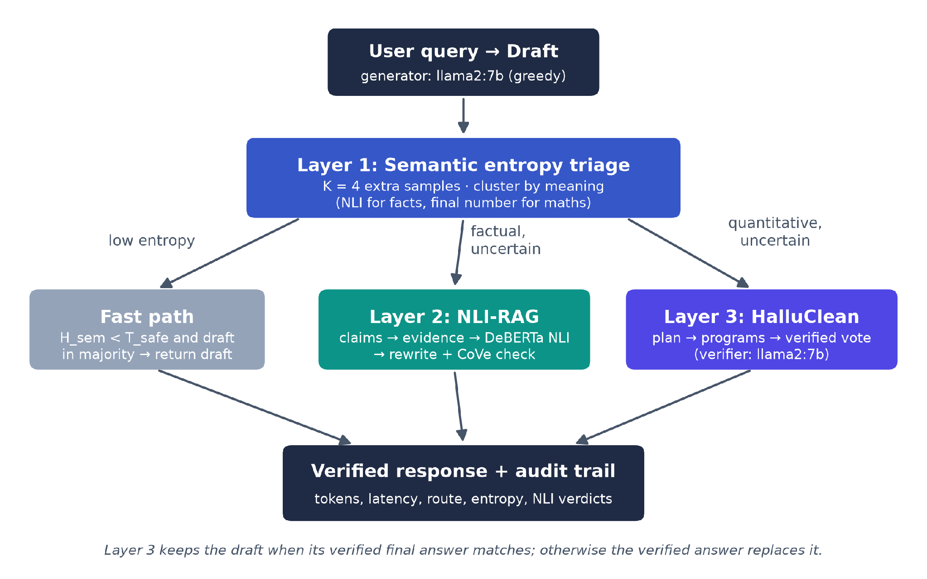
Phase 1 Execution: Implemented System
Pipeline as built and evaluated
Role | Model / tool
Generator (baseline) | llama2:7b (Ollama)
Verifier / reviser | llama2:7b (Ollama)
NLI + clustering | DeBERTa-v3-base NLI
Evidence retrieval | Web search (duckduckgo search)
Application | Python 3.12 + FastAPI
Design rule: one model (llama2:7b) drafts, verifies and repairs. Every gain comes from the pipeline itself, not from a stronger model. The evaluation judge is a separate model.
Ms. Sakshi Sunil Chougule
Hallucination Mitigation in LLMs
16

Slide 10
Evaluation Setup
Datasets, configurations, metrics and statistics
Property | Setting
Datasets | GSM8K test (items 0–99) · TruthfulQA generation (items 0–99)
Configurations | Baseline (raw llama2:7b) · Defense-in-Depth framework (llama2:7b in every role)
Pairing | Baseline = the exact greedy draft the framework received (same question, same draft)
GSM8K metric | Exact match of the extracted final number (strict)
TruthfulQA metrics | % truthful and % truthful & informative (judge: qwen2.5:7b with correct + incorrect answer keys); ROUGE-L accuracy
Ms. Sakshi Sunil Chougule
Hallucination Mitigation in LLMs
19

Slide 11
Results: GSM8K (N = 100)
Multi-step arithmetic reasoning - 8500 Math based question and answer dataset provided by OpenAI for Benchmarking LLMs
Configuration | Accuracy | Δ vs baseline | McNemar p | Latency (s) | Tokens
Baseline: raw llama2:7b | 24.0% | – | – | 22.5 | 272
Defense-in-Depth (proposed) | 32.0% | +8.0 pts | 0.134 | 116.0 | 3,709
Per-route breakdown (Defense-in-Depth)
Layer 1 route | Queries | Baseline acc. | Framework acc. | Answer changed | Mean H_sem
Knowledge → Layer 2 | 1 | 100.0% | 100.0% | 100.0% | 0.42
Reasoning → Layer 3 | 98 | 23.5% | 31.6% | 56.1% | 0.59
Safe → fast path | 1 | 0.0% | 0.0% | 0.0% | 0.00
+8.0 pts
p = 0.134
13.6×
accuracy gain over the baseline
exact McNemar test (paired)
tokens per query vs. baseline
Ms. Sakshi Sunil Chougule
Hallucination Mitigation in LLMs
20

Slide 12
Results: TruthfulQA (N = 100)
Factual truthfulness under misleading questions. It comprises 817 questions across 38 categories, including health, law, finance, and politics
Configuration | Truthful | Δ | p | Truthful & inform. | ROUGE-L acc. | Latency (s) | Tokens
Baseline: raw llama2:7b | 61.0% | – | – | 60.0% | 51.0% | 25.4 | 334
Defense-in-Depth (proposed) | 79.0% | +18.0 pts | 0.004 | 74.0% | 58.0% | 158.6 | 5,343
Per-route breakdown (Defense-in-Depth)
Layer 1 route | Queries | Baseline truthful | Framework truthful | Answer changed | Mean H_sem
Knowledge → Layer 2 | 89 | 59.6% | 79.8% | 100.0% | 0.83
Safe → fast path | 11 | 72.7% | 72.7% | 0.0% | 0.14
+18.0 pts
p = 0.004
16.0×
truthfulness gain over the baseline
exact McNemar test (paired)
tokens per query vs. baseline
Ms. Sakshi Sunil Chougule
Hallucination Mitigation in LLMs
21

Slide 13
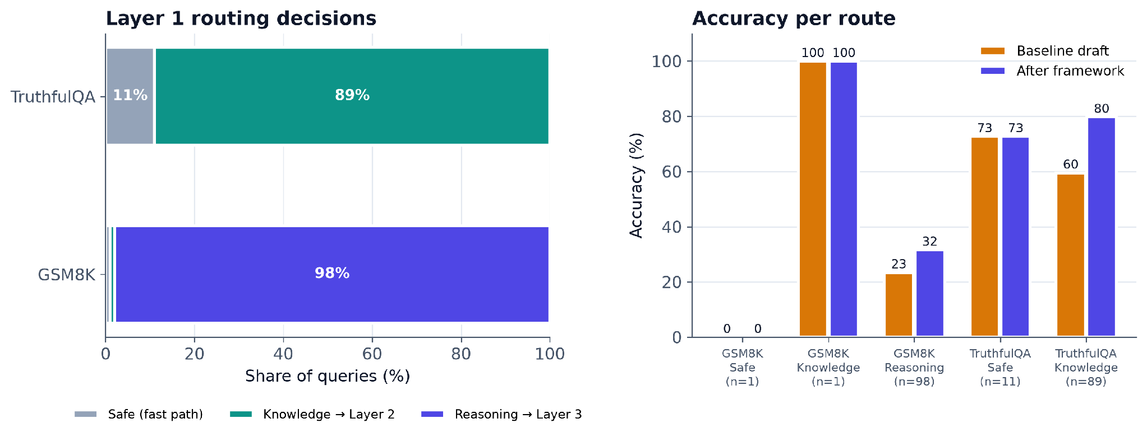
Results: Layer 1 Routing
Where queries went, and accuracy on each route
Takeaway: routed queries gain the most; the fast path keeps the draft unchanged at no extra verification cost.
Ms. Sakshi Sunil Chougule
Hallucination Mitigation in LLMs
23

Slide 14
Discussion and Limitations
How to read the Phase 1 results
Main result: the framework beats the raw llama2:7b baseline on both benchmarks (GSM8K +8.0 pts, p = 0.134; TruthfulQA +18.0 pts, p = 0.004).
Significance: a gain with p < 0.05 is statistically significant at N = 100; a larger p means the gain needs a bigger sample to confirm.
Selective verification: Layer 1 sends only uncertain drafts to the verifier; safe drafts are returned unchanged.
Imitative falsehoods: a model can repeat the same false answer in every sample; semantic entropy then stays low and the error passes the fast path.
Reasoning threshold: on the dev slice llama2 was mostly wrong even at zero entropy, so every quantitative query is verified (T_safe = 0).
Evaluation limits: N = 100 and 100 items on one machine; the TruthfulQA judge is an LLM, so ROUGE-L is reported as a model-free check.
Ms. Sakshi Sunil Chougule
Hallucination Mitigation in LLMs
26

