Slide 1

Agentic Swarm Orchestration for Intelligent Automated Vulnerability Detection and Patching
Dissertation Phase I Synopsis
Tejas Manojkumar Chavan · URN: 1025230010 Under the guidance of Dr. Amol S. Dange
Annasaheb Dange College of Engineering & Technology, Ashta, Sangli
Autonomous Institute Affiliated to Shivaji University, Kolhapur M.Tech in Computer Science and Engineering · AY 2026–27 · Semester I

Slide 2
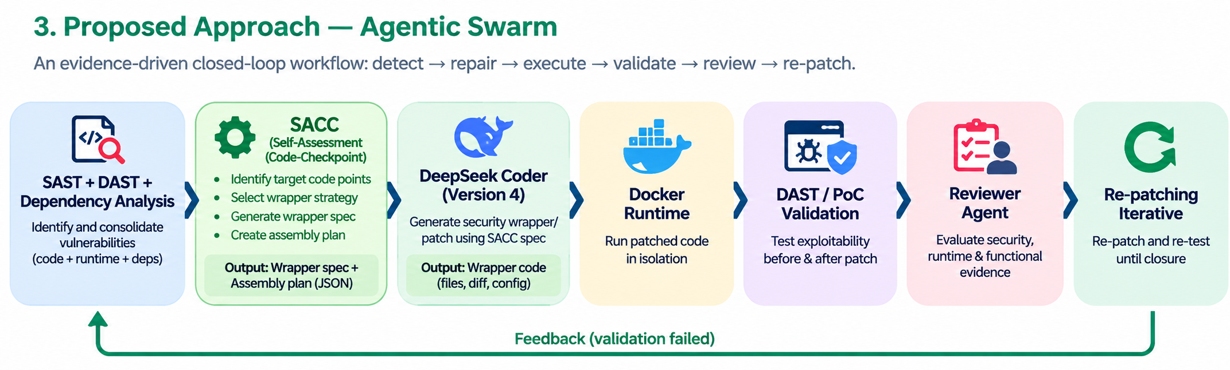
1. Background And Introduction
1. Growing Software Security Challenges
Modern software applications contain security vulnerabilities that can be difficult to detect and fix.
SAST identifies potential vulnerabilities, but static findings do not always prove actual exploitability.
LLMs can assist with vulnerability detection, code understanding and automated repair.
2. Role of Agentic AI
Multiple specialized AI agents divide tasks such as detection, code repair, testing and review.
LLM-based decisions may produce false positives, incomplete fixes or newly introduced defects.

Slide 3
Paper & Year | Main Contribution | Key Limitation
AIBugHunter: A Practical Tool for Predicting, Classifying and Repairing Software Vulnerabilities — Empirical Software Engineering, 2024 | Introduces AIBugHunter, an ML-based VS Code tool for vulnerability localization, classification, severity estimation, and automated repair of C/C++ software vulnerabilities. | Provides vulnerability detection and repair, but does not explicitly perform isolated runtime exploit testing and evidence-based validation to confirm that the generated patch completely closes the vulnerability.
HMF: Enhancing Reentrancy Vulnerability Detection and Repair with a Hybrid Model Framework — Automated Software Engineering, 2026 | Proposes a hybrid framework combining LLM and deep learning for reentrancy vulnerability detection and repair, improving detection performance and repair rate. | Focuses on detecting and repairing vulnerabilities but does not explicitly perform isolated runtime exploit testing to verify whether the generated repair completely closes the vulnerability.
APR4Vul: An Empirical Study of Automatic Program Repair Techniques on Real-World Java Vulnerabilities — Empirical Software Engineering, 2024 | Evaluates ten automatic program repair tools on 79 real-world Java vulnerabilities using testability, exploit closure, and functional correctness. | Shows that patch generation alone by LLM is insufficient; only about 44% of testable patches both close the vulnerability and preserve functionality, highlighting the need for exploit replay and regression-gated validation.
Automated Construction of Security Integrity Wrappers for Industry 4.0 Applications — Journal of Logical and Algebraic Methods in Programming, 2022 | Presents automated construction of security integrity wrappers from identified attack message flows, adding policy layers that protect critical communications. | Focuses on formal Industry 4.0 communication security and message integrity; it does not address LLM-based source-code vulnerability repair or runtime validation of application wrappers around vulns.

Slide 4
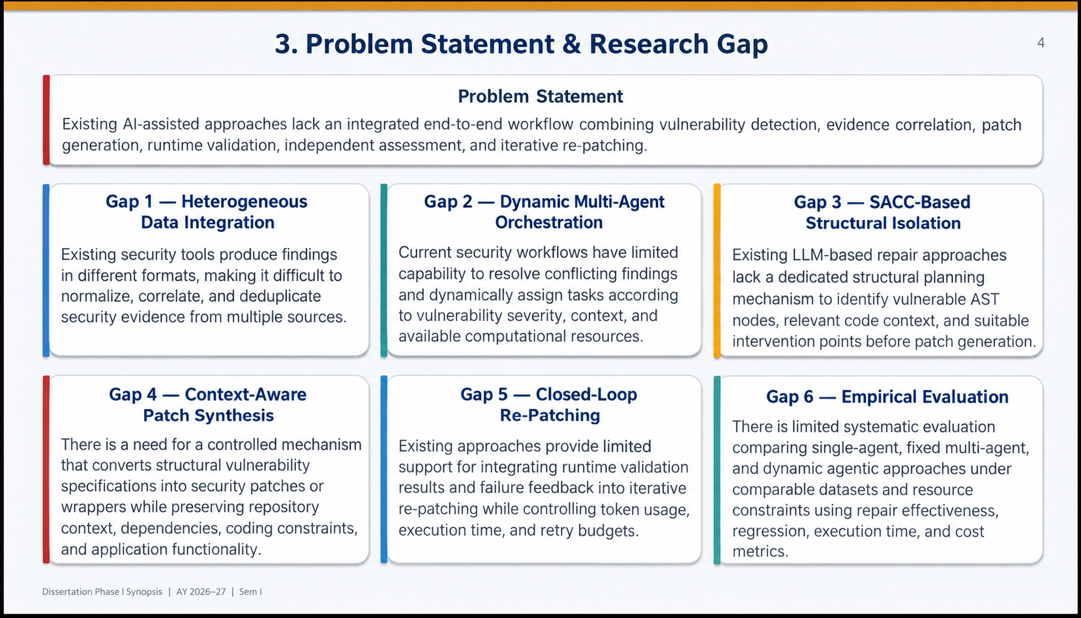
3. Problem Statement & Research Gap
4
Problem Statement
Existing AI-assisted approaches lack an integrated end-to-end workflow combining vulnerability detection, evidence correlation, patch generation, runtime validation, independent assessment, and iterative re-patching.
Gap 1 — Reliable Detection
Individual security checks may miss vulnerabilities or produce inconsistent findings; multiple analysis techniques need to be combined.
Gap 2 — Evidence Integration & Task Allocation
Different security tools produce heterogeneous evidence, making consistent correlation and coordinated agent task allocation difficult.
Gap 3 —Security Wrapper Approach
Existing approaches mainly modify vulnerable source code; limited work explores dynamically generated security wrappers around vulnerable code..
Gap 3 — Runtime Validation
Static analysis and generated repairs alone cannot confirm whether a vulnerability remains exploitable in a running application.
Gap 5 — Feedback-Guided Remediation
Validation or review findings may not be systematically used to guide subsequent repair attempts.
Gap 6 — Controlled Evaluation
The effectiveness and resource cost of agentic orchestration need evaluation against defined baselines under comparable conditions.
Dissertation Phase I Synopsis | AY 2026–27 | Sem I

Slide 5
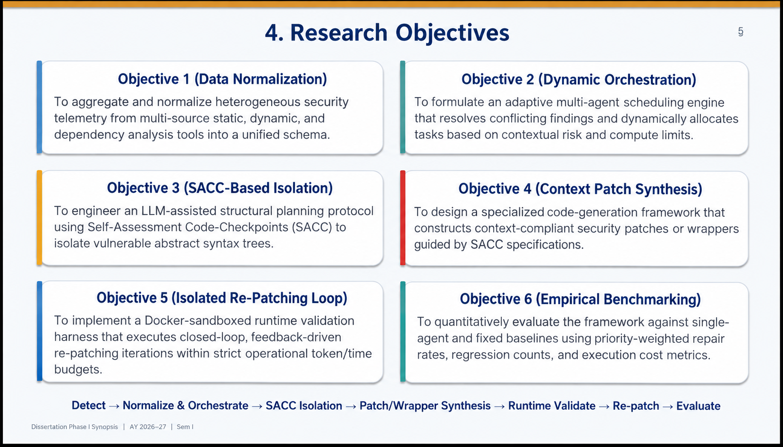
4. Research Objectives
5
5
Objective 1 — Reliable Detection
Integrate static analysis, dependency/CVE analysis, controlled dynamic testing, and threat-intelligence evidence.
Objective 2 — Evidence Integration & Task Allocation
Correlate findings, assess risk, and dynamically allocate specialized-agent tasks using vulnerability context and available resources.
Objective 3 —SAAC Implementation
Develop SACC to generate and assemble vulnerability-specific security wrappers around identified vulnerable code points
Objective 4— Automated Repair
Generate context-aware security patches using validated vulnerability evidence, affected source code, and remediation constraints
Objective 5 — Runtime Validation
Use Docker-isolated DAST/PoC testing to determine whether a documented vulnerability remains exploitable after patching.
..
Objective 6 — Feedback-Guided Re-patching
Use bounded validation/review feedback to revise repairs and create or update a PR with the final validated commit.
Objective 7 — Controlled Evaluation
Evaluate the harness on documented vulnerabilities using P0–P5 verified remediation rates and compare repair success, time, and computational overhead with defined baselines.
Detect → Correlate & Allocate → Repair → Runtime Validate → Independently Assess → Re-patch → Evaluate
Dissertation Phase I Synopsis | AY 2026–27 | Sem I

Slide 6
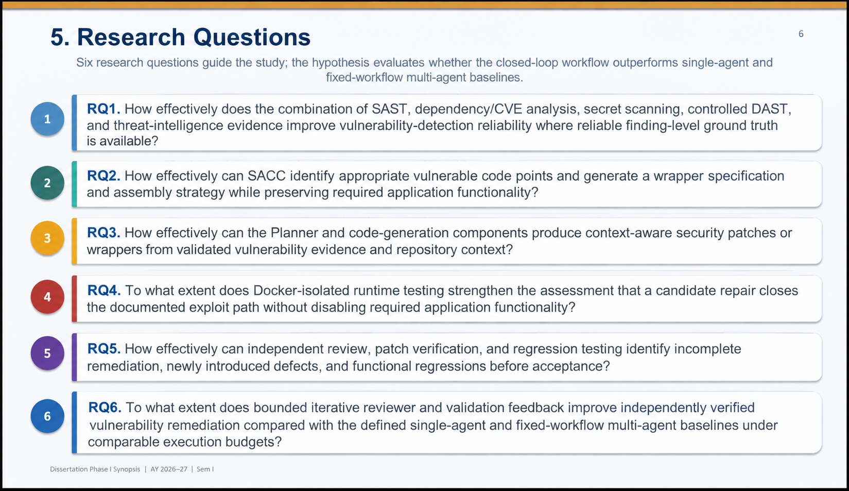
5. Research Questions
6
Five research questions guide the study; the hypothesis evaluates whether the closed-loop workflow outperforms a single-pass repair process.
1
How effectively does SAST,DAST,Dependancy CVEs analysis improve vulnerability-detection reliability and reduce false positives?
2
How can SACC generate and assemble security wrappers around vulnerable code while preserving the original application functionality?
3
To what extent does Docker-based runtime environment improve confidence that a patch closes the vulnerability?
4
How effectively can an independent Reviewer detect new defects and functional regressions?
5
To what extent does iterative reviewer feedback vulnerability closure compared with a single repair attempt?
Dissertation Phase I Synopsis | AY 2026–27 | Sem I

Slide 7
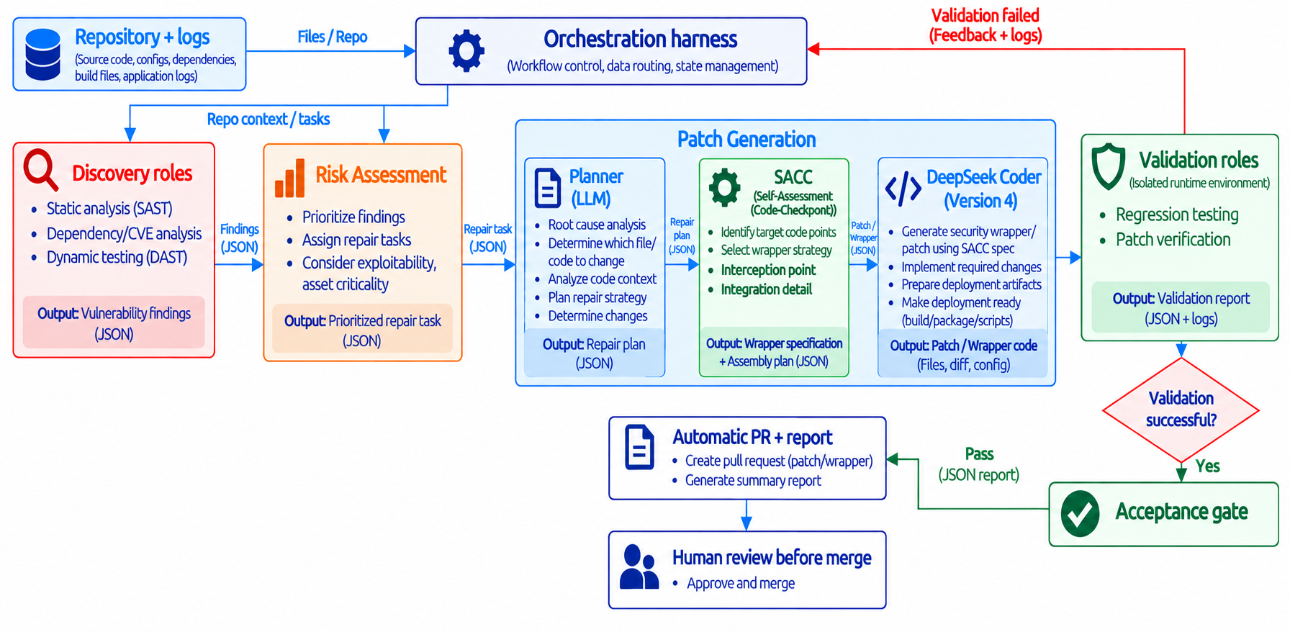
Proposed Architecture
The harness will select tasks, maintain evidence and control the remediation lifecycle

Slide 8
Workflow – Working Explanation
1)Repository + Logs
→ Source code, dependencies and build files → Orchestration Harness
2)Discovery
→ SAST + Dependency/CVE + DAST → Vulnerability Findings (JSON)
3)Risk Assessment
→ Prioritize findings & assign repair task → Repair Task (JSON)
4)Planner (LLM)
→ Root-cause analysis + identify file/code to change → Repair Plan (JSON)
5)SACC (Algorithm)
→ Select wrapper strategy + define target & assembly plan → Wrapper Specification (JSON)
6)DeepSeek Coder v4
→ Generate wrapper/patch + deployment artifacts → Patch/Wrapper Files
7)Validation
→ Regression Testing + Patch Verification → Validation Report
8)Success: Acceptance Gate → PR + Report → Human Approve & Merge
Failure: Feedback + Logs → Harness → Re-patching & Re-validation

Slide 9
Specialized Agent Responsibilities
Agent | Principal responsibility and output
Static Analysis (SAST) | Static analysis examining the source code without executing the program.
Dependency/CVE Analysis | The process of scanning software project libraries and packages to find security flaws.
Dynamic Testing (DAST) | Dynamic analysis evaluates software behavior by executing.
Risk Assessment | Collect correlated evidence and prepare operational priorities.
Planner (LLM) | Root cause analysis, determine which file/code to change, analyze code context, plan repair strategy.
SACC (Self-Assessment) | Identify target code points, select wrapper strategy, generate wrapper specification and assembly plan.
DeepSeek Coder (Version 4) | Generate security wrapper patch using SACC spec, implement required changes, prepare deployment artifacts.
Regression Testing | Build, functional and regression results against the baseline.
Patch Verification | Independent security review, re-analysis after patching to source code.
logical roles may share a model backend and use deterministic security tools

Slide 10
Primary Evaluation Metrics
Six priority-wise remediation rates and one overall weighted score
Priority-wise remediation rate
Overall priority-weighted score
w_{i}S_{i}
R =
S
× 100
i
W= × 100
i
i
N_{i}
w_{i}N_{i}
i
Both sums cover i = 0, …, 5; weights fixed in advance
One percentage for each priority, P0–P5
N_{i}
Known vulnerabilities in priority P_{i}
S_{i}
Independently verified repairs in priority P_{i}
w_{i}
Predefined positive weight for priority P_{i}
Report raw counts and variability across trials. Show N/A when a priority has no benchmark cases.

Slide 11
Secondary Metrics — Measurement Formulas
Additional measures for repair efficiency, resource usage and functional reliability
1. Verified Repair Time
2. Resource & Repair Cost
3. Regression Rate
Time from remediation start to independently verified repair.
Measure tokens, model calls, cost and repair attempts per task.
Percentage of final patches that fail required functional tests.
Tᵢ = Tverified − Tstart
Tokensᵢ = Input + Output
RR = F / Nf × 100%
Average: T̄ = ΣTᵢ / S
Callsᵢ = total model calls
Costᵢ = input cost + output cost
Attemptsᵢ = repair attempts
F = failed final candidates
Nf = final candidates tested

Slide 12
Tools and Technology
Component | Proposed implementation / boundary
Orchestration | Custom Node.js harness with persistent task state and an auditable event log.
Models and tools | OpenAI-compatible APIs, SAST/SCA, dependency intelligence and test runners.
Execution | Docker sandbox, constrained network and resource limits, clean repository revisions.
Operator and Git integration | REZI dashboard and hosted Git API for branch push and automatic PR creation.
Resource planning | We will decide the required CPU, memory, and storage after testing the system with a small pilot.

Slide 13
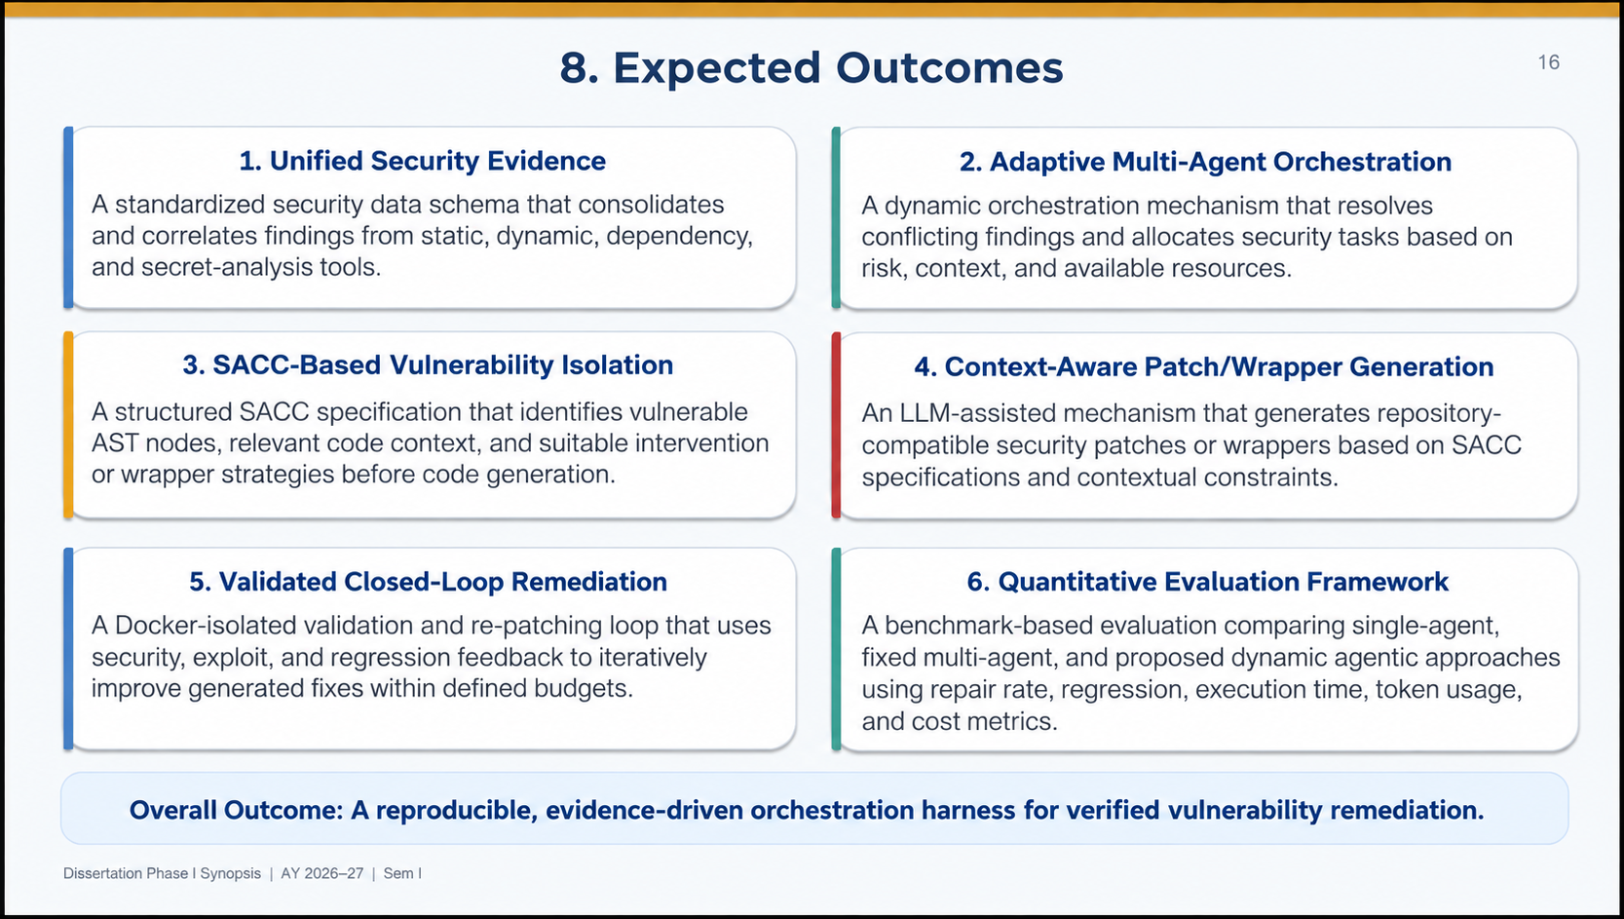
8. Expected Outcomes
16
16
1. Reliable Vulnerability Detection
A unified detection workflow integrating static analysis, dependency/CVE analysis, and dynamic testing.
2. Evidence-Driven Task Allocation
A structured mechanism to correlate vulnerability evidence and dynamically assign tasks to specialized agents.
3. SACC Implementtion
DeepSeek Coder v4 generates a validated runtime security wrapper that protects the vulnerable execution point while preserving the core business logic
4. Runtime-Verified Patching
A Docker + DAST/PoC validation mechanism to determine whether the vulnerability remains exploitable after patching.
5. Feedback-Guided Re-patching
A bounded closed-loop mechanism for feedback → re-patch → re-test when a candidate repair fails validation.
6. Controlled Experimental Evaluation
A comparative evaluation against defined baselines using verified remediation, time, repair attempts, resource usage, and regression rate.
Overall Outcome: A reproducible, evidence-driven orchestration harness for verified vulnerability remediation.
Dissertation Phase I Synopsis | M.Tech CSE | AY 2026–27 | Sem I

Slide 14
9.Scope And Limitations
11
Scope
Automated vulnerability detection, patch generation, runtime validation and iterative remediation.
Integration of SAST, LLM analysis, DeepSeek-Coder, Docker, DAST testing and independent review.
Limitations
LLM performance may vary with model capability, prompts, context and quality of security evidence.
DAST testing validates the tested exploit paths and cannot by itself prove the absence of every possible exploit that were not mentioned.
Docker-based execution may not reproduce every production deployment condition such as network latency
Complex vulnerabilities may require multiple iteration.
Dissertation Phase I Synopsis | AY 2026–27 | Sem I

