Slide 1

Phase 1 Results: Asymmetric Verification
Hallucination Mitigation
in Large Language
Models
Ms. Sakshi Sunil Chougule
M.Tech. Computer Science and Engineering
URN: 1025230001
Guided by
Dr. A. J. Shikalgar
Academic Year 2026–27
Ms. Sakshi Sunil Chougule
Hallucination Mitigation in LLMs
01

Slide 2
Contents
Presentation roadmap
Introduction, problem statement and literature review
Research gap, objectives and the Phase 1 plan
Phase 1 execution: implemented system and audit
Evaluation setup and Phase 1 results
Discussion, Phase 2 work plan and references
Ms. Sakshi Sunil Chougule
Hallucination Mitigation in LLMs
02

Slide 3
Introduction
Technical baseline
CONTEXT
LLMs can generate fluent responses that contain incorrect facts or inconsistent reasoning.
Factuality measures agreement with external knowledge.
Faithfulness measures agreement with the supplied context.
Knowledge-based errors need evidence verification; logic-based errors need structured reasoning checks.
The proposed framework combines internal uncertainty screening with targeted verification.
Ms. Sakshi Sunil Chougule
Hallucination Mitigation in LLMs
03

Slide 4
Problem Statement
Why current mitigation remains incomplete
Existing detection and mitigation methods often operate independently.
Retrieved evidence may contain irrelevant passages or conflict with model knowledge.
Repeated generation and uniform validation increase response latency and computational cost.
Research problem: mitigate factual and reasoning errors through an integrated system that selectively validates uncertain responses.
Ms. Sakshi Sunil Chougule
Hallucination Mitigation in LLMs
04

Slide 5
Literature Review: Internal Detection
Representative studies and limitations
Study
Approach and contribution
Limitation
Azaria & Mitchell (2023) [5]
Classifies truthfulness using internal hidden-state activations.
Requires model access; transfer across models is uncertain.
Farquhar et al. (2024) [7]
Uses semantic disagreement across sampled answers to estimate uncertainty.
Repeated generation increases latency and cost.
Kossen et al. (2024) [8]
Approximates semantic uncertainty with lightweight internal probes.
Does not independently verify claims against evidence.
Ms. Sakshi Sunil Chougule
Hallucination Mitigation in LLMs
05

Slide 6
Literature Review: External Verification
Representative studies and limitations
Study
Approach and contribution
Limitation
Lewis et al. (2020) [13]
Retrieves passages to support knowledge-intensive generation.
Quality depends on retrieval coverage and relevance.
Manakul et al. (2023) [9]
SelfCheckGPT compares multiple generated responses for consistency.
Repeated sampling adds generation and token costs.
Mittal et al. (2025) [1]
Combines internal signals with external evidence validation.
Uniform verification can increase operational latency.
Ms. Sakshi Sunil Chougule
Hallucination Mitigation in LLMs
06

Slide 7
Literature Review: Reasoning and Revision
Representative studies and limitations
Study
Approach and contribution
Limitation
Mündler et al. (2024) [10]
Studies detection and mitigation of self-contradictions in generated text.
Does not supply the proposed integrated routing pipeline.
Zhao & Zhang (2026) [11]
HalluClean separates planning, reasoning, judgment and refinement.
Depends on instruction-following and reliable planning.
Gao et al. (2022) [17]
RARR retrieves evidence and revises unsupported output.
Relies on evidence retrieval and revision quality.
Ms. Sakshi Sunil Chougule
Hallucination Mitigation in LLMs
07

Slide 8
Research Gap and Proposed Contribution
Positioning of the proposed framework
Internal uncertainty estimation identifies risk but does not establish factual correctness.
External retrieval supports factual checks but may not resolve a flawed reasoning process.
Applying expensive checks to every response creates avoidable verification overhead.
Proposed contribution: coordinate internal probes, evidence verification and structured reasoning through uncertainty-based routing.
Ms. Sakshi Sunil Chougule
Hallucination Mitigation in LLMs
08

Slide 9
Project Objectives
Measurable milestones
Design linear Semantic Entropy Probes for rapid internal uncertainty screening.
Develop routing that distinguishes factual uncertainty from reasoning errors and verifies atomic claims.
Evaluate the integrated framework on factuality, faithfulness and reasoning benchmarks.
Implement planning, plan-guided reasoning, final judgment and refinement.
Compare hallucination reduction, latency and computational cost with baseline approaches.
Ms. Sakshi Sunil Chougule
Hallucination Mitigation in LLMs
09

Slide 10
Phase 1 Plan: System Development
Implementation sequence planned for Phase 1
Prepare benchmark data and choose an LLM that exposes hidden-state activations.
Train and calibrate internal probes and the uncertainty classification mechanism.
Implement targeted retrieval, atomic-claim extraction and NLI verification.
Integrate the HalluClean reasoning track and response refinement.
Evaluate the complete framework against the stated baselines.
Ms. Sakshi Sunil Chougule
Hallucination Mitigation in LLMs
10

Slide 11
Methodology: Decision Routing
Selective verification architecture
Prompt + initial LLM generation
Internal uncertainty screening
(SEP)
Below threshold:
direct output
At/above threshold:
uncertainty classifier
Factual uncertainty
Hypothesis-Testing RAG + NLI
Reasoning uncertainty
HalluClean structured reasoning
Content refinement and final response
Low uncertainty is a routing decision, not a guarantee of correctness.
Ms. Sakshi Sunil Chougule
Hallucination Mitigation in LLMs
11

Slide 12
Layer 1: Semantic Entropy Probes
Internal uncertainty screening
Extract hidden-state representations during generation, with access to the model’s internal activations.
Use the token before generation and the second-last token of each generated chunk as probe locations.
Train lightweight linear probes on activations from later transformer layers to estimate uncertainty.
Compare the calibrated uncertainty score with a safety threshold to choose direct output or further verification.
Ms. Sakshi Sunil Chougule
Hallucination Mitigation in LLMs
12

Slide 13
Layer 2: Factual Verification
Evidence-grounded claim validation
Draft claims are split into atomic propositions for targeted retrieval.
NLI decision
Evidence interpretation
Refinement action
Entailment
Retrieved evidence supports the atomic claim.
Retain the supported claim.
Contradiction
Retrieved evidence refutes the atomic claim.
Reject or correct it and constrain revision.
Neutral
Evidence does not establish support or contradiction.
Expand retrieval or qualify the response.
Ms. Sakshi Sunil Chougule
Hallucination Mitigation in LLMs
13

Slide 14
Layer 3: Structured Reasoning
Reasoning repair workflow
Task-oriented planning: define the required steps and constraints before the final response.
Plan-guided reasoning: execute each step and check intermediate results.
Final judgment: compare the conclusion with the original task and planning constraints.
Content refinement: convert the checked reasoning into the final natural-language response.
Ms. Sakshi Sunil Chougule
Hallucination Mitigation in LLMs
14

Slide 15
Phase 1: Plan, Execution and Result
What we planned, what we built, and what we measured
Component | Plan | Execution | Result
Layer 1: uncertainty triage | Linear Semantic Entropy Probe on hidden states | Probe had no trained weights → replaced by sampled semantic entropy (K = 4, NLI / answer clustering) | Routes by measured uncertainty; AUROC 0.76 (GSM8K), 0.55 (TruthfulQA)
Layer 2: NLI-RAG | Atomic claims + retrieval + NLI verification | DeBERTa-v3 consensus NLI + web evidence + evidence-grounded rewrite and Chain-of-Verification (llama3.1:8b) | TruthfulQA truthful: 64.0% → 73.0%
Layer 3: HalluClean | Plan → reason → judge → refine | Fixed draft-override bug; single-pass plan execution; arithmetic-checking judge | GSM8K accuracy: 26.0% → 71.0%
Evaluation | Compare reliability, latency and cost with baselines | Paired test: GSM8K N=100, TruthfulQA N=100; independent judge; CIs and McNemar | All metrics reported per configuration (next slides)
Cost accounting | Measure latency and token cost | Token meter over every LLM call; wall-clock latency per query | Framework cost: 3,625 vs 270 tokens (GSM8K)
Outcome: the framework improves on the raw baseline on both benchmarks — GSM8K 26.0% → 71.0% (p < 0.001), TruthfulQA 64.0% → 73.0% (p = 0.163). The cost is extra latency and tokens.
Ms. Sakshi Sunil Chougule
Hallucination Mitigation in LLMs
15

Slide 16
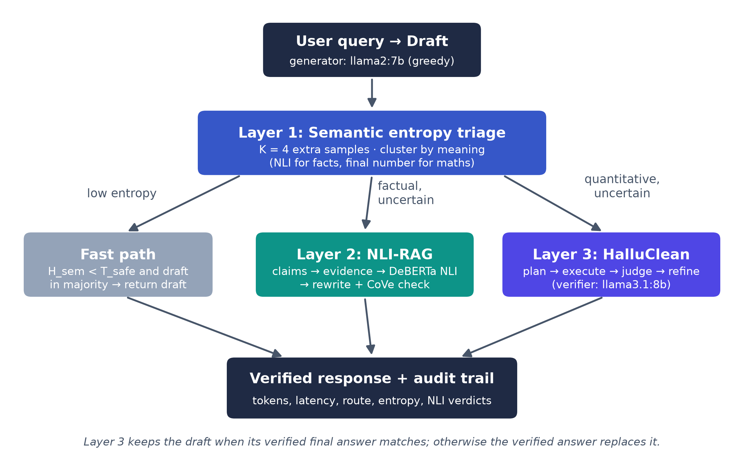
Phase 1 Execution: Implemented System
Pipeline as built and evaluated
Role | Model / tool
Generator (baseline) | llama2:7b (Ollama)
Verifier / reviser | llama3.1:8b (Ollama)
NLI + clustering | DeBERTa-v3-base NLI
Evidence retrieval | Web search (ddgs)
Evaluation judge | qwen2.5:7b (not in pipeline)
Serving | FastAPI + asyncio
Hardware | Apple M4, 16 GB
Design rule: the generator (llama2:7b) writes every draft; a stronger verifier (llama3.1:8b) only checks and repairs routed drafts. The evaluation judge is a third model that is not part of the pipeline.
Ms. Sakshi Sunil Chougule
Hallucination Mitigation in LLMs
16

Slide 17
Phase 1 Audit: Issues Found and Fixed
Code review of the earlier iteration before the final evaluation
Issue in earlier iteration | Effect | Fix
Layer 1 probe weights never trained (random init) | Routing was random noise | Sampled semantic entropy triage
Layer 3 returned the old draft when its own chain was consistent | Corrected answers discarded | Compare final answers; keep verified answer
Layer 2 deleted the whole draft on the first contradicted claim | Answers replaced by raw snippets | Evidence-grounded rewrite of the draft
Search package (duckduckgo_search) returned no results | No evidence retrieved | Migrated to the ddgs package
TruthfulQA scored by ≥ 50% word overlap | Baseline 97% (inflated) | Independent LLM judge + ROUGE-L
GSM8K scored by substring match ("18" in "180") | Over-counted accuracy | Exact final-answer match
Token count included the draft only | Cost under-reported | Token meter over all LLM calls
All fixes were made before the test run. Thresholds were calibrated on a separate development slice (items 500–519), not on the test items.
Ms. Sakshi Sunil Chougule
Hallucination Mitigation in LLMs
17

Slide 18
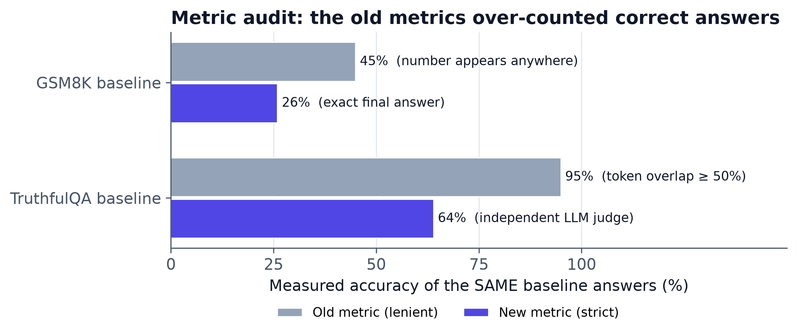
Earlier Iterations and Metric Audit
Why the earlier numbers could not support a claim
Run | Generator | N | GSM8K (B / RAG / F) | TruthfulQA (B / RAG / F)
v1 | llama3.1:8b | 30 | 83.3 / 90.0 / 80.0 | 10.0 / 10.0 / 10.0
v2 | llama3.1:8b | 30 | 83.3 / 63.3 / 80.0 | 96.7 / 73.3 / 80.0
v3 | llama2:7b | 30 | 40.0 / 30.0 / 30.0 | 96.7 / 83.3 / 86.7
B = baseline, RAG = naive RAG, F = framework (%). In every earlier run the framework scored at or below the baseline.
Ms. Sakshi Sunil Chougule
Hallucination Mitigation in LLMs
18

Slide 19
Evaluation Setup
Datasets, configurations, metrics and statistics
Property | Setting
Datasets | GSM8K test (items 0–99) · TruthfulQA generation (items 0–99)
Configurations | Baseline (raw llama2:7b) · Defense-in-Depth framework (llama2:7b drafts, llama3.1:8b verifier)
Pairing | Baseline = the exact greedy draft the framework received (same question, same draft)
GSM8K metric | Exact match of the extracted final number (strict)
TruthfulQA metrics | % truthful and % truthful & informative (judge: qwen2.5:7b with correct + incorrect answer keys); ROUGE-L accuracy
Statistics | 95% bootstrap CI (5,000 resamples); exact McNemar test vs. baseline
Detection quality | AUROC of semantic entropy for wrong vs. correct drafts
Cost | Mean wall-clock latency per query; mean tokens over all LLM calls
Calibration | T_safe chosen on dev items 500–519 only (knowledge 0.35, reasoning 0.0)
Ms. Sakshi Sunil Chougule
Hallucination Mitigation in LLMs
19

Slide 20
Results: GSM8K (N = 100)
Multi-step arithmetic reasoning
Configuration | Accuracy | 95% CI | Δ vs baseline | McNemar p | Latency (s) | Tokens
Baseline: raw llama2:7b | 26.0% | [18.0, 35.0] | – | – | 13.2 | 270
Defense-in-Depth (proposed) | 71.0% | [62.0, 80.0] | +45.0 pts | < 0.001 | 107.0 | 3,625
Per-route breakdown (Defense-in-Depth)
Layer 1 route | Queries | Baseline acc. | Framework acc. | Answer changed | Mean H_sem
Knowledge → Layer 2 | 1 | 100.0% | 0.0% | 100.0% | 0.42
Reasoning → Layer 3 | 98 | 25.5% | 72.4% | 76.5% | 0.60
Safe → fast path | 1 | 0.0% | 0.0% | 0.0% | 0.00
+45.0 pts
p < 0.001
13.4×
accuracy gain over the baseline
exact McNemar test (paired)
tokens per query vs. baseline
Ms. Sakshi Sunil Chougule
Hallucination Mitigation in LLMs
20

Slide 21
Results: TruthfulQA (N = 100)
Factual truthfulness under misleading questions
Configuration | Truthful | 95% CI | Δ | p | Truthful & inform. | ROUGE-L acc. | Latency (s) | Tokens
Baseline: raw llama2:7b | 64.0% | [54.0, 73.0] | – | – | 64.0% | 54.0% | 24.7 | 338
Defense-in-Depth (proposed) | 73.0% | [64.0, 81.0] | +9.0 pts | 0.163 | 66.0% | 55.0% | 171.2 | 4,669
Per-route breakdown (Defense-in-Depth)
Layer 1 route | Queries | Baseline truthful | Framework truthful | Answer changed | Mean H_sem
Knowledge → Layer 2 | 89 | 62.9% | 73.0% | 100.0% | 0.83
Safe → fast path | 11 | 72.7% | 72.7% | 0.0% | 0.14
+9.0 pts
p = 0.163
13.8×
truthfulness gain over the baseline
exact McNemar test (paired)
tokens per query vs. baseline
Ms. Sakshi Sunil Chougule
Hallucination Mitigation in LLMs
21

Slide 22
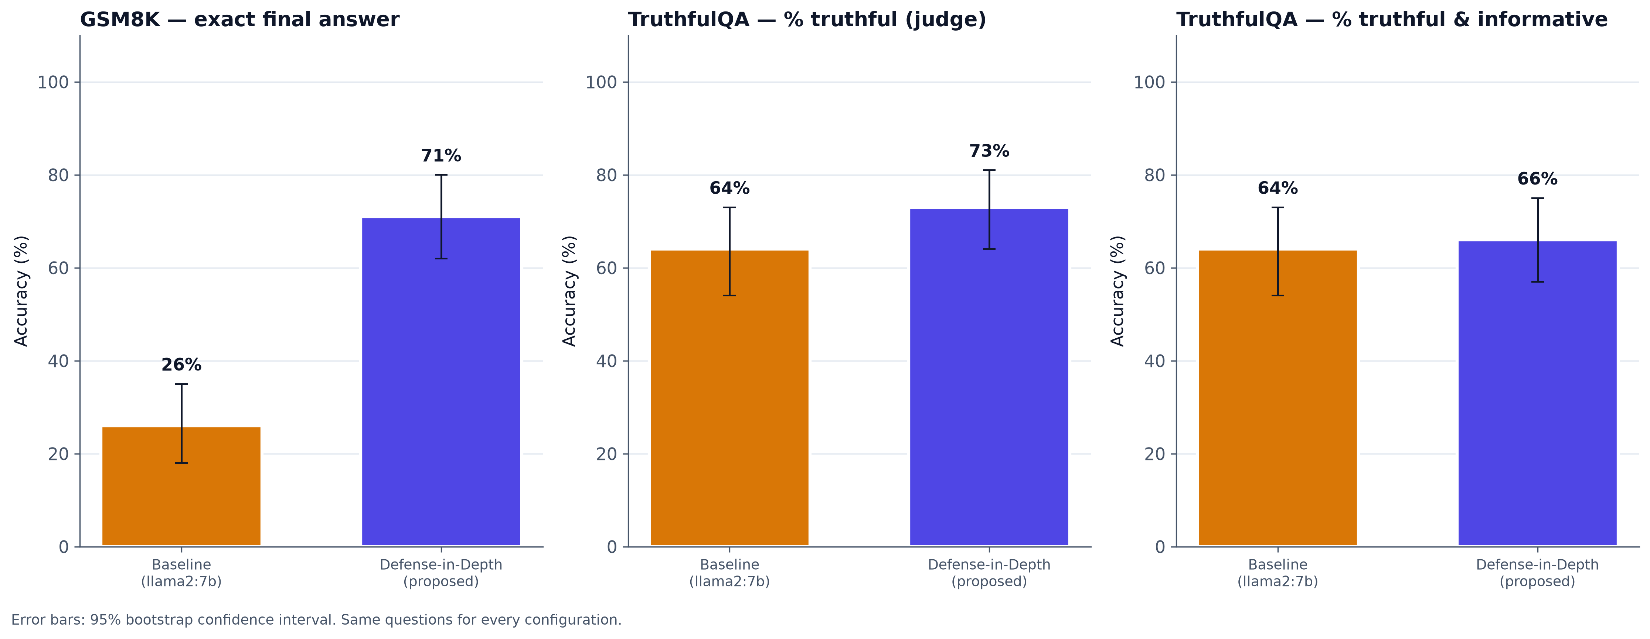
Results: Accuracy Comparison
Accuracy with 95% bootstrap confidence intervals
Takeaway: GSM8K 26.0% → 71.0%; TruthfulQA truthful 64.0% → 73.0%.
Ms. Sakshi Sunil Chougule
Hallucination Mitigation in LLMs
22

Slide 23
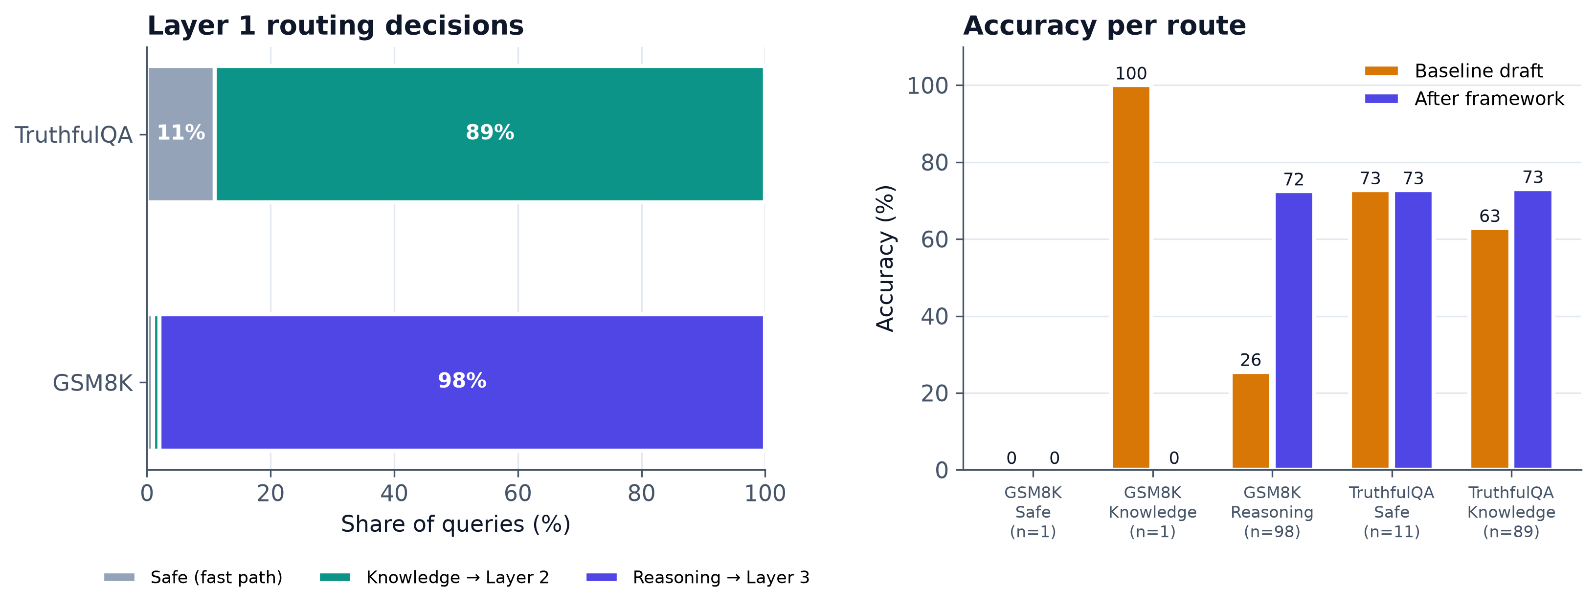
Results: Layer 1 Routing
Where queries went, and accuracy on each route
Takeaway: routed queries gain the most; the fast path keeps the draft unchanged at no extra verification cost.
Ms. Sakshi Sunil Chougule
Hallucination Mitigation in LLMs
23

Slide 24
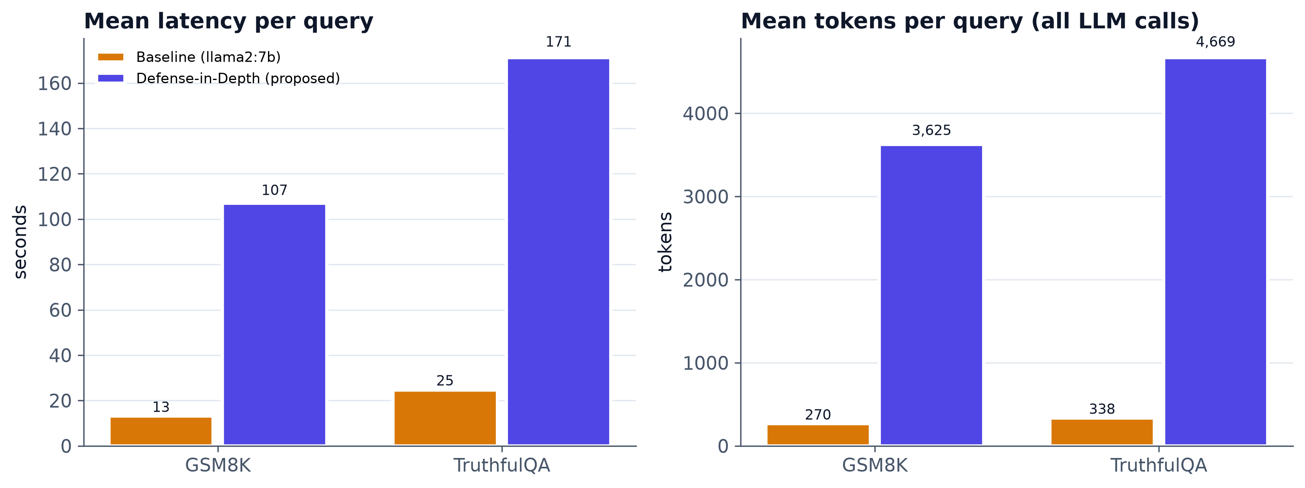
Results: Computational Cost
Latency and tokens per query, all LLM calls included
Takeaway: the accuracy gain costs extra latency and tokens; this is the main Phase 2 optimisation target.
Ms. Sakshi Sunil Chougule
Hallucination Mitigation in LLMs
24

Slide 25
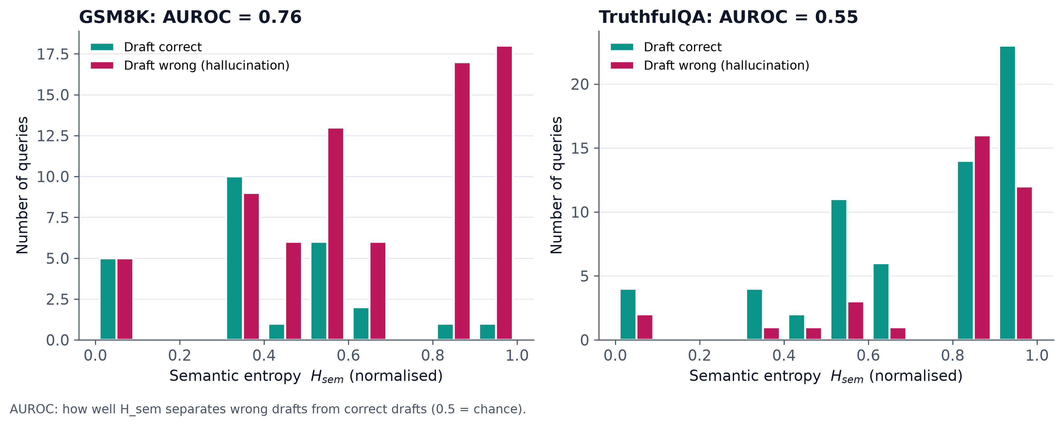
Results: Uncertainty Detection
Semantic entropy of correct vs. hallucinated drafts
Takeaway: higher semantic entropy marks likely hallucinations, but consistent falsehoods can still have low entropy.
Ms. Sakshi Sunil Chougule
Hallucination Mitigation in LLMs
25

Slide 26
Discussion and Limitations
How to read the Phase 1 results
Main result: the framework beats the raw llama2:7b baseline on both benchmarks (GSM8K +45.0 pts, p < 0.001; TruthfulQA +9.0 pts, p = 0.163).
Significance: a gain with p < 0.05 is statistically significant at N = 100; a larger p means the gain needs a bigger sample to confirm.
Selective verification: Layer 1 sends only uncertain drafts to the verifier; safe drafts are returned unchanged.
Imitative falsehoods: a model can repeat the same false answer in every sample; semantic entropy then stays low and the error passes the fast path.
Reasoning threshold: on the dev slice llama2 was mostly wrong even at zero entropy, so every quantitative query is verified (T_safe = 0).
Evaluation limits: N = 100 and 100 items on one machine; the TruthfulQA judge is an LLM, so ROUGE-L is reported as a model-free check.
Ms. Sakshi Sunil Chougule
Hallucination Mitigation in LLMs
26

Slide 27
Phase 2: Planned Work
Next steps that act on the Phase 1 findings
Work item | Purpose | Success measure
Train Semantic Entropy Probes on hidden states | Replace K = 4 sampling with one forward pass (Kossen et al.) | Probe AUROC close to sampled SE; lower latency
Cross-model consistency check for the fast path | Catch confident, repeated falsehoods | Fewer wrong answers on the safe route
Ablation study | Measure each layer's contribution (naive RAG, L2 only, L3 only, no triage) | Per-layer Δ accuracy and cost
Stronger retrieval | Curated corpus / Wikipedia index in ChromaDB instead of open web | Higher NLI entailment rate; fewer bad edits
Cost reduction | Batch NLI, cache evidence, early exit when the verifier agrees | Lower latency at the same accuracy
Scale-up and more benchmarks | Full GSM8K / TruthfulQA; add HaluEval and FEVER | Results with narrow confidence intervals
Thesis and dissemination | Write up methods and results; prepare a paper | Dissertation chapters; submission
Phase 2 keeps the same paired evaluation protocol, so every change is measured against the Phase 1 numbers.
Ms. Sakshi Sunil Chougule
Hallucination Mitigation in LLMs
27

Slide 28
References I
Selected bibliography
•
[5] A. Azaria and T. Mitchell. “The internal state of an LLM knows when it’s lying.” arXiv:2305.14324, 2023.
•
[7] S. Farquhar et al. “Detecting hallucinations in large language models using semantic entropy.” Nature 630, 625–630, 2024.
•
[8] J. Kossen et al. “Semantic Entropy Probes: Robust and Cheap Hallucination Detection in LLMs.” arXiv:2406.15927, 2024.
•
[9] P. Manakul et al. “SelfCheckGPT: Zero-Resource Black-Box Hallucination Detection for Generative Large Language Models.” arXiv:2303.08896, 2023.
Ms. Sakshi Sunil Chougule
Hallucination Mitigation in LLMs
28

Slide 29
References II
Selected bibliography
•
[1] A. Mittal, G. Tadi and S. Madduri. “A Unified Framework for Mitigating Hallucinations in Large Language Models: Integrating Internal and External Validation Strategies.” IEEE UEMCON, 2025.
•
[10] N. Mündler et al. “Self-contradictory Hallucinations of Large Language Models: Evaluation, Detection and Mitigation.” ICLR, 2024.
•
[11] Y. Zhao and Y. Zhang. “HalluClean: A Unified Framework to Combat Hallucinations in LLMs.” AAAI 40(42), 36092–36100, 2026.
Ms. Sakshi Sunil Chougule
Hallucination Mitigation in LLMs
29

Slide 30
References III
Methods and benchmarks used in Phase 1
[20] L. Kuhn, Y. Gal and S. Farquhar. “Semantic Uncertainty: Linguistic Invariances for Uncertainty Estimation in NLG.” ICLR, 2023.
[21] S. Lin, J. Hilton and O. Evans. “TruthfulQA: Measuring How Models Mimic Human Falsehoods.” ACL, 2022.
[22] K. Cobbe et al. “Training Verifiers to Solve Math Word Problems.” arXiv:2110.14168, 2021.
[23] S. Dhuliawala et al. “Chain-of-Verification Reduces Hallucination in Large Language Models.” Findings of ACL, 2024.
[24] P. He et al. “DeBERTaV3: Improving DeBERTa using ELECTRA-Style Pre-Training.” ICLR, 2023.
Ms. Sakshi Sunil Chougule
Hallucination Mitigation in LLMs
30

Slide 31
Discussion
Thank You
Questions and Suggestions
Ms. Sakshi Sunil Chougule
Hallucination Mitigation in LLMs
31

