Slide 1
UNIT-3 Natural Language Processing with Probabilistic Models

Slide 2
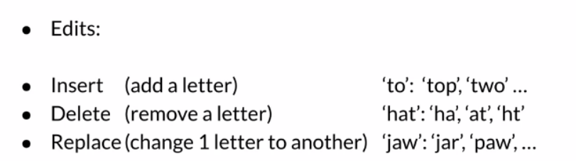
Autocorrect: Minimum Edit Distance
The Minimum Edit Distance (MED) is a fundamental concept in natural language processing, especially relevant in tasks like autocorrect, spell checking, and text similarity.
The minimum edit distance between two strings is defined as the minimum number. of editing operations (insertion, deletion, substitution) needed to transform one string into another. These operations are typically:
Insertion: Adding a character.
Deletion: Removing a character.
Substitution: Replacing one character with another.

Slide 3
Real-life Example: Spell Checkers
The minimum edit distance is a measure of how many changes (insertions, deletions, or substitutions) are required to transform one string into another. This concept has practical applications in various real-life scenarios. Here's a simple example to illustrate:
When you type a word in a document or a search engine, and it’s misspelled, the software tries to suggest the correct word by determining which valid word is closest to your input. For instance:
Misspelled word: "recieve"
Correct word: "receive"
The software uses the concept of minimum edit distance to transform "recieve" into "receive." Here’s how:
Substitution: Change the 'i' to 'e' → "receive"
In this case, the minimum edit distance is 1, as only one substitution is needed. Spell checkers use this technique to identify the closest valid words based on the smallest number of edits. This approach ensures that suggestions are both relevant and accurate.

Slide 4
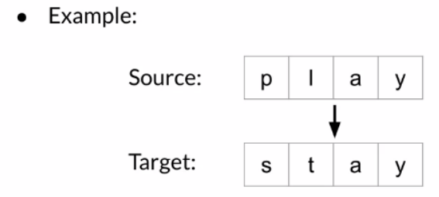
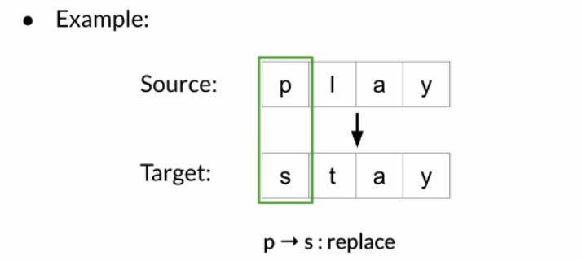
Example:
You want to convert word play into stay

Slide 5
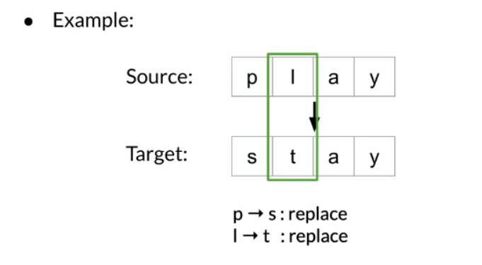
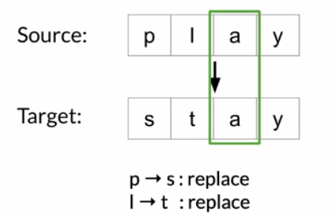
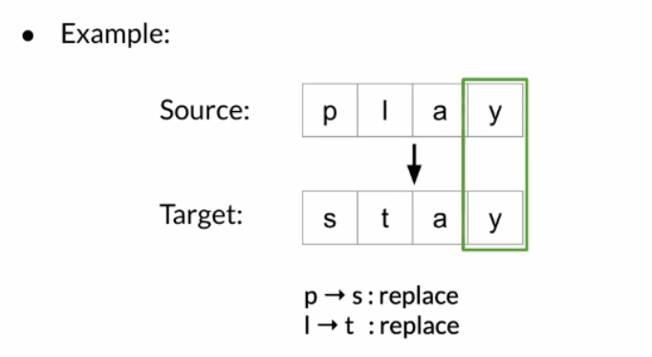

Slide 6
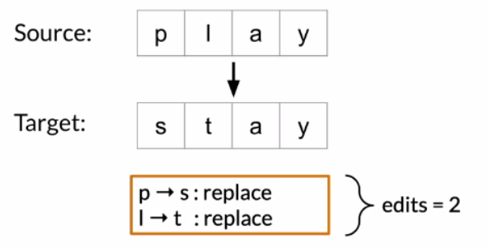
So to turn p into s, you replace p with an s and to turn l into t you replace l with a t. Both a and a are the same. So do nothing and it’s the same with y and y.
So the total number of edits is 2. Until this point you’ve considered all edits operations to cost the same. That is a cost of one but now you will consider a different cost for each type of operation.

Slide 7
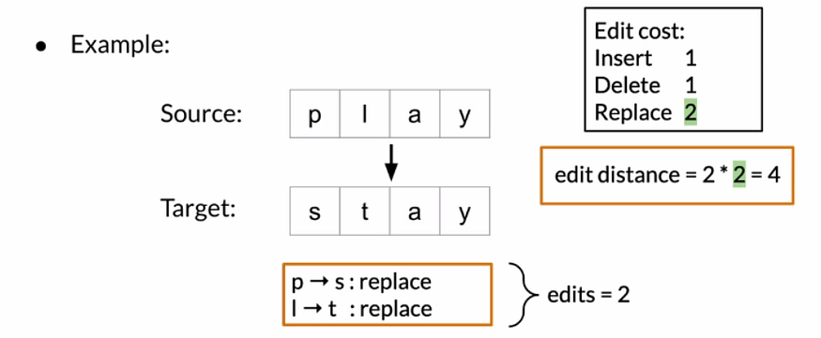
Inserts and deletes will have a cost of 1 and replace has a cost of 2. This makes intuitive sense if you think of replacement as it deletes followed by an insert.
Calculate for this example. You have to replace edit at a cost of 2 each for a total added distance of 4.
This is a relatively simple example and it was possible to find the minimum edit distance just by looking at it.

Slide 8
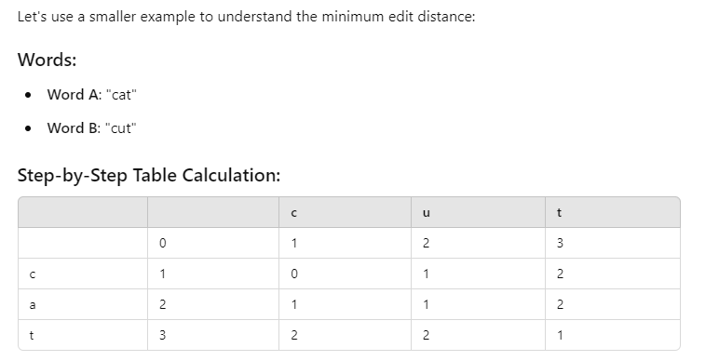
Example

Slide 9
Explanation
Initialization:
The first row represents the cost of inserting characters to go from an empty string to "cut."
The first column represents the cost of deleting characters to turn "cat" into an empty string.
Filling the Table:
Compare 'c' with 'c': They match, so the cost is 0.
Compare 'a' with 'u': They differ, so the cost is 1 for substitution.
Compare 't' with 't': They match, so the cost is 0.
Result:
The minimum edit distance between "cat" and "cut" is 1 (only one substitution: change 'a' to 'u').

Slide 10
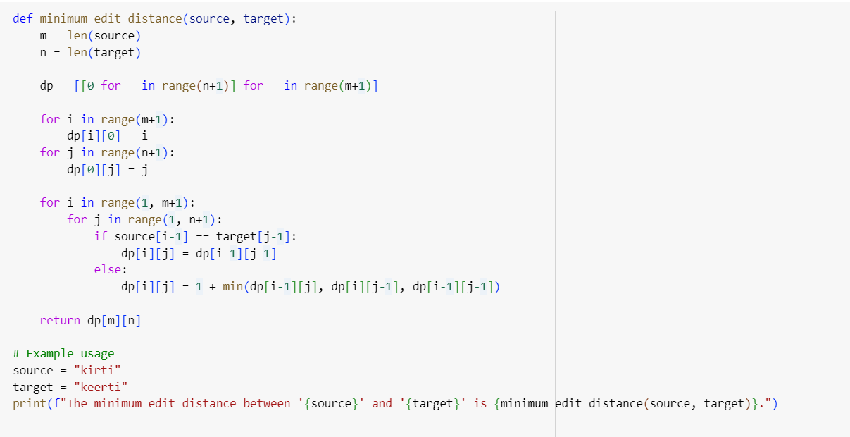
Example

Slide 11
Complete code link
https://colab.research.google.com/drive/1Gge5CwXGoK1DwQpY-eRyYLY1YeXASvMO?usp=sharing

Slide 12
Spell Checkers
In NLP, spell checkers are tools designed to identify and correct spelling errors in text. They play a crucial role in preprocessing text data to improve the quality of input for various applications like sentiment analysis, machine translation, or search engines. Here’s a breakdown of the key concepts and methods involved in building spell checkers:
1. Error Detection and Correction
Error Detection: Identifying words that are misspelled or out of place in a given text.
Error Correction: Suggesting the most probable correct spelling for the detected errors.
2. Types of Spelling Errors
Non-word errors: Words that do not exist in the dictionary (e.g., "speling" instead of "spelling").
Real-word errors: Incorrect but valid words due to typos or misuse (e.g., "from" instead of "form").

Slide 13
Spellchecker to Correct Misspelled Words:
Creating a spellchecker to correct misspelled words in NLP involves several key steps, including tokenization, detecting potential misspellings, and suggesting corrections. Following are the necessary steps for implementing spellchecker.
Load Dictionary: Load a dictionary of valid words.
Tokenization: Split the input text into individual words.
Detect Misspellings: Check if each word is in the dictionary.
Suggest Corrections: For misspelled words, suggest the closest match from the dictionary using Minimum Edit Distance.
Replace Words: Replace misspelled words with their suggested corrections.

Slide 14
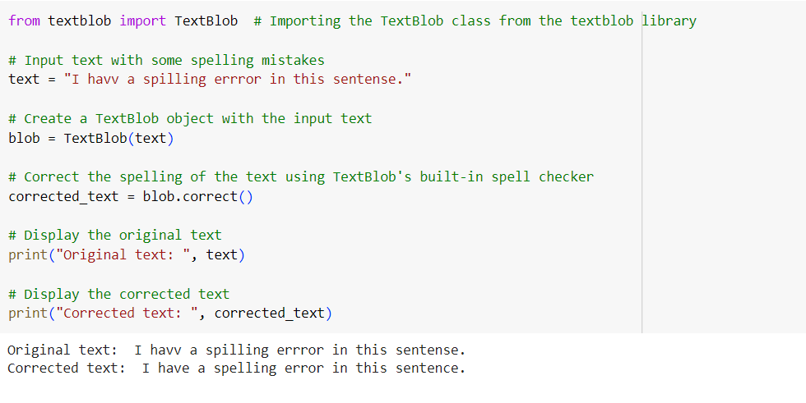
Example with pre trained library

Slide 15
Complete code link
https://colab.research.google.com/drive/1aiiwcRzMVBfe_HeaQ96R0M8qRNnjfepY?usp=sharing

Slide 16
What is Dynamic Programming (DP)?
Algorithmic technique to solve problems by breaking them down into simpler subproblems
Stores results of subproblems to avoid redundant calculations

Slide 17
Key Concepts
Overlapping Subproblems: The problem can be broken into subproblems that are solved repeatedly. DP solves each subproblem only once and stores the result to avoid redundant computations.
Optimal Substructure: The optimal solution to the overall problem can be constructed from the optimal solutions of its subproblems.
Types of Dynamic Programming Approaches
Top-Down (Memoization): Start with the main problem and recursively solve subproblems, storing results to avoid recomputation.
Bottom-Up (Tabulation): Solve all smaller subproblems first, then combine them to solve larger problems.

Slide 18
Applications of DP in NLP
Common NLP Tasks using DP:
Part-of-Speech Tagging
Parsing
Machine Translation
Sequence Alignment
Edit Distance
Named Entity Recognition (NER)
Advantages of Dynamic Programming
Efficiency: Reduces the time complexity by storing solutions to subproblems.
Applicability: Useful for problems involving optimization, counting, partitioning, etc.

Slide 19
Part-of-Speech Tagging
Part-of-Speech (POS) Tagging is a fundamental task in Natural Language Processing (NLP) that involves assigning a part of speech (such as noun, verb, adjective, etc.) to each word in a given sentence or text.
Purpose of POS Tagging:
Syntactic Analysis: Helps in understanding the structure of a sentence by identifying the syntactic categories of words.
Semantic Understanding: Enhances machine understanding of meaning by knowing the role each word plays.
Preprocessing: Useful for other NLP tasks like parsing, named entity recognition, and machine translation.

Slide 20
POS Tags Example:
For the sentence:
"The cat sat on the mat."
A POS tagger might assign the following tags:
"The" → Determiner (DT)
"cat" → Noun (NN)
"sat" → Verb (VBD)
"on" → Preposition (IN)
"the" → Determiner (DT)
"mat" → Noun (NN)

Slide 21
Common POS Tags:
Nouns (NN, NNP): Person, place, thing (e.g., dog, house, John).
Verbs (VB, VBD, VBG, VBN): Action words (e.g., run, jumps, ate).
Adjectives (JJ): Describe nouns (e.g., big, fast).
Adverbs (RB): Modify verbs/adjectives (e.g., quickly, very).
Prepositions (IN): Words that show relationship (e.g., on, in, at).
Pronouns (PRP): Replace nouns (e.g., he, she, it).
Conjunctions (CC): Join phrases or sentences (e.g., and, but).

Slide 22
Applications of POS Tagging:
Text-to-Speech Systems: Helps decide the pronunciation of words.
Machine Translation: Helps in translating sentences by understanding the grammatical structure.
Information Retrieval: Improves search engines by identifying the context of queries.
Named Entity Recognition (NER): Often used as a preprocessing step to recognize names of people, places, organizations, etc.

Slide 23
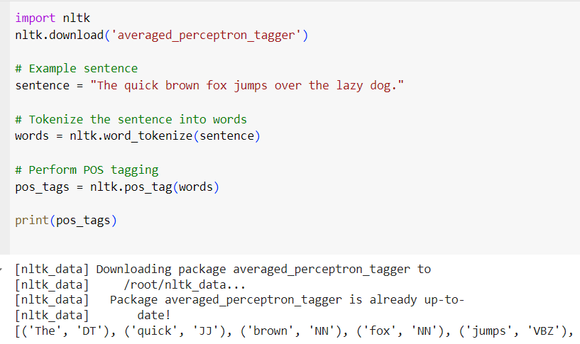
Example

Slide 24
POS Tagging Techniques:
Rule-based Tagging:
Uses a dictionary of words with their possible POS tags.
Relies on hand-crafted rules to determine the correct tag based on context.
Statistical Tagging:
Uses probabilistic models (like Hidden Markov Models (HMM)) to predict the most likely POS tag for a word based on the context.
Models are trained on a labeled dataset to learn transition probabilities between POS tags.
Machine Learning-based Tagging:
Neural Networks: Deep learning models like Recurrent Neural Networks (RNNs) or Long Short-Term Memory (LSTM) networks are now commonly used for POS tagging, as they can capture complex dependencies across words in a sentence.

Slide 25
HIDDEN MARKOV MODEL
A Hidden Markov Model (HMM) is a statistical model used to represent systems that transition between states in a probabilistic manner.
In Natural Language Processing (NLP), HMMs are widely used for tasks where sequential data is involved, such as Part-of-Speech (POS) tagging, speech recognition, and named entity recognition.

Slide 26
Basic Concepts of HMM:
An HMM is characterized by the following components:
1. States:
The system is assumed to be in one of several possible hidden states at any time.
In NLP, the states often correspond to linguistic categories, such as parts of speech or named entities (like noun, verb, organization, person).
2. Observations:
These are the observable data or symbols emitted by the system.
In NLP, the observations are usually words in a sentence.
3. Transition Probabilities (A):
These represent the probability of moving from one hidden state to another. In other words, P(state_i | state_(i-1)) is the probability of transitioning from one part of speech to another, like from a noun to a verb.
4. Emission Probabilities (B):
These represent the probability of observing a particular word given a specific hidden state. This is P(observation | state), such as the probability of observing the word "dog" given the hidden state is noun.
5. Initial Probabilities (π):
These represent the probability distribution over the possible initial states, i.e., the probability that the first word belongs to a specific part of speech.

Slide 27
Structure of an HMM:
Hidden States: The actual sequence of states (e.g., POS tags) that we don’t directly observe.
Observed Sequence: The sequence of observable data (e.g., words in a sentence).
Markov Property: The assumption that the probability of transitioning to a new state depends only on the current state (not the entire history).
Example of HMM in POS Tagging:
"The dog barks."
In this case:
States (hidden) could be: DT (Determiner), NN (Noun), VBZ (Verb).
Observations (visible): "The", "dog", "barks".
An HMM would model the POS tagging task as follows:
Each word is an observation, and each corresponding POS tag is a hidden state.
The task is to infer the most likely sequence of hidden states (POS tags) given the sequence of observed words.
HMM's Role in NLP:
HMM is used for sequence prediction where the data is sequential and the goal is to find the most likely sequence of hidden states based on observable data.

Slide 28
Applications
HMMs are widely used in various fields, including:
Speech Recognition: Modeling phonemes in spoken language.
Natural Language Processing: Part-of-speech tagging and named entity recognition.
Bioinformatics: Gene prediction and protein sequence analysis.
Finance: Modeling stock prices and economic indicators.

Slide 29
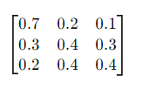
Example Scenario
Imagine you're analyzing weather patterns. You have three hidden states: Sunny, Rainy, and Cloudy. You can observe various weather-related outputs, like the presence of an umbrella or sunglasses.
States: Sunny, Rainy, Cloudy.
Observations: Umbrella, Sunglasses, No Accessories.
Transition Matrix
Emission Probabilities:
Sunny → Sunglasses: 0.8, Umbrella: 0.1, No Accessories: 0.1
Rainy → Sunglasses: 0.1, Umbrella: 0.9, No Accessories: 0.0
Cloudy → Sunglasses: 0.3, Umbrella: 0.3, No Accessories: 0.4

Slide 30
Conclusion
HMMs are powerful tools for modeling temporal or sequential data, where the system dynamics are not fully observable. Their ability to handle uncertainty and variability makes them applicable to many real-world problems.

Slide 31


POS Tagging with Hidden markov model
Part-of-speech (POS) tagging with Hidden Markov Models (HMM) involves several steps.
Install NLTK: You need to have the NLTK library installed. You can install it using pip if you haven't already:
Import necessary libraries: Import the required libraries from NLTK:

Slide 32
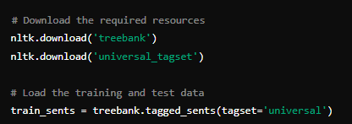

Prepare the data: You need to load and prepare the data. NLTK’s treebank corpus is often used for training POS taggers.
Train the HMM POS Tagger: Create and train the HMM POS tagger using the training sentences.

Slide 33
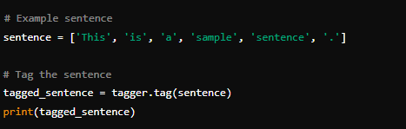

Tagging new sentences: Use the trained tagger to tag new sentences.
Evaluate the tagger: You can evaluate the performance of your tagger on test data.

Slide 34
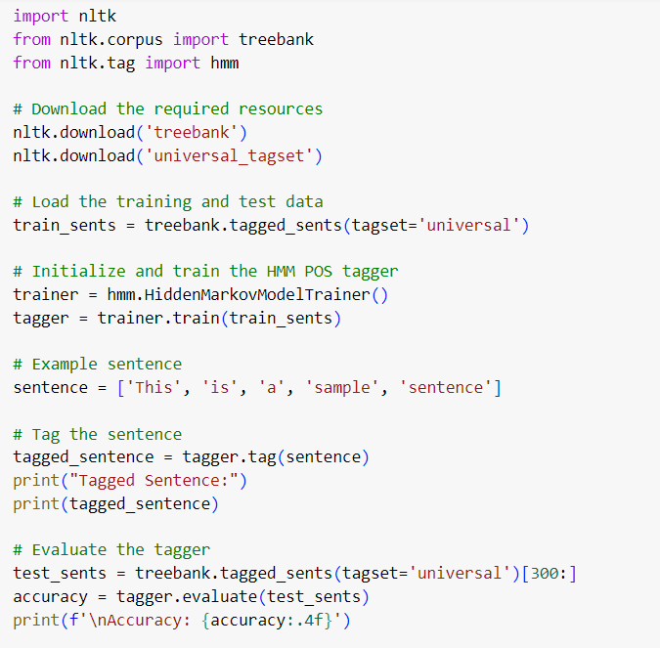
example

Slide 35
Complete Code Link
https://colab.research.google.com/drive/1mmuLGgT7u4MsmPWxv7r8eYTd9Vv_aacf?usp=sharing

Slide 36
N-GRAM Modelling
An N-gram language model is a statistical language model used to predict the probability of a sequence of words based on their historical context.
It breaks down sentences into sequences (n-grams) of n words and calculates their occurrence probabilities.
Unigram: Considers each word independently.
Bigram: Considers a sequence of two words (n = 2).
Trigram: Considers a sequence of three words (n = 3).
N-gram: For n = N, it predicts the next word based on the previous N-1 words.

Slide 37
Example of a Bigram Model:
Corpus: "I love NLP. NLP is fun. I love learning."
Bigrams: ("I love", "love NLP", "NLP is", "is fun", "I love", "love learning")
Probabilities:
P(love ∣ I)
P(NLP ∣ love)
P(is ∣ NLP)
The model would compute the probabilities of these word sequences and use them to predict the next word in a sentence.

Slide 38
Calculating Sequence Probabilities:
The N-gram model estimates the probability of a sequence of words by calculating the conditional probabilities of each word based on its preceding n-1 words.
For example, given the sequence I love NLP and a bigram model, the probability of this sequence is:
P(I, love, NLP) = P(I) × P(love ∣ I) × P(NLP ∣ love)
Using a trigram model:
P(I, love, NLP) = P(I) × P(love ∣ I) × P(NLP ∣ I, love)
N-gram models make a Markov assumption, meaning that the probability of a word only depends on the previous N-1 words, reducing the complexity of prediction.

Slide 39
Applications:
N-gram models are used in various natural language processing tasks such as speech recognition, machine translation, text prediction, and spelling correction.

Slide 40
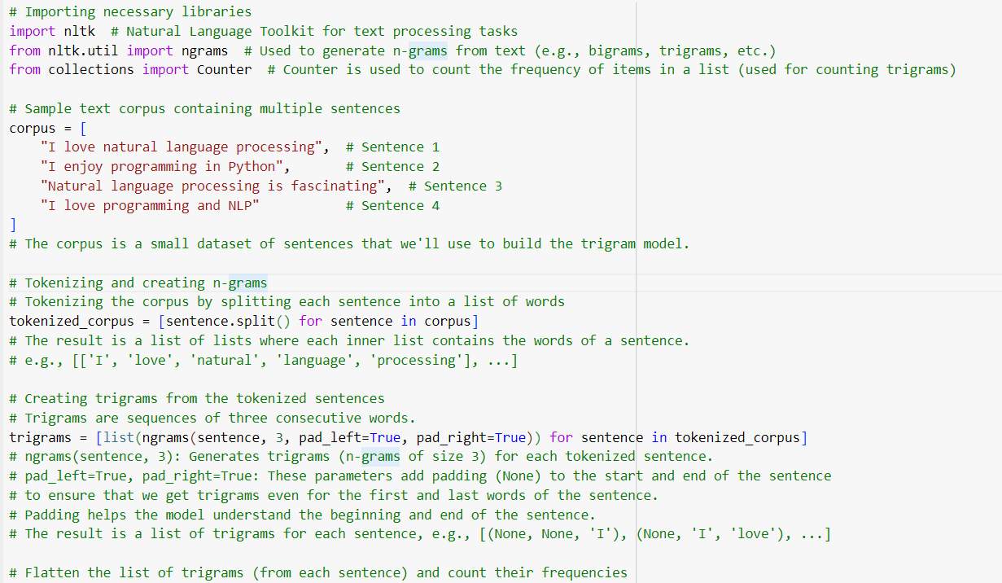

Slide 41
Autocomplete Language Model:
An autocomplete language model is a predictive text system that suggests words or phrases as a user types. The model is trained on a text corpus and uses the likelihood of N-gram sequences to make real-time predictions.
How Autocomplete Works:
Input: A partially typed sentence (e.g., "I love N...").
Prediction: Based on the N-gram model, the system will predict possible next words, such as "NLP", "nature", or "names".
The model uses the highest probability of the sequence to choose the next word. For example:
P(NLP ∣ love) > P(nature ∣ love) > P(names ∣ love)
The prediction is based on the training corpus and the probability of word sequences in the language model.

Slide 42
Example:
Text Corpus: "I love machine learning. Machine learning is cool. I love coding."
User types: "I love "
Autocomplete Suggestions: "machine", "coding", "learning".
The model suggests "machine", "learning", or "coding" based on the N-gram probabilities learned from the corpus.

Slide 43
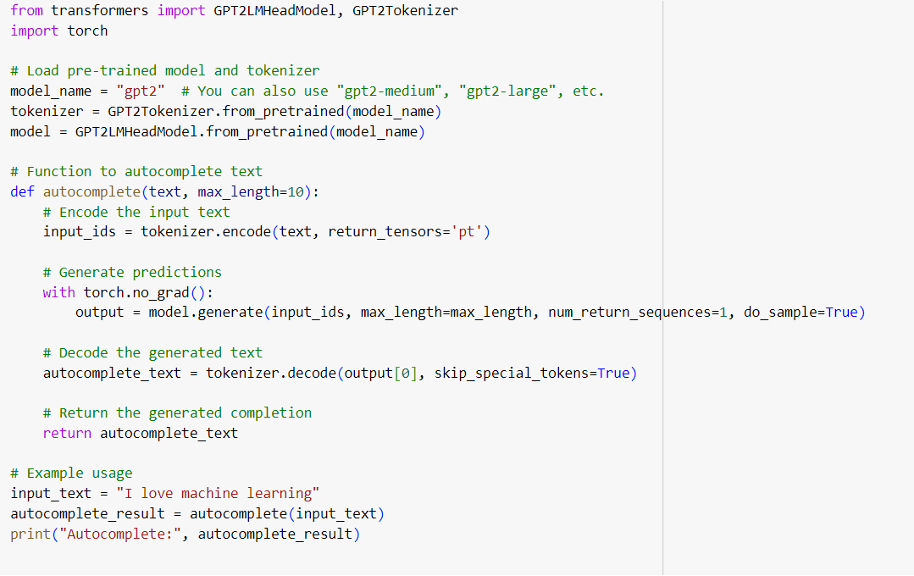
Autocomplete Example

Slide 44
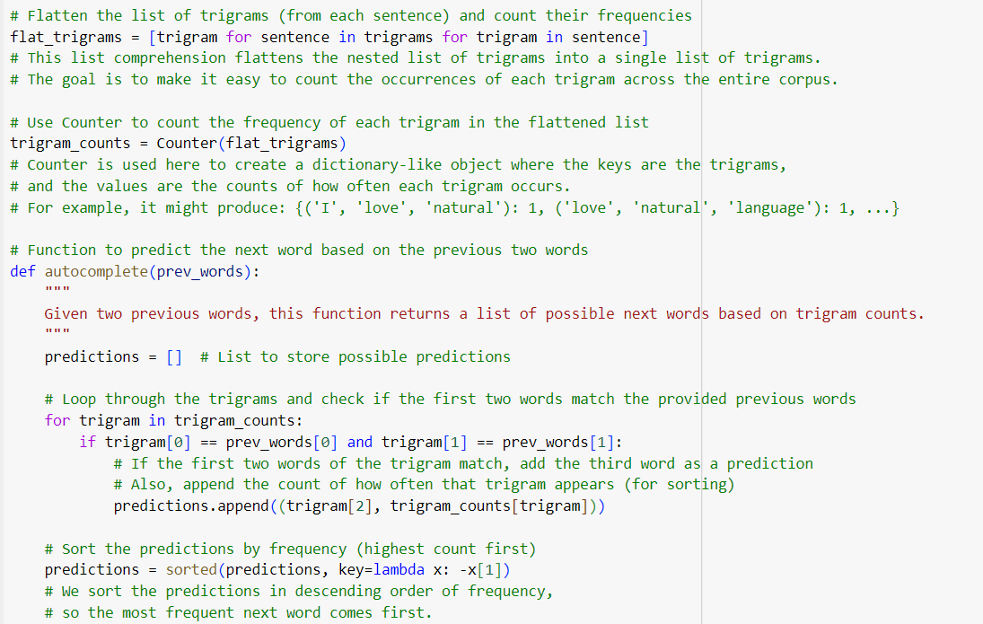

Slide 45
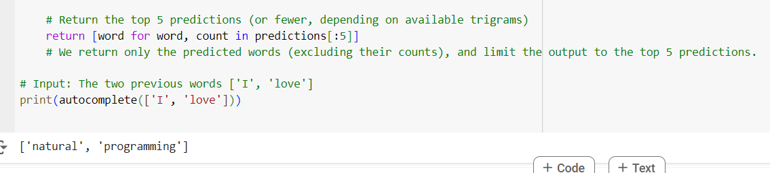

Slide 46
Word Embeddings with Neural Networks: Word Embeddings:
Word embedding is a technique in natural language processing (NLP) where words are represented as vectors of real numbers.
This method allows words with similar meaning to have a similar representation.
Word embeddings are used to capture semantic and syntactic relationships between words in a high-dimensional space.

Slide 47
Word Embeddings with Neural Networks
Word Embeddings are a crucial aspect of Natural Language Processing (NLP) that allow words to be represented as continuous vectors in a high-dimensional space. This representation captures the semantic meaning of words, allowing machines to understand their relationships and contexts.
Word Embeddings: Word embeddings map words or phrases to vectors of real numbers in a continuous vector space. Each dimension represents a latent feature of the words.
Semantic Meaning of Words: Words that have similar meanings or are used in similar contexts will have vectors that are close to each other. For example, "king" and "queen" would be closer than "king" and "apple.“
Analogy Tasks: Word embeddings can also perform analogy tasks, such as "king - man + woman = queen." This demonstrates that the embeddings capture gender relationships as well.
Common Techniques for Creating Word Embeddings:
Word2Vec uses two architectures: Continuous Bag of Words (CBOW) and Skip-Gram.
GloVe (Global Vectors for Word Representation)

Slide 48
NLP Tasks Using Word Embeddings
Word embeddings play a vital role in various NLP tasks, such as:
Text Classification: Classifying documents or sentiments by using embeddings as input features for classifiers (e.g., logistic regression, neural networks).
Named Entity Recognition (NER): Identifying entities in text (like names, dates, locations) by using embeddings to provide context for classification.
Machine Translation: Translating text from one language to another by capturing the meaning and context of words through embeddings.
Question Answering: Enhancing systems to understand and respond to questions based on the semantic meaning captured in embeddings.

Slide 49
Steps involve in NN for word embedding
Preprocessing:
The corpus is tokenized, and sequences of word indices are created.
Context-target pairs are generated for training, where each target word has surrounding context words.
Model Definition:
A simple neural network is defined with an embedding layer followed by a dense layer for classification.
Training:
The model is trained on the context-target pairs to learn word embeddings.
Extracting Embeddings:
After training, we can obtain the learned embedding for a specific word.

Slide 50
Steps involve in NN for word embedding
Tokenization:
The Tokenizer is used to convert words into integers. Each word in the vocabulary is assigned a unique integer, and the sentence is represented as a sequence of integers.
Padding:
Since the model expects input sequences of the same length, we use pad_sequences to ensure all input sequences have the same length by padding shorter sequences with zeros.
Embedding Layer:
The Embedding layer maps the integer-encoded words into dense vectors of size embedding_dim. This embedding layer learns the word embeddings during training.
The input_dim is the size of the vocabulary, output_dim is the dimension of the word vectors, and input_length is the length of the padded input sequences.

Slide 51
Dense Layer:
A fully connected layer with ReLU activation is added after the flattened embedding layer. This layer allows the model to learn non-linear relationships in the data.
Output Layer:
The final layer uses a sigmoid activation function, which is appropriate for binary classification (outputs a probability between 0 and 1).
Model Compilation:
The model is compiled using the Adam optimizer and the binary crossentropy loss function, which is commonly used for binary classification tasks.
Training:
The model is trained for 10 epochs using a batch size of 2. The input data X is fed to the model along with the labels y.
Prediction:
A new sample text is tokenized and padded before being fed into the trained model for prediction. The model outputs a probability indicating the class of the input.

Slide 52
Word embeddings with LSTM
Word embeddings with LSTM is a common technique in Natural Language Processing (NLP) for learning meaningful word representations (embeddings) and capturing the sequential nature of language using LSTMs (Long Short-Term Memory networks).
Word embeddings provide dense vector representations of words that capture semantic meanings, while LSTMs are used to capture the temporal dependencies in sequences like sentences or documents.

Slide 53
Step-by-Step Explanation
Word Embedding: Word embeddings map words to fixed-size vectors, usually of lower dimensions (e.g., 100, 300), that capture semantic relationships.
LSTM Layer: LSTM is a type of Recurrent Neural Network (RNN) capable of learning long-term dependencies. It processes sequences of words and is particularly good at handling sequential data such as text.
Dense Layer: After the LSTM layer, we add a fully connected (Dense) layer that is typically used for classification.

Slide 54
Steps involves in LSTM
1. Tokenization:
The Tokenizer object is used to convert words into integers. The function texts_to_sequences converts a sentence like "I love machine learning" into a sequence of numbers like [1, 2, 3, 4], where each number represents a word in the vocabulary.
2. Padding:
pad_sequences is used to ensure that all input sequences are of the same length. Since LSTMs expect fixed-length input, this function pads shorter sequences with zeros.
3. Embedding Layer:
The Embedding layer takes the integer-encoded words and maps them to dense vectors (word embeddings). The input_dim is the vocabulary size, output_dim is the embedding dimension (e.g., 100), and input_length is the maximum sequence length.
4. LSTM Layer:
The LSTM layer processes the sequences of word embeddings and learns patterns in the sequences. Here we use return_sequences=False because we want the LSTM to output only the final state (a single vector) rather than the entire sequence of hidden states.
5. Dense Layer:
After the LSTM layer, a Dense layer is added for binary classification. It uses a sigmoid activation function to output a value between 0 and 1.
6. Model Compilation and Training:
The model is compiled using the Adam optimizer and binary_crossentropy loss function. The model is then trained using the training data (X, y) for 10 epochs.
7. Prediction:
A sample text is tokenized, padded, and passed through the trained model to predict its class (0 or 1).

Slide 55
Thank You!

