Slide 1
Copyright Notice
These slides are distributed under the Creative Commons License.
DeepLearning.AI makes these slides available for educational purposes. You may not use or distribute these slides for commercial purposes. You may make copies of these slides and use or distribute them for educational purposes as long as you cite DeepLearning.AI as the source of the slides.
For the rest of the details of the license, see https://creativecommons.org/licenses/by-sa/2.0/legalcode

Slide 2
Part of Speech Tagging
deeplearning.ai

Slide 3


Outline
What is part of speech tagging?
Markov chains
Hidden Markov models
Viterbi algorithm
Example
Coding assignment!

Slide 4
What is part of speech?
Why not learn something ?
adverb adverb verb
noun
punctuation mark, sentence closer

Slide 5
Part of speech (POS) tagging
Part of speech tags:
lexical term | tag | example
noun | NN | something, nothing
verb | VB | learn, study
determiner | DT | the, a
w-adverb | WRB | why, where
... | ...
Why not learn something ?
WRB RB VB NN .

Slide 6



Applications of POS tagging
324m
Named entities
Co-reference resolution
Speech recognition

Slide 7
Markov Chains
deeplearning.ai

Slide 8
Example
Why not learn ...
verb
verb? noun?
… ?

Slide 9
Part of Speech Dependencies
Why not learn ...
verb
verb?
noun?
… ?

Slide 10
The Most Likely Next Word
Why not learnswimming?
verb noun

Slide 11
Less Likely Words
Why not learnswim?
verb verb

Slide 12
Visual Representation
0.6
0.2
verb
noun

Slide 13
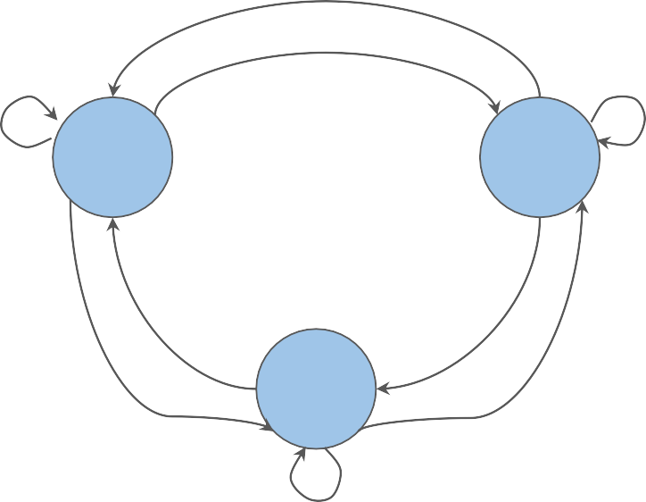
What are Markov chains?

Slide 14
States
q₁
q₂
q₃

Slide 15
Markov Chains and POS Tags
deeplearning.ai

Slide 16

POS tags as States
NN
VB
O

Slide 17
Transition probabilities
0.4
0.2
0.2
0.3
NN
VB
0.2
0.3
0.6
0.3
O
0.5

Slide 18

Transition probabilities
0.4
0.2
0.2
0.3
NN
VB
Why not
learn
something ?
0.2
0.3
0.6
0.3
O
0.5

Slide 19
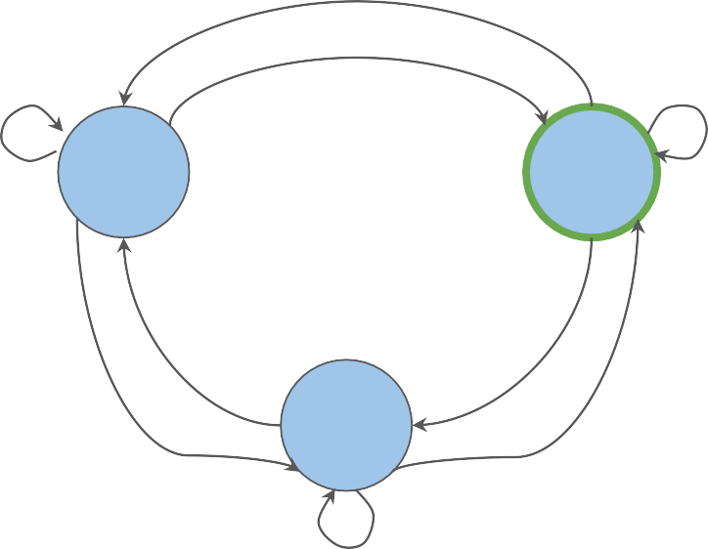
Transition probabilities
0.4
0.2
0.2
0.3
NN
VB
Why not
learn
something ?
0.2
0.3
0.6
0.3
O
0.5

Slide 20
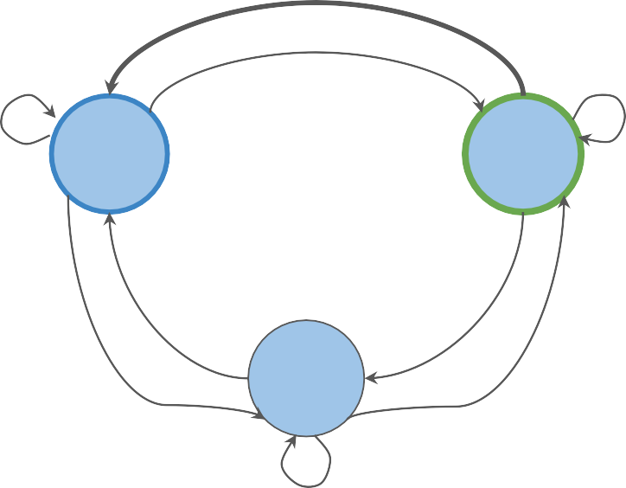
Transition probabilities
0.4
0.2
0.2
0.3
NN
VB
Why not
learn
something
?
0.2
0.3
0.6
0.3
O
0.5

Slide 21
The transition matrix
0.4
0.2
0.2
0.3
 | NN | VB | O
NN (noun) | 0.2 | 0.2 | 0.6
VB (verb) | 0.4 | 0.3 | 0.3
O (other) | 0.2 | 0.3 | 0.5
NN
VB
0.2
0.3
0.6
0.3
O
0.5

Slide 22
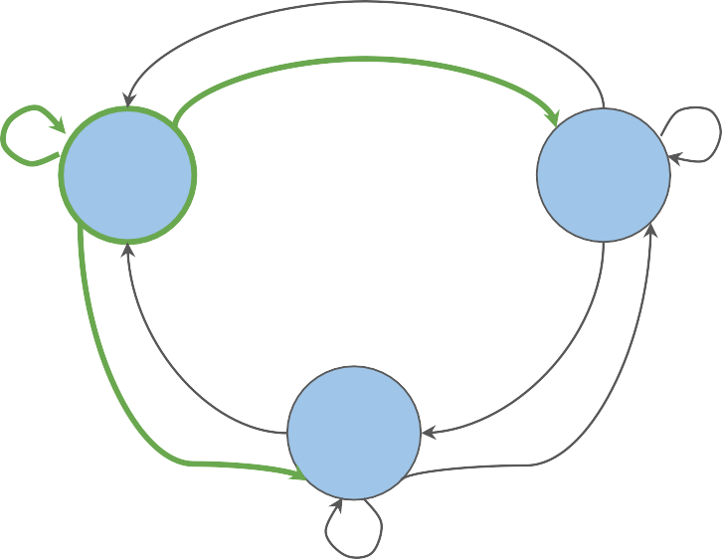

The transition matrix
0.4
0.2
0.2
0.3
 | NN | VB | O
NN (noun) | 0.2 | 0.2 | 0.6
VB (verb) | 0.4 | 0.3 | 0.3
O (other) | 0.2 | 0.3 | 0.5
NN
VB
0.2
0.3
0.6
0.3
O
0.5

Slide 23
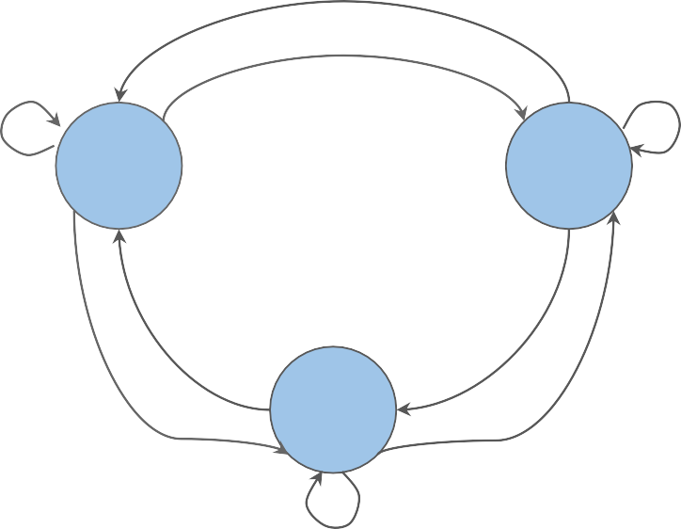
The first word
0.4
0.2
0.2
0.3
NN
VB
Why not learn something ?
NN?
VB?
O?
0.2
0.3
0.6
0.3
O
0.5

Slide 24
Initial probabilities
0.4
0.2
 | NN | VB | O
𝜋 (initial) | 0.4 | 0.1 | 0.5
NN (noun) | 0.2 | 0.2 | 0.6
VB (verb) | 0.4 | 0.3 | 0.3
O (other) | 0.2 | 0.3 | 0.5
0.2
0.3
NN
VB
0.4
𝜋
0.1
0.2
0.5
0.3
0.6
0.3
O
0.5

Slide 25
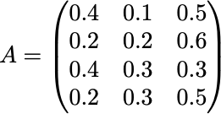
Transition table and matrix
 | NN | VB | O
𝜋 (initial) | 0.4 | 0.1 | 0.5
NN (noun) | 0.2 | 0.2 | 0.6
VB (verb) | 0.4 | 0.3 | 0.3
O (other) | 0.2 | 0.3 | 0.5

Slide 26
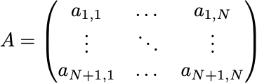
Summary
States
Transition matrix

Slide 27
Hidden Markov Models
deeplearning.ai

Slide 28
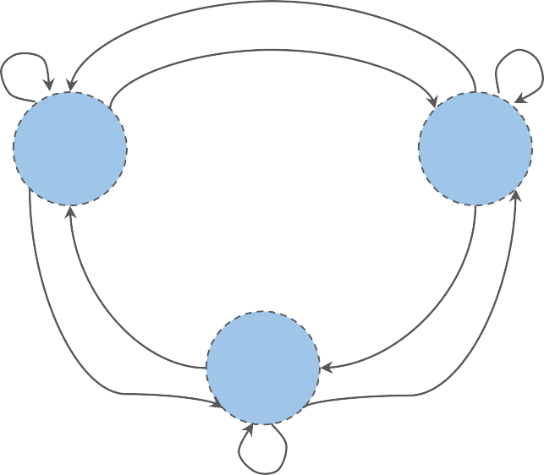
Hidden Markov Model
hidden states
NN
VB
O

Slide 29


you
jump = verb
machine
jump = ?

Slide 30

you
machine
*
jump =
verb
run = verb fly = verb
jump
run
fly
*observable

Slide 31

Transition probabilities
0.4
0.2
 | NN | VB | O
𝜋 (initial) | 0.4 | 0.1 | 0.5
NN (noun) | 0.2 | 0.2 | 0.6
VB (verb) | 0.4 | 0.3 | 0.3
O (other) | 0.2 | 0.3 | 0.5
0.2
0.3
NN
VB
0.4
𝜋
0.1
0.2
0.5
0.3
0.6
0.3
O
0.5

Slide 32
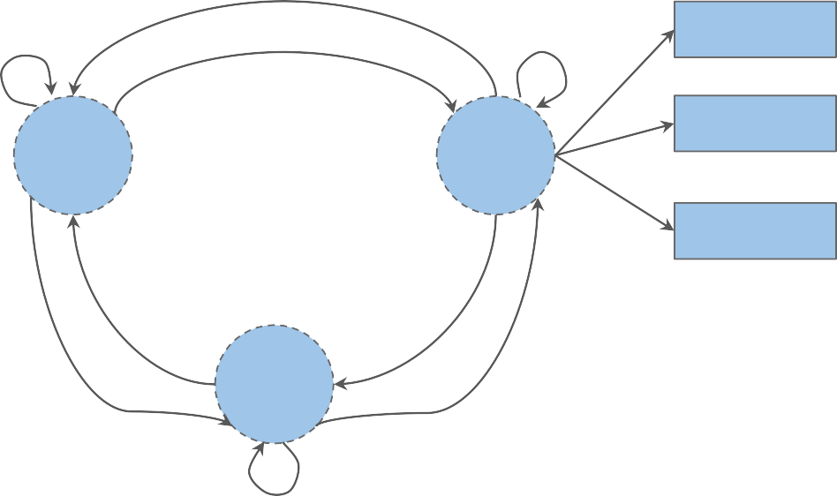
Emission probabilities
0.3
going
to
hidden states
NN
VB
0.1
...
observables
0.5
eat
O

Slide 33

Emission probabilities
0.3
going
 | going | to | eat | ...
NN (noun) | 0.5 | 0.1 | 0.02
VB (verb) | 0.3 | 0.1 | 0.5
O (other) | 0.3 | 0.5 | 0.68
to
NN
VB
0.1
...
0.5
eat
O

Slide 34
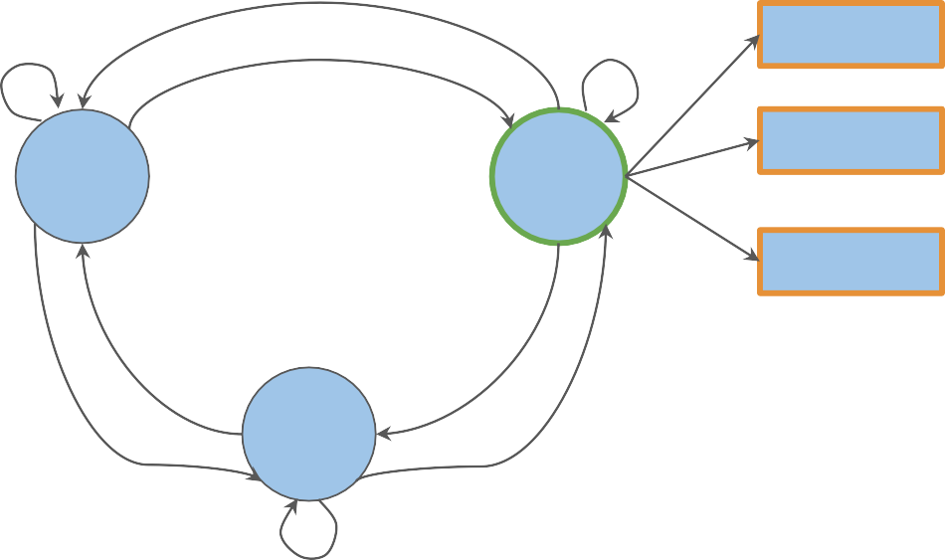
Emission probabilities
0.3
going
 | going | to | eat | ...
NN (noun) | 0.5 | 0.1 | 0.02
VB (verb) | 0.3 | 0.1 | 0.5
O (other) | 0.3 | 0.5 | 0.68
to
NN
VB
0.1
...
0.5
eat
O

Slide 35

The emission matrix
 | going | to | eat | ...
NN (noun) | 0.5 | 0.1 | 0.02
VB (verb) | 0.3 | 0.1 | 0.5
O (other) | 0.3 | 0.5 | 0.68
He lay on his back.
I’ll be back.

Slide 36
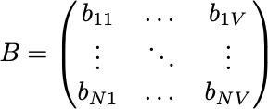
Summary
States
Transition matrix
Emission matrix

Slide 37
Calculating Probabilities
deeplearning.ai

Slide 38
Transition probabilities
You | eat
The | oatmeal
You | eat
corpus

Slide 39
Transition probabilities
corpus
+
Count: 2
+
?
Count: 3

Slide 40
Transition probabilities
corpus
transition probability:
+ = ⅔

Slide 41
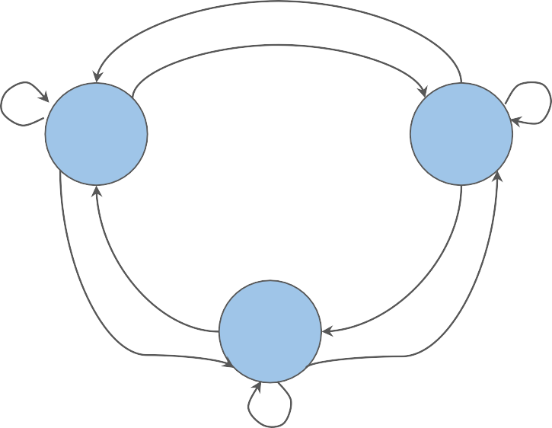
Transition probabilities
?
?
?
?
1. Count occurrences of tag pairs
NN
VB
?
?
?
?
O
?

Slide 42

Transition probabilities
?
?
?
?
1. Count occurrences of tag pairs
NN
VB
?
?
1. Calculate probabilities using the counts
?
?
O
?

Slide 43
The corpus
In a Station of the Metro
The apparition of these faces in the crowd : Petals on a wet , black bough .
Ezra Pound –
1913

Slide 44
Preparation of the corpus
<s> In a Station of the Metro
<s> The apparition of these faces in the crowd
:
<s> Petals on a wet , black bough .
Ezra Pound –
1913

Slide 45
Preparation of the corpus
<s> in a station of the metro
<s> the apparition of these faces in the crowd
:
<s> petals on a wet , black bough .
Ezra Pound –
1913

Slide 46
Populating the Transition Matrix
deeplearning.ai

Slide 47
Populating the transition matrix
 | NN | VB | O
𝜋
NN (noun)
VB (verb)
O (other)
<s> in a station of the metro
<s> the apparition of these faces in the crowd
:
<s> petals on a wet , black bough .
Ezra Pound –
1913

Slide 48
Populating the transition matrix
 | NN | VB | O
𝜋
NN (noun)
VB (verb)
O (other)
<s> in a station of the metro
<s> the apparition of these faces in the crowd
:
<s> petals on a wet , black bough .
Ezra Pound –
1913

Slide 49
Populating the transition matrix
 | NN | VB | O
𝜋
NN (noun)
VB (verb)
O (other)
<s> in a station of the metro
<s> the apparition of these faces in the crowd
:
<s> petals on a wet , black bough .
Ezra Pound –
1913

Slide 50
Populating the transition matrix
 | NN | VB | O
𝜋 | 1
NN (noun)
VB (verb)
O (other)
<s> in a station of the metro
<s> the apparition of these faces in the crowd
:
on a wet , black bough .
<s> petals
Ezra Pound –
1913

Slide 51
Populating the transition matrix
 | NN | VB | O
𝜋 | 1
NN (noun) | 0
VB (verb)
O (other)
<s> in a station of the metro
<s> the apparition of these faces in the crowd
:
<s> petals on a wet , black bough .
Ezra Pound –
1913

Slide 52
Populating the transition matrix
 | NN | VB | O
𝜋 | 1
NN (noun) | 0
VB (verb) | 0
O (other)
<s> in a station of the metro
<s> the apparition of these faces in the crowd
:
<s> petals on a wet , black bough .
Ezra Pound –
1913

Slide 53
Populating the transition matrix
 | NN | VB | O
𝜋 | 1
NN (noun) | 0
VB (verb) | 0
O (other) | 6
<s> in
<s>
:
a station
of
the metro
the apparition
of
these faces
in
the crowd
<s> petals on a wet , .
black bough
Ezra Pound –
1913

Slide 54
Populating the transition matrix
 | NN | VB | O
𝜋 | 1
NN (noun) | 0
VB (verb) | 0
O (other) | 6
<s> in a station of the metro
<s> the apparition of these faces in the crowd
:
<s> petals on a wet , black bough .
Ezra Pound –
1913

Slide 55
Populating the transition matrix
 | NN | VB | O
𝜋 | 1 | 0
NN (noun) | 0 | 0
VB (verb) | 0 | 0 | 0
O (other) | 6 | 0
<s> in a station of the metro
<s> the apparition of these faces in the crowd
:
<s> petals on a wet , black bough .
Ezra Pound –
1913

Slide 56
Populating the transition matrix
 | NN | VB | O
𝜋 | 1 | 0 | 2
NN (noun) | 0 | 0
VB (verb) | 0 | 0 | 0
O (other) | 6 | 0
a station of the metro
apparition of these faces in the crowd
:
<s> petals on a wet , black bough .
<s> in
<s> the
Ezra Pound –
1913

Slide 57
Populating the transition matrix
 | NN | VB | O
𝜋 | 1 | 0 | 2
NN (noun) | 0 | 0 | 6
VB (verb) | 0 | 0 | 0
O (other) | 6 | 0
<s> in a
<s> the
:
<s>
station of
the metro
these
apparition of
faces in
the
crowd
petals on
a wet , black
bough .
Ezra Pound –
1913

Slide 58
Populating the transition matrix
 | NN | VB | O
𝜋 | 1 | 0 | 2
NN (noun) | 0 | 0 | 6
VB (verb) | 0 | 0 | 0
O (other) | 6 | 0 | 8
<s> station
metro
faces
in a
of the
<s> the apparition
:
<s> petals
of these
in the
crowd
on a wet , black
bough .
Ezra Pound –
1913

Slide 59

Populating the transition matrix
 | NN | VB | O
𝜋 | 1 | 0 | 2
NN | 0 | 0 | 6
VB | 0 | 0 | 0
O | 6 | 0 | 8

Slide 60

Populating the transition matrix
 | NN | VB | O
𝜋 | 1 | 0 | 2 | 3
NN | 0 | 0 | 6 | 6
VB | 0 | 0 | 0 | 0
O | 6 | 0 | 8 | 14

Slide 61

Populating the transition matrix
 | NN | VB | O
𝜋 | 1 | 0 | 2 | 3
NN | 0 | 0 | 6 | 6
VB | 0 | 0 | 0 | 0
O | 6 | 0 | 8 | 14

Slide 62
Populating the transition matrix
 | NN | VB | O
𝜋 | 1 | 0 | 2 | 3
NN | 0 | 0 | 6 | 6
VB | 0 | 0 | 0 | 0
O | 6 | 0 | 8 | 14

Slide 63

Smoothing
 | NN | VB | O
𝜋 | 1+ε | 0+ε | 2+ε | 3+3*ε
NN | 0+ε | 0+ε | 6+ε | 6+3*ε
VB | 0+ε | 0+ε | 0+ε | 0+3*ε
O | 6+ε | 0+ε | 8+ε | 14+3*ε

Slide 64
Smoothing
 | NN | VB | O
𝜋 | 0.3333 | 0.0003 | 0.6663
NN | 0.0001 | 0.0001 | 0.9996
VB | 0.3333 | 0.3333 | 0.3333
O | 0.4285 | 0.0000 | 0.5713

Slide 65
Populating the Emission Matrix
deeplearning.ai

Slide 66
Emission probabilities
You | eat
The | oatmeal
You | eat
corpus

Slide 67
Transition probabilities
You | eat
The | oatmeal
You | eat
You
Count: 2
corpus
Count: 3

Slide 68
Transition probabilities
You | eat
The | oatmeal
You | eat
emission probability:
You
= ⅔
corpus

Slide 69
The emission matrix
 | in | a | ...
NN (noun)
VB (verb)
O (other)
<s> in a station of the metro
<s> the apparition of these faces in the crowd
:
<s> petals on a wet , black bough .
Ezra Pound –
1913

Slide 70
The emission matrix
 | in | a | ...
NN (noun)
VB (verb)
O (other)
<s> in a station of the metro
<s> the apparition of these faces in the crowd
:
<s> petals on a wet , black bough .
Ezra Pound –
1913

Slide 71
The emission matrix
 | in | a | ...
NN (noun) | 0
VB (verb)
O (other)
<s> in a station of the metro
<s> the apparition of these faces in the crowd
:
<s> petals on a wet , black bough .
Ezra Pound –
1913

Slide 72
The emission matrix
 | in | a | ...
NN (noun) | 0
VB (verb) | 0
O (other)
<s> in a station of the metro
<s> the apparition of these faces in the crowd
:
<s> petals on a wet , black bough .
Ezra Pound –
1913

Slide 73
The emission matrix
 | in | a | ...
NN (noun) | 0
VB (verb) | 0
O (other) | 2
<s> a station of the metro
<s> the apparition of these faces the crowd
:
<s> petals on a wet , black bough .
in
in
Ezra Pound –
1913

Slide 74
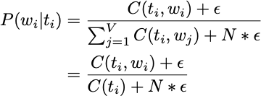
The emission matrix
 | in | a | ...
NN (noun) | 0 | ... | ...
VB (verb) | 0 | ... | ...
O (other) | 2 | ... | ...

Slide 75
Summary
1. Calculate transition and emission matrix
1. How to apply smoothing

Slide 76
The Viterbi Algorithm
deeplearning.ai

Slide 77
Why | not | learn | something ?
? | ? | ? | ? ?

Slide 78
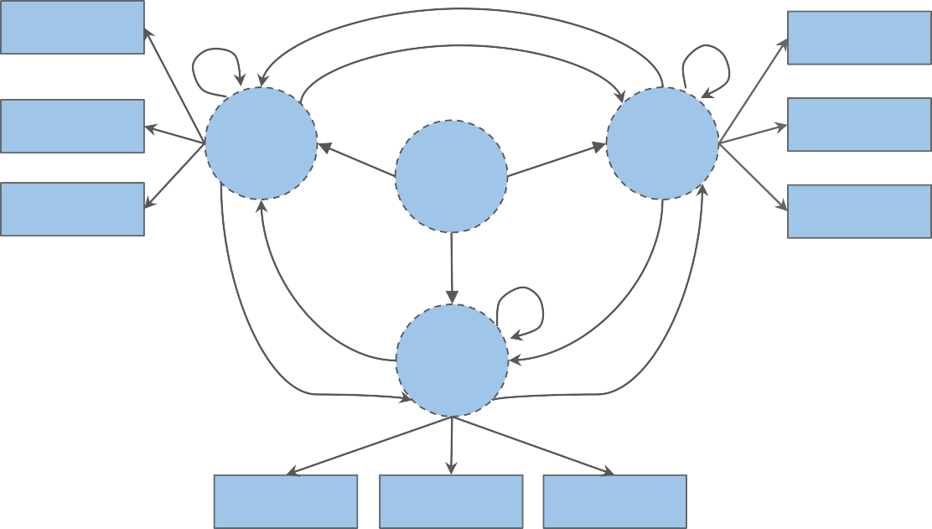
Viterbi algorithm – a graph algorithm
love
love
pony
NN
VB
eat
𝜋
sweets
learn
<s>
I
to
love learn
O
I
to
you

Slide 79
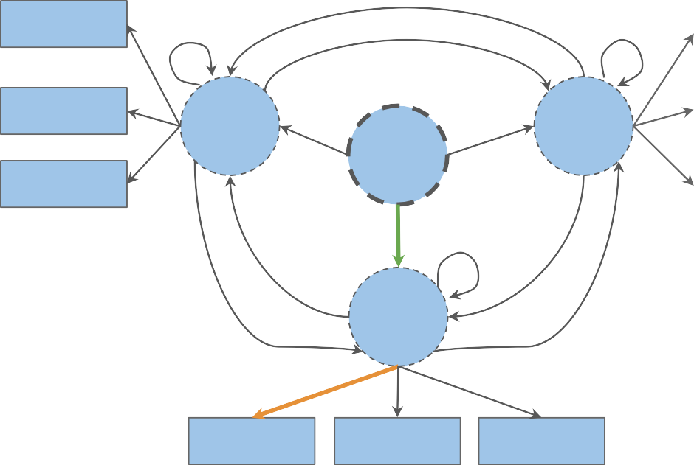
Viterbi algorithm – a graph algorithm
love
love
pony
NN
VB
eat
𝜋
sweets
learn
<s>
I
to
love learn
0.3
𝜋
O
O
0.15
0.5
I
to
you

Slide 80
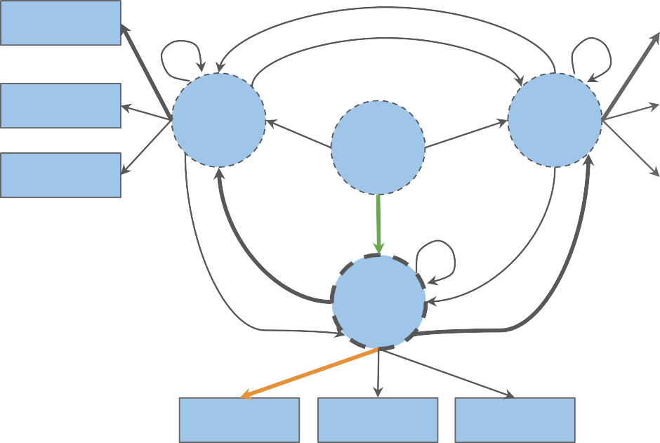
Viterbi algorithm – a graph algorithm
love
0.1
0.5
love
pony
NN
VB
eat
𝜋
sweets
learn
<s>
I
to
love learn
0.5
0.5
𝜋
O
O
0.15
I
to
you

Slide 81
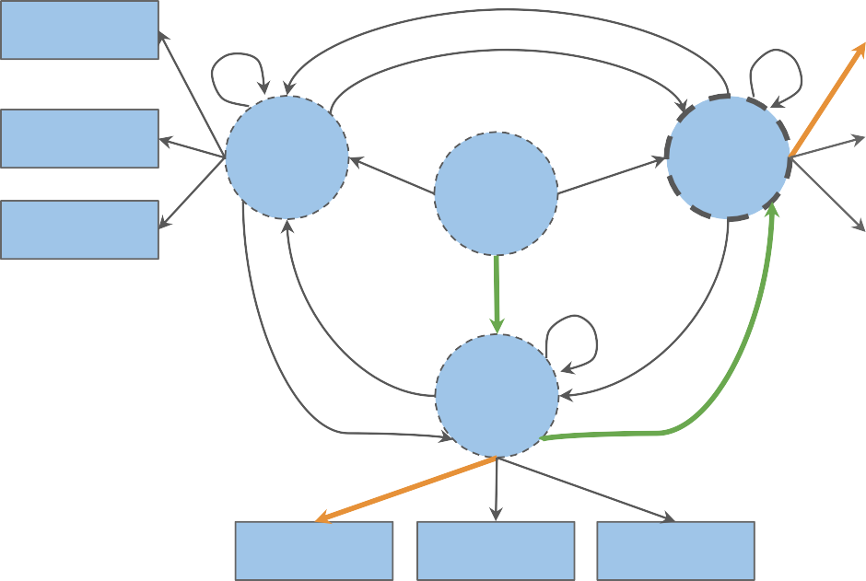
Viterbi algorithm – a graph algorithm
love
0.5 love
eat
learn |  | <s> | I to | love learn
 |  | 𝜋 | O | VB
 | 0.15 0.25
pony
NN
VB
𝜋
sweets
0.5
O
I
to
you

Slide 82

Viterbi algorithm – a graph algorithm
love
love
pony
NN
VB
eat
𝜋
sweets
learn
<s> to
I
learn
love
0.2
𝜋
O
O
VB
O
0.4
0.15 0.25
0.08
I
to
you

Slide 83
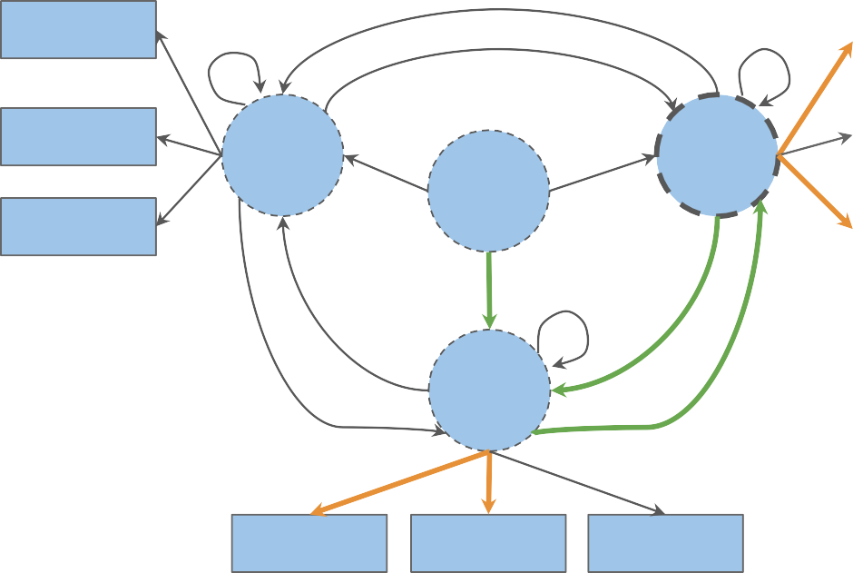
Viterbi algorithm – a graph algorithm
love
love
pony
NN
VB
eat
𝜋
sweets
0.2
learn
<s> to
I
learn
love
0.5
𝜋
O
O
VB
VB
O
0.15 0.25
0.08
0.1
I
to
you

Slide 84
Viterbi algorithm – a graph algorithm
love
love
pony
NN
VB
eat
𝜋
sweets
0.2
learn
<s> to
I
learn
love
0.5
𝜋
O
O
VB
VB
O
0.15 * 0.25 * 0.08 * 0.1
Probability for this sequence of
hidden states: 0.0003
I
to
you

Slide 85
Viterbi algorithm – Steps
 | w₁ | w₂ | ... | w_{K}
t₁
...
t_{N}
Initialization step
Forward pass
Backward pass
 | w₁ | w₂ | ... | w_{K}
t₁
...
t_{N}

Slide 86
Viterbi: Initialization
deeplearning.ai

Slide 87
Viterbi algorithm – Steps
1. Initialization step

Slide 88
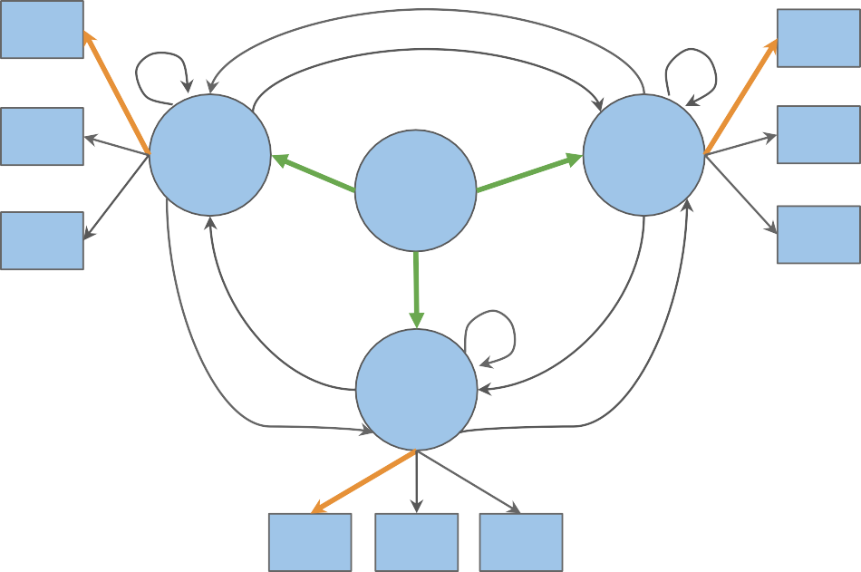

Initialization step
 | w₁ | w₂ | ... | w_{K}
t₁ | ^{c}1,1
...
t_{N} | ^{c}N,1
w₁
w₁
w₂
t₂
t₁
w₂
𝜋
w₃
w₃
t₃
w₁ w₂ w₃

Slide 89
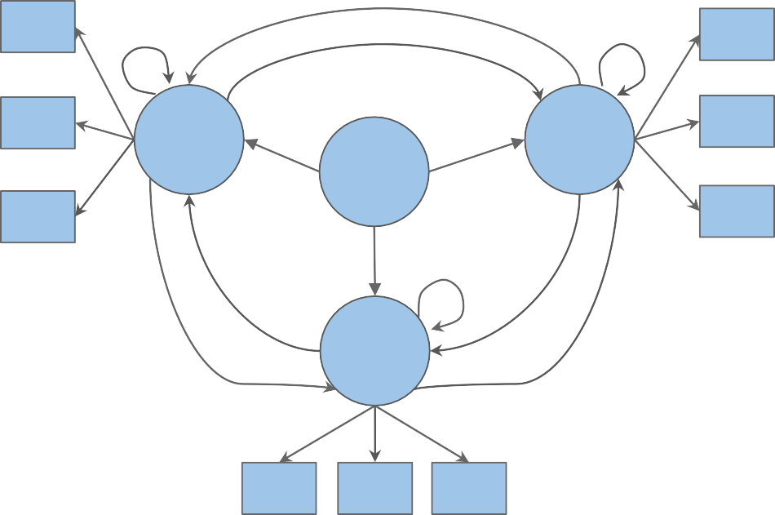
Initialization step
 | w₁ | w₂ | ... | w_{K}
t₁ | ^{d}1,1
...
t_{N} | ^{d}N,1
w₁
w₁
w₂
t₂
t₁
w₂
𝜋
w₃
w₃
t₃
w₁ w₂ w₃

Slide 90
Viterbi: Forward Pass
deeplearning.ai

Slide 91
Viterbi algorithm – Steps
2. Forward pass

Slide 92
Forward pass
 | w₁ | w₂ | ... | w_{K}
t₁ | ^{c}1,1 | ^{c}1,2 |  | ^{c}1,K
...
t_{N} | ^{c}N,1 | ^{c}N,2 |  | ^{c}N,K
w₁
w₁
w₂
t₂
t₁
w₂
𝜋
w₃
w₃
t₃
w₁ w₂ w₃

Slide 93
Forward pass
 | w₁ | w₂ | ... | w_{K}
t₁ | ^{c}1,1 | ^{c}1,2 |  | ^{c}1,K
...
t_{N} | ^{c}N,1 | ^{c}N,2 |  | ^{c}N,K
w₁
w₁
w₂
t₂
t₁
w₂
𝜋
w₃
w₃
t₃
w₁ w₂ w₃

Slide 94


Forward pass
 | w₁ | w₂ | ... | w_{K}
t₁ | ^{c}1,1 | ^{c}1,2 |  | ^{c}1,K
...
t_{N} | ^{c}N,1 | ^{c}N,2 |  | ^{c}N,K
w₁
w₁
w₂
t₂
t₁
w₂
𝜋
w₃
w₃
t₃
w₁ w₂ w₃

Slide 95
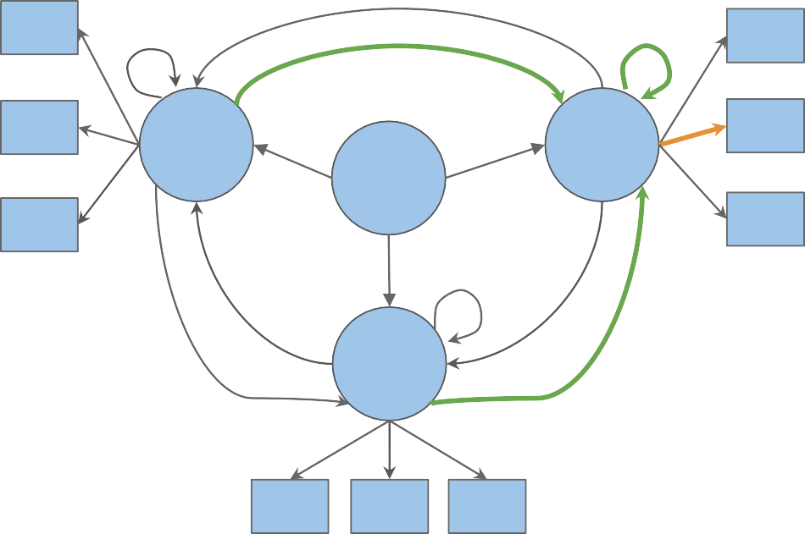

Forward pass
 | w₁ | w₂ | ... | w_{K}
t₁ | ^{c}1,1 | ^{c}1,2 |  | ^{c}1,K
...
t_{N} | ^{c}N,1 | ^{c}N,2 |  | ^{c}N,K
w₁
?
?
w
1
w₂
t₂
t₁
w₂
𝜋
w₃
w₃
t₃
?
w₁ w₂ w₃

Slide 96

Forward pass
 | w₁ | w₂ | ... | w_{K}
t₁ | ^{c}1,1 | ^{c}1,2 |  | ^{c}1,K
...
t_{N} | ^{c}N,1 | ^{c}N,2 |  | ^{c}N,K
w₁
?
?
w
1
w₂
t₂
t₁
w₂
𝜋
w₃
w₃
t₃
?
w₁ w₂ w₃

Slide 97
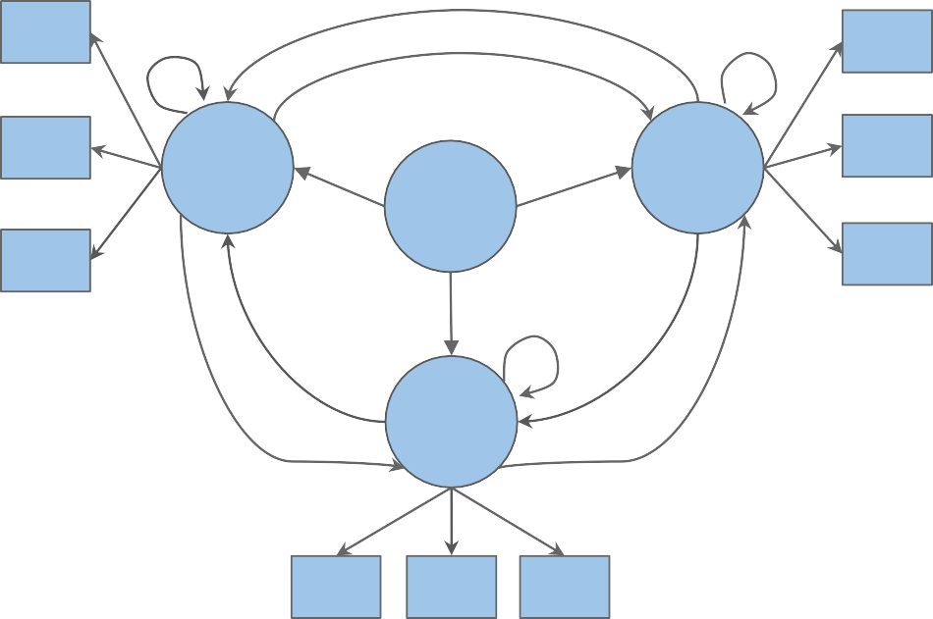
Forward pass
 | w₁ | w₂ | ... | w_{K}
t₁ | ^{d}1,1 | ^{d}1,2 |  | ^{d}1,K
...
t_{N} | ^{d}N,1 | ^{d}N,2 |  | ^{d}N,K
w₁
w₁
w₂
t₂
t₁
w₂
𝜋
w₃
w₃
t₃
w₁ w₂ w₃

Slide 98
Viterbi: Backward Pass
deeplearning.ai

Slide 99
Viterbi algorithm – Steps
3. Backward pass

Slide 100
Backward pass
 | w₁ | w₂ | ... | w_{K}
t₁ | ^{c}1,1 | ^{c}1,2 |  | ^{c}1,K
...
t_{N} | ^{c}N,1 | ^{c}N,2 |  | ^{c}N,K
 | w₁ | w₂ | ... | w_{K}
t₁ | ^{d}1,1 | ^{d}1,2 |  | ^{d}1,K
...
t_{N} | ^{d}N,1 | ^{d}N,2 |  | ^{d}N,K

Slide 101
Backward pass
 | w₁ | w₂ | w₃ | w₄ | w₅
t₁ | 0 | 1 | 3 | 2 | 3
t₂ | 0 | 2 | 4 | 1 | 3
t₃ | 0 | 2 | 4 | 1 | 4
t₄ | 0 | 4 | 4 | 3 | 1
<s>
w1 w3 w5
w2 w4

Slide 102

Backward pass
 | w₁ | w₂ | w₃ | w₄ | w₅
t₁ | 0.25 | 0.125 | 0.025 | 0.0125 | 0.01
t₂ | 0.1 | 0.025 | 0.05 | 0.01 | 0.003
t₃ | 0.3 | 0.05 | 0.025 | 0.02 | 0.0000
t₄ | 0.2 | 0.1 | 0.000 | 0.0025 | 0.0003

Slide 103
Backward pass
 | w₁ | w₂ | w₃ | w₄ | w₅
t₁ | 0 | 1 | 3 | 2 | 3
t₂ | 0 | 2 | 4 | 1 | 3
t₃ | 0 | 2 | 4 | 1 | 4
t₄ | 0 | 4 | 4 | 3 | 1
<s>
w1 w3 w5
w2 w4

Slide 104
Backward pass
 | w₁ | w₂ | w₃ | w₄ | w₅
t₁ | 0 | 1 | 3 | 2 | 3
t₂ | 0 | 2 | 4 | 1 | 3
t₃ | 0 | 2 | 4 | 1 | 4
t₄ | 0 | 4 | 4 | 3 | 1
<s>
w1 w3 w5
w2 w4
t₁

Slide 105
Backward pass
 | w₁ | w₂ | w₃ | w₄ | w₅
t₁ | 0 | 1 | 3 | 2 | 3
t₂ | 0 | 2 | 4 | 1 | 3
t₃ | 0 | 2 | 4 | 1 | 4
t₄ | 0 | 4 | 4 | 3 | 1
<s> | w1 w3 w5 | w2 w4
 | t₁ | t₃

Slide 106
Backward pass
 | w₁ | w₂ | w₃ | w₄ | w₅
t₁ | 0 | 1 | 3 | 2 | 3
t₂ | 0 | 2 | 4 | 1 | 3
t₃ | 0 | 2 | 4 | 1 | 4
t₄ | 0 | 4 | 4 | 3 | 1
<s>
w1 w3 w5
w2 w4
t₁ t₁
t₃

Slide 107
Backward pass
 | w₁ | w₂ | w₃ | w₄ | w₅
t₁ | 0 | 1 | 3 | 2 | 3
t₂ | 0 | 2 | 4 | 1 | 3
t₃ | 0 | 2 | 4 | 1 | 4
t₄ | 0 | 4 | 4 | 3 | 1
<s>
w1 w3 w5
w2 w4
t₁ t₁
t₃

Slide 108
Backward pass
 | w₁ | w₂ | w₃ | w₄ | w₅
t₁ | 0 | 1 | 3 | 2 | 3
t₂ | 0 | 2 | 4 | 1 | 3
t₃ | 0 | 2 | 4 | 1 | 4
t₄ | 0 | 4 | 4 | 3 | 1
<s> | w1 | w2
 | w3 | w4
 | w5
t
3
t₁ t₁
t₃

Slide 109
Backward pass
 | w₁ | w₂ | w₃ | w₄ | w₅
t₁ | 0 | 1 | 3 | 2 | 3
t₂ | 0 | 2 | 4 | 1 | 3
t₃ | 0 | 2 | 4 | 1 | 4
t₄ | 0 | 4 | 4 | 3 | 1
<s> | w1 | w2
 | w3 | w4
 | w5
t
3
t₁ t₁
t₃

Slide 110
Backward pass
 | w₁ | w₂ | w₃ | w₄ | w₅
t₁ | 0 | 1 | 3 | 2 | 3
t₂ | 0 | 2 | 4 | 1 | 3
t₃ | 0 | 2 | 4 | 1 | 4
t₄ | 0 | 4 | 4 | 3 | 1
<s> | w1 w3 w5 | w2 w4
𝜋 | t₂ t₁ | t₃ t₃
t₁

Slide 111
Implementation notes
In Python index starts with 0!
Use log probabilities

Slide 112
Summary
From word sequence to POS tag sequence
Viterbi algorithm
Log probabilities

