Slide 1

AUTO ATTENDANCE SYSTEM
Presented By: TITANS
Aditya Sharma-04511502819
Mohit Sharma-06111502819
Hemant Kumar-06311502819
Rohit-05611502819

Slide 2


Overview
In this project we propose a system that takes the attendance. Our system takes the attendance automatically using Face Recognition.
Face recognition technology is gradually evolving to a universal biometric solution since it requires virtually zero efforts from the user end while compared to the other biometric options. It is accurate and allows for high verification enrollment rate.

Slide 3

Division Of Work
Face detection
Data Collection
Face Recognition
Auto Attendance System

Slide 4
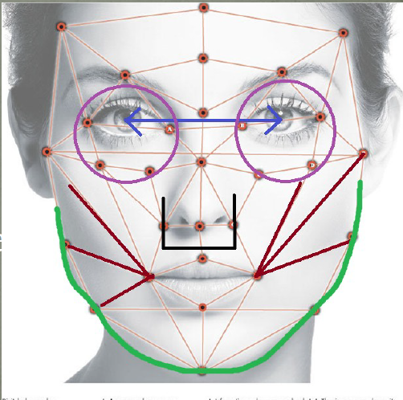
Methodology of face recognition
Facial recognition software is based on the ability to first recognize faces, which is a technological feat in itself. If you look at the mirror, you can see that your face has certain distinguishable landmarks. These are the peaks and valleys that make up the different facial features.
These landmarks are defined as nodal points. There are about 80 nodal points on a human face. Some of them are:-
Distance between the eyes
Width of the nose
Depth of the eye socket
Cheekbones
Jaw line
Chin

Slide 5
How It Work
There are certain steps to built an auto attendance system.
Detection:- This step involves the face detection process which we have done with the help of viola jones algorithm.
Capture:- A physical or behavioral sample is captured by the system during Enrollment and also in identification or verification process. In this step we collect data of the person.
Extraction:- unique data is extracted from the sample and a data collection file is created. then this data is used in training of the model.
Comparison:- In this step the collected data is compared to the new samples and the process is known as testing.
Match/non-match: the system decides if the features extracted from the new Samples are a match or a non match.

Slide 6
Now moving to the simulation of the system

Slide 7
Computer vision toolbox
Image acquisition toolbox
Image processing toolbox
Deep learning toolbox model for Alexnet.s
Tools used

Slide 8
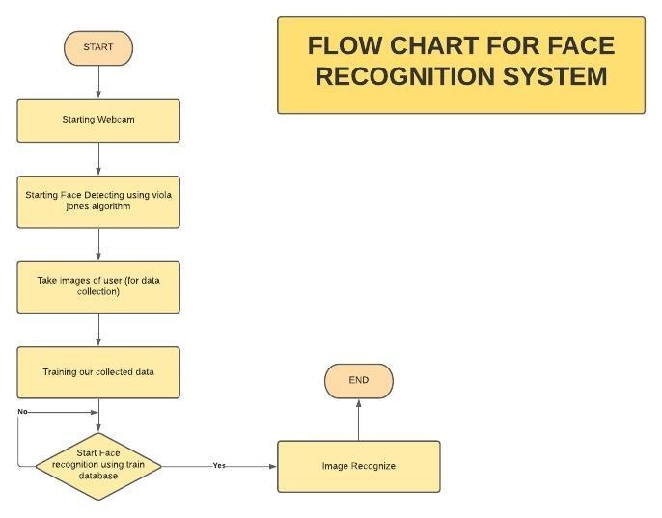
BLOCK Diagram of face recognition

Slide 9
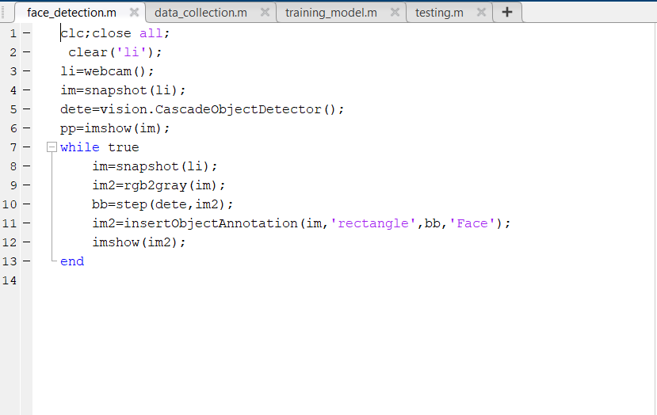
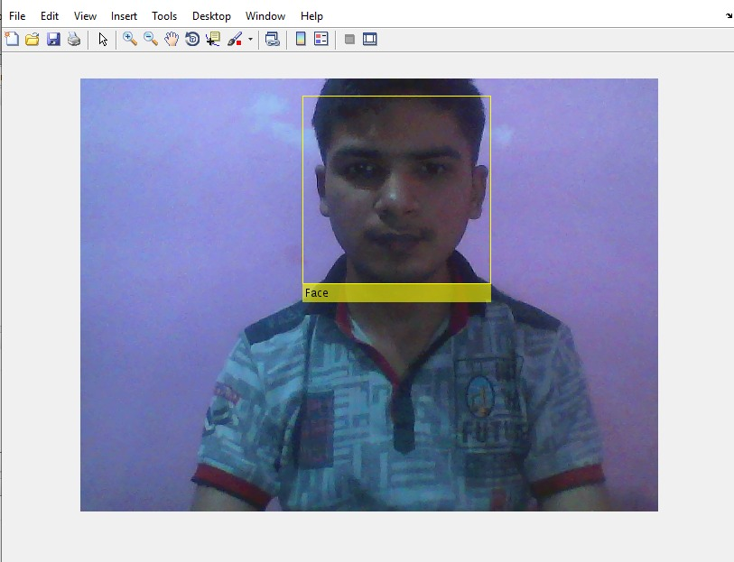
detection process
REAL TIME FACE DETECTION CODE
OUTPUT OF FACE DETECTION

Slide 10
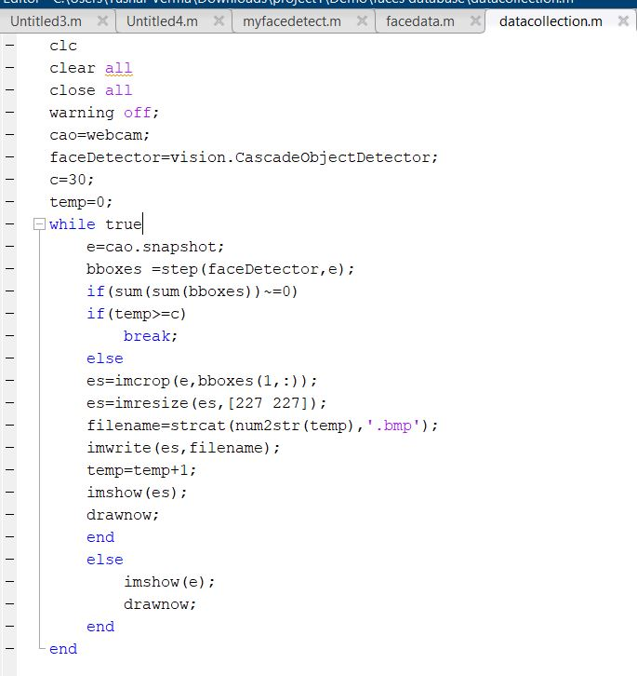
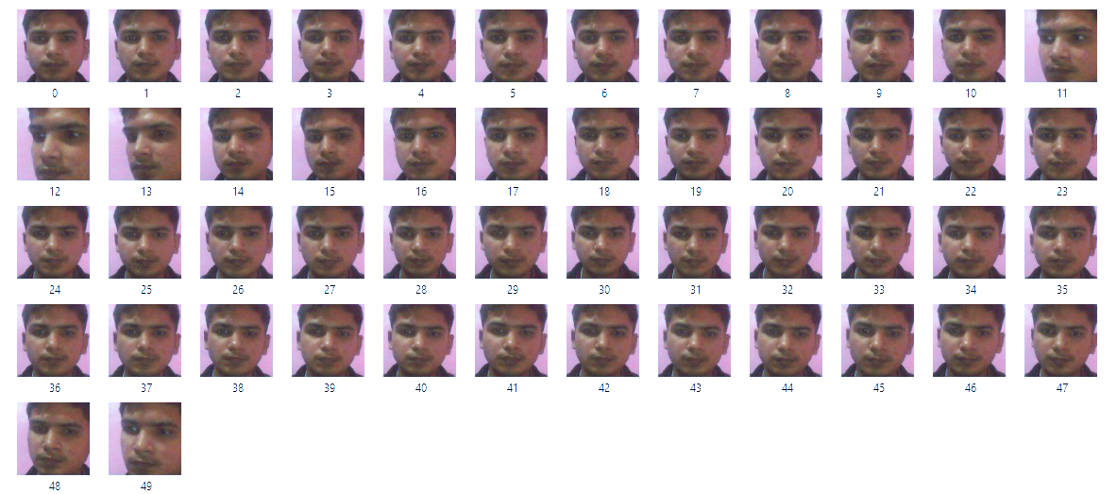
Data collection
CODE OF DATA COLLECTION
OUTPUT OF DATA COLLECTION

Slide 11
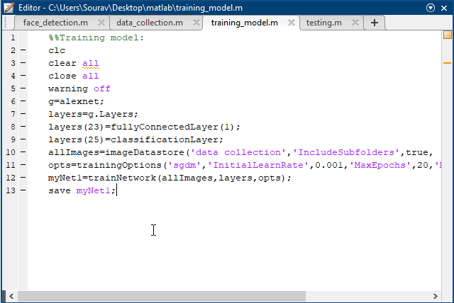
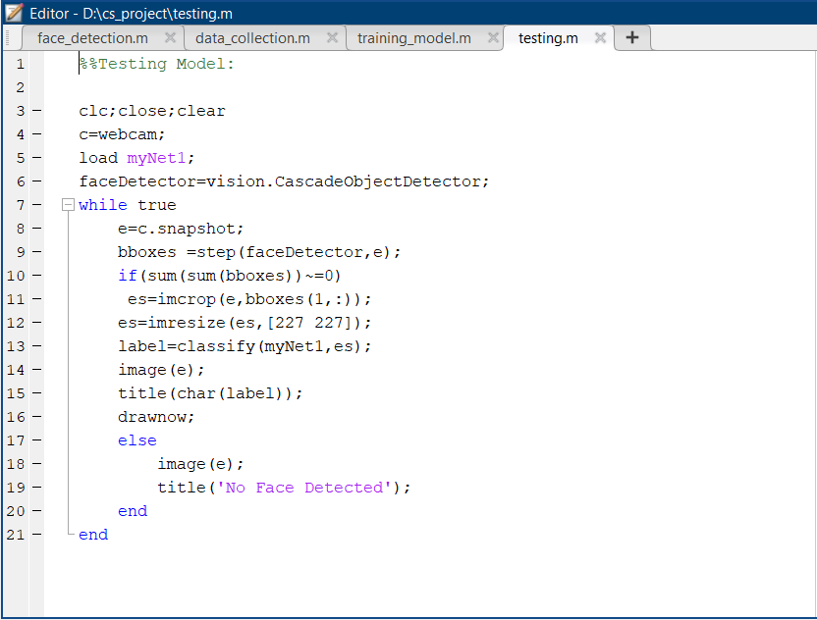
Code of training of the model
Code of testing of the model

Slide 12
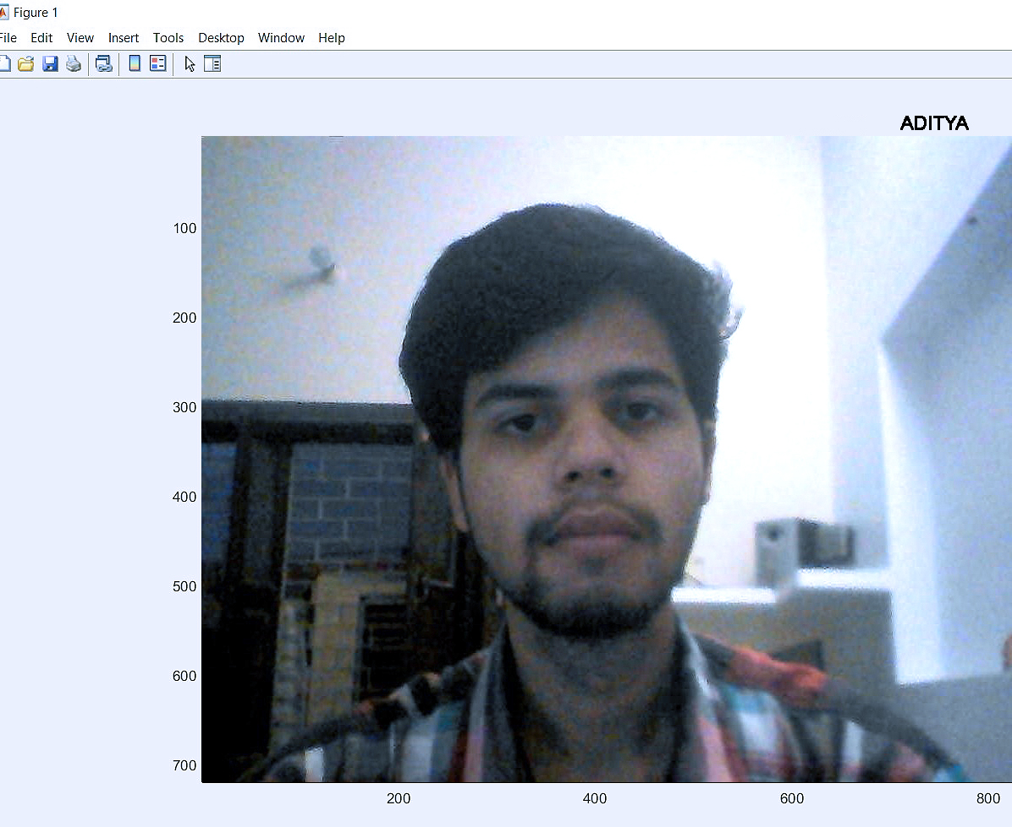
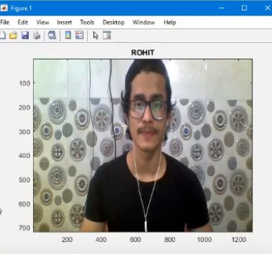
Output 1
Output 2

Slide 13
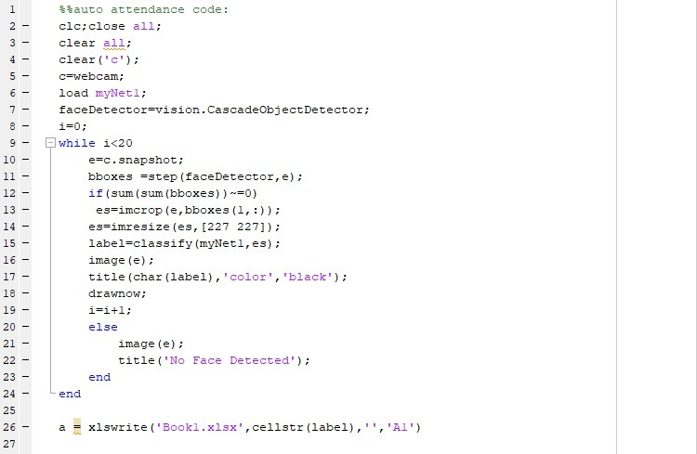
CODE OF ATTENDANCE SYSTEM

Slide 14
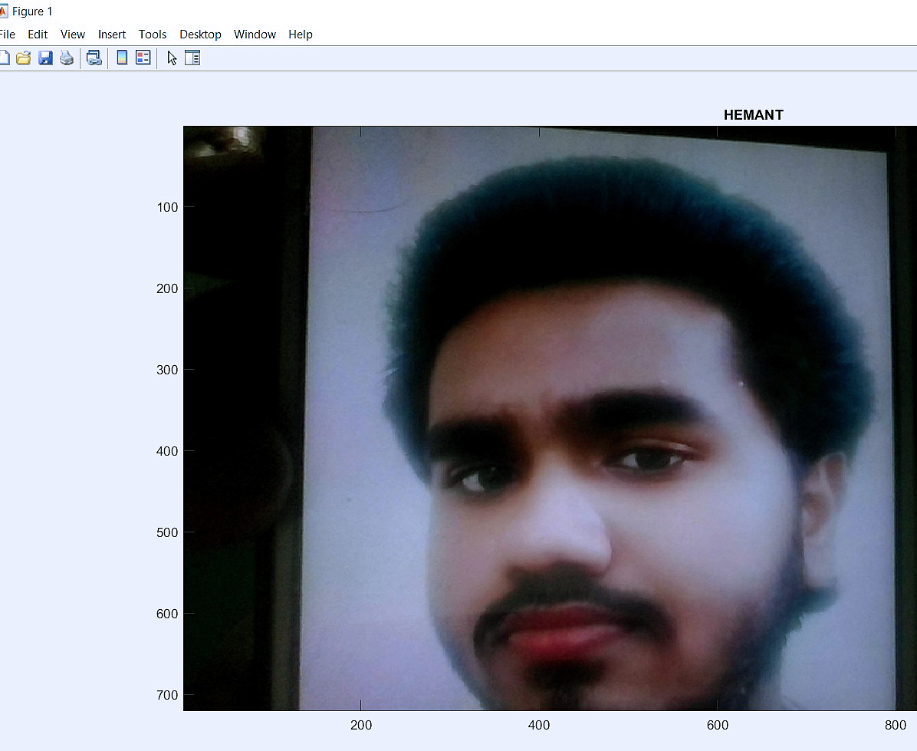
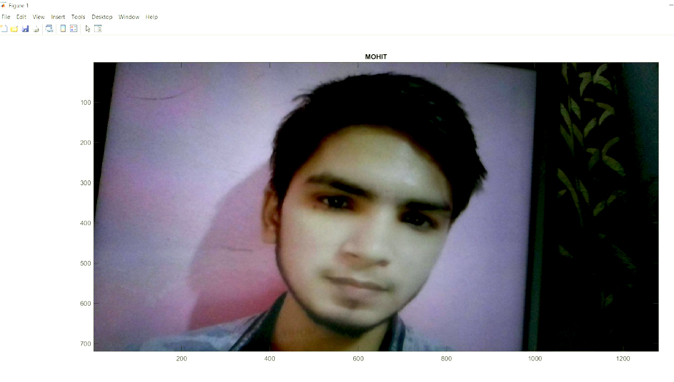
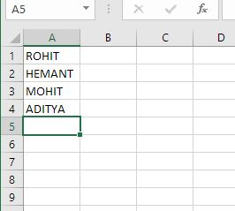
OUTPUT OF AUTO ATTENDANCE SYSTEM

Slide 15


APPLICATIONS:-
Attendance Marking in various Fields like Education, Army, Corporate Sector etc.
In Security System to recognise criminals.
User Authorization and Authentication.

Slide 16
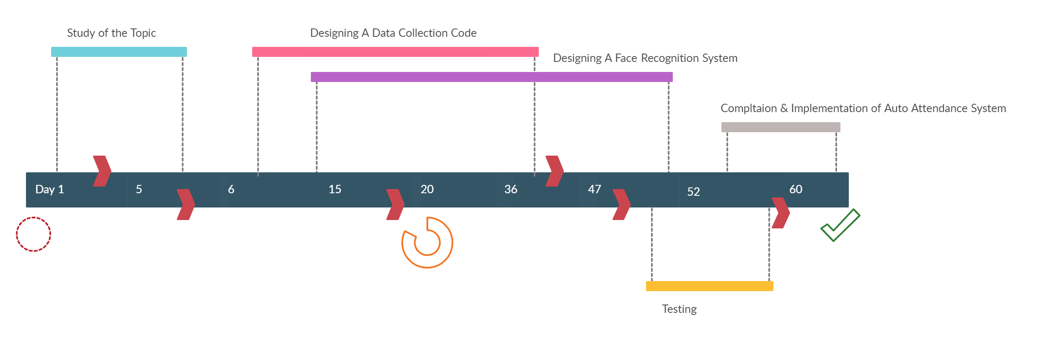
PROJECT TIMELINE

Slide 17
REFERENCES
https://in.mathworks.com/help/matlab/ref/xlswrite.html
https://www.google.com/
https://in.mathworks.com/help/deeplearning/ref/alexnet.html
https://in.mathworks.com/matlabcentral/answers/index

Slide 18
THANK YOU

