Slide 1
BOLT HACKATHON
TEAM : 73
PROBLEM STATEMENT : CAPM1

Slide 2
OUR AIM?
Our aim is to build a interface which will have kind of health assistant which can be used efficiently by any person. The health assistant will remind about the timings of the medicine, will guide about the nearest hospital and clinics. It will also be aware of the health parameters like blood sugar level, blood pressure and a lot medical terms.
This will help even the people who are disabled
they can use this interface to buy medicines
and get info regarding the medicines and disease

Slide 3
SUCH SYSTEMS EXIST ??
WAIT….
There are a lot problems no one has focused and we provide you the solution for them

Slide 4
What’s innovative?
We have decided to solve the problem of lack of data and detection of viruses .
We will make an interface over which anyone from the world will be able to upload the cell images and we then use image processing to find the defected parts in the cell using contour identification method
Our system will input all the cell images and then extract the features as contour areas and make a csv dataset file out of
It which can be shared around the globe and used by various
researchers and made as an input to any ML algorithm

Slide 5

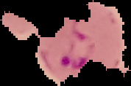


NORMAL CELL VS AFFECTED CELL
PROCESSED IMAGES

Slide 6
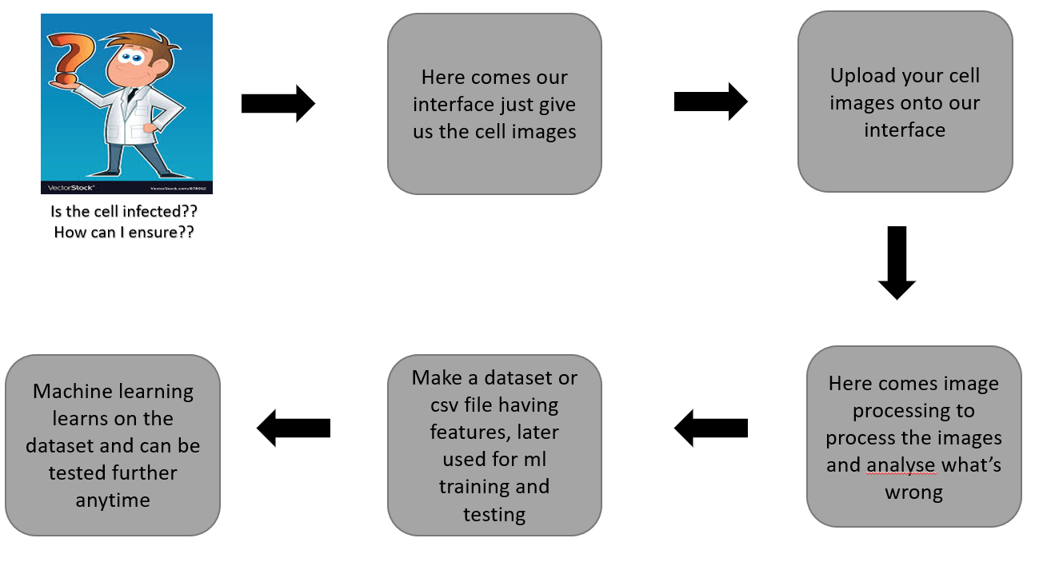
SOLUTION WORKFLOW

Slide 7
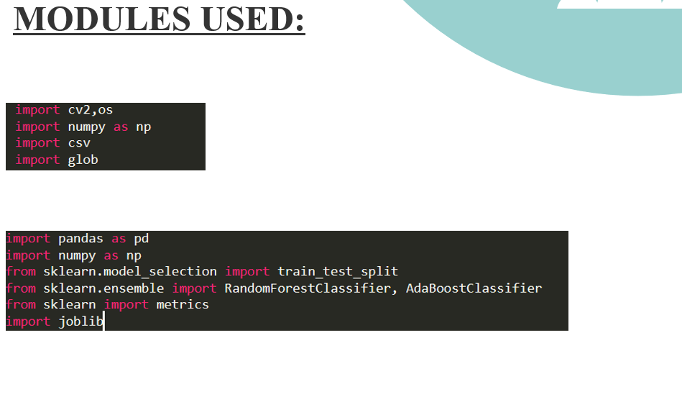

Slide 8
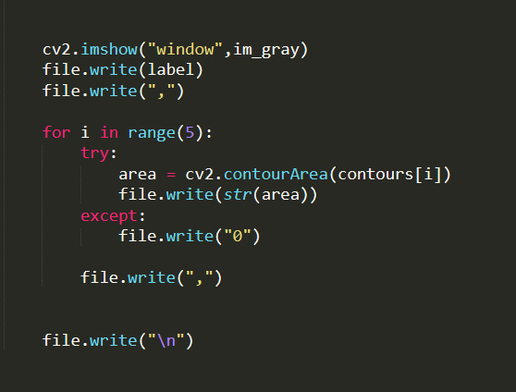
Loading contour areas in csv

Slide 9
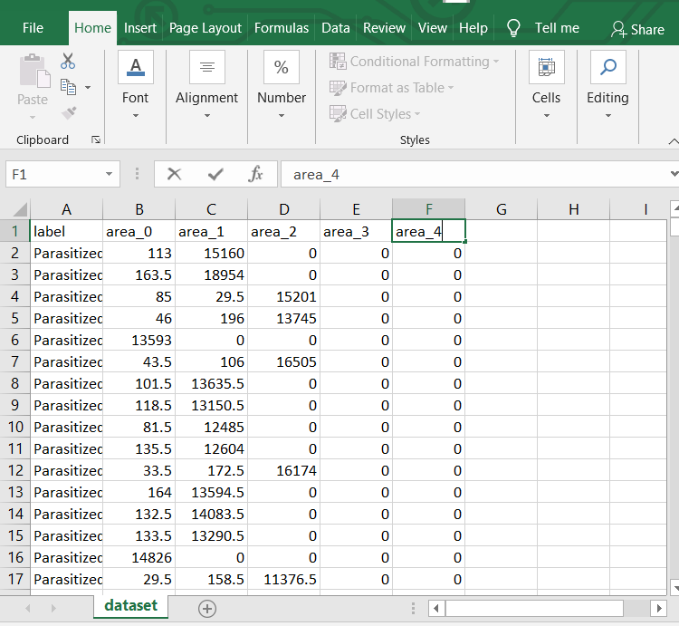
DATASET CREATED

Slide 10
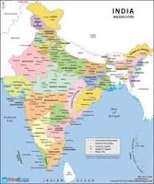
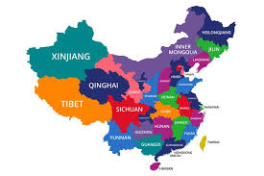
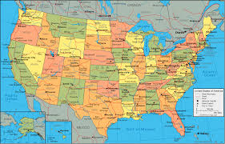
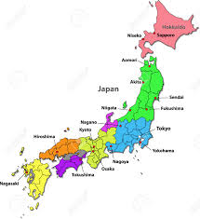
Give us cell images
OUR INTERFACE
Get dataset ready

Slide 11
2.LONG REPORT PROBLEM
VOICE INPUT
Conversion of audio message to text
Conversion of audio message to text
Match the input audio word and find the part it is present in
REPORT INPUT
Converting the file into multiple jpeg images
Process each jpeg image and extract the text written in it

Slide 12
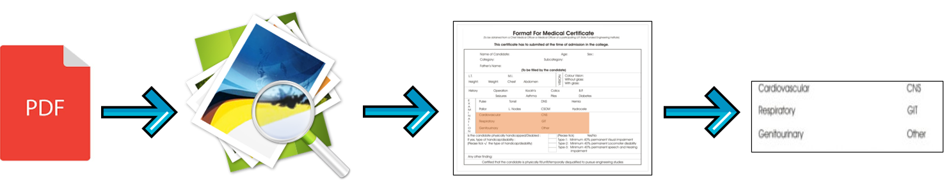
Also the large reports are a big trouble to handle for the doctors and even the people who have no knowledge about the report
For example someone only wants info about blood group from a scanned report. Our software will take voice input from the user about the word or portion he wants and only that portion will be displayed.
This will save the time of doctors to search a 1000 pages long
report and even help the people who have no knowledge about
medical reports.

Slide 13
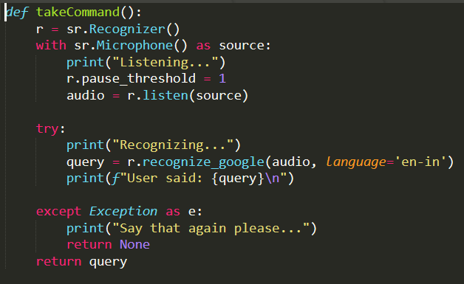
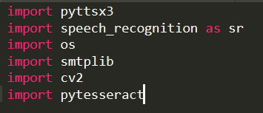

STEP : 1

Slide 14
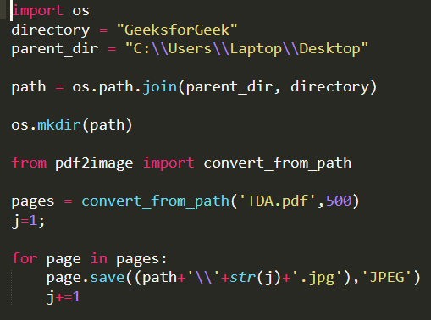

STEP -2

Slide 15
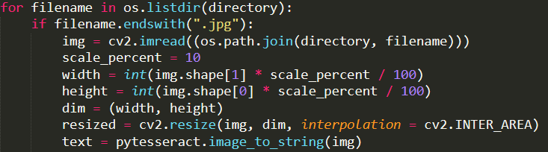


STEP-3

Slide 16
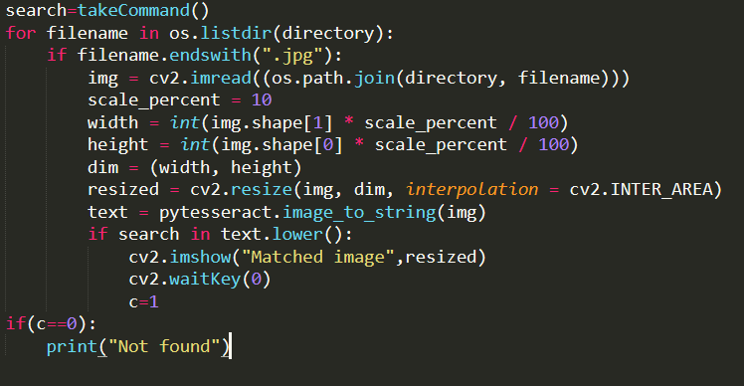
FINAL STEP

Slide 17
FUNCTIONALITY
Our algorithm can be used not only in the field of health and medicine but can be even generalized to any domain. For example searching text from scanned books and notebooks which are large in size and its hard to find a particular topic.
Also as we have made our program user-friendly and our algorithm searches for the part given by the user it makes it more flexible.

Slide 18
OUR IDEA
Not to scare from large scanned reports
Help globally to detect a virus and give its characters

