Slide 1
Movie Rental Analysis
Sakila DVD Rental Store By Hemant Goswami

Slide 2

Introduction
This analysis aims to delve into the dynamics of a DVD rental store, examining various aspects such as customer behavior, film popularity, rental trends, and geographic patterns. By exploring and interpreting the available data, we seek to uncover actionable insights that can inform strategic decision-making and drive business growth.

Slide 3
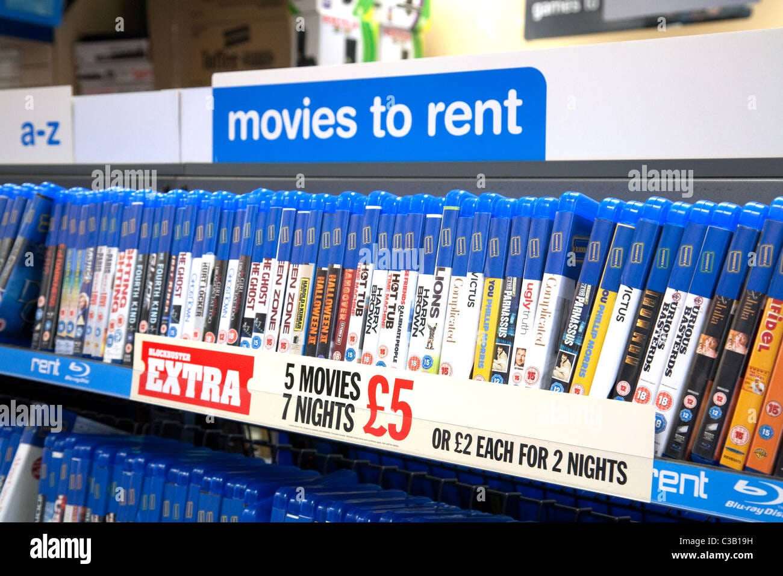

Exploratory Data
Analysis
SQL

Slide 4
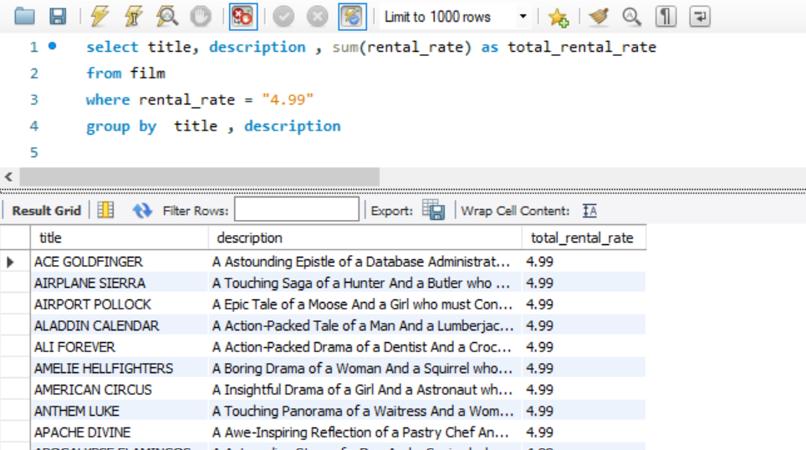
Which films have the highest rental rates and are most in demand?
The films which has highest rental.
This query will give us all the movies which have highest rental and are most in demand
Total 336 movies has the highest rental rate which “4.99”

Slide 5
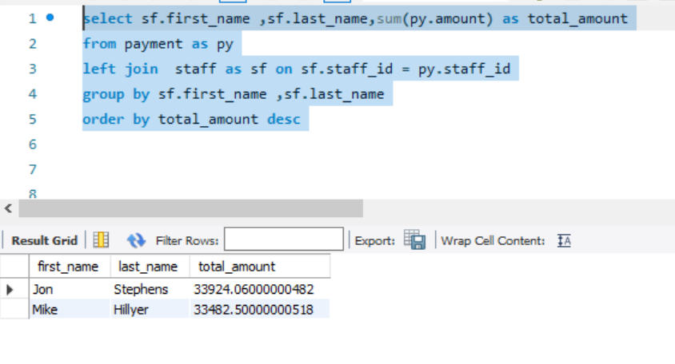
Are there correlations between staff performance and customer satisfaction?
Staff Performance this are some staff members who have performed well.
The total_amount represent the sales of the staff members
This will give you the performance of the staff
Here “Jon Stephens” has made highest sales of 33,924

Slide 6
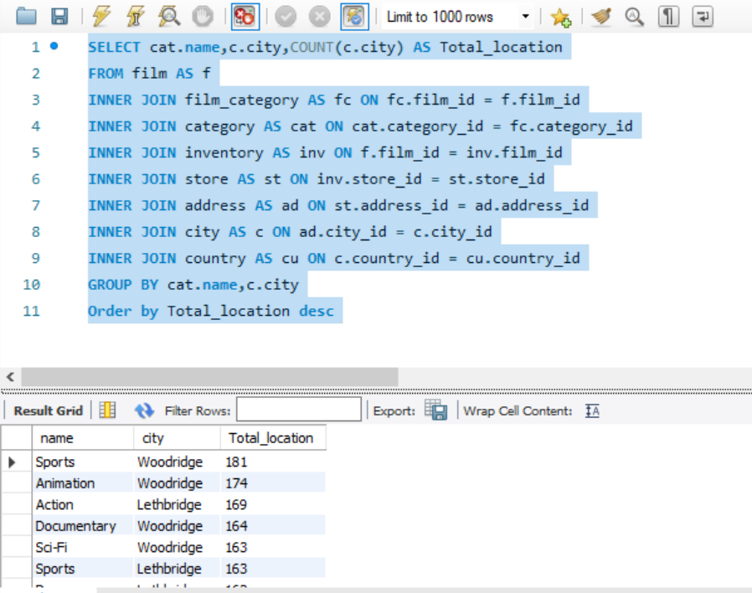
Are certain film categories more popular in specific locations?
This are some popular films category in specific locations.
Sports category has the most popularity in both city Woodbridge and Lethbridge which is total 344.
Animation has the second most popularity in both city Woodbridge and Lethbridge which is total 335
Row Labels | Lethbridge | Woodridge | Grand Total
Action | 169 | 143 | 312
Animation | 161 | 174 | 335
Children | 129 | 140 | 269
Classics | 131 | 139 | 270
Comedy | 142 | 127 | 269
Documentary | 130 | 164 | 294
Drama | 162 | 138 | 300
Family | 157 | 153 | 310
Foreign | 153 | 147 | 300
Games | 128 | 148 | 276
Horror | 112 | 136 | 248
Music | 122 | 110 | 232
New | 148 | 127 | 275
Sci-Fi | 149 | 163 | 312
Sports | 163 | 181 | 344
Travel | 114 | 121 | 235
Grand Total | 2270 | 2311 | 4581

Slide 7
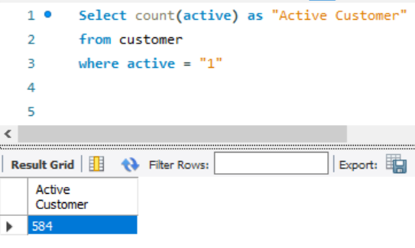
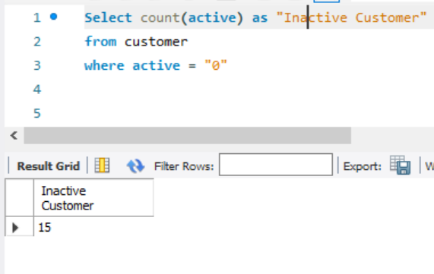
Number of Active & Inactive customers
This query will give you number of active and Inactive Customer.
This table shoes that the number of active customer are more which means we can focus on the preference of the active users.
We need to take feedback of the Inactive user which will helps us to regain those customer again.

Slide 8
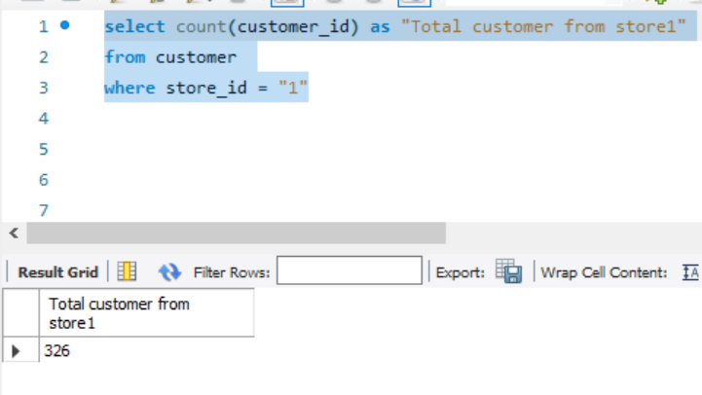
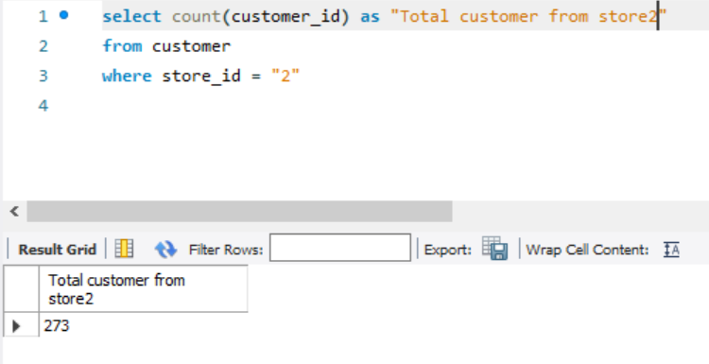
Total customer from Store 1 & 2
This query will give you number of total number of customer each store have.
Store has the large number of customer which is “326”
Because of this number we can clearly make the decision what are the steps store 1 is taking so that they have large numbers of customers.

Slide 9
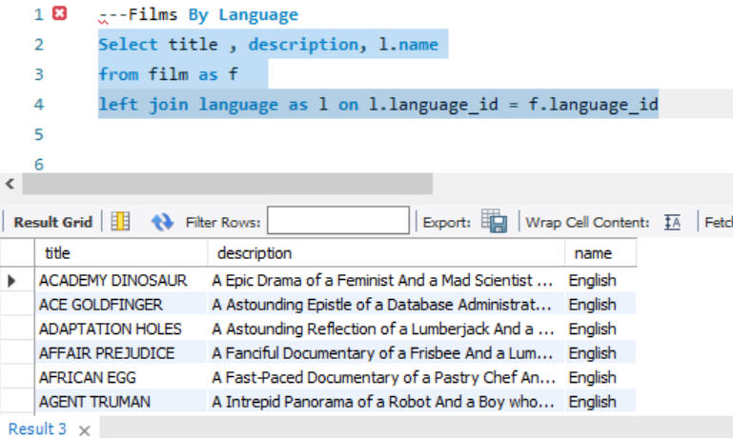
Films By Language
There are total 1000 films with the language English
This language is mainly selected by the customers

Slide 10
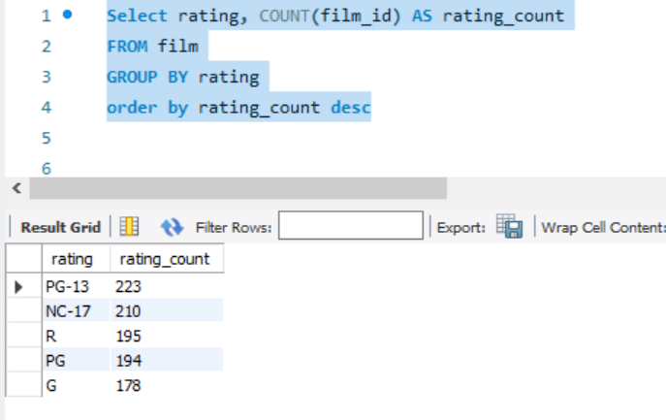
Total Films By Rating
Total films by Different rating
PG-13 has the highest number of films which is “223”
NC-17 has the second highest number of films which is “210”
By knowing customer demand Films rating can helps us to increase the inventory volume which customer love to watch according to rating.

Slide 11
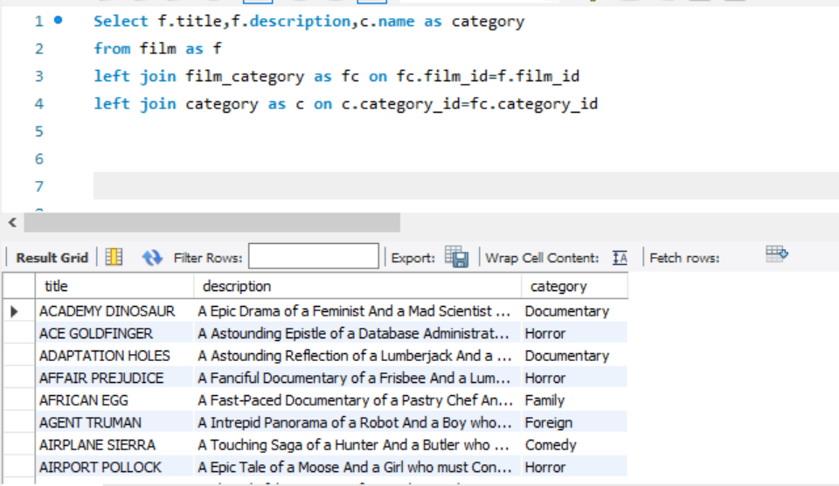
Films with category
Films with the category
Sports has the highest numbers of films which is “74”
This analysis gives the idea category films need to be add more
Category Name | Number of films
Sports | 74
Foreign | 73
Family | 69
Documentary | 68
Animation | 66
Action | 64
New | 63
Drama | 62
Games | 61
Sci-Fi | 61
Children | 60
Comedy | 58
Classics | 57
Travel | 57
Horror | 56
Music | 51
Grand Total | 1000

Slide 12
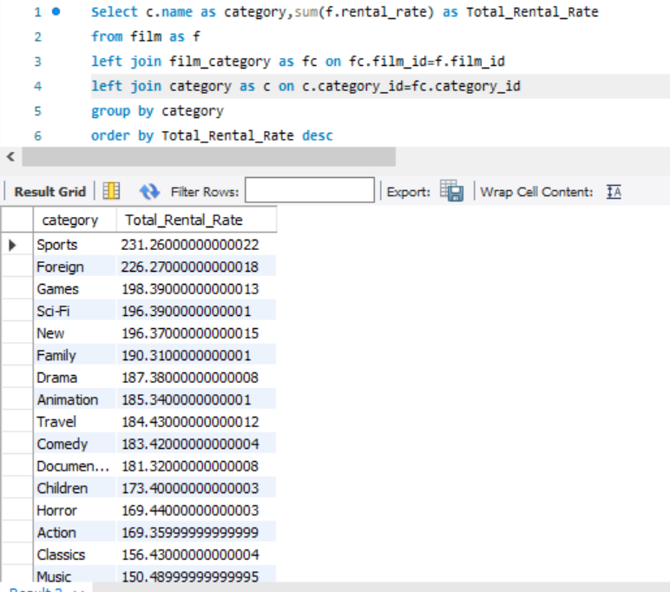
Total rental rate category
Here this analysis give the maximum earnings earns by the category of the film.
The “Sports” give us the highest earning which means our customer loves watching documentary films more than other category.
We can take decision upon which category films needs to add more so that revenue can earn more.

Slide 13
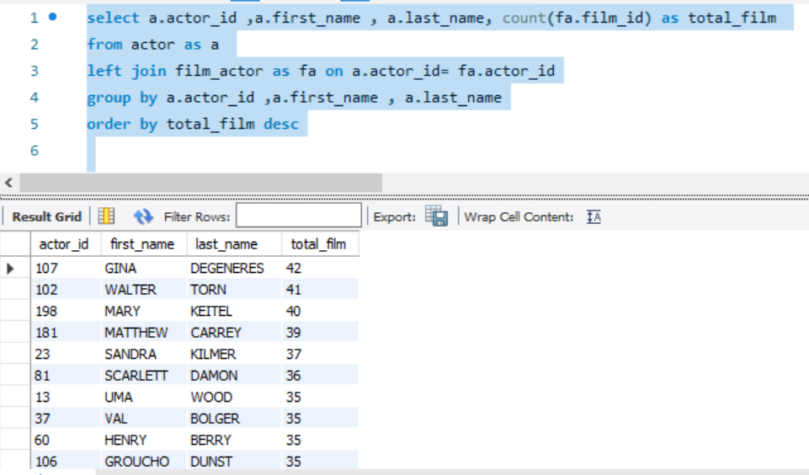
Highest films done by an actor
Highest film done by an actor
The actor which has done highest films is “GINA DEGENERES” which has done “42” films.
Our inventory have maximum films of this actor now we can take decision on the popularity of this actor whether we should add more film for him.

Slide 14
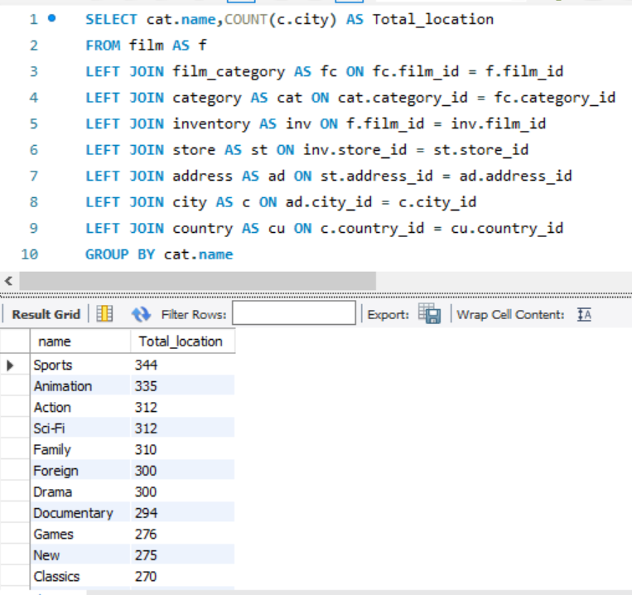
Total film categories by location
Total films category by the location
The “Sports” category has the highest no of the location available.
The “Animation” category has the second highest no of location available
This analysis show the film category which is widely available in the location, We need to focus on the category which has least number of location have.

Slide 15
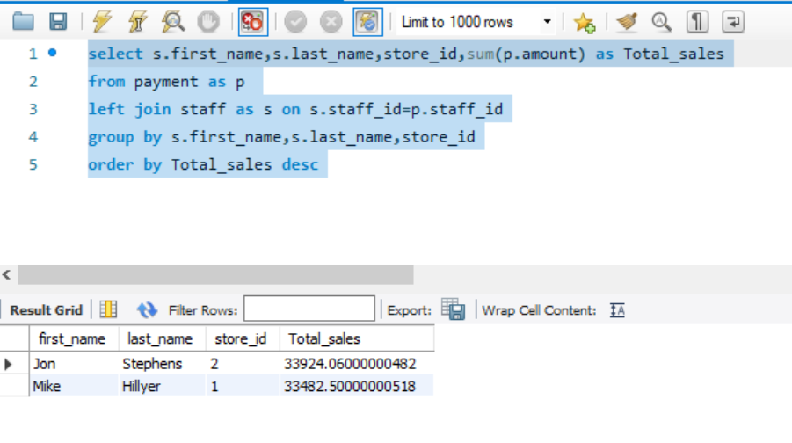
Highest sales of stores with staff members
Highest sales of the store with staff
“Jon Stephens” has made the highest sales which work in store number “2” the total sales made is 33,924
Where “Mike Hilyer” has made sales of 33,482 from store “1”.
This analysis give the report that Jon is using some technics which helping him to gain more sales or may be there is something where Mike is lagging need to figure out where is the problem.

Slide 16
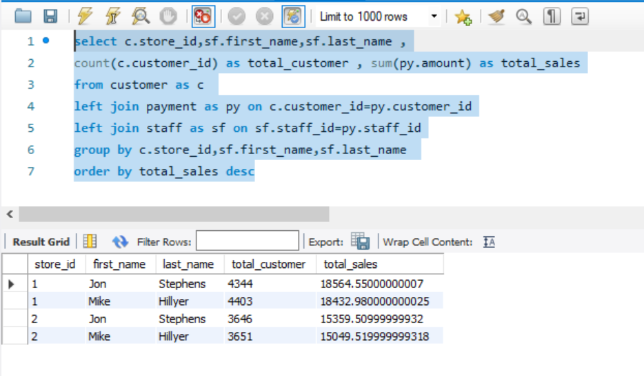
Total sales of stores with staff and total customers
Total sales of stores with staff and total customers
The Store 1 has made sales more than store 2.
This analysis show the clarity that the reason of store 1 made more sales than store 2 is the customer.
That means to increase sales of store 2 needs to increase customer.

Slide 17
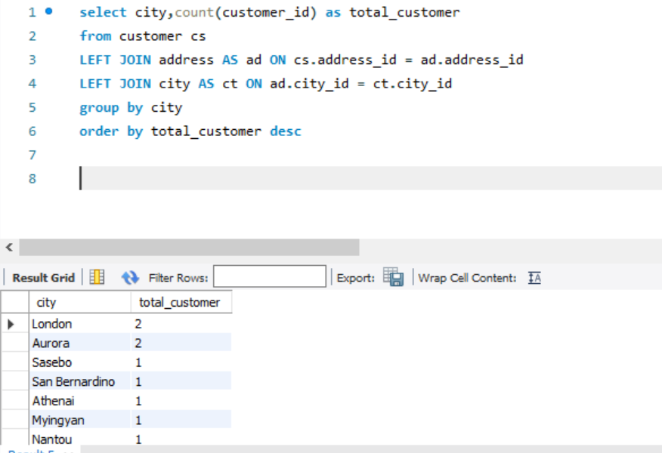
Highest numbers of customer in a city
Maximum number of customer comes from which city
The London and Aurora is the city which have maximum numbers of customer
We need to focus on more city to increase our customer which will help us to increase in sales

Slide 18
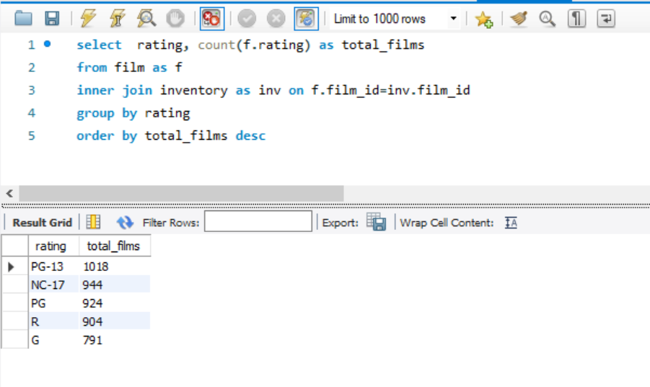
Total Films available in inventory by rating
Films available in inventory by rating
PG-13 has the highest number of films in inventory which is “1018”
We need to focus on the other rating which has least number and increase the number to available more films in inventory.

