Slide 1
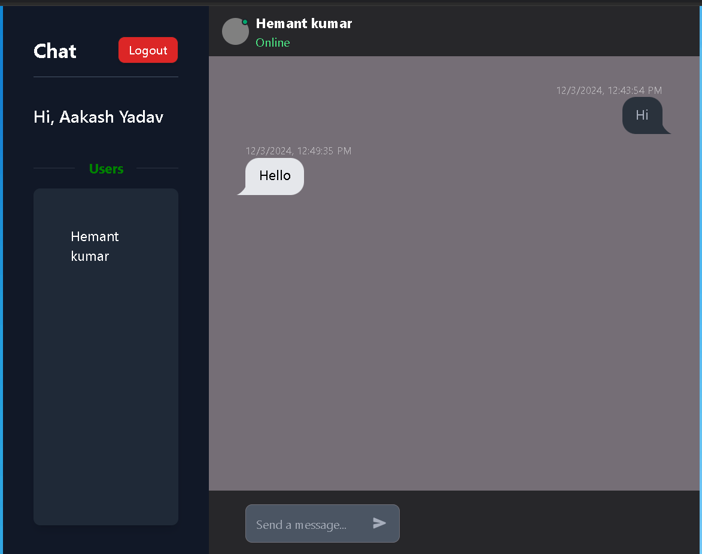
MERN Chat App: Building a Real-time Communication Platform
Welcome to this presentation exploring the development of a real-time chat application built with the MERN stack and Socket.IO. This project demonstrates the power of these technologies for building interactive and engaging communication platforms. We'll delve into the key features, technology stack, and development process, showcasing a seamless and dynamic chat experience.
HK
by Hemant Kumar

Slide 2
Introduction to the Project
The MERN Chat App is a full-stack project designed to provide users with a secure and user-friendly platform for real-time messaging. Built using the popular MERN stack (MongoDB, Express.js, React.js, Node.js) and enhanced with Socket.IO for real-time communication, the app enables private messaging and file sharing.
This project aims to showcase the capabilities of these technologies in creating a dynamic and interactive chat experience. We'll explore the core features, technical architecture, and the development process, emphasizing the benefits of using MERN and Socket.IO for real-time communication applications.

Slide 3
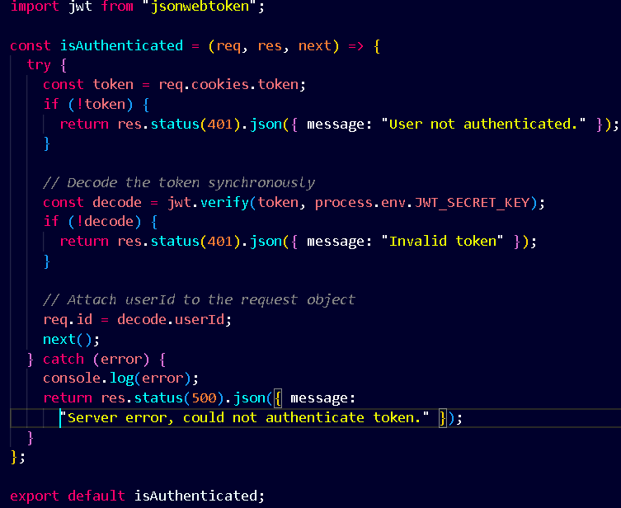
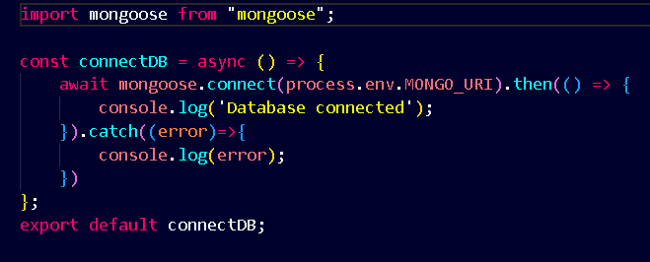
Application Features
User Authentication and Authorization
Real-time Messaging
Instant message delivery and updates using Socket.IO. Notification system for new messages and online status.
Secure user accounts with login/signup functionalities. Role-based access control for private messaging and user profiles.
Private Messaging
Database Integration
Secure storage of user data, messages, and file uploads using MongoDB. Efficient database design and management.
Direct communication between users. Sending and receiving private message.

Slide 4
Technology Stack
MongoDB
Express.js
React.js
NoSQL database for storing user data, messages, and file uploads.
Node.js web application framework for API endpoints and backend logic.
JavaScript library for building the user interface and handling dynamic content.
Node.js
Socket.IO
JavaScript runtime environment for server-side development and backend logic.
Real-time communication library for instant message delivery and updates.

Slide 5
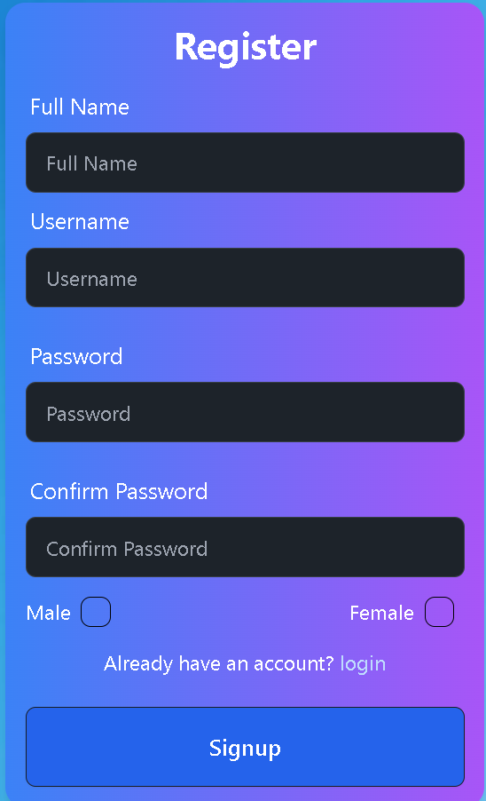

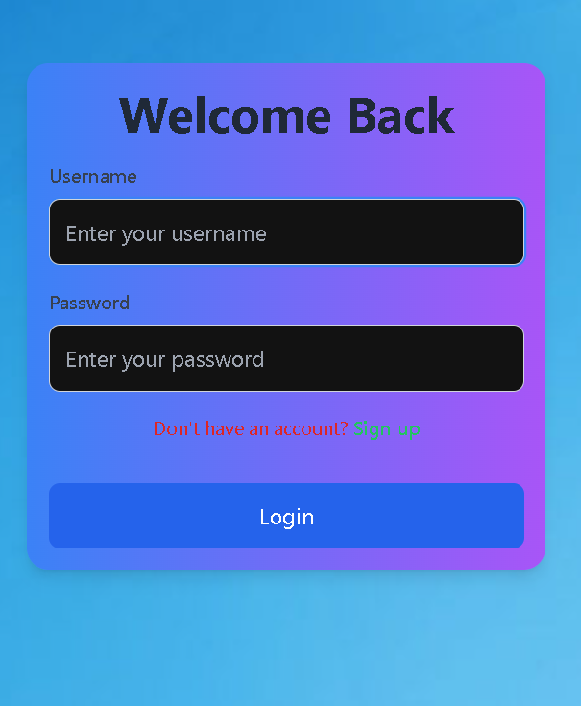


User Authentication and Authorization
User Registration
A secure registration form allows users to create accounts with unique usernames
and passwords. Email verification and password hashing ensure account security.
Login and Logout
Users can log in with their credentials, granting access to
private messaging features. Secure logout functionality
ensures user data privacy.
Authorization
Role-based access control restricts unauthorized access to sensitive data, ensuring privacy and security.

Slide 6
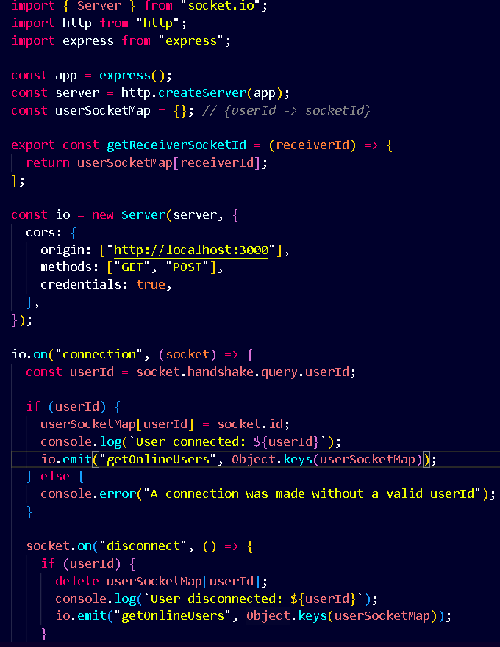
Real-time Messaging with Socket.IO
1
Socket.IO establishes a persistent connection between the client (user's browser) and the server (Node.js application).
2
When a user sends a message, Socket.IO emits an event to the server. This event carries the message content and the recipient's information.
3
The server broadcasts the message to the intended recipient using Socket.IO's event-driven architecture. The recipient's browser receives the message in real-time, updating the chat interface.

Slide 7
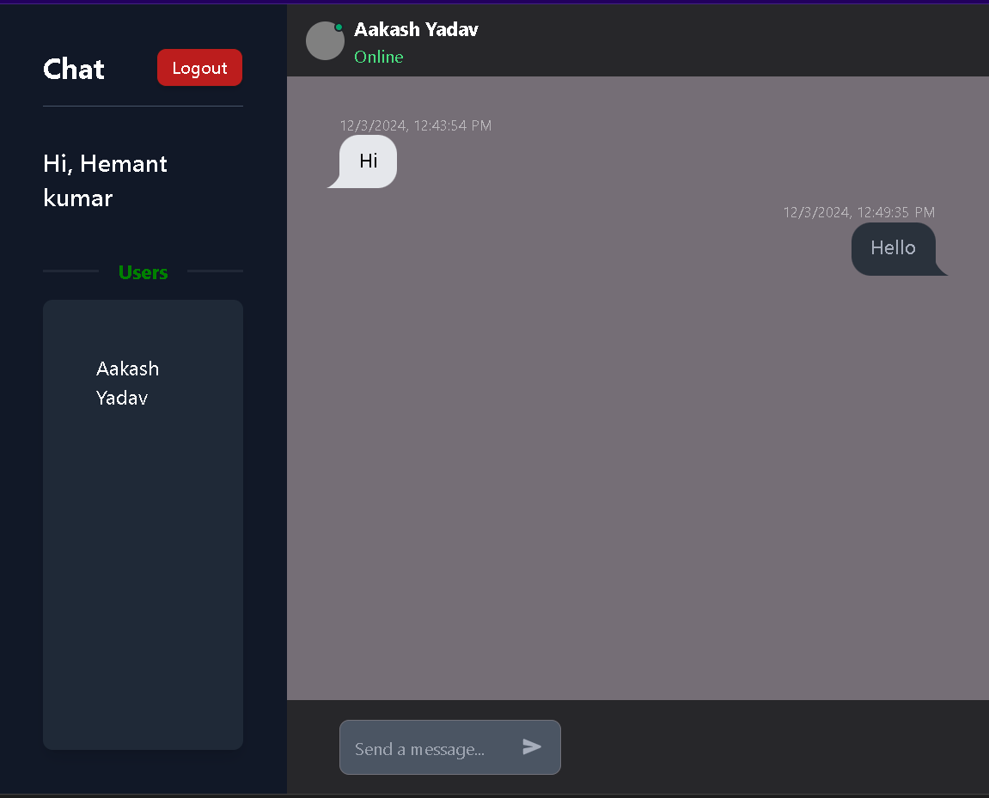


Private Messaging Only
Direct Messages
Users can initiate private conversations by selecting a recipient from their contacts list.
Message Encryption
For sensitive conversations, messages can be encrypted end-to-end using encryption algorithms.
.

Slide 8
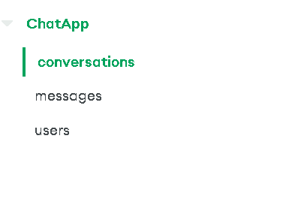



Database Design and Integration
User Collection
1
Stores user information, including username, email , and password.
Users Conversation
2
Stores conversation Array of two user, sender and receiver.
Message Collection
3
Stores messages and their respective timestamps .

Slide 9
Deployment and Hosting
Backend Deployment
1
The Node.js server is deployed on a cloud platform like Heroku, AWS, or DigitalOcean.
Frontend Deployment
2
The React.js application is built and deployed using a front-end hosting services.
Database Management
3
The MongoDB database is hosted on a cloud provider on MongoDB Atlas.

Slide 10
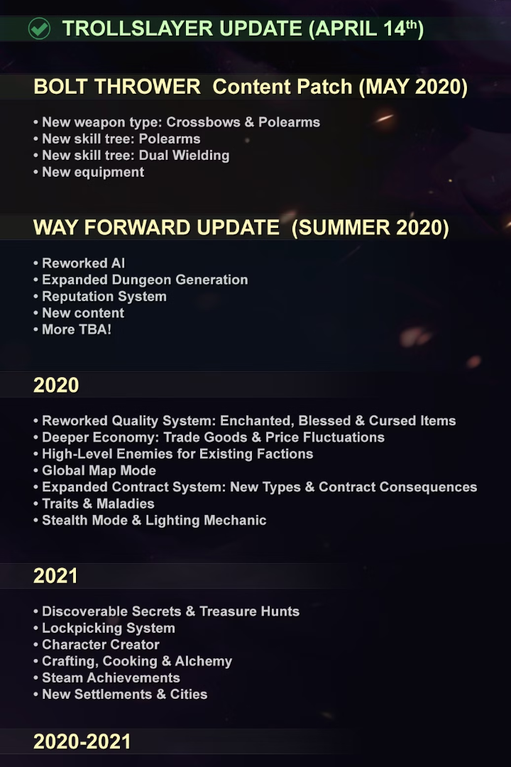
Conclusion and Future Enhancements
1
Key Takeaways
The MERN Chat App demonstrates the effectiveness of the MERN stack and Socket.IO for building real-time communication applications.
2
Future Enhancements
We can expand the app with group chat functionality, voice/video calling, and advanced features like file sharing.
3
Next Steps
Explore advanced security measures, user interface improvements, and integrating AI-powered features.

