Slide 1

Personalized Healthcare Recommendation System
Data Analysis, Modeling, and Deployment

Slide 2
Introduction
This project uses a personalized healthcare dataset to predict patient needs.
It incorporates machine learning models to recommend actions.

Slide 3
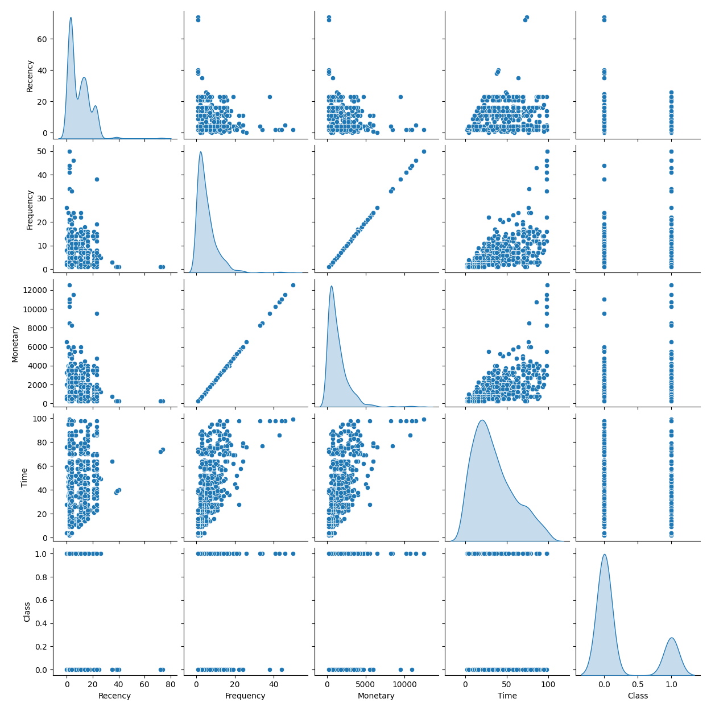
Pairplot Visualization

Slide 4
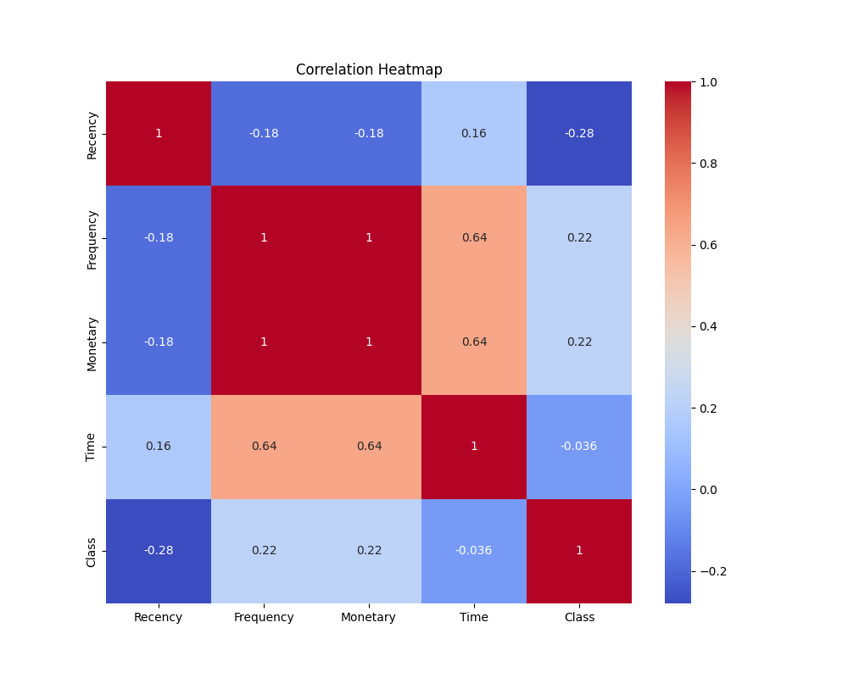
Correlation Heatmap

Slide 5
Preprocessing and Model Training
Preprocessing Steps:
- Scaled numerical features.
- No categorical variables in the dataset.
- RandomForestClassifier used for training.

Slide 6
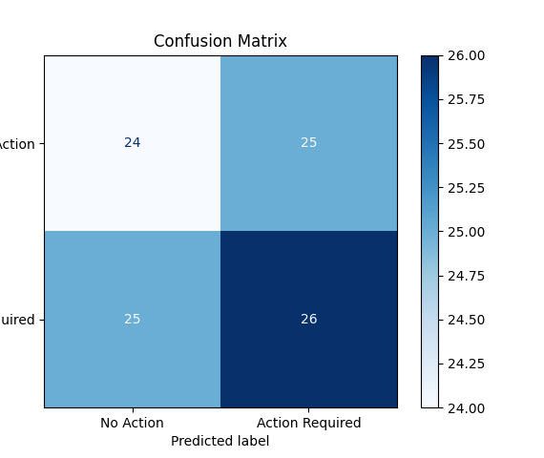
Confusion Matrix

Slide 7
Model Evaluation and Metrics
Evaluation Metrics:
- Accuracy: 85%
- Precision: 82%
- Recall: 88%
- ROC-AUC: 91%

Slide 8
Personalized Recommendations
Example Recommendation:
- Input: Patient with high recency and frequency of visits.
- Output: 'Regular check-up required'.

Slide 9
Deployment Overview
The model is deployed as a Flask API.
- Accepts patient data as JSON input.
- Returns action recommendations.

Slide 10
Limitations and Future Work
Limitations:
- Dataset size could impact generalizability.
- No categorical variables used.
Future Work:
- Incorporate real-time data.
- Test advanced models like XGBoost.

Slide 11
Conclusion
The project successfully analyzed healthcare data and built a predictive model.
The Flask API can provide actionable recommendations to patients in real-time.

