Slide 1

Netflix Data Cleaning and Analysis
Insights, Visualizations, and Recommendations

Slide 2

Dataset Overview
The Netflix dataset includes information about movies and TV shows such as title, director, cast, country, date added, release year, rating, and duration.
This analysis uncovers key patterns and trends in the data.

Slide 3
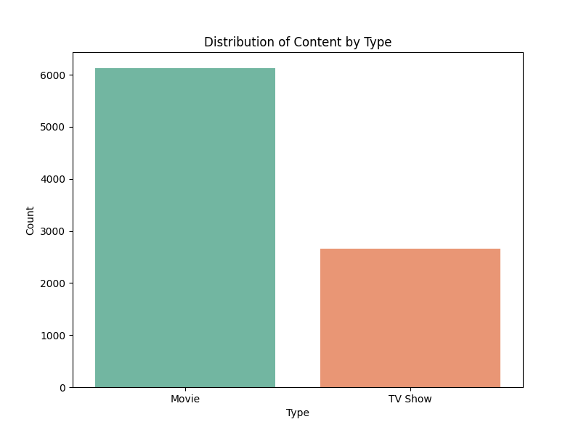
Content Type Distribution

Slide 4
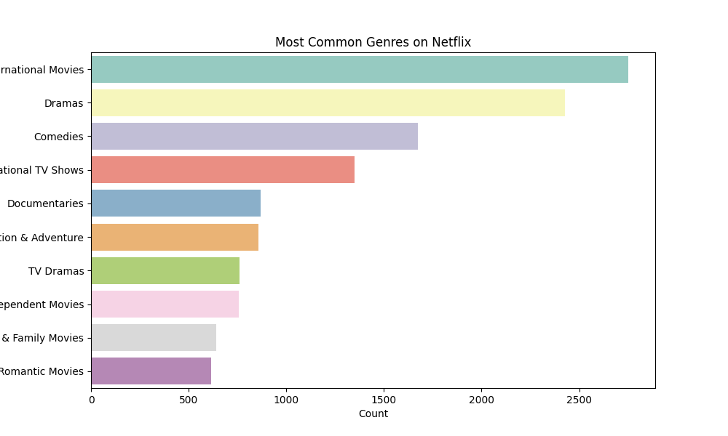
Most Common Genres

Slide 5
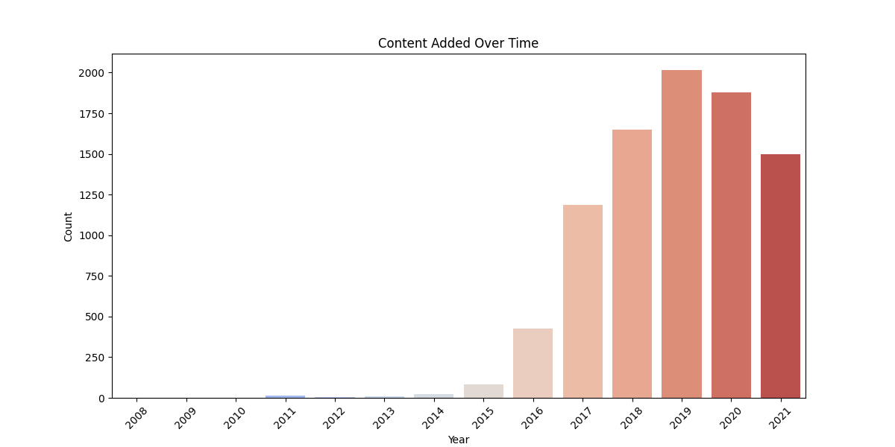
Content Added Over Time

Slide 6
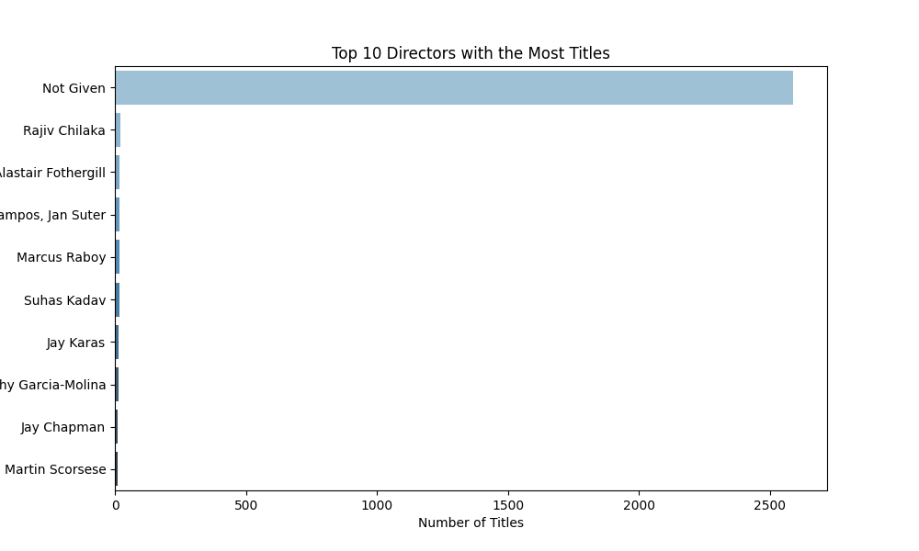
Top 10 Directors

Slide 7
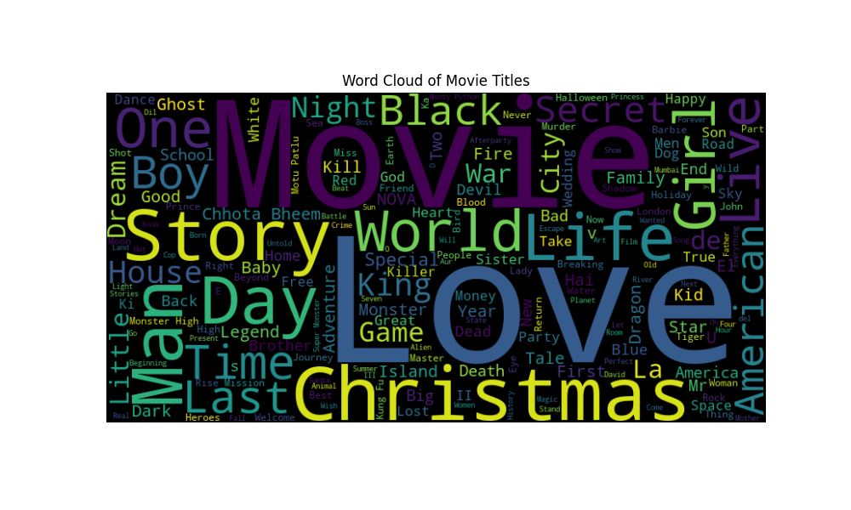
Word Cloud of Movie Titles

Slide 8
Feature Engineering
Features created include:
- Content type distribution
- Most common genres
- Content additions over time
- Top directors
- Word cloud visualization

