Slide 1
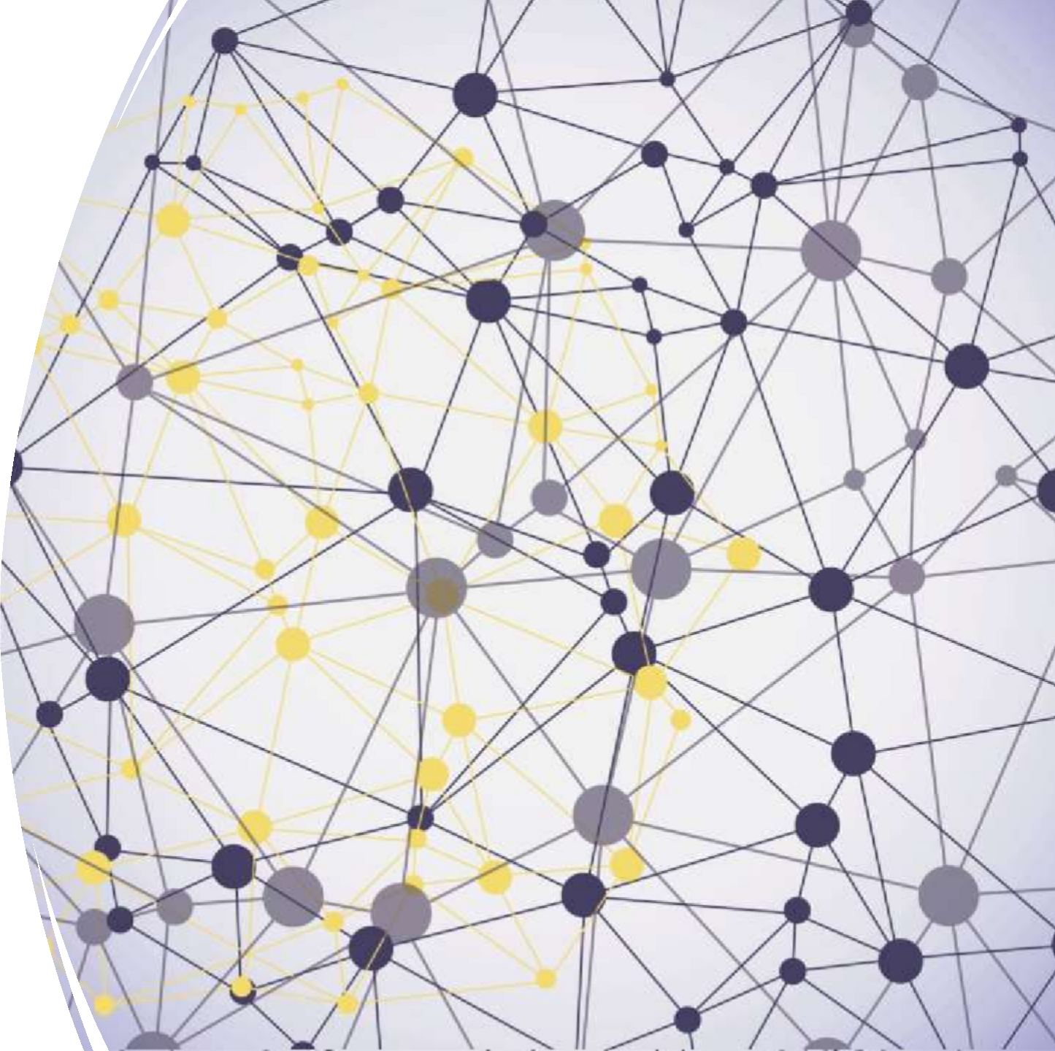
Grafana Dashboard
Bhushan rane

Slide 2
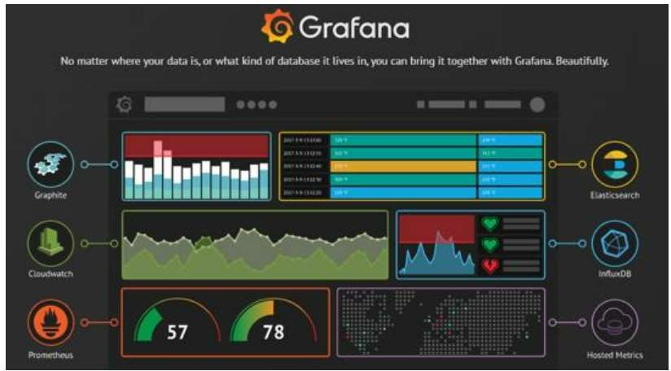
What is Grafana ?
Open platform for analytics and monitoring.
It is one of the leading open source software for
time series analytics .
The idea is no matter where your data is, or what kind of database it lives in, you can build dashboards
seamlessly using Grafana.
https://grafana.com grafana/testimonials

Slide 3



Why Grafana??
Advanced visualization and rich metrics dashboard
Reporting and monitoring server. Alert Notification feature

Slide 4

Scope of Grafana ?
Grafana has been the most utilized tool in the market in various domains.
Grafana provided many visualization
plugins.
We can add our own customized plugin.

Slide 5









Architecture
Collect
Analyze
UI
Influxdb
Grafana
QL
http
Result

Slide 6
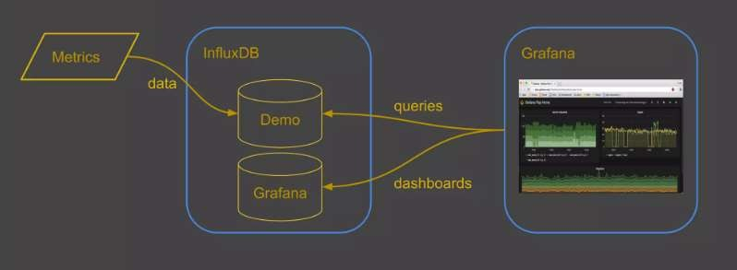

Slide 7

Influxdb
InfluxDB is an open-source time series database (TSDB)
Self contained binary
No, External dependency
Support for cluster
Provide HTTP Native support by doing read/write, manage data via http
Security
SQL style quries
Ports 8083 - UI
8086 -
API - Send and query data
Cluster management raft
8090
8099
Cluster management protobuf

Slide 8

What is Time- Series Data
A time-series is a sequence of data points, consisting of successive measurement made over a time interval.
Major type: Regular and Irregular
They are used in statistics, mathematical finance, pattern recognition, IoT..

Slide 9

Down-sampling and Data Retention
Working with much data over a long period of time can create storage concerns.
Solution : Down sampling or expire
InfluxDB offers two mechanisms for dealing with this issue: Continuous Quires and Retention Policies
Other interesting feature:
Clustering

