Slide 1
BITMAP v/s B⁺TREE INDEXING IN DATA WAREHOUSING

Slide 2

JNTUH College of Engineering Hyderabad
Jawaharlal Nehru Technological University Hyderabad
Kukatpally,Hyderabad-85
rgwgProject Guide
Dr. K. P. SUPREETHI
Assistant Professor
Department of Computer Science and Engineering
ASHOK KUMAR YENDA 12011A0506
HEMANT KOTI 12011A0515
SRIKAR YAGAVANDLA 12011A0541

Slide 3
TABLE OF CONTENTS
INTRODUCTION
LITERATURE SURVEY
PROBLEM STATEMENT
IMPLEMENTATION
RESULTS AND PERFORMANCE EVALUATION
CONCLUSIONS AND FUTURE WORK
REFERENCES

Slide 4
INTRODUCTION
1.1 Objective :
The main objective of this report is to compare the retrieval time for Bitmap, B⁺Tree indexing and sequential extraction of data.
1.2 Scope :
Through this report, we sort out the various drawbacks that we face in case of sequential retrieval of data in case of Data Warehouses.
Bitmap indexing technique works best when the database has low-selectivity and B⁺Tree works best when the database has high selectivity.
The graphs are plotted to illustrate the time taken for retrieving the records.

Slide 5
LITERATURE SURVEY
2.1 File Organisation :
File organisation refers to logical structuring of the records as determined by the way in which they are accessed.
In choosing a file organization, several criteria are important: Short access time, ease of update, economy of storage, simple maintenance, reliability.
The various types of file organizations are as follows :
2.1.1 The Pile :
The least-complicated form of file organization may be termed the pile. Data are collected in the order in which they arrive.
Each record consists of one burst of data.
The purpose of the pile is simply to accumulate the mass of data and save it.

Slide 6
2.1.2 The Sequential File :
The most common form of file structure is the sequential file.
In this type of file, a fixed format is used for records.
All records are of the same length, consisting of the same number of fixed-length fields in a particular order.
Because the length and position of each field are known, only the values of fields need to be stored.
2.1.3 The Indexed Sequential File :
A popular approach to overcoming the disadvantages of the sequential file is the indexed sequential file.
The indexed sequential file maintains the key characteristic of the sequential file: Records are organized in sequence based on a key field.
Two features are added: an index to the file to support random access, and an overflow file.

Slide 7
2.1.4 The Indexed File :
The indexed sequential file retains one limitation of the sequential file: Effective processing is limited to that which is based on a single field of the file.
For example, when it is necessary to search for a record on the basis of some other attribute than the key field, both forms of sequential file are inadequate.
In some applications, the flexibility of efficiently searching by various attributes is desirable.
2.1.5 The Direct or Hashed File :
The direct, or hashed, file exploits the capability found on disks to access directly any block of a known address.
As with sequential and indexed sequential files, a key field is required in each record. However, there is no concept of sequential ordering here.
The direct file makes use of hashing on the key value.

Slide 8
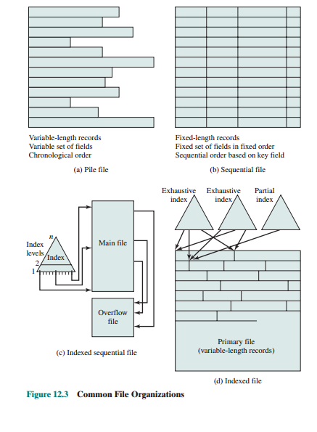
Common file Organization

Slide 9
2.2 Disk Organisation :
The rate in improvement in secondary storage performance has been considerably less than the rate for processors and main memory.
This mismatch has made the disk storage system perhaps the main focus of concern in improving overall computer system performance.
To improve disk performance a standardized scheme for multiple-disk database design, known as RAID (redundant array of independent disks) has been introduced.
2.2.1 RAID Schemes :
The RAID scheme consists of seven levels, from zero to six.
RAID is a set of physical disk drives viewed by the OS as a single logical drive.
Data are distributed across the physical drives of an array in a scheme known as striping.
The different RAID levels are tabulated as follows.

Slide 10
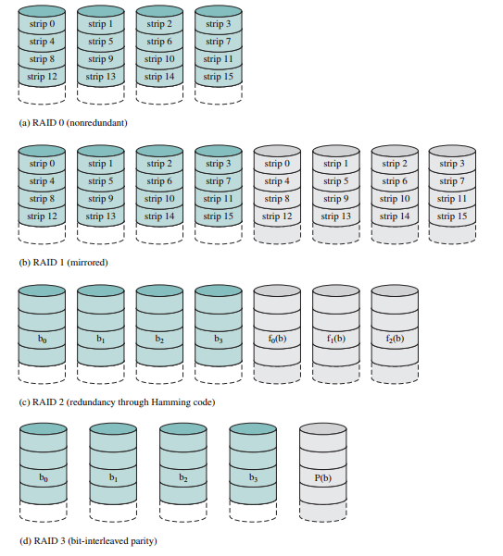
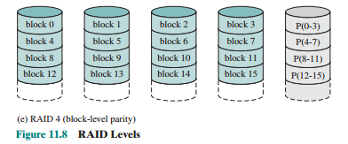
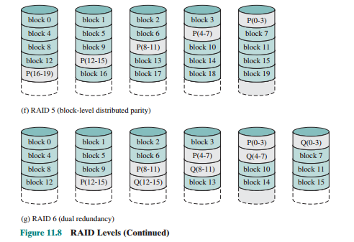

Slide 11
2.3 Index And Types Of Indexes :
Indexes are database objects associated with database tables and created to speed up access to data within the tables.
In data warehouse systems, there are many indexing techniques. Each existing indexing technique is suitable for a particular situation.
2.3.1 The B-Tree Index :
The B-Tree Index is the default index for most relational database systems.
The top most level of the index is called the root. The lowest level is called the leaf node. All other levels in between are called branches.
Both the root and branch contain entries that point to the next level in the index.
2.3.2 Projection Index :
A Projection Index on an indexed column A in a table T stores all values of A in the same order as they appear in T.
Each row of the Projection Index stores one value of A. The row order of value x in the index is the same as the row order of value x in T.

Slide 12
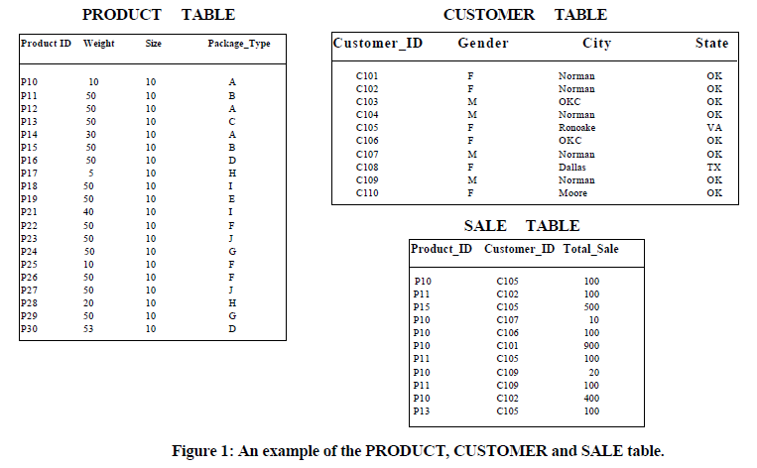
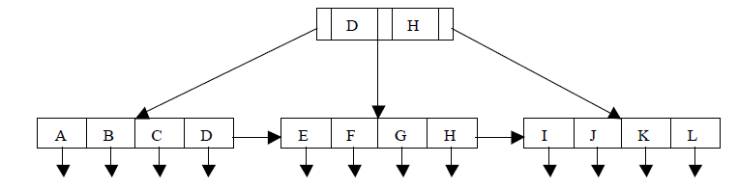
B⁺ Tree Index on Product Table

Slide 13
2.3.3 Bitmap Index :
The bitmap representation is an alternate method of the row ids representation.
It is simple to represent, and uses less space and CPU-efficient than row ids when the number of distinct values of the indexed column is low.
The indexes improve complex query performance by applying low-cost Boolean operations such as OR, AND, and NOT in the selection predicate on multiple indexes at one time to reduce search space.
The different variations of bitmap index are introduced to further reduce search time. Which are : Pure bitmap index and Encoded bitmap index.
2.3.4 Join Index :
A Join Index is built by translating restrictions on the column value of a dimension table (i.e., the gender column) to restrictions on a large fact table.
The index is implemented using one of the two representations: row id or bitmap, depending on the cardinality of the indexed column.

Slide 14
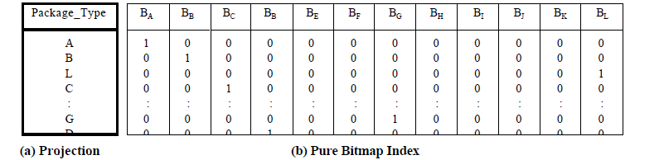
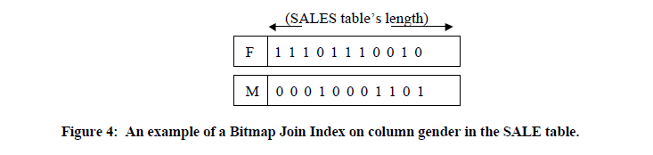
Projection index and Bitmap index on Product Table
Bitmap join index on Sale Table

Slide 15
PROBLEM STATEMENT
Indexes are data structures that improve data retrieval from tables in a database.
When data is stored on disk based storage devices, it is stored as blocks of data. These blocks are accessed in their entirety, making them the atomic disk access operation.
Disk blocks are structured in much the same way as linked lists; both contain a section for data, a pointer to the location of the next node (or block), and both need not be stored contiguously.
Searching in records using sequential access needs N/2 block access, where N is the number of blocks that table spans. Whereas with a sorted field, a Binary Search may be used, this has log2 N block accesses.
Indexing is a way of sorting a number of records on multiple fields. Creating an index on a field in a table creates another data structure which holds the field value, and pointer to the record it relates to.

Slide 16
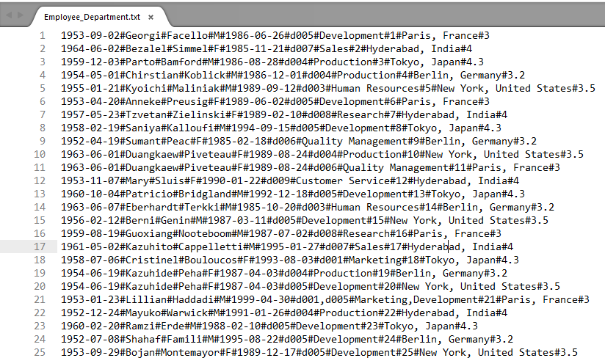
IMPLEMENTATION
Data warehouse typically involves query processing on huge data.
Conventional searching techniques consume a lot time for this processing, hence we use indexing techniques.
We carry out performance testing on files typically of size 50 MB containing over 5,00,000 records.

Slide 17
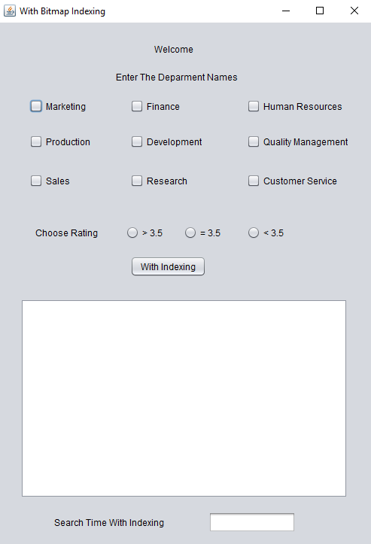
4.1 User Interface
The User Interface consists of the following:
Nine unique departments
Rating range
Text area
Retrieval time

Slide 18
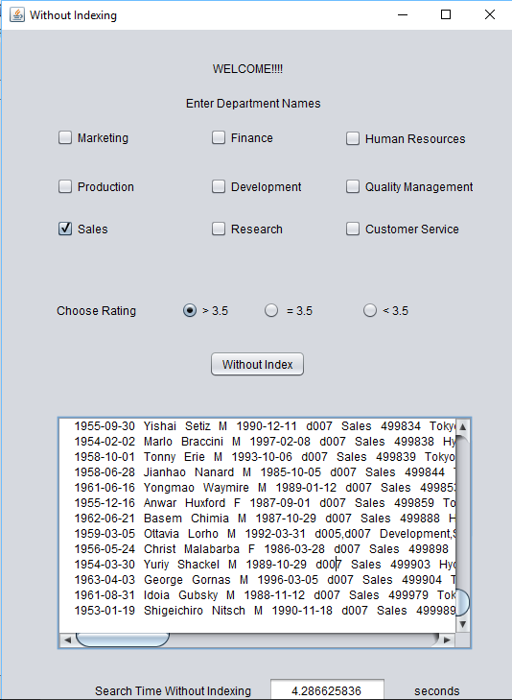
4.2 Without Indexing Implementation:
In this technique, search for query is performed sequentially.
This technique puts considerable overhead on the hardware thereby increasing the retrieval time.
The user selects “Sales” department and rating >3.5.
The filtered records get displayed in the text area below.
This process takes 4.28s.
For this reason, we go for indexing techniques.

Slide 19
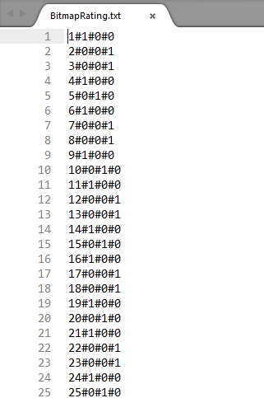
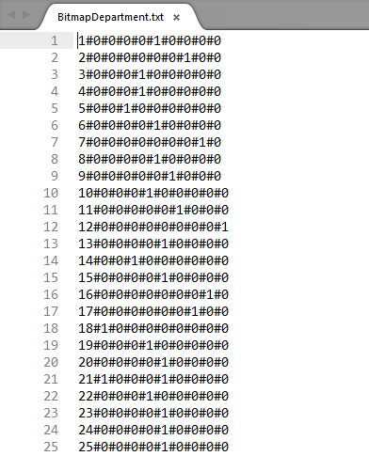
4.3 Bitmap Indexing Implementation
Bitmap indexes use bit arrays (commonly called bitmaps) and answer queries by performing bitwise logical operations on these bitmaps.
Bitmap indexes have a significant space and performance advantage over other structures for query of such data.

Slide 20
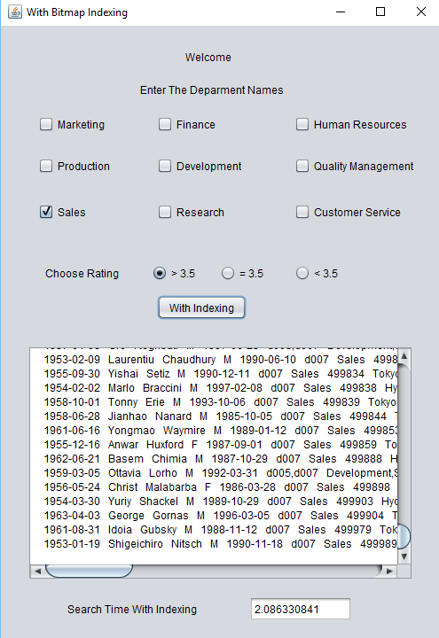
4.4 Bitmap Indexing Result
The user selects “Sales” department and rating >3.5.
The filtered records get displayed in the text area below.
This process takes 2.08s.

Slide 21
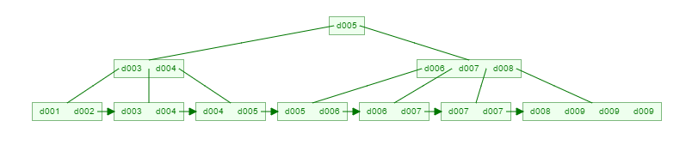
4.5 B⁺Tree Indexing Implementation
A B⁺ tree is an n-ary tree with a variable but large number of children per node.
A B⁺ tree can be viewed as a B-tree in which each node contains only keys (not key-value pairs).
The primary value of a B⁺ tree is in storing data for efficient retrieval in a block-oriented storage context — in particular, file systems.
The figure above shows the B⁺Tree visualization of degree 3 with unique values as department code.

Slide 22
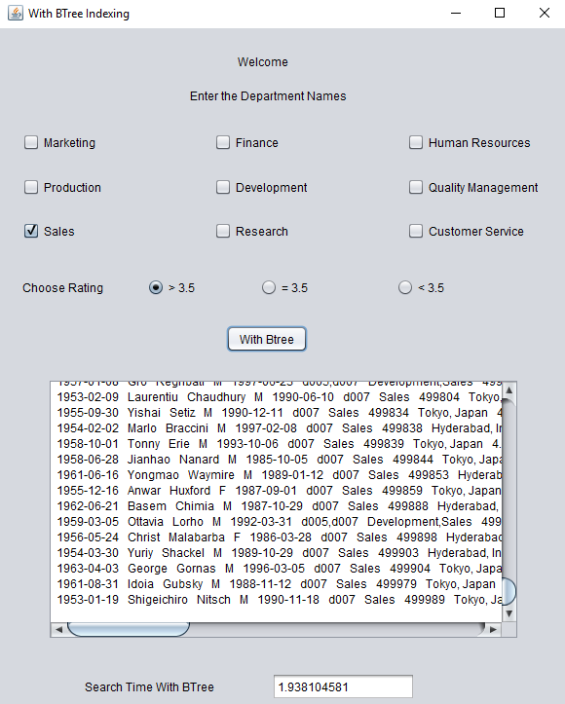
4.6 B⁺Tree Indexing Results
The user selects “Sales” department and rating >3.5.
The filtered records get displayed in the text area below.
This process takes 1.93s.

Slide 23
RESULTS AND PERFORMACE EVALUATION
B⁺Tree Indexing
Bitmap Indexing

Slide 24
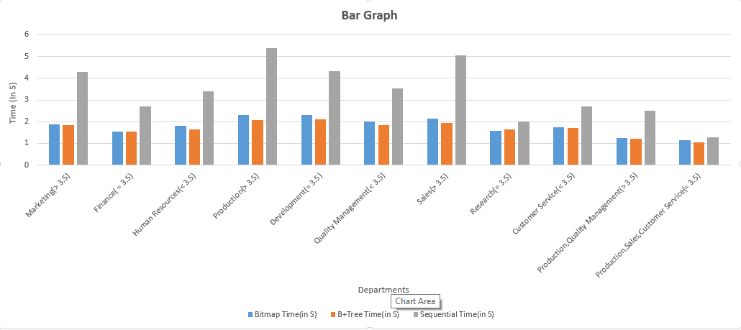
BAR GRAPH

Slide 25
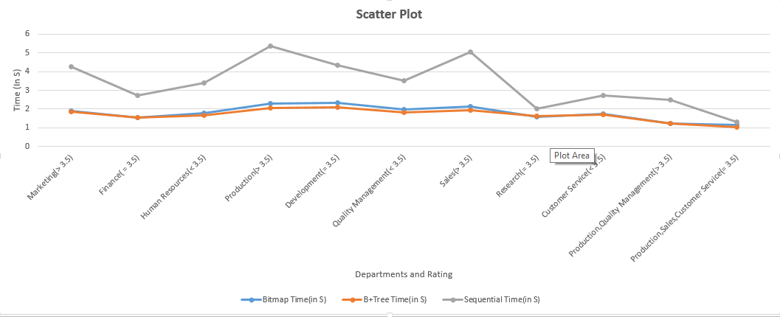
SCATTER PLOT

Slide 26
CONCLUSIONS AND FUTURE WORK
Bitmap index is efﬁcient for other types of queries, such as joins on keys, multidimensional range queries and computations of aggregates.
B⁺Tree outperforms Bitmap when updations are to be done and when cardinality of the column is high.
We conclude that Bitmap index is the conclusive choice for columns with low cardinality.
Future works includes the evaluation of I/O costs on an upgraded hardware system.

Slide 27
REFERENCES
REFERENCES
Chan, C.-Y., & Ioannidis. “Bitmap Index Design and Evaluation.” Volume 27 Issue 2, June 1998 New York: ACM Proc. SIGMOD Conf.1998. pp. 355-366
Chan, C.-Y., & Ioannidis, “An Efficient Bitmap Encoding Scheme for Selection Queries” ,New York : ACM Proc. SIGMOD Conf.1999. pp. 215-226
Johnson, T. “Performance Measurements of Compressed Bitmap Indices”. Jan 2002 Massachusetts: Kluwer Academic Publishers Norwell Proc. Int’l Conf. On Very Large Data Bases (VLDB) .1999. pp. 278-289
Stockinger, K., & Wu, K., & Shoshani. “Evaluation Strategies for Bitmap Indices with Binning” August 30-September 3, 2004 Spain: Proc. Int’l Conf. Database and Expert Systems Applications (DEXA).2004. pp. 120-129
Wu, K., & Otoo, E.J., & Shoshani, A. “Compressing Bitmap Indexes for Faster Search Operations”, July 2002. Washington, DC, USA Proc. Int’l Conf. Scientific and Statistical Database Management (SSDBM).2002. pp. 99-108
V. Sharma, Bitmap index vs. b-tree index: Which and when, http://www.oracle.com, 2006.

Slide 28
Wu, K., & Otoo, E.J., & Shoshani, A. “Compressing Bitmap Indexes for Faster Search Operations”, July 2002. Washington, DC, USA Proc. Int’l Conf. Scientific and Statistical Database Management (SSDBM).2002. pp. 99-108
Wu, M.-C., & Buchmann, A.P. “Encoded Bitmap Indexing for Data Warehouses”, June 1998 New York: ACM Proc. Int’l Conf. Data Engineering (ICDE).1998. pp. 220-230
P. O’Neil and G. Graefe, A. “Multi-Table joins through Bitmapped join indices”, Volume 24 Issue 3, Sept. 1995 New York: ACM Proc. SIGMOD Conf.1995. pp. 8-11
Raghurama Krishnan, J. Gehrke, Data base Management Systems, TATA McGrawHill 3rd Edition, 2002. pp. 485-500
D.A. Patterson and J.L. Hennessy, Computer Organization and Design: The hardware software interface, 3rd Edition, 2005. pp. 574-579
William Stallings, Operating Systems – Internal and Design Principles, Pearson education/PHI, 5th Edition, 2005. pp. 558-562
Alex Berson and S.J. Smith, Data Warehousing, Data Mining and OLAP, TATA MGH, 3rd Edition, 2004. pp. 63-66
S. Chaudhuri, U.Dayal. “An Overview of Data Warehousing and OLAP Technology”, Volume 26 Issue 1, March 1997 New York: ACM SIGMOD RECORD.1997. pp. 65-74

Slide 29
THANK YOU,
QUERIES ARE WELCOME

