Slide 1
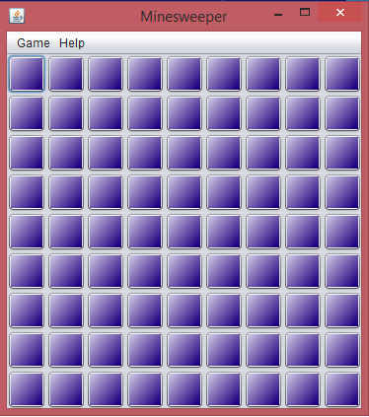
MINESWEEPER
- Exploring the MINES

Slide 2
What is a Minesweeper …????
* Minesweeper is a single-player puzzle video game.
* The game originates from the 1960s, and has been written for many computing platforms in use today.

Slide 3
Objective …
The objective of the game is to clear a rectangular board containing hidden "mines" without detonating any of them, with help from clues about the number of neighboring mines in each field.

Slide 4
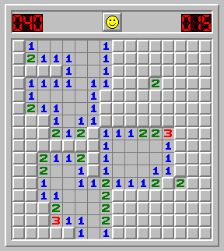
Minesweeper at a glance
Uncover a mine and the game ends.
Uncover an empty square, and you keep playing.
Uncover a number, and it tells you how many mines lay hidden in the eight surrounding squares—information you use to deduce which nearby squares are safe to click.

Slide 5
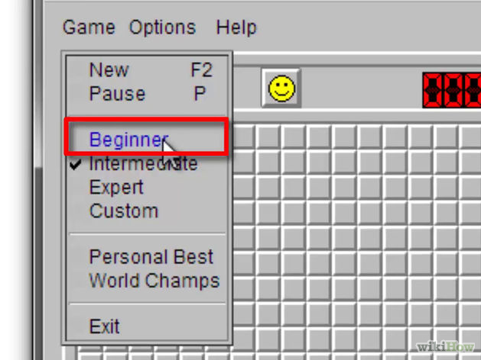
BOARD
Minesweeper has three standard boards , each progressively more difficult.
BEGINNER
( 9X9 with 10 mines)
INTERMEDIATE
(16X16 with 40 mines)
EXPERT
(30X16 with 99 mines)

Slide 6
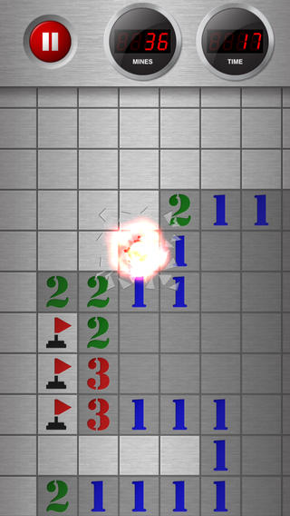
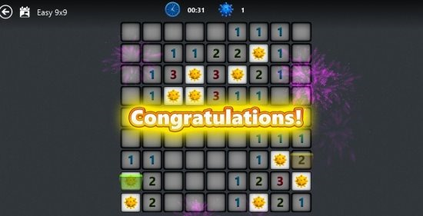
How to Play … ???

Slide 7
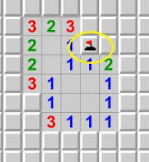
You can uncover a square by clicking it.
If a number appears on a square, it indicates how many total mines are in the eight squares that surround the numbered one.
If you suspect a square conceals a mine, right-click it. This puts a flag on the square.
You win by clearing all the safe squares and lose if you click on a mine.

Slide 8
ESSENTIAL COMPONENTS OF JAVA

Slide 9
1.STAtic Members
A member is declared inside a class with a ‘static modifier’ is known as a class member or static member.
These are global members which are global to the class and its objects.
These members are bound with class name and are accessed without creating objects.
Memory for static variables is only allocated once and that is during loading of the class (helps in saving memory).
Even main method is declared static so that JVM can call this without creating an instance of the class.
A static block is used to initialize the static data member . It is executed before main method at the time of class loading.

Slide 10
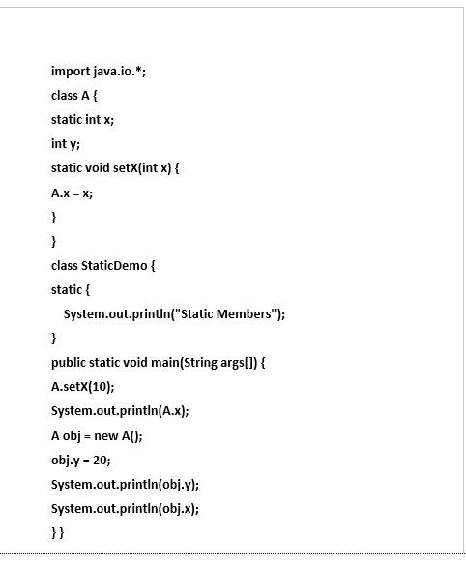
Let’s a take a simple example:
OUTPUT
Static Members
10
20
10

Slide 11
2.Final
A variable declared as final can’t be modified. It can be used as a constant.
Example : final float PI = 3.14;
Final keyword can be used to prevent method overriding . Final methods are usually inlined by the java compiler.
Final keyword can be used to prevent a class from being inherited . This will implicitly declare all methods in the class as final too.
EXAMPLE class A { final void meth() { System.out.println(“Final Method”); } class B extends A { void meth() { System.out.println(“ERROR!”); //Error } }
EXAMPLE final class A { void meth() { System.out.println(“Final Method”); } class B extends A { //Error ! void sample() { System.out.println(“ERROR!”); } }

Slide 12
3.INNER CLASS
Java inner class or nested class is a class i.e. declared inside the class or interface.
We use inner classes to logically group classes and interfaces in one place so that it can be more readable and maintainable.
Inner class can access all the members of outer class including private data members and methods.
4.JFRAME
Java Swing is a part of Java Foundation Classes (JFC) that is used to create window-based applications. It is built on the top of AWT (Abstract Windowing Toolkit) and entirely written in java.
All swing components are represented by classes defined within javax.swing package .
Jframe is a top level container that is used for swing applications .
It’s a window with title, border, (optional) menu bar and user-specified components.
It can be moved, resized, iconified.

Slide 13
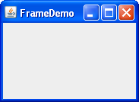
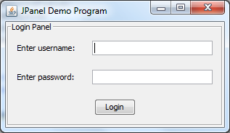
Example : JFrame frm = new JFrame(“FrameDemo”);
5. JPANEL
JPanel is a Swing’s lightweight container which is used to group a set of components together.
Example : JPanel jp = new JPanel(); // This will create a new JPanel
We can set the layout of the panel , add components to the panel , customize the panel’s appearance with the help of built in functions and classes.
6.JBUTTON
The JButton class provides the functionality of a push button.
Jbutton allows icon , string , or both to be associated with a push
button.
The constructors of JButton are : 1. JButton(Icon icon) 2. JButton(String str)

Slide 14
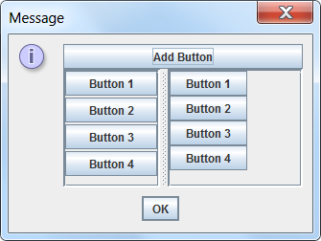
3. JButton(String str,Icon icon)
JButton is derived from JComponent class(which contains all swing components).
There are several types of buttons in swings
Command buttons
Toggle buttons
Check boxes
Radio buttons
7.IMAGEICON
We have included an icon in JButton class as show earlier. Java provides a default imageicon.
Instead of using default icon , we can use our own icon using ImageIcon class.
ImageIcon implements Icon and encapsulates the image.

Slide 15
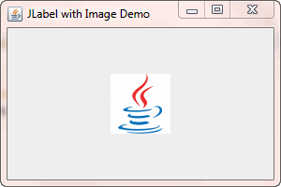
The constructor of ImageIcon class is : ImageIcon(String filename)
Example : ImageIcon icon = new ImageIcon("images\\java.gif");
The other essential components of swings include :
Menu Bar
Text area
Password field
Separator
Progress Bar
Scroll Bar

Slide 16
MODEL-VIEW-CONTROLLER ARCHITECTURE

Slide 17
What is MVC ?
Presented by Trygve Reenskaug in 1979
Architectural design pattern which works to separate data and UI ,for a more modularized system
MVC is a sound architectural design for almost any GUI application

Slide 18
MODEL : Represents the data model
Contains all application specific content and processing logic
Includes all the content objects
Includes processing functionality that are application specific
Responds to user requests from the view
Responds to instructions from the controller to update itself
VIEW : Represents the screen shown to user
Contains all interface specific functions and enables the presentation of content and processing logic
Includes processing functionality required by end user
CONTROLLER : Interactions from user that change data and view
The means by which the user interacts with the application
Controller’s responsibilities :
Accept user input
Send messages to the model, which may in turn notify it to observers
Send appropriate messages to the view

Slide 19
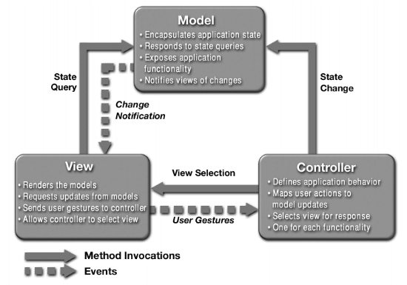
MVC ARCHITECTURE

Slide 20
How does it work?
User inputs a command
Controller handles input and updates model or changes the view
View, which relies on model to show data to user, updates if necessary
Again ,the same is repeated .

Slide 21
ADVANTAGES OF MVC
Provides a logical structure for heavily interactive system
Adheres to good engineering design principles and practices
Information hiding, simplicity, etc.
Clarity of design
easier to implement and maintain
Modularity
changes to one don't affect the others
can develop in parallel once you have the interfaces
Multiple views
games, spreadsheets, PowerPoint, ….

Slide 22
MAKING OF GUI

Slide 23
Creating Board
Create a new JFRAME
Drag MENUBAR from PALETEE to Jframe
MENUBAR contains two MENUS
MENU1
MENU2
Add MENUITEMS to each MENU
If we want to add more than one MENUITEM add by using SEPERATOR
MENU1
Name MENU1 as GAME
Add two MENUITEMS to GAME
Name MENUITEM1 as NEWGAME
Name MENUITEM2 as QUIT
MENU2
Name MENU2 as HELP
Add one MENUITEM to HELP
NAME that MENUITEM as ABOUT

Slide 24
How to create method of MenuItem
By doubleclicking on MENUITEM it will create method of that MENUITEM
private void MenuitemActionPerformed(java.awt.event.ActionEvent evt)
{
}

Slide 25
Actions performed by each MenuItem
ABOUT
we should display dialouge i.e the author of Game
Dialogue is class in SWING i.e Joptionpane
The dialouge can be displayed by using
Joptionpane.showmessagedialog(parent,dialouge,”ABOUT”)
2. NEWGAME
Create a new buttonspanel
buttonsPanel = new JPanel();
In the pannel buttons should be added in the form of grid for that we should set Layout manager
buttonsPanel.setLayout(new GridLayout(rows, cols));
Set size of buttonspanel where we consider image size,rows,cols
buttonsPanel.setSize(cols * imageSize, rows *imageSize);
Now buttons pannel is ready and now buttons should be added to that pannel

Slide 26
Actions performed by each MenuItem
Add buttons to pannel and declare buttons in the form of array
JButton [][]buttons;
Create buttons
buttons=newJButton[rows][cols];
Initialize the buttons by using images

Slide 27
Actions performed by each MenuItem
set image icons for all mines,flag,explode
EX: ImageIcon CLOSED=new ImageIcon();
Now intilalize all the buttons with CLOSED image
buttons[][]=new JButton(CLOSED);
Now buttons panel with buttons is ready
Now we should add buttons panel to Jframe
this.getcontentpane().add(buttonspanel);
Now frame with buttons is ready
We will call this newgame in method of NEWGAME menuitem
private void mniNewGameActionPerformed(java.awt.event.ActionEvent evt) {
newGame();
}

Slide 28
Actions performed by each MenuItem
3. QUIT
Exit from the game
system.exit(0);

Slide 29
Mouse listeners
LEFTMOUSEBUTTON
If game is in progress and if the button is open then get the neighbour count of that button and set image of that neighbour count
If game is won then show message dialog that you won
If game is over then all the buttons which containing mines should be exploded

Slide 30
Mouse listeners
2. RIGHTMOUSEBUTTON
If button is opened then don’t do anything
If button is closed then set image of flag if right mouse button is clicked
If again right mouse button is clicked on the flag then set the image of CLOSED

Slide 31
Model of Minesweeper
Square Class
Mines logic
Neighbour Count
Click interface

Slide 32
MinesweeperModel Class
1.Purpose
2.Variables to be used:
1.No. of rows-Integer
2.No. of cols-Integer
3.Static status defining variables:
1.Over-0
2.inProgress-1
3.Won-2
3.Constructor
public MinesweeperModel(int rows,int cols,int mines)

Slide 33
Square Class
1.Purpose
2.Attributes of Square class:
Rows-Integer
Cols-Integer
isMine-Boolean
isFlagged-Boolean
isOpen-Boolean
neighbourCount-Integer
3.Constuctor
public Square(int i, int j, boolean isMine)

Slide 34
Mines Logic And Neighbour Count
1.Allocate space for the board by
-Square board[][]=new Square[rows][cols];
2.Call the insertMines function as follows:
-public MinesweeperModel(int rows,int cols,int mines);
3.Calculate the neighbour count for each cell by using functions
-public void neighborCount();
-private int getNeighbourMinesCount(int i,int j);

Slide 35
Click Interface
Purpose
Function declaration
public int click(int i,int j);
Check specific conditions and return the corresponding value.
If the square is flagged already and if we left click it, it should return inprogress.
If the above is not the case, check if the square has a mine in it, if it has then return game over value.
Or else open all the neighbouring boxes’ mines count.

Slide 36
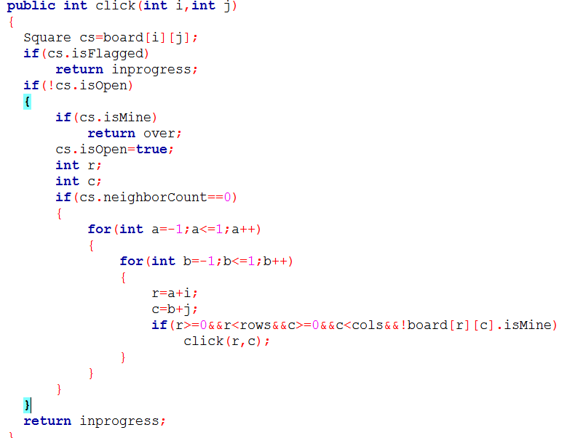
Click interface logic

Slide 37
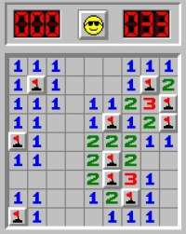
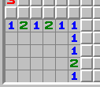
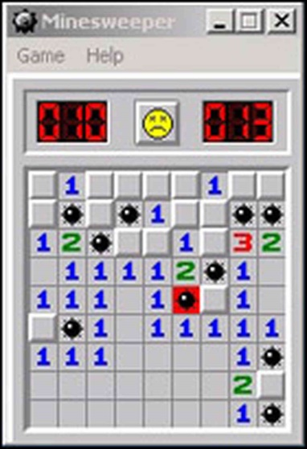
Status of the Game

Slide 38
Over to the next Presentation, Thank You!

Slide 39
Controller:
Software Code that controls the interactions
between the Model and View.
The controller is responsible for responding to user input and perform interactions on the data model objects. The controller receives the input, it validates the input and then performs the business operation that modifies the state of the data model.

Slide 40
Event Handling:
What is an Event?
Change in the state of an object is known as event
What is Event Handling?
Event Handling is the mechanism that controls the event and decides what should happen if an event occurs. This mechanism have the code which is known as event handler that is executed when an event occurs.

Slide 41

Java Uses the Delegation Event Model to handle the events.
The Delegation Event Model has the following key participants namely:
Source - The source is an object on which event occurs. Source is responsible for providing information of the occurred event to it's handler. Java provide as with classes for source object.
Listener - It is also known as event handler. Listener is responsible for generating response to an event. From java implementation point of view the listener is also an object. Listener waits until it receives an event. Once the event is received , the listener process the event an then returns.

Slide 42

MouseListener
EventListeners
Event Listeners are used to translate user interaction into actual code. To listen for a particular event, the programmer must know the event source.
Steps involved in using Event Listeners are:
1.Implement the Listener interface and override its methods
2.Register the component with the Listener.

Slide 43
MouseListener:
MouseEvent is generated whenever user performs an action with the mouse.
A class that responds to MouseEvent implements the MouseListener interface which is available in java.awt.event.MouseListener package.
The applet instance running is registered as MouseListener to have its mouse methods called.It can be registered using the addMouseListener() method.
declaration for java.awt.event.MouseListener interface:
public interface MouseListener extends EventListener

Slide 44
Interface methods:
S.NO | Method & Description
1 | void mouseClicked(MouseEvent e) Invoked when the mouse button has been clicked (pressed and released) on a component.
2 | void mouseEntered(MouseEvent e) Invoked when the mouse enters a component.
3 | void mouseExited(MouseEvent e) Invoked when the mouse exits a component.
4 | void mousePressed(MouseEvent e) Invoked when a mouse button has been pressed on a component.
5 | void mouseReleased(MouseEvent e) Invoked when a mouse button has been released on a component.

Slide 45
INTERACTION BETWEEN USERINTERFACE AND MODEL

Slide 46
USER INTERFACE : The user interface includes the events to be processed according to the action performed by user . The user interface is provided with buttons needed to control and display the gamestate .
MODEL : The model consists of the logic that implements the functionalities such as generating the board and inserting the mines based on the level of complexity choosen by the user , updating the neighbourcounts based on the mines placed on the minesweeper board and click processing.

Slide 47
Delegation Event Model
The delegation event model is the modern approach of handling events.
In this model , the source generates an event and sends it to one or more listeners.
A source is an object that generates an event.
A listener is an object that is notified when an event occurs.
Advantage of delegation event model :
The application logic that processes events is cleanly separated from the user interface logic that generates those events . This makes the application logic independent of user interface logic , so as to easily extend the application logic in future.

Slide 48
Interaction between UI and Model
The source(ui) must register listeners(model) inorder for the listeners to receive notifications about the events . This is done by instantiating the object of the listener in source.
In UI , the model should be initialized by invoking the constructor .The model simply waits until it receives an event.
The model must implement methods to receive and process the notifications from UI . Once an event is received ,the model processes the event and then returns.

Slide 49
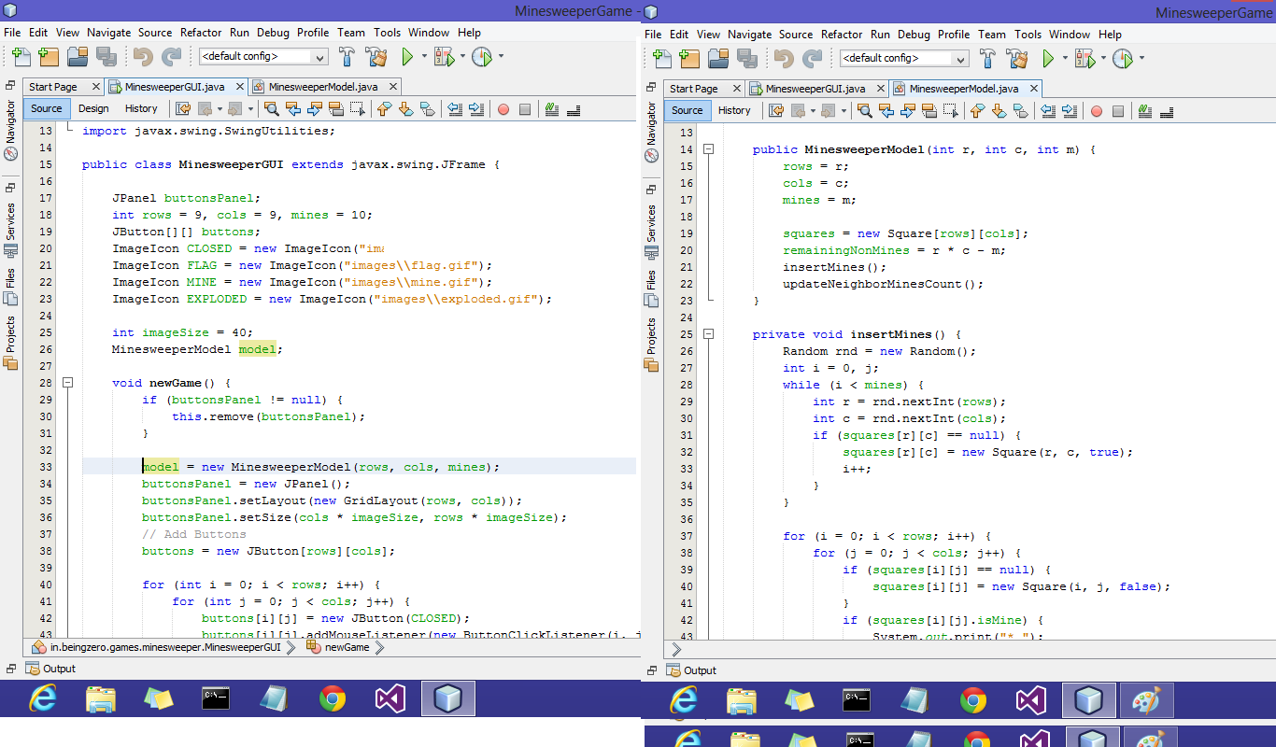

Slide 50
To access other methods of model in UI like click() , isOpen() , they should be invoked using object reference of model.
The UI provides facility to choose the level of the game . Based on complexity chosen , the model processes accordingly.

Slide 51
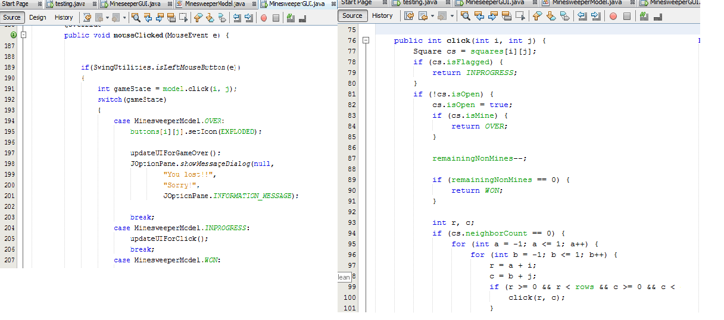

Slide 52
Key Learning's
1)How to Play?
2)How to start solving a problem?
3)MVC architecture.
4)Application of DS to the problem.
5)How to generate a UI?
6)How to add functionality to components in UI?
7)How to use buttons,frames package?
8)Toggle pictures,Mines,count of mines,buttonclick listener.
9)Application of swing and awt concepts.

Slide 53
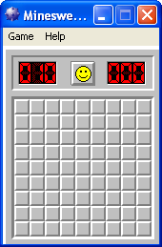
Summary
Problem statement: Develop a minesweeper app.
How did we start?
We first created a UI which is the final screen to the user. We added the menu bar(in content panel) for the UI. We created buttons (on different panel).
Then next ..

Slide 54
We then created a Model class which does the backend part.
We defined functions for :
Generating board
Placing mines
Getting mine count
Toggling images to button
Event to be initiated when clicked
Then finally we linked the 2 ends.

