Slide 1
MODEL-VIEW-CONTROLLER ARCHITECTURE

Slide 2
What is MVC ?
Presented by Trygve Reenskaug in 1979
Architectural design pattern which works to separate data and UI ,for a more modularized system
MVC is a sound architectural design for almost any GUI application

Slide 3
MODEL : Represents the data model
Contains all application specific content and processing logic
Includes all the content objects
Includes processing functionality that are application specific
Responds to user requests from the view
Responds to instructions from the controller to update itself
VIEW : Represents the screen shown to user
Contains all interface specific functions and enables the presentation of content and processing logic
Includes processing functionality required by end user
CONTROLLER : Interactions from user that change data and view
The means by which the user interacts with the application
Controller’s responsibilities :
Accept user input
Send messages to the model, which may in turn notify it to observers
Send appropriate messages to the view

Slide 4
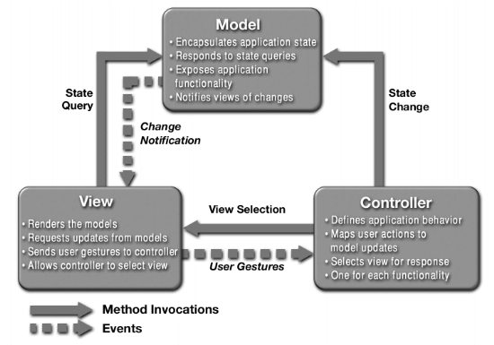
MVC ARCHITECTURE

Slide 5
How does it work?
User inputs a command
Controller handles input and updates model or changes the view
View, which relies on model to show data to user, updates if necessary
Again ,the same is repeated .

Slide 6
ADVANTAGES OF MVC
Provides a logical structure for heavily interactive system
Adheres to good engineering design principles and practices
Information hiding, simplicity, etc.
Clarity of design
easier to implement and maintain
Modularity
changes to one don't affect the others
can develop in parallel once you have the interfaces
Multiple views
games, spreadsheets, PowerPoint, ….

