Slide 1
INTERACTION BETWEEN USERINTERFACE AND MODEL

Slide 2
USER INTERFACE : The user interface includes the events to be processed according to the action performed by user . The user interface is provided with buttons needed to control and display the gamestate .
MODEL : The model consists of the logic that implements the functionalities such as generating the board and inserting the mines based on the level of complexity choosen by the user , updating the neighbourcounts based on the mines placed on the minesweeper board and click processing.

Slide 3
Delegation Event Model
The delegation event model is the modern approach of handling events.
In this model , the source generates an event and sends it to one or more listeners.
A source is an object that generates an event.
A listener is an object that is notified when an event occurs.
Advantage of delegation event model :
The application logic that processes events is cleanly separated from the user interface logic that generates those events . This makes the application logic independent of user interface logic , so as to easily extend the application logic in future.

Slide 4
Interaction between UI and Model
The source(ui) must register listeners(model) inorder for the listeners to receive notifications about the events . This is done by instantiating the object of the listener in source.
In UI , the model should be initialized by invoking the constructor .The model simply waits until it receives an event.
The model must implement methods to receive and process the notifications from UI . Once an event is received ,the model processes the event and then returns.

Slide 5
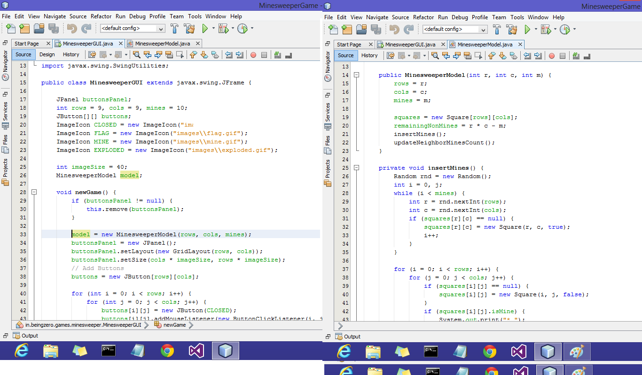

Slide 6
To access other methods of model in UI like click() , isOpen() , they should be invoked using object reference of model.
The UI provides facility to choose the level of the game . Based on complexity chosen , the model processes accordingly.

Slide 7
