Slide 1
Key Learning's
1)How to Play?
2)How to start solving a problem?
3)MVC architecture.
4)Application of DS to the problem.
5)How to generate a UI?
6)How to add functionality to components in UI?
7)How to use buttons,frames package?
8)Toggle pictures,Mines,count of mines,buttonclick listener.
9)Application of swing and awt concepts.

Slide 2
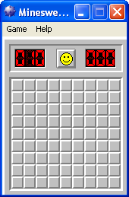
Summary
Problem statement: Develop a minesweeper app.
How did we start?
We first created a UI which is the final screen to the user. We added the menu bar(in content panel) for the UI. We created buttons (on different panel).
Then next ..

Slide 3
We then created a Model class which does the backend part.
We defined functions for :
Generating board
Placing mines
Getting mine count
Toggling images to button
Event to be initiated when clicked
Then finally we linked the 2 ends.

