Slide 1

SpeakSmartAI
HackGPT
By Hemant Kumar
IIT Patna
ytbhemant@gmail.com

Slide 2




🦜SpeakSmartAI
SpeakSmartAI is a cutting edge web app, which unlocks your communication potential by providing a platform to enhance Communication Skills in an Interactive way.
It asks you questions based on situation you choose and provide you Live Feedback and Intelligent Personalized Suggestions to the answers you provide.
Tech Stack Used

Slide 3
How it Works?
It Prompt’s you to choose a situation (Interview / Informal Talk / Knowledge Test)
Based on what situation you choose, it generates a set of 5 questions, using OpenAI.
It asks you each question one by one.
After Answering, it analyzes your Answer again using OpenAI and rates it in terms of Creativity, Clarity and Effectiveness
It also provides you a suggestion to improve the one of Creativity, Clarity or Effectiveness which has lowest rating.
After All Questions, Your cumulative rating (average of all ratings) is shown.
Note if you are providing answers too fast, then it might be possible that analyzing of some answer would take about 1 minute (as there are 5 questions but rate limit for most models is 3/minute).
However answering a question legitimately will in itself spend some time between requests, so it has very less possibility of happening.

Slide 4
Behind the Scenes
Different Temperatures for Question generator and Answer Analyzer.
Analyzes each question answer pair independently, without any history. So Tokens used will be much less.
New questions each time, due to higher temperature.

Slide 5
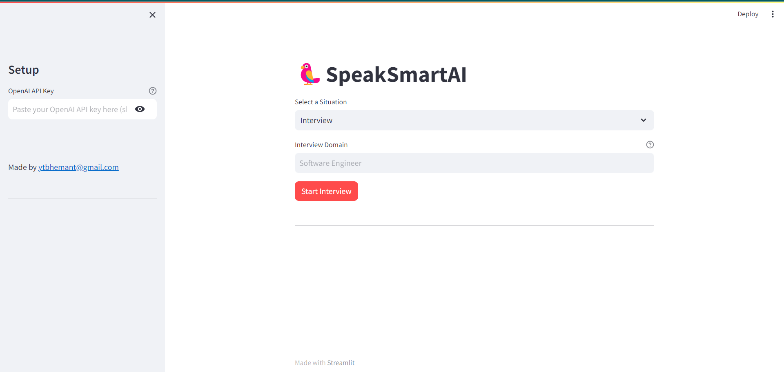
Screenshots

Slide 6
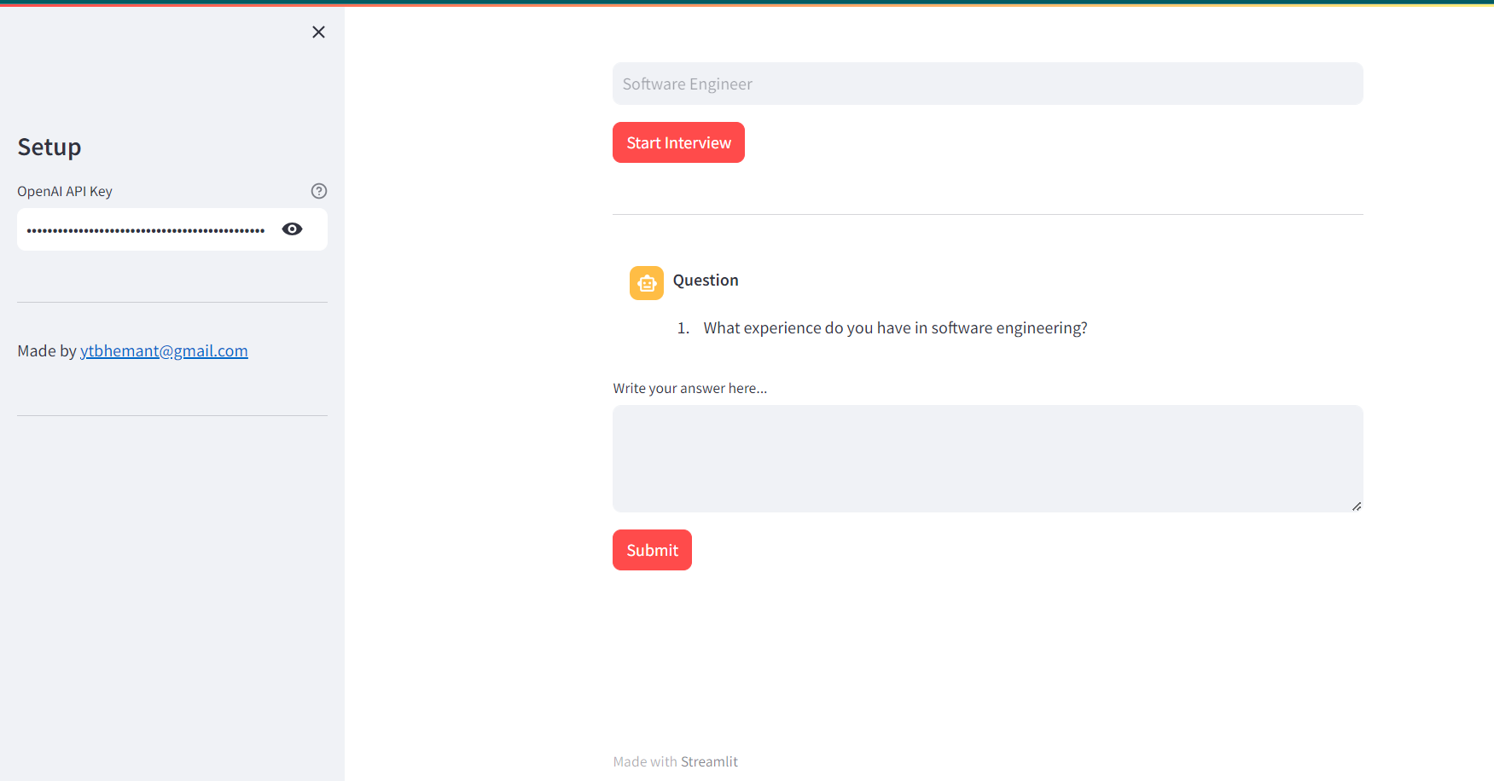
Screenshots

Slide 7
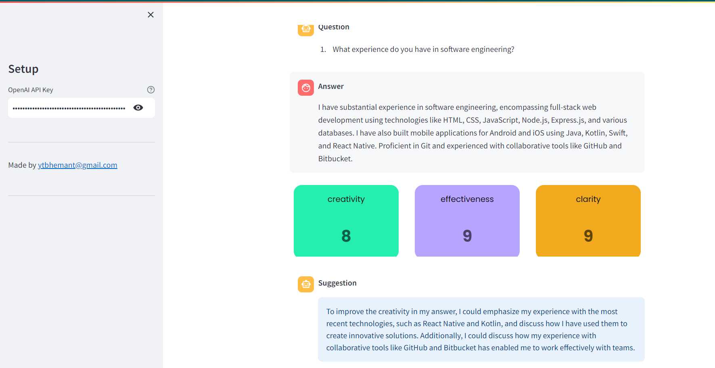
Screenshots

Slide 8
Github
https://github.com/HemantKumar01/SpeakSmartAI
$ pip install –r requirements.txt
$ streamlit run main.py

Slide 9

Participant’s Info
Hemant Kumar
IIT Patna
Roll no. 2301CS20
Email: ytbhemant@gmail.com
Contant: 8756839271

