Slide 1
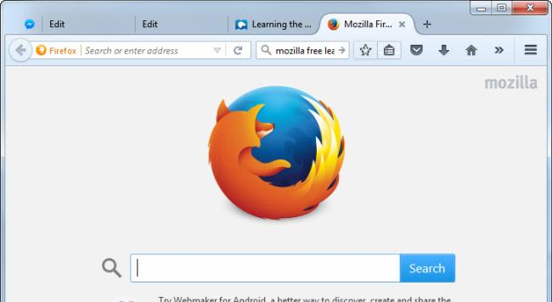
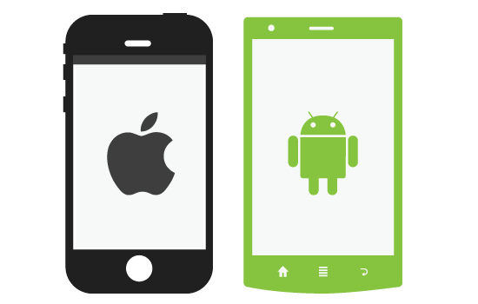

External Internet Content
(Cloud)
Web browser
Mobile app(Android or IOS)
Payment mode
Big Data Analytics and Reporting
InternalUser
(LDAP)
APIAPIs
Real-Time User Model
Oracle(Database)
Business-User interface
Search Engine
Business Rules & Dictionaries
Content Processing
Data Staging
Product catalog
customer support documents
MyInventory
Public Web site content
Sales Data
Other Documents
Financial Data

