Slide 1
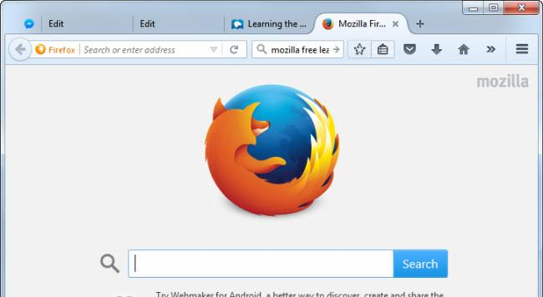
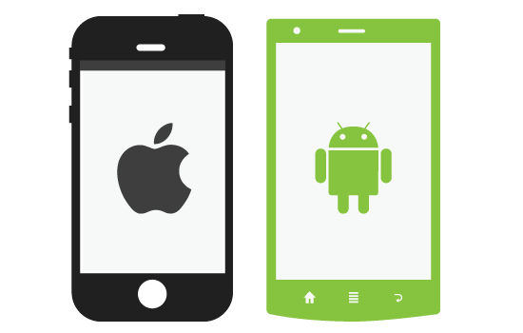

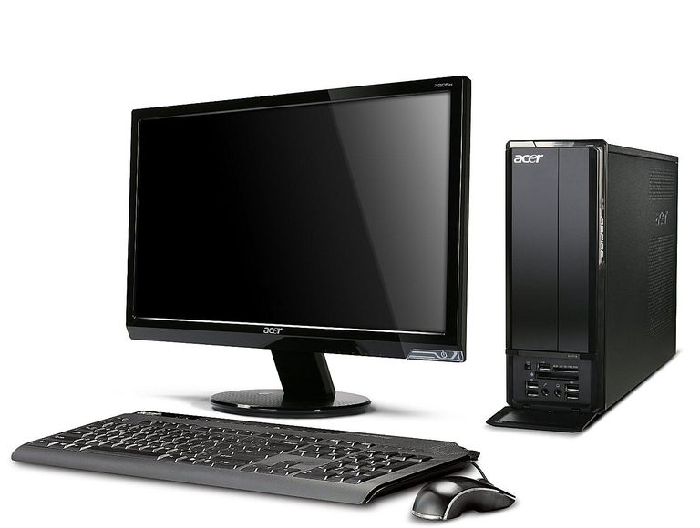
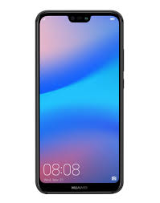
Date Center
Old Version
New application
Web browser
Mainframe
Assume that the old version was using a normal browser
REST API’s
LDAP
JBoss
Mobile app
E-commerce
Retail shops
MyInventory
Internal Users
Oracle
Cloud(Deploy)
Old Inventory

