Slide 1
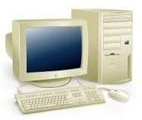




Old System
Data center
XML
Old Stock Management
Synchronization
Main Frame
SQL
DB
New System
Application Server
Rest API
Mobile app
Web Browser
E-commerce
Web API
Payment Method
Oracle Database
Customer
MyInventory
Mobile phone
Computer
Rest API
Cloud

