Slide 1
Continuous Integration

Slide 2
Objectives
Upon completing this session, you should be able to:
Understand why Continuous Integration is important
Configure Jenkins
Create a Jenkins job
Automate a job to check quality
Notes:
Instructor Notes:
Discuss the objectives and the key points that will be covered in this session.

Slide 3
What is Continuous Integration?
Continuous integration is a software development practice whereby developers codes are frequently merged, leading to multiple automatic integrations per day.
It also covers quality checks via quality testing tools, such as sonar, as well as puts a lot of emphasis on automated testing.

Slide 4
What is Continuous Integration?
At a specified interval (frequency), the application is automatically:
Integrated – All changes commited on the versioning tool are combined
Built – The code is compiled into a package
Tested – Automated test suites are launched
Archived – Version and stored (like on maven repository or nexus)
Deployed – Deployed on our servers, depending on which environment was chosen

Slide 5
Why is Continuous Integration important?
Continuous Integration allows us to rapidly integrate all pending changes, build and automatically deploy our applications.
This allows us to:
Check whether the application still builds and is stable
Launch automated unit tests which allows us to detect any error in the application’s logic
Check the quality of our applications
Thus, we can rapidly detect any errors as early as possible
Notes:
Browse through the Maven repository to show them the structure

Slide 6
Why is Continuous Integration important?
Continuous Integration allows us to rapidly integrate all pending changes, build and automatically deploy our applications.
This allows us to:
Check whether the application still builds and is stable
Launch automated unit tests which allows us to detect any error in the application’s logic
Check the quality of our applications
Thus, we can rapidly detect any errors as early as possible
Notes:
Browse through the Maven repository to show them the structure

Slide 7

Continuous Integration
Regular
Intervals
Artifact Repository
Repository
CI system
Package/
Executables
Reports
Codes and tests
Deployment
Reports
Developers
Notes:
Browse through the Maven repository to show them the structure

Slide 8
Continuous Delivery
Continuous Delivery ≠ Continuous Integration
Continuous delivery is an extension to continuous integration, which ensures that we are able to deliver releases to our end client as quickly as possible
This involves not only having a robust automated testing suite in place but also that you have automated your release process.
For example : I have a continuous integration job that tests my application and allows me to deploy effectively on all my environments, be it integration or production
Notes:
Browse through the Maven repository to show them the structure

Slide 9
Continuous Delivery
RELEASE
Development
Test
Production
Continuous Integration
Continuous delivery
Approval gate
Continuous deployment
What is “Continuous deployment” and how is it important?
Notes:
Browse through the Maven repository to show them the structure

Slide 10
Continuous Integration tools
Below is a list of continuous integration tools:
Jenkins
GitLab
Bamboo
Circleci
Codeship
TeamCity
Travis CI
However, our main focus will be on Jenkins
Notes:
Browse through the Maven repository to show them the structure

Slide 11
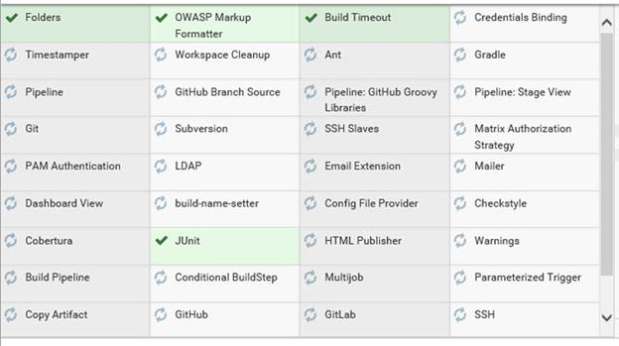
Installation of Jenkins
Download/Copy the Jenkins 2.124 provided and launch the jenkins.msi file
You will be prompted in your default web browser to enter a password. The password link has been provided (usually in C:\Program Files (x86)\Jenkins\secrets\initialAdminPassword. Simply copy and paste the password.
Select the install custom plugins and select the following plugins :
Notes:
Analysis of these tags

Slide 12
Installation of Jenkins
When installation is done, create an admin account. This account will be used in order to manage Jenkins and install plugins, create accounts, …
Your default Jenkins URL will be : http://localhost:8080
Be careful as this might conflict with other applications using port 8080
Notes:
Analysis of these tags

Slide 13

Configuration for GIT Access
In order to allow the checkout from GIT, we need to configure our innersource/GIT Repository in order to allow SSH checkout in our Jenkins job.
To perform this configuration, we need to :
open a GIT bash
Launch the command ssh-keygen -t rsa
You will be prompted to enter a location and a passphrase
Once generated, you will obtain a private and a public key
Notes:
Analysis of these tags

Slide 14
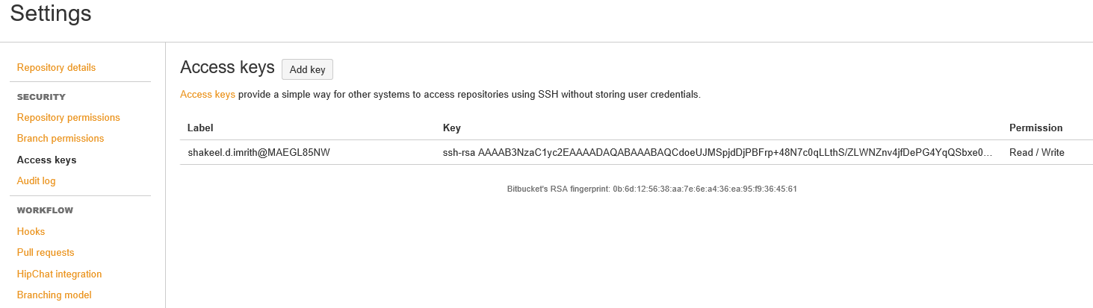
Configuration for GIT Access
Once the keys are generated, we need to include the public key in our Innersouce/GIT repository
On Innersource :
Navigate on your Innersource repository.
Click on the settings icon
Click on Access Keys button and then on the Add Key button.
Open the public key file and add your public key
Notes:
Analysis of these tags

Slide 15
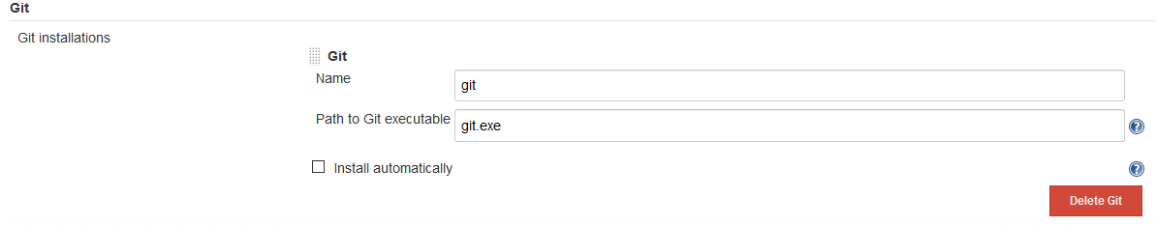
Configuration for GIT Access
We also need to specify the git.exe file
Note : Git needs to be installed on a writable directory :
Example : C:/git
Before configuring the Global Tool Configuration panel, we need to add GIT_HOME and JENKINS_HOME in our environment variables
We also need to add the bin in our path
On Jenkins, in the Global Tool Configuration panel, we need to ensure that git.exe is correctly found by jenkins
Notes:
Analysis of these tags

Slide 16

www.menti.com
Code : 184379
Notes:
15 minutes for mini quiz in game form (with points ☺ )

Slide 17

You wake up 20 years in the future and the world has changed drastically.
Describe one of the weirdest invention that could have emerged at that time?
Example: A machine where you input water and gets liquor as output
Notes:
15 minutes for mini quiz in game form (with points ☺ )

Slide 18
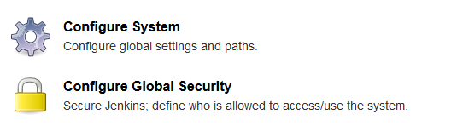
Configuration for SonarQube
In order to use SonarQube on our jobs, we need to set the server link in the configurations of Jenkins.
In the Manage Jenkins section, we need to navigate on the configure system section
Then we need to add a SonarQube server, with our server’s URL
Notes:
Analysis of these tags

Slide 19
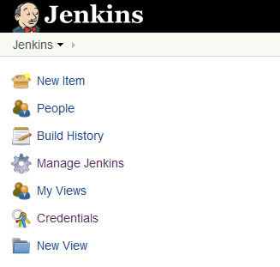
Creating a Jenkins Job
To create a new job on Jenkins, we need to click on New Item button
Choose the Freestyle project to create our job
You can also create a job from an existing job, using the Copy From option
Notes:
https://github.com/shakeelimrith/aa-sonar/tree/develop

Slide 20
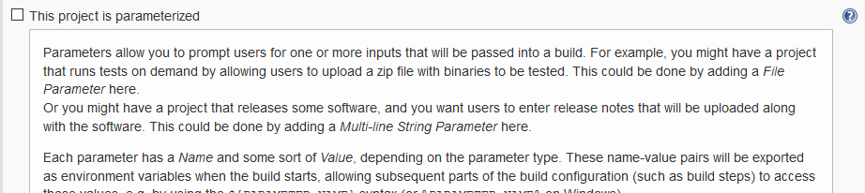
Jenkins Job - Parametrizing
Jenkins offers a wide range of parameters that can be easily customized.
It also offers a help button which gives us an overview of the parameter
The Jenkins job is subdivided into 6 sections :
General
Source Code Management
Build Triggers
Build Environment
Build
Post-build Actions
Notes:
Analysis of these tags

Slide 21
Jenkins Job – General Section
In the General section, we can add a wide varieties of parameters for our job
Git Parameter
File Parameter
Boolean Parameter
Password Parameter
…
These parameters allows us to better configure our jobs
Notes:
How ca

Slide 22
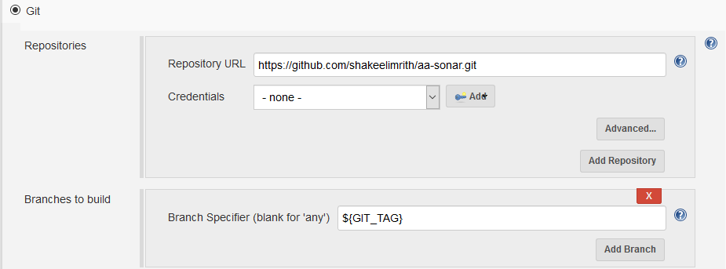
Jenkins Job – Source Code Management Section
In the Source Code Management section, we can specify where we want to fetch our source codes
GIT
Subversion
…
We can also use parameters specified in our General section in order to allow a user to choose his branch from a list of branches or tags
Notes:
How ca

Slide 23
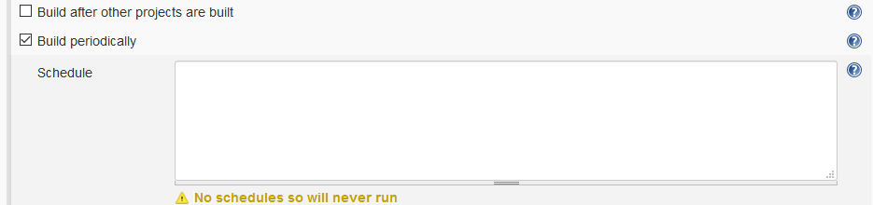
Jenkins Job – Build Triggers Section
After retrieving our source codes, we can specify, in the Build Triggers section, whether we want our jobs to be launched automatically and what will be the frequency
We can also launch our job, based on the status of another job, by using the “Build after other projects are built” option.
Notes:
How ca

Slide 24
Jenkins Job – Build Environment Section
The Build Environment section allows us to specify the different configuration files needed in order to proceed with our build.
It also allows us to :
Clean our workspace completely or partially before we start building our application
Execute commands over SSH
Inject any environment variables important for our build
Execute shell scripts
Notes:
How ca

Slide 25
Jenkins Job – Build Section
The Build section is where the job performs its main activities.
Conditional steps, based on parameters from the General Section can be used to execute only some steps.
Where do you think this will be essential in Continuous Delivery?
Notes:
How ca

Slide 26
Jenkins Job – Build Section
The Build section allows the following main actions (but is not limited to this list) :
Copy artifacts from another job
Execute shell scripting
For example : If we need to create a directory, delete a file, or rename it, as well as unzip a compressed file to modify some attributes
Use maven commands to clean and install our application into its compressed version
Use of ant scripts to deploy on a server
Launch a Sonar analysis
Trigger the execution of another job and thus this job waits until the triggered job’s execution is over.
Can fail this main job if the triggered job is failed
Notes:
How ca

Slide 27
Jenkins Job – Post Build Actions Section
The Post Build Actions section allows us to specify the actions we want to perform when the build is over.
It also allows us to :
Send mails to a list of recipients with any attached log file
Archive any artifact from this job (can be used by any other jobs)
Publish to GIT
Delete this job’s workspace
Notes:
How ca

Slide 28
Further Materials (References)
https://jenkins.io/doc/
Notes:
Analysis of these tags

