Slide 1
Maven

Slide 2
Objectives
Upon completing this session, you should be able to:
Understand how Maven works.
Understand the different maven tags (example : <dependencies>)
Configure a simple pom.xml and settings.xml file
Configure your IDE and update maven dependencies
Perform maven actions : clean, install, deploy
Notes:
Instructor Notes:
Discuss the objectives and the key points that will be covered in this session.

Slide 3

What is a Maven?
Maven is a build automation/integration tool, mainly used on Java Projects
Based on the XML concept called “Project Object Model” (Or short for POM)
The “pom.xml” file is what makes the backbone of maven
It is also a Build Management Tool, which
defines how our .java files will be compiled into .class files.
EAR
WAR
JAR
Manages our dependencies inside our project
Launches out test scripts (Junit Tests) and allows for exclusions as well
Generates reports.

Slide 4
Why use Maven?
Maven allows downloading of all specified libraries (specified in pom.xml) to be used in the project and adds them to a Local Repository. This helps keeping the project clean and avoid any mistake whenever a specific library need to be updated.
It uses predefined tasks; clean, install, test, compile, package. So there is no need to define those tasks and write codes for their execution
It allows the installation of different plugins that helps in schema generation, measuring of test coverage.
Everything is configured in the pom.xml file.
It is easily executed by continuous integration tools, like Jenkins.
Maven provides :
Easy Build Process
Uniform Build System
Quality Project Information
Guidelines for Best Development Practices

Slide 5

Why use Maven?
VS
Maven is a project management tool
Maven has a formal convention and knows where the source code is located (as the convention was followed). So we do not need to provide information about the project structure.
Maven is declarative. You only need to configure you pom.xml and put your code in the default directory structure.
Maven’s plugins and repositories are reusable.
Ant is a Build Tool,
Ant does not have any convention. We must specify where the code is located and give project structure information in the build.xml file.
Ant is procedural and we need to provide what to do and when to do it.
Ant scripts are not reusable.

Slide 6
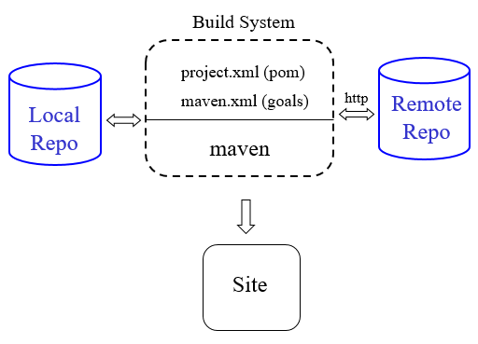
Maven Architecture Overview
For any Maven Project, we have the following :
A local Repository where all dependencies are downloaded and cached for later use.
A Central repository where all dependencies are kept.
Example : https://repo.maven.apache.org/maven2
Main Apache Maven Site : https://maven.apache.org/
Notes:
Browse through the Maven repository to show them the structure

Slide 7
Maven Project
A Maven Project must have a pom.xml file, in order to make the necessary configurations.
The build (the EAR, WAR, JAR, …) is usually kept in the “target” folder.
By default, in any maven project,
The source codes are found under src/main/java
And the test files are found under src/test/java
Notes:
Browse through the Maven repository to show them the structure

Slide 8
Maven Conventions
Maven is opinionated about project structure
target: Default work directory
src: All project source files go in this directory
src/main: All sources that go into primary artifact
src/test: All sources contributing to testing project
src/main/java: All java source files
src/main/webapp: All web source files
src/main/resources: All non compiled source files
src/test/java: All java test source files
src/test/resources: All non compiled test source files
Notes:
Browse through the Maven repository to show them the structure

Slide 9
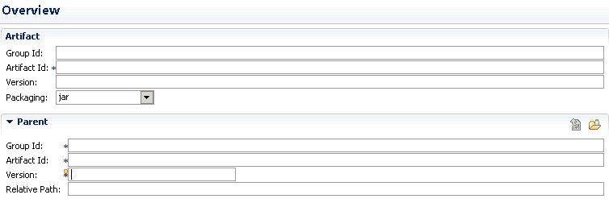
Maven POM
POM (Project Object Model) is the main xml file for Maven.
It describes a project’s :
Name
Group Id
Artifact id
Version
Packaging type (EAR, WAR, JAR, …)
Dependencies
Build
Test
Compilation
Notes:
Browse through the Maven repository to show them the structure

Slide 10
Maven POM (Simple Example)
<project xmlns = "http://maven.apache.org/POM/4.0.0" xmlns:xsi = "http://www.w3.org/2001/XMLSchema-instance" xsi:schemaLocation = "http://maven.apache.org/POM/4.0.0 http://maven.apache.org/xsd/maven-4.0.0.xsd">
<modelVersion> 4.0.0 </modelVersion>
<groupId> com.Accenture.academy.app </groupId>
<artifactId> my-aa-app </artifactId>
<packaging> jar </packaging>
<version> 1.0-SNAPSHOT </version>
<name> Maven Quick Start Archetype </name>
<dependencies>
<dependency>
<groupId> junit </groupId>
<artifactId> junit </artifactId>
<version> 4.8.2 </version>
<scope> test </scope>
</dependency>
</dependencies>
</project>
Notes:
Browse through the Maven repository to show them the structure

Slide 11
Maven POM – Project Management Section
The 1st level of the pom.xml is the “Project management Section”.
The main tag is the <project> tag, which contains attributes defining the xsd of the xml file
<project xmlns="http://maven.apache.org/POM/4.0.0" xmlns:xsi="http://www.w3.org/2001/XMLSchema-instance"
xsi:schemaLocation="http://maven.apache.org/POM/4.0.0 http://maven.apache.org/xsd/maven-4.0.0.xsd">
…
</project>
Everything is defined inside this <project> tag, like :
ID and Name of the project
Version
groupId and artifactId (this will be used to download an artifact from the Central Repository).
packaging
<project xmlns="http://maven.apache.org/POM/4.0.0" xmlns:xsi="http://www.w3.org/2001/XMLSchema-instance" xsi:schemaLocation="http://maven.apache.org/POM/4.0.0 http://maven.apache.org/xsd/maven-4.0.0.xsd">
<modelVersion>4.0.0</modelVersion>
<!-- Coordonees Maven projet Parent-->
<groupId>com.accenture.academy.app</groupId>
<artifactId>AccentureAcademy</artifactId>
<version>0.0.1</version>
<!-- Packaging du projet Parent = POM-->
<packaging>jar</packaging>
<name>Accenture Academy</name>
</project>
Notes:
Browse through the Maven repository to show them the structure

Slide 12
Maven POM – Project Management Section
We also have the <organization> tag which regroups data about the organisation
<project xmlns="http://maven.apache.org/POM/4.0.0" xmlns:xsi="http://www.w3.org/2001/XMLSchema-instance" xsi:schemaLocation="http://maven.apache.org/POM/4.0.0 http://maven.apache.org/xsd/maven-4.0.0.xsd">
<modelVersion>4.0.0</modelVersion>
<!-- Coordonees Maven projet Parent-->
<groupId>com.accenture.academy.app</groupId>
<artifactId>AccentureAcademy</artifactId>
<version>0.0.1</version>
<!-- Packaging du projet Parent = POM-->
<packaging>jar</packaging>
<name>Accenture Academy</name>
<organization>
<name>Accenture Academy Org.</name>
<url>http://www.accenture-academy.com</url>
<logo>/images/AA_logo.gif</logo>
</organization>
</project>
Notes:
Browse through the Maven repository to show them the structure

Slide 13
Maven POM – Project Dependency Section
Below the <project> tag, on the 2nd level, we have the <dependencies> tag.
This tag allows us to input various <dependency> tags, which allows us to download the different libraries needed for our projects.
Example : We need the “log4j-1.2.8.jar”, which contains java classes for logging data inside a “*.log” file.
One solution will be to download the jar and put it in the build path of our project.
However, what will happen if log4j has created a new, improved and secured version of this library and we need to swap it for all of our projects?
Notes:
Browse through the Maven repository to show them the structure

Slide 14
Maven POM – Project Dependency Section
The <dependencies> tag allow us to download several libraries from the Central Repository into our Local/Cached Repository.
This is done using the <dependency></dependency> tag found inside the <dependencies> tag.
Inside the <dependency> tag, we have 4 main tags :
<groupId>…</groupId>
<artifactId>…</artifactId>
<version>…</version>
<scope>…</scope>
Example :
<dependencies>
<!-- https://mvnrepository.com/artifact/log4j/log4j -->
<dependency>
<groupId>log4j</groupId>
<artifactId>log4j</artifactId>
<version>1.2.8</version>
<scope>test</scope>
</dependency>
</dependencies>
Notes:
Browse through the Maven repository to show them the structure

Slide 15
Maven POM – Project Dependency Section
To download a dependency, we only need to provide values for <groupId>, <artifactId> and <version>.
These three values form the project's fully qualified artifact name. This is in the form of <groupId>:<artifactId>:<version>
Usually on a central repository, the “groupId” represents the 1st levels of folders before obtaining the main folder for the artifact.
Notes:
Browse through the Maven repository to show them the structure

Slide 16
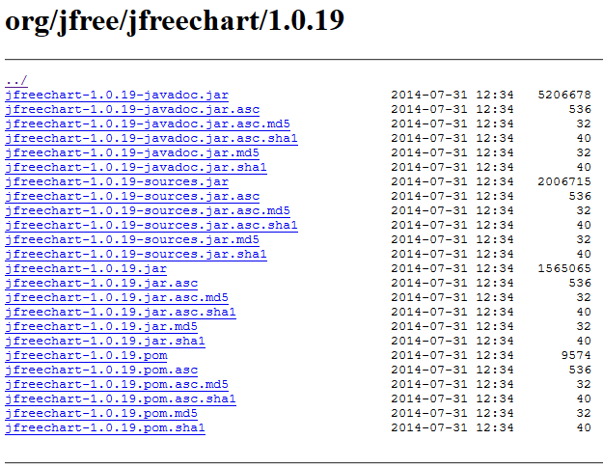
Maven POM – Project Dependency Section
For Example, we want to access the jfreechart-1.0.19.jar file and download it.
On the Central Repository, the navigation is like show below :
groupId
artifactId
version
<dependency>
<groupId>org.jfree</groupId>
<artifactId>jfreechart</artifactId>
<version>1.0.19</version>
</dependency>
Notes:
Browse through the Maven repository to show them the structure

Slide 17
Maven POM – Project Dependency Section
We can have several <dependency> tags in order to manage our different libraries.
<dependencies>
<!-- https://mvnrepository.com/artifact/log4j/log4j -->
<dependency>
<groupId>log4j</groupId>
<artifactId>log4j</artifactId>
<version>1.2.8</version>
</dependency>
<!-- https://mvnrepository.com/artifact/junit/junit -->
<dependency>
<groupId>junit</groupId>
<artifactId>junit</artifactId>
<version>4.12</version>
<scope>test</scope>
</dependency>
<dependency>
<groupId>org.mockito</groupId>
<artifactId>mockito-core</artifactId>
<version>2.13.0</version>
<scope>test</scope>
</dependency>
<dependency>
<groupId>org.assertj</groupId>
<artifactId>assertj-core</artifactId>
<version>3.7.0</version>
<scope>test</scope>
</dependency>
</dependencies>
Notes:
Browse through the Maven repository to show them the structure

Slide 18
Maven POM – Project Dependency Section
The <scope> tag is optional and libraries can be downloaded, even if it is not specified.
But what is its use?
Notes:
Browse through the Maven repository to show them the structure

Slide 19
Maven POM – Project Dependency Section
The <scope> is used to limit the transitivity of a dependency and can have the following 6 values :
compile : This is the default scope and we do not need to explicitly specify it. Compile dependencies are available in all classpaths of a project. Furthermore, those dependencies are propagated to dependent projects.
provided : Same as the compile mode, except that it expects the the JDK or a container to provide the dependency at runtime. For example, when building a web application for the Java Enterprise Edition, you would set the dependency on the Servlet API and related Java EE APIs to scope provided because the web container provides those classes.
runtime : This scope indicates that the dependency is not required for compilation, but is for execution. It is in the runtime and test classpaths, but not the compile classpath
test : This scope indicates that the dependency is not required for normal use of the application, and is only available for the test compilation and execution phases. This scope is not transitive.
system : Similar to provided except that you have to provide the JAR which contains it explicitly. The artifact is always available and is not looked up in a repository.
import : (only available in Maven 2.0.9 or later). This scope is only supported on a dependency of type pom in the <dependencyManagement> section. It indicates the dependency to be replaced with the effective list of dependencies in the specified POM's <dependencyManagement> section. Since they are replaced, dependencies with a scope of import do not actually participate in limiting the transitivity of a dependency.
Notes:
Browse through the Maven repository to show them the structure

Slide 20
Maven POM – Project Dependency Section
We also have the <exclusions> tag, as shown below.
If project X depends on project Y, and project Y depends on project Z, the owner of project X can explicitly exclude project Z as a dependency, using the "exclusion" element.
What is happening in the code snippet below?
<dependency>
<groupId>org.codehaus.castor</groupId>
<artifactId>castor</artifactId>
<version>1.0.4</version>
<exclusions>
<exclusion>
<groupId>adaptx</groupId>
<artifactId>adaptx</artifactId>
</exclusion>
<exclusion>
<groupId>xerces</groupId>
<artifactId>xerces</artifactId>
</exclusion>
</exclusions>
</dependency>
Notes:
Browse through the Maven repository to show them the structure

Slide 21

www.menti.com
Code : 636884
Notes:
15 minutes for mini quiz in game form (with points ☺ )

Slide 22
Maven POM – Project Build Section
On the 2nd level of the pom.xml, we also have the <build> tag.
Defines the location of source, test and resource files.
[…]
<build>
<nagEmailAddress>buildmaster@myinc.com</nagEmailAddress>
<sourceDirectory>${src.java.dir}</sourceDirectory>
<unitTestSourceDirectory>${src.test.dir}</unitTestSourceDirectory>
<aspectSourceDirectory/>
[…]
src/java
src/test
src/aspect

Slide 23
Maven POM – Project Build Section
Inside the <build> tag, we can define the maven-compiler-plugin and provide the compilation level of our java classes.
Recap : What is a compilation level?
<build>
<plugins>
<plugin>
<artifactId>maven-compiler-plugin</artifactId>
<version>3.5.1</version>
<configuration>
<source>1.8</source>
<target>1.8</target>
<encoding>${project.build.sourceEncoding}</encoding>
<failOnError>true</failOnError>
</configuration>
</plugin>
</plugins>
</build>
Notes:
Analysis of these tags

Slide 24
Maven POM – Project Build Section
We can also specify different plugins, allowing the build to perform several actions, like :
Executing Junit Tests
Generating Reports of Test Coverage
<plugin>
<groupId>org.apache.maven.plugins</groupId>
<artifactId>maven-surefire-plugin</artifactId>
<version>2.20.1</version>
<configuration>
<argLine>${jacoco.agent.ut.arg}</argLine>
<!-- Specific to generate mapping between tests and covered code -->
<properties>
<property>
<name>listener</name>
<value>org.sonar.java.jacoco.JUnitListener</value>
</property>
</properties>
<!-- test failure ignore -->
<testFailureIgnore>true</testFailureIgnore>
<excludes>
<exclude>
…
</exclude>
</excludes>
Notes:
Analysis of these tags

Slide 25
Maven POM – Project Build Section
Reports Generation
<plugin>
<groupId>org.jacoco</groupId>
<artifactId>jacoco-maven-plugin</artifactId>
<version>0.7.9</version>
<executions>
<!-- Prepares a variable, jacoco.agent.ut.arg, that contains the info
to be passed to the JVM hosting the code being tested. -->
<execution>
<id>prepare-ut-agent</id>
<phase>process-test-classes</phase>
<goals>
<goal>prepare-agent</goal>
</goals>
<configuration>
<destFile>${sonar.jacoco.reportPath}</destFile>
<propertyName>jacoco.agent.ut.arg</propertyName>
<append>true</append>
</configuration>
</execution>
<!-- Prepares a variable, jacoco.agent.it.arg, that contains the info
to be passed to the JVM hosting the code being tested. -->
<execution>
<id>prepare-it-agent</id>
<phase>pre-integration-test</phase>
<goals>
<goal>prepare-agent</goal>
</goals>
<configuration>
<destFile>${sonar.jacoco.itReportPath}</destFile>
<propertyName>jacoco.agent.it.arg</propertyName>
<append>true</append>
</configuration>
</execution>
</executions>
</plugin>
Notes:
Analysis of these tags

Slide 26
Maven POM – Distribution Management
Upon building a Maven Application, we can also specify whether the compiled artifact will be sent to our Central Repository.
For this, we use the <distributionManagement> tag.
Compiled applications can be sent in 2 different types :
Snapshots
Releases
A snapshot version in Maven is one that has not been released. The idea is that before a 1.0 release (or any other release) is done, there exists a 1.0-SNAPSHOT . That version is what might become 1.0 . It's basically " 1.0 under development“
A release version is a final working version that has been sent to the Central Repository.
Notes:
Analysis of these tags

Slide 27
Maven POM – Distribution Management
<distributionManagement>
<repository>
<uniqueVersion>true</uniqueVersion>
<id>nexus-application-releases</id>
<name>nexus-application-releases</name>
<url>http://repositorypath.com/repository/application-releases</url>
<layout>default</layout>
</repository>
<snapshotRepository>
<uniqueVersion>false</uniqueVersion>
<id>nexus-application-snapshots</id>
<name>nexus-application-snapshots</name>
<url>http://repositorypath.com/repository/application-snapshots</url>
<layout>default</layout>
</snapshotRepository>
</distributionManagement>
Notes:
Analysis of these tags

Slide 28
Maven Settings.xml
The settings element in the settings.xml file contains elements used to define values which configure Maven execution in various ways, like the pom.xml, but should not be bundled to any specific project, or distributed to an audience.
These include values such as the local repository location, alternate remote repository servers, and authentication information.
There are two locations where a settings.xml file may live:
The Maven install: ${maven.home}/conf/settings.xml
A user’s install: ${user.home}/.m2/settings.xml
Notes:
Analysis of these tags

Slide 29
Maven Settings.xml
<settings xmlns="http://maven.apache.org/SETTINGS/1.0.0"
xmlns:xsi="http://www.w3.org/2001/XMLSchema-instance"
xsi:schemaLocation="http://maven.apache.org/SETTINGS/1.0.0
https://maven.apache.org/xsd/settings-1.0.0.xsd">
<localRepository/>
<interactiveMode/>
<usePluginRegistry/>
<offline/>
<pluginGroups/>
<servers/>
<mirrors/>
<proxies/>
<profiles/>
<activeProfiles/>
</settings>
Notes:
Analysis of these tags

Slide 30
Maven Settings.xml
In the settings.xml file, we can define the “localRepository” to a path on our workstation.
By default, it is {user.home}/.m2
All artifacts will be downloaded into this Local Repository
We also have the <mirrors> tag. We can provide several Repositories from where to download the artifacts.
The default is the maven central repository.
Notes:
Analysis of these tags

Slide 31
Installing and configuring Maven
Extraction of Maven on our workstation, using the apache-maven-3.5.2.zip file.
By default, maven is not configured to be used in command line.
To set up maven commands, we need to add the maven home in our environment variables.
We need to set the path to the /bin folder of maven, in order to use all executable bat files found in this path.
Notes:
Demo on how to add Maven in environment variables.

Slide 32
Maven Commands
The main command used for maven is the mvn
We can assign several actions to it as show below :
mvn install
Invokes generate* and compile, test, package, integration-test, install
mvn clean
Invokes just clean
mvn clean compile
Clean old builds and execute generate*, compile
mvn compile install
Invokes generate*, compile, test, integration-test, package, install
mvn test clean
Invokes generate*, compile, test then cleans
Notes:
Demo on how to add Maven in environment variables.

Slide 33
Setting up a Maven Project
Live Demo on Eclipse
Notes:
Analysis of these tags

Slide 34
Further Materials (References)
Maven Home : http://maven.apache.org/
Maven Getting Started Guide : http://maven.apache.org/guides/getting-started/index.html
Steps for creating a Maven-based Website : http://www.javaworld.com/javaworld/jw-02-2006/jw-0227-maven_p.html
Maven 2 Plugins Project : http://mojo.codehaus.org/
Maven Integration for Eclipse : http://m2eclipse.codehaus.org/
start.spring.io
Notes:
Analysis of these tags

