Slide 1
E-commerce Delivery
& Logistics Performance Analysis
Individual Project Presentation
Week 4 – Day 5
Tools: Power BI · Python · Pandas · Excel · SQL
Presented by: ROSHINI S

Slide 2
Project Overview
01 / CONTEXT
PROJECT FOCUS
ANALYTICAL APPROACH
COMMUNICATION
Delivery efficiency
Measure → Compare
Power BI
Delays · cancellations · regions
Identify issues using data
Dashboards for key findings
ABOUT THE PROJECT
PROJECT OBJECTIVES
• Examines delivery efficiency, delays, cancellations and regional variation.
• Uses data analysis to identify operational problem areas.
• Measure delivery performance using clearly defined KPIs.
• Compare regional and shipping-mode performance.
• Recommend practical improvements to logistics operations.
• Analyzes e-commerce delivery and logistics performance.
E-COMMERCE DELIVERY & LOGISTICS PERFORMANCE ANALYSIS
2

Slide 3
Dataset Overview
02 / DATA
TOTAL RECORDS
DISTINCT ORDERS
DATASET TYPE
180,519
65,752
E-commerce
Rows in source dataset
Unique Order IDs
Supply-chain operations
IMPORTANT ATTRIBUTES
DATA PREPARATION
• Order ID and Order Date
• Delivery Status and Order Status
• Shipping Mode and Order Region
• Actual and scheduled shipping days
• Checked missing values and duplicate records.
• Reviewed delivery and cancellation information.
• Prepared the cleaned dataset for KPI analysis.
E-COMMERCE DELIVERY & LOGISTICS PERFORMANCE ANALYSIS
3

Slide 4
Introduction to Logistics KPIs
03 / MEASUREMENT
Key Performance Indicators (KPIs) are measurable values used to evaluate how effectively a business achieves its objectives.
01
TOTAL ORDERS
02
ON-TIME DELIVERY RATE
Measures the volume of unique customer orders.
Measures the share of eligible deliveries made early or on time.
65,752
42.69%
03
CANCELLATION RATE
04
AVERAGE DELIVERY DURATION
Measures canceled orders as a share of all distinct orders.
Measures average actual shipping time for eligible orders.
2.08%
3.50 days
E-COMMERCE DELIVERY & LOGISTICS PERFORMANCE ANALYSIS
4

Slide 5
KPI Definitions & Formulas
03 / MEASUREMENT
TOTAL ORDERS
Distinct Count (Order ID)
Count each unique order once.
ON-TIME DELIVERY RATE
(Early + On-Time Orders) ÷ Eligible Delivery Orders × 100
Canceled delivery records are excluded.
CANCELLATION RATE
Canceled Orders ÷ Total Distinct Orders × 100
Canceled means Order Status = CANCELED.
AVERAGE DELIVERY DURATION
Sum of Actual Shipping Days ÷ Eligible Orders
Uses actual shipping duration in days.
Important: “Order Status = CANCELED” is distinct from “Delivery Status = Shipping canceled.”
E-COMMERCE DELIVERY & LOGISTICS PERFORMANCE ANALYSIS
5

Slide 6
Overall Logistics Performance
04 / RESULTS
TOTAL ORDERS
ON-TIME DELIVERY RATE
65,752
42.69%
Distinct orders
Early + on-time / eligible deliveries
CANCELLATION RATE
AVERAGE DELIVERY DURATION
2.08%
3.50 days
Canceled orders / distinct orders
Average actual shipping duration
KEY OBSERVATION
Only 42.69% of eligible deliveries were early or on time; delivery punctuality is the main improvement area.
E-COMMERCE DELIVERY & LOGISTICS PERFORMANCE ANALYSIS
6

Slide 7
Delivery Delay Analysis
05 / DELIVERY
ACTUAL VS SCHEDULED
• Late deliveries account for 57.31% of eligible orders.
• Early and on-time deliveries account for 42.69%.
• Actual shipping duration is assessed against scheduled duration.
PRIORITY: REDUCE LATE ORDERS
Insert Power BI visual: Delivery Delay Comparison
E-COMMERCE DELIVERY & LOGISTICS PERFORMANCE ANALYSIS
7

Slide 8
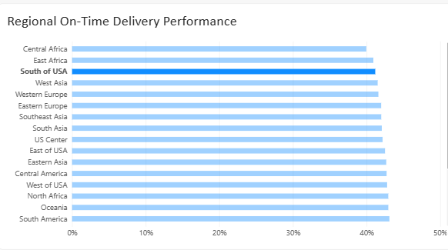
Regional Delivery Performance
06 / REGIONAL
CENTRAL AFRICA ON-TIME RATE
REGIONAL PERFORMANCE VARIES
≈23.6%
Delivery performance is not uniform across regions. Local operating conditions and logistics processes may require different responses.
One of the lowest reported regions
Key insight: Focus investigations on regions with weaker on-time performance.
E-COMMERCE DELIVERY & LOGISTICS PERFORMANCE ANALYSIS
8

Slide 9
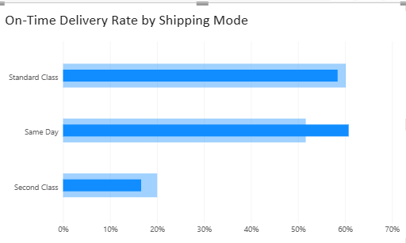
Shipping-Mode Performance
07 / SHIPPING
SHIPPING-MODE COMPARISON
• Delivery outcomes differ across shipping modes.
• Standard Class handles a large delivery volume.
• First Class shows an unusual zero early/on-time rate in the analyzed data.
INSERT POWER BI VISUAL
Shipping-Mode Performance
Replace this area with your actual chart.
VALIDATE BEFORE INTERPRETING
The First Class result should be checked for data quality, filtering and classification issues before drawing conclusions.
E-COMMERCE DELIVERY & LOGISTICS PERFORMANCE ANALYSIS
9

Slide 10
Major Delivery Issues
08 / FINDINGS
01
HIGH DELIVERY DELAYS
57.31% of eligible orders were late.
02
LOW ON-TIME PERFORMANCE
Only 42.69% were early or on time.
03
REGIONAL DIFFERENCES
Some regions show notably weaker performance.
04
SHIPPING-MODE ANOMALY
First Class result requires validation.
05
MONITORING NEED
Delivery timelines and regional KPIs need regular review.
E-COMMERCE DELIVERY & LOGISTICS PERFORMANCE ANALYSIS
10

Slide 11
Recommendations
09 / ACTION PLAN
01
Scheduling & routes
02
Delay monitoring
Improve delivery scheduling and route planning.
Track delayed orders and escalate exceptions regularly.
03
Regional investigation
04
Data validation
Review processes in low-performing regions.
Investigate the unusual First Class outcome.
05
Team coordination
06
KPI dashboard
Strengthen coordination between warehouses and delivery teams.
Use Power BI dashboards for continuous performance monitoring.
E-COMMERCE DELIVERY & LOGISTICS PERFORMANCE ANALYSIS
11

Slide 12
PROJECT TAKEAWAYS
Conclusion
• Evaluated logistics performance using four major KPIs.
• Identified high delivery delays and regional performance differences.
• Used Power BI dashboards to communicate operational indicators.
• Generated evidence-based directions for improving delivery operations.
Thank You
Questions & Discussion
E-COMMERCE DELIVERY & LOGISTICS PERFORMANCE ANALYSIS

