Slide 1
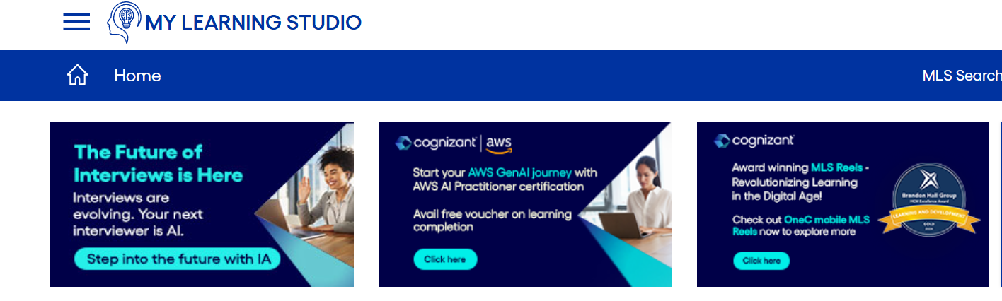
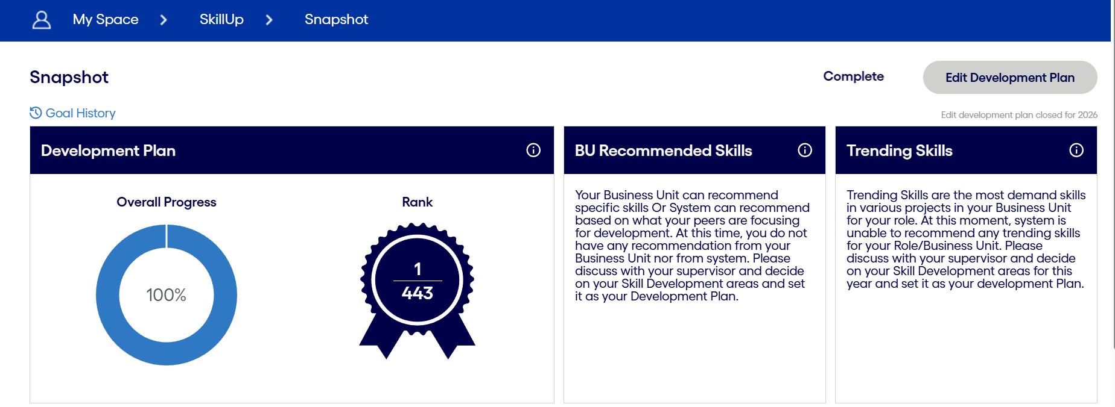
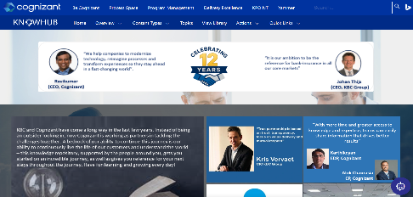
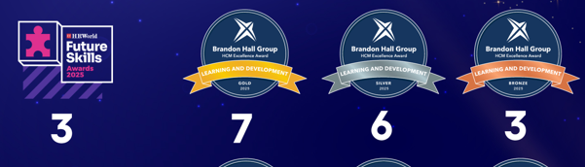
Learn & Grow`
Gen C Framework
L&D Onboarding Framework
Mentor / Mentee
Learning Tools
Miniatures | Gamification | Simulations | E-learning | Community
E-learning Platform
(KBC Portal)
Overall Outcomes - Reduced Performance Termination| Committed Quality | Providing Right Talent | Professionalism in Delivery
KBC Radio 2.0
KBC Surf Studio
Governance
Notes:
Learning solution approach built a KBC Learning Ecosystem by blending the ease of learning and achieving our goal by making the associates adaptable to the new environment faster and be productive.
0 – 30 days goal is set to be productive with hands on experience in the customer environment(able to deliver to the customer tasks with the help of shadow support (Platform KBC Portal)
30 – 60 days objective is to understand the communities. (such as technical, domain, process, AI, etc). Leveraging KBC communities for their support and slowly reducing the shadow support. Preparing for the System Demo in PI planning (soft skills)
60 – 90 days objective is to understand the innovation process through KBC surf studio platform, understanding Gen AI offerings, skilling and participating in the innovation process (I&P week)

Slide 2
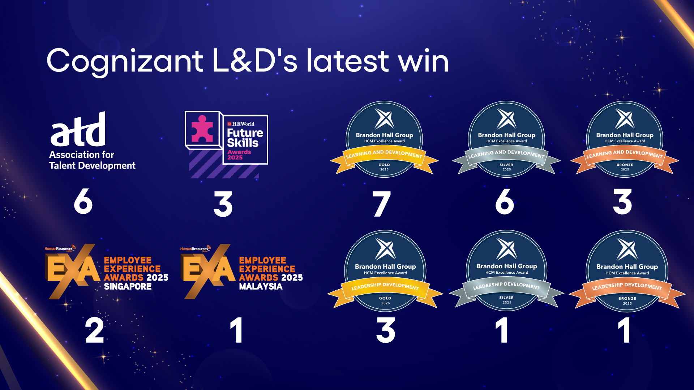
Learning & Development : 2025 Accolades and Awards
2
© 2026 Cognizant

