Slide 1




VERIL C
Edge-Driven, Cloud-Native Classroom
occupancy monitoring System
GUIDE :
PRIYANKA R V , ASSISTANT PROFESSOR
DEPT OF CSE
TEAM MEMBERS :
Ganesha M 4NI22CS062
Harshitha S Shankar 4Ni22Cs076
Hemanth Kumar R 4NI22CS079

Slide 2
Introduction:
Modern colleges face difficulties in tracking classroom availability in real time.
Traditional methods use manual registers or whiteboards, which are slow and error-prone.
Students and faculty often waste time searching for free classrooms.
An automated web-based system can provide real-time information, improving efficiency and resource utilization.
The project combines MERN stack web development with IoT support for live updates.

Slide 3
The integration of biometric authentication (R307 fingerprint sensor) ensures only authorized admins can modify occupancy status, enhancing system integrity.
System also helps to track the attendance of faculties.
Real-time data synchronization between IoT hardware and cloud database enables instant visibility across web and mobile interfaces for all stakeholders.
The proposed VERILOC system supports scalability, allowing deployment across multiple buildings with minimal hardware cost and centralized management.

Slide 4

Objectives :
Build a web-based classroom availability tracking system for students and faculty.
Provide an admin panel to manage classroom data and schedules.
Ensure real-time updates of room occupancy.
Secure the system so only authorized users can update room status.
Reduce manual effort, errors, and time wasted in finding free classrooms.
Enable scalability to multiple departments and classrooms.

Slide 5
Existing System and Drawbacks:
Existing System:
Manual or semi-manual tracking of classrooms.
Whiteboards, spreadsheets, or verbal communication are commonly used.
Drawbacks:
Time-consuming for students and faculty.
Prone to errors due to delayed updates.
No centralized database for real-time availability.
Not scalable for multiple classrooms or departments.
Difficult to track last-minute schedule changes.

Slide 6
Proposed System and Advantages:
Proposed System:
Web-based application built using MERN stack.
Admin panel for managing classroom schedules and availability.
Faculties attendance tracker using web app and hardware device.
Hardware device built with ESP32 ,fingerprint and lcd display.
Advantages:
Accurate and real-time classroom status.
Secure updates by authenticated users only.
Easy to use with intuitive interface.
Reduces time and effort spent searching for free classrooms.

Slide 7
Literature Survey
Title | Author and Published year | Description
Occupancy Prediction in IoT-Enabled Smart Buildings: Technologies, Methods, and Future Directions | M. A. Al-Garadi et al., Sensors (MDPI), 2024 | ML/DL methods for classroom occupancy prediction using IoT sensors like WiFi/CO2, with cloud dashboards for real-time visualization.
Towards Smart Education through Internet of Things: A Survey | N. A. Alshammari et al., ACM Computing Surveys, 2025 | Comprehensive survey on IoT-AI integration in smart classrooms for attendance and resource allocation with biometric authentication.
Smart Classrooms: How Sensors and AI Are Shaping Educational Paradigms | Y. Zhang et al., Sensors (MDPI), 2024 | Sensor-AI fusion for classroom monitoring, including fingerprint-based attendance to reduce substitute fraud by 40%.
An Intelligent Classroom Management System Based on AI + IoT Technology | Y. Li et al., IEEE ICAICA, 2023 | AI-IoT framework for classroom control with biometric enrollment and real-time status updates via NB-IoT/WiFi.

Slide 8
Title | Author and Published year | Description
Design and validation of IoT based smart classroom | M. Szczurek et al., Multimedia Tools and Applications (Springer), 2023 | IoT sensors for multi-occupant detection in classrooms using privacy-preserving techniques like CO2/temperature monitoring.
Monitoring Indoor Air Quality and Occupancy with an IoT System: Evaluation in a Classroom Environment | J. M. Corchado et al., IEEE Sensors Conference, 2023 | Low-cost IoT sensors for classroom occupancy and IAQ, achieving 25% accuracy improvement but requiring authentication enhancements.
A Development of an IoT-Based Connected University System: Progress Report | M. Szczurek et al., Sensors (MDPI), 2023 | IoT subsystems for smart classrooms including occupancy tracking and environmental monitoring with web/mobile interfaces.
AI-powered Biometrics for Internet of Things Security: A Review and Future Vision | M. A. Al-Garadi et al., Internet of Things (ScienceDirect), 2024 | Lightweight biometric (fingerprint) authentication for IoT in educational settings, focusing on secure classroom access.

Slide 9
System Requirements:
Hardware Requirements:
IoT device : ESP32 microcontroller, fingerprint sensor, LCD display, Push buttons , jumper wires.
Software Requirements:
Backend: Node.js v18+, Express, MongoDB v6+, Mongoose, JWT, bcrypt.
Frontend: React v18+, Tailwind CSS, Axios, React Router, Chart.js.
Hardware: Arduino IDE v2+, Adafruit libraries (Fingerprint, WiFi, Http)
Tools: Postman for API testing, Git for version control.

Slide 10
Functional Requirements
Enroll fingerprints with 4-digit ID validation and duplicate check.
Authenticate admins and update room status via API.
Manage admins/rooms via dashboard (CRUD).
Non-Functional Requirements:
Security: JWT, unique fingerprintID, hashed passwords.
Usability: Responsive UI, LCD feedback.
Scalability: Support 1000+ rooms via MongoDB.

Slide 11
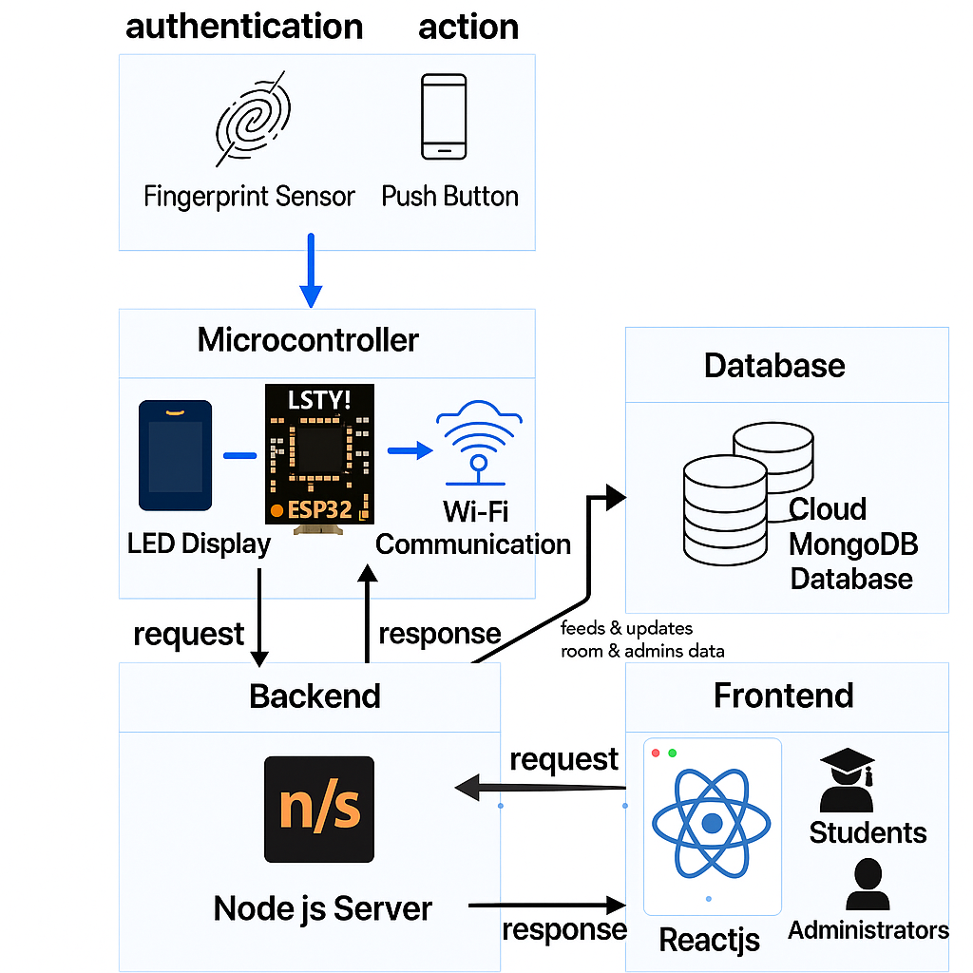
System Design:
Frontend (React + Tailwind CSS) → Real-time room status dashboard with admin dashboard.
Server (Node.js + Express + MongoDB) → RESTful API validates fingerprintID and admin authorization before updating room status.
Hardware (ESP32 + R307 + LCD) → Edge device performs local fingerprint matching and displays feedback on LCD, sending only verified updates to server via Http Protocol.
Fig :- Veriloc system architecture

Slide 12
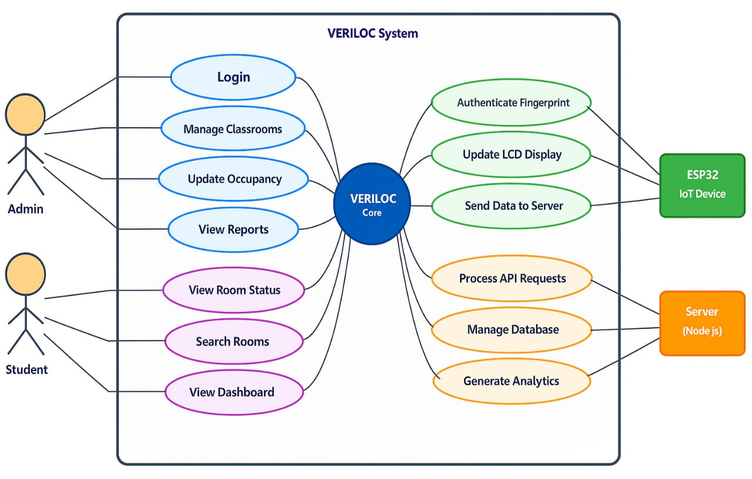
UseCase Diagram:
System Entities :
Admin
Student
ESP32 MC
Node.js Server

Slide 13
System Implementation
React + Tailwind: Responsive dashboard with live RoomList & Chart.js g
Node.js + Express: Validates ID & authorization → Updates MongoDB
JWT + bcrypt: Secure admin login and session management
ESP32 + R307: Fingerprint enrollment & matching with 4-digit ID (1000–9999)
LCD Display: Real-time feedback (e.g., “Access Granted ID: 1001”)
WiFi + HTTP POST: Sends {room, status, fingerprintID} to /api/rooms/update
Code(github url) :- https://github.com/Hemanth-4301/veriloc.git

Slide 14
System Testing :
User Group | Test Scenario | Expected Behavior | User Feedback | Status
Faculty | Fingerprint-based room authentication | Immediate recognition and status update | Authentication smooth and quick (avg. <1.5s) | Accepted
Faculty | OLED status display readability | Clear “Occupied/Vacant” display | Text clearly visible in all lighting conditions | Accepted
IoT Device Operator | Network recovery test | Auto-reconnect to WiFi after disconnect | Device reconnects within 3–5 seconds | Accepted
Maintenance Staff | System error handling | Display fallback messages during failures | Clear “Offline” messages shown | Accepted
Admin | Dashboard login and token handling | Secure login and session persistence | Login smooth; tokens auto-refreshed properly | Accepted
Admin | Room creation and status view | Create/view/update room info in real time | Very responsive; all updates reflect instantly | Accepted
General Users | Mobile dashboard usability | Smooth access on tablets/phones | Interface responsive and fast | Accepted

Slide 15
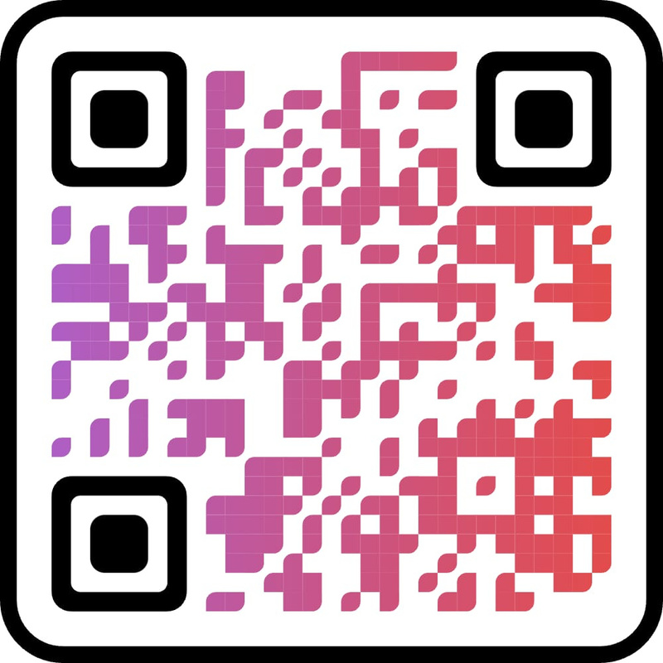
Results of the System:

Slide 16
References :
Al-Garadi et al. (2024) A study on IoT-based occupancy prediction in smart buildings using machine learning. The system integrates real-time sensor data with cloud dashboards for classroom monitoring.
Alshammari et al. (2025) A comprehensive survey on IoT applications in smart education systems. It highlights biometric authentication and real-time resource management in modern classrooms.
Zhang et al. (2024) Research on AI and sensor fusion for smart classroom environments. It demonstrates fingerprint-based attendance systems reducing fraud by up to 40%.
Li et al. (2023) An AI+IoT framework for intelligent classroom management. It uses ESP32 and biometric sensors for secure, real-time status updates.
Szczurek et al. (2023) Validation of IoT-based smart classroom systems using environmental sensors. The design ensures privacy-preserving occupancy detection.

Slide 17
Corchado et al. (2023) Evaluation of low-cost IoT systems for indoor air quality and occupancy monitoring. The study reports 25% improved accuracy in classroom settings.
Szczurek et al. (2023) A progress report on IoT infrastructure for connected university campuses. It includes web interfaces for real-time room status tracking
Al-Garadi et al. (2024) A review of AI-powered biometric authentication in IoT devices. It focuses on lightweight fingerprint verification for edge security.
Boe et al. (2024) An automated biometric attendance system using real-time recognition. The solution supports cloud logging and instant status updates.
Alqudah et al. (2023) A smart attendance system using biometric authentication and cloud integration. It enables real-time classroom status management via a web dashboard.

Slide 18
Thank
You!

