Slide 1
RevShop – Console Based E‑Commerce Application
Java | JDBC | Oracle | Log4j | JUnit

Slide 2
Project Overview
RevShop is a secure console-based e-commerce application.
Supports Buyer and Seller roles.
Buyers can browse products, manage cart, place orders and review products.
Sellers can manage products, inventory, orders and reviews.

Slide 3
Technology Stack
• Java (Core Java)
• JDBC
• Oracle Database
• Maven
• Log4j for logging
• JUnit for testing

Slide 4
Buyer Features
• Register & Login
• Browse and search products
• View product details & reviews
• Add/Remove cart items
• Checkout (payment simulated)
• View orders
• Add reviews & favorites

Slide 5
Seller Features
• Register & Login
• Add / Update / Delete products
• Manage inventory & stock alerts
• View orders
• View customer reviews
• Receive notifications

Slide 6
Application Architecture
Layered Architecture:
• Presentation Layer – Console UI
• Service Layer – Business Logic
• Model Layer – Domain Objects
• DAO Layer – Database Access
• Utility Layer – DB Connection

Slide 7
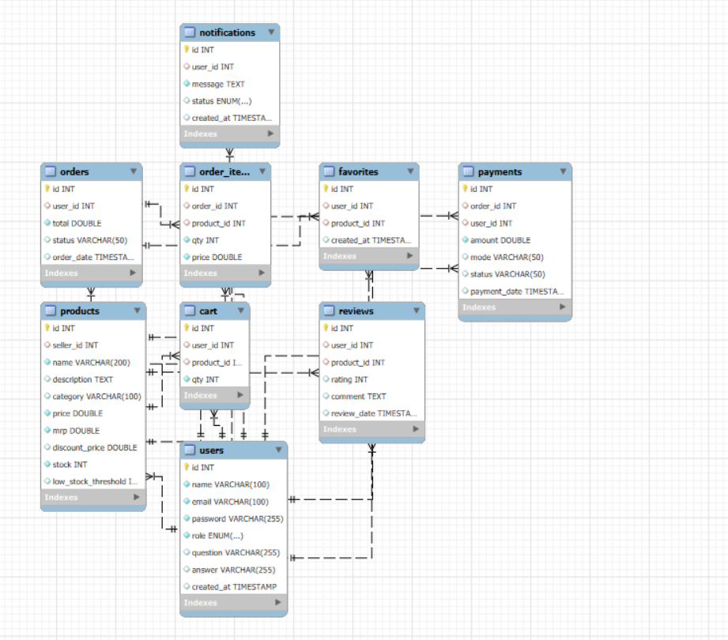
ER Diagram

Slide 8
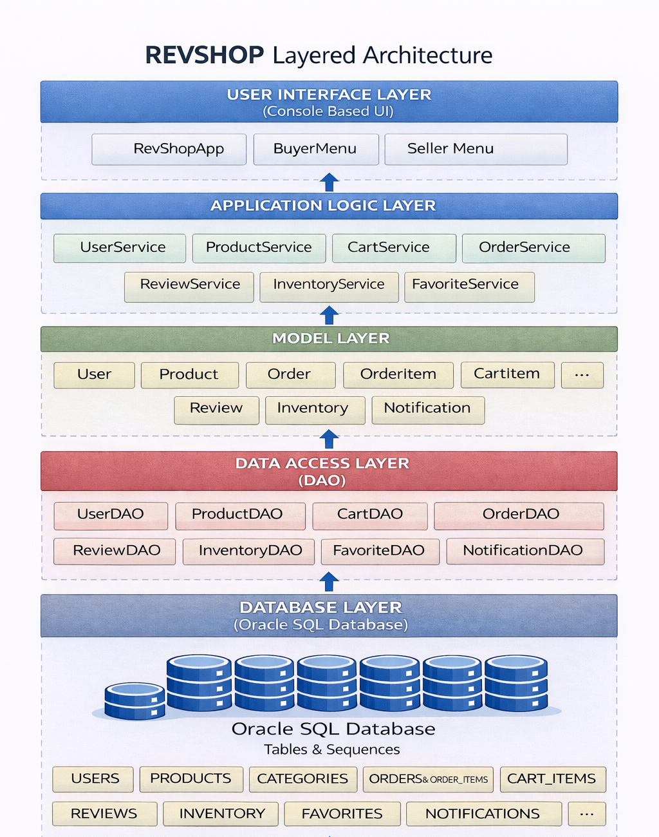

Slide 9
Database Design
Main Tables:
Users
Products
Orders & Order Items
Cart Items
Inventory
Reviews
Wishlist
Notifications

Slide 10
Logging & Testing
• Log4j used for application logging
• Logs stored in revshop.log
• JUnit tests for core functionalities
• Ensures reliability and correctness

Slide 11
Future Enhancements
- Convert console app to Web application (Spring Boot)
- REST APIs & Microservices architecture
- Real payment gateway integration
- Address persistence & delivery tracking
- Admin dashboard
- Cloud deployment (AWS/Azure)
- Security enhancements (JWT, OAuth)

Slide 12
Conclusion
• Fully functional console e-commerce system
• Modular & scalable architecture
• Easy to extend to web/microservices
• Meets all project specifications

